Slide 1
AI Powered Lecturer.
Using OpenAI. Sage.
What is sage?

Slide 2

Goals
Helping student to learn math and science with help of AI that have persona.

Slide 3
Tech Stack
Lets start with tools that i made to create sage
Meta framework | Next.js
Styling | Tailwindcss, Shadcn/ui, Vercel AI
Database | Mysql using planetscale
AI service | OpenAI
Authentication | Authjs
Icons | Lucide icons

Slide 4
App Flow

Slide 5
01
Feature & Limitation
Feature and limitation that sage currently have

Slide 6
Sage Feature
Persona-based Conversations
Example Messages
User-Friendly Interface
Regenerate Response
Sage Limitations
Subject Coverage
Accuracy and Precision
Symbol supports(math)
Chat history

Slide 7
02
App user interface
App landing page

Slide 8
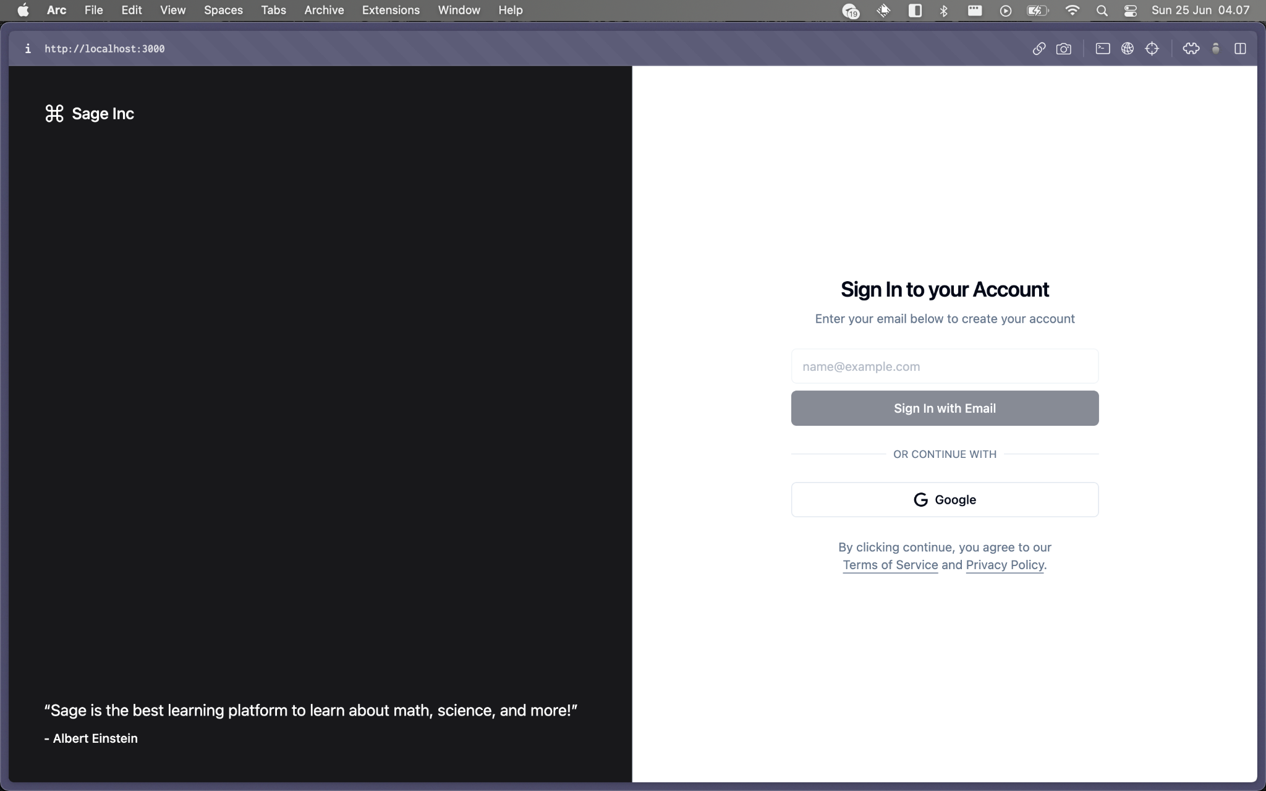
Sign in page

Slide 9
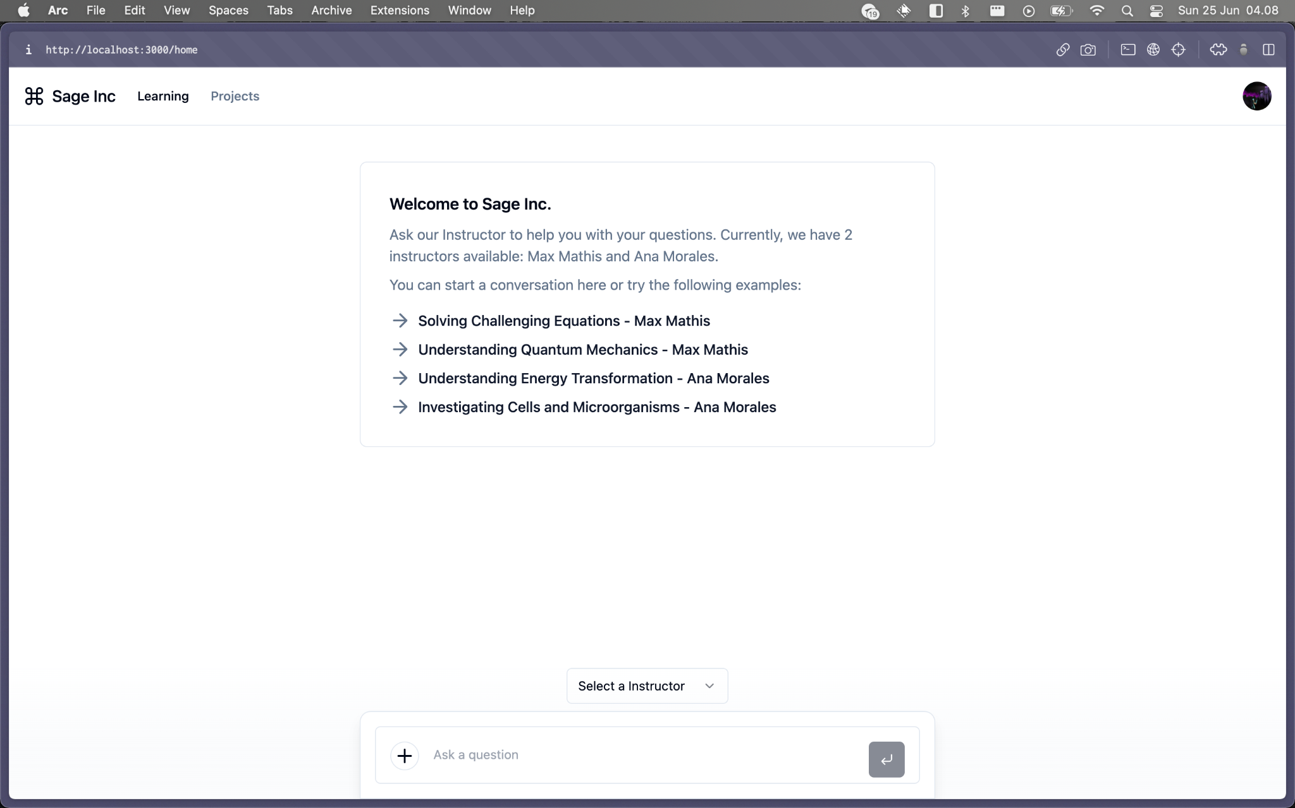
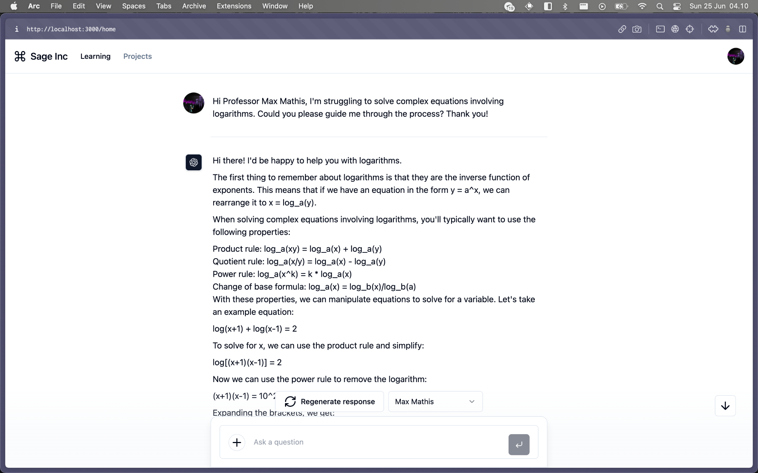
Home page
Empty State
Asking Max Mathis

