Slide 1
Paxos
Kyle Fauerbach
CS7610 Fall 2018

Slide 2
Agenda
Context/Motivation
Problem statement
What was the plan
What was accomplished
Implementation details
Challenges
Demo

Slide 3
Context/Motivation
Relevance to other systems
Foundational
Level of Documentation

Slide 4
Problem Statement
State Machine Replication
Actually have the protocol work

Slide 5
What was the plan
100% functional
Reconciliation = hard
Reconciliation = not well documented
Everything except Reconciliation
How to handle crashes without reconciliation
Normal case operation

Slide 6
What was Accomplished
Leader election
Prepare phase
Proposal
Client update <HOPEFULLY BY MONDAY>

Slide 7
Implementation Details
Written in C
Easier?
Networking with UDP Datagrams
Support the original Paxos assumptions
Predefined membership list
Let’s not complicate things
Who starts leader election

Slide 8
Challenges
Paxos for Systems Builders
Lots of detail except for when it’s not
Client Updates
Paxos makes sure it will happen
Not much use without a real application
So we add instrumentation
Also sometimes C is dumb

Slide 9
Demo
https://drive.google.com/file/d/1x3epDxTkO_vY1KaqRnpaWMOxgffSNBkW/view?usp=sharing

Slide 10
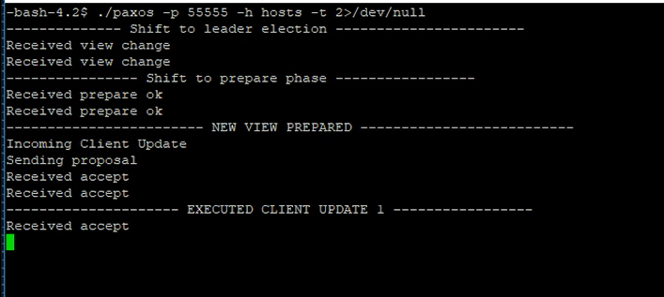

Slide 11
What we went over
Context/Motivation
Problem statement
What was the plan
What was accomplished
Implementation details
Challenges
Demo

Slide 12
Questions?

