Slide 1
DIGITAL CLOCK IN C++
A Simple Console-Based Clock

Slide 2

⚙️Features
Takes custom input for hour, minute, and second
Validates time input (hour < 24, minute/second < 60)
Real-time updating every second
Clears and updates screen using system("cls")
Uses Sleep(1000) for 1-second delay (Windows-specific)

Slide 3
🔧 How It Works
User enters valid current time
If the input is invalid, prompts again
A loop continuously updates the time
Handles overflow:
60 seconds → 1 minute
60 minutes → 1 hour
24 hours → resets to 0

Slide 4
🖱️ How to Use
Compile the code with a C++ compiler (e.g., g++ on Windows)
Run the program in a terminal or command prompt
Input the current time
Watch your console-based clock in action!

Slide 5
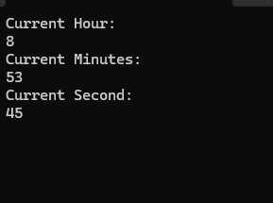
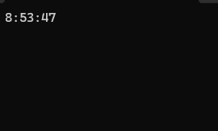
📷 Screenshots / Demo

Slide 6
📁 Project Files
digital_clock.cpp
README.md
digital_clock.pptx (this presentation)

