Slide 1

KrishiBazar
AI-Powered Smart Agriculture Platform
Final Project Showcase
Muhammad Faujul Kabir - 2023200000794
Md. Rakib Hasan - 2023200000769
Md. Mahmud Hossain - 2023200000799
Jubair Abdullah - 2023200000773
https://github.com/Faujull/KrishiBazar
Course: Software Development and Project Management | Instructor: Ms. Namirah Rasul
KrishiBazar — Final Project Showcase
1
Notes:
Good [morning/afternoon]. We're presenting KrishiBazar, an AI-powered smart agriculture platform, as our final project showcase for Software Development and Project Management. Our team is Muhammad Faujul Kabir, Md. Rakib Hasan, Md. Mahmud Hossain, and Rohan. Over the next slides we'll walk through what we originally planned, what we actually built, how we tested it, and what we learned.

Slide 2







INTRODUCTION
What Is KrishiBazar?
A bilingual (বাংলা / English) smart-agriculture platform for Bangladeshi farmers — unifying live weather, AI-driven crop guidance, farm management, and a produce marketplace into one mobile-first application.
CORE IDEA
One app that walks a farmer from planting to profit — then connects that harvest directly to a buyer.
The Problem
Farmers juggle disconnected tools for weather, market prices, disease diagnosis, and sales — with little localized AI guidance to support day-to-day decisions.
This showcase presents the working farmer-side prototype — the portion of the original vision that was fully implemented this term.
Farmer
Plan
Monitor
Diagnose
Manage
Sell
Note: the current prototype fully implements the Farmer experience above. The original concept also envisioned Consumer, Government, Investor, Reseller and Administrator roles — see next slide.
KrishiBazar — Final Project Showcase
2
Notes:
KrishiBazar is a bilingual smart-agriculture app for Bangladeshi farmers. Instead of juggling separate apps for weather, prices, disease diagnosis and selling, a farmer gets one app that walks them from planning through monitoring, diagnosis, farm management and finally selling their produce. It's important to be upfront here: this flow describes the Farmer experience, which is the part we fully built. The original idea was broader — we'll explain that on the next slide.

Slide 3



SCOPE & PRIORITIZATION
From Original Plan to Final Implementation
ORIGINAL VISION
DEVELOPMENT REALITY
PRIORITIZATION
CURRENT RESULT
Six connected stakeholder groups across one ecosystem
Large scope, backend complexity, and limited term time
Focus resources on the Farmer-side workflow end-to-end
A substantial, working Farmer-side prototype
This reflects deliberate scope management — not a shortfall. A smaller, complete system beats a large, unfinished one.
IMPLEMENTED
NOT YET IMPLEMENTED
BACKEND
Farmer
• Consumer / Buyer
Not completed
• Government Officer
Full workflow: registration, AI decision support, monitoring, planning, marketplace and orders.
No persistent database or full server layer. A thin API proxy handles Gemini calls only (see Slide 6).
• Investor
• Reseller / Wholesaler
• Administrator
KrishiBazar — Final Project Showcase
3
Notes:
This is the most important slide for understanding our project's story. We originally envisioned six connected stakeholders — Farmer, Consumer, Government Officer, Investor, Reseller and Administrator — plus a full backend. In practice, that scope combined with our limited development time and backend complexity meant we had to prioritize. We chose to build the Farmer side completely rather than build five stakeholders shallowly. So today we're showing a substantial, working Farmer prototype. Consumer, Government, Investor, Reseller and Administrator modules were not implemented, and the backend — meaning a full server and database — was not completed either. We want to be direct about this: it reflects a scope decision we made deliberately, not something we're hiding.

Slide 4
PLANNING & SCHEDULING
Updated Project Timeline
Phases shown in relative project weeks (1–16), not calendar dates — adjust to exact dates as needed.
KrishiBazar — Final Project Showcase
4
Notes:
Here's our updated timeline, shown in relative project weeks since we didn't want to invent exact calendar dates that weren't part of our original records. We started with requirements and planning, moved into UI/UX design, then spent the bulk of our time on Farmer-side development. Open-Meteo and Gemini integration happened in parallel with monitoring, marketplace and notification features, followed by testing, debugging, and documentation. Feel free to adjust this to exact dates if needed for submission.

Slide 5




IMPLEMENTED FARMER FEATURES
A Complete Farmer-Side Workflow
Farm Management
AI Decision Support
Monitoring
• Smart Farm Registration
• Crop Recommendation
• Open-Meteo Live Weather
• Farm Portfolio
• AI Farm Intelligence Center
• Farm Monitoring Dashboard
• Crop Tracking
• Disease Analysis
• Simulated IoT Telemetry
• Crop Lifecycle
• Pest / Fertilizer / Irrigation
• Yield, Profit & Market Analysis
Farmer Services
Language
• Seasonal Farming Planner
• Bangla (বাংলা) & English
• Marketplace & Farmer Listings
• One-tap interface switching
• Order Management
• Notifications
KrishiBazar — Final Project Showcase
5
Notes:
Rather than listing every screen, we've grouped what we built into five categories. Farm Management covers registration and crop tracking. AI Decision Support is our biggest category — crop recommendations, an AI Farm Intelligence Center, disease analysis, and guidance on pests, fertilizer, irrigation, yield, profit and market trends. Monitoring covers live Open-Meteo weather and our farm monitoring dashboard, which includes simulated IoT telemetry — we'll clarify that 'simulated' point on the architecture slide. Farmer Services covers the seasonal planner, marketplace, orders and notifications, and the whole app supports Bangla and English.

Slide 6






SYSTEM DESIGN
AI + API Architecture
Farmer
End user on mobile device
KrishiBazar Frontend
React 19 + TypeScript + Tailwind — all farmer-facing screens and logic
Open-Meteo API
Server-Side API Proxy
Live weather: temperature, humidity, rainfall, wind, 7-day forecast — used directly by the frontend, no key required.
Minimal Express route — forwards requests to Gemini and keeps GEMINI_API_KEY out of the browser. Not a full application backend.
Gemini API
AI reasoning: daily farm recommendations, chat assistant, and image-based disease analysis.
Farmer Decision Support
Combined weather + AI guidance surfaced across dashboard and tools
KrishiBazar — Final Project Showcase
6
Notes:
Our architecture is straightforward. The farmer interacts with our React and TypeScript frontend. That frontend calls Open-Meteo directly for live weather — temperature, humidity, rainfall, and forecasts — no key needed there. For anything involving Gemini — daily recommendations, our AI assistant, and image-based disease analysis — the frontend goes through a minimal server-side proxy we wrote in Express. That proxy's only job is to keep our Gemini API key out of the browser; it is not a full application backend, and we're not claiming it is. Both weather and AI results feed into the decision support the farmer sees across the dashboard and tools.

Slide 7
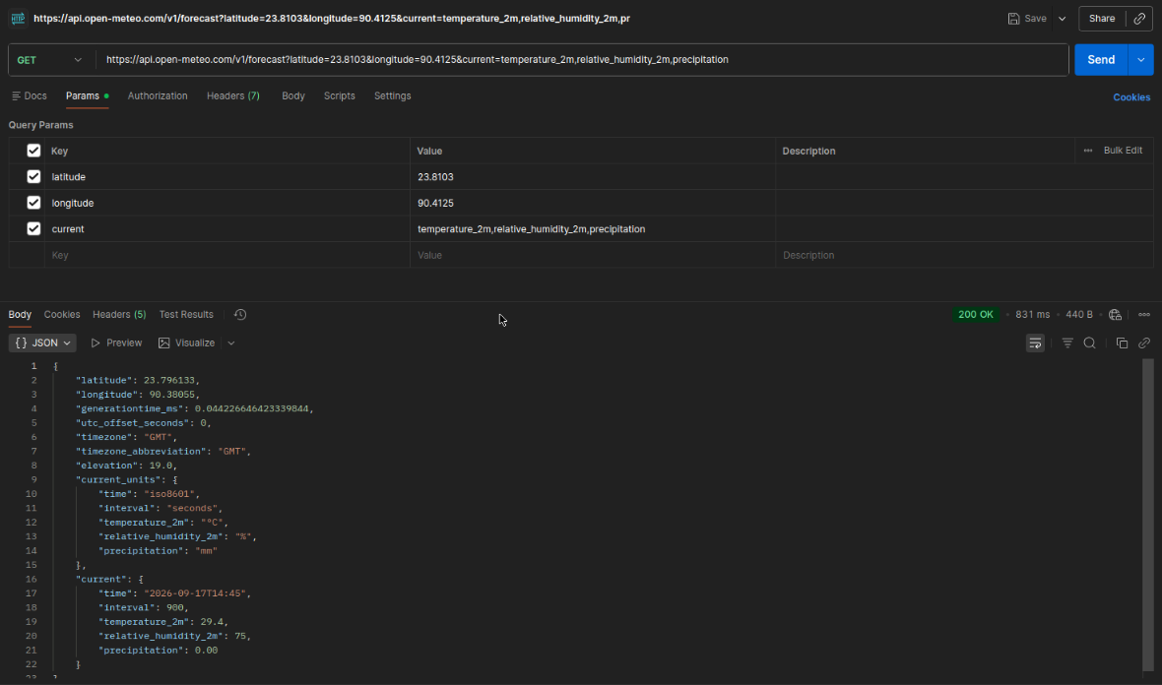
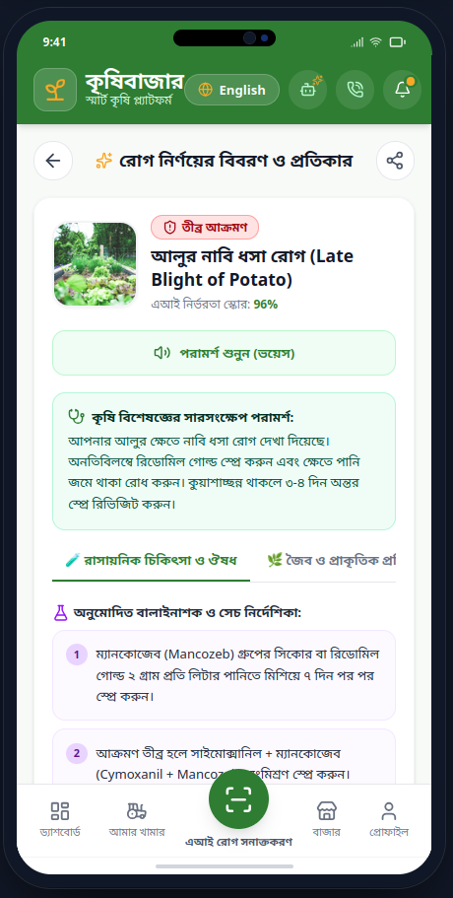
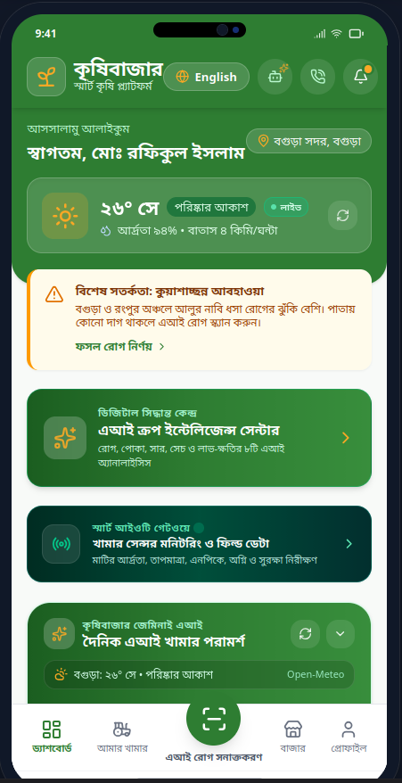
QUALITY ASSURANCE
Testing Done
Test Type | Purpose | Result
TypeScript type-checking | Ensure code compiles without type errors | Passed — no type errors
Production build (Vite) | Confirm app builds into deployable assets | Build completed successfully
Open-Meteo API testing | Validate live weather retrieval by district | Correct data returned for tested locations
Gemini API testing | Validate AI recommendation & analysis responses | Structured JSON returned as expected
API failure / fallback testing | Confirm rule-based fallback when Gemini is unavailable | Fallback advisory generated correctly
Route / page testing | Verify all app routes render without crashing | All routes load correctly
Manual UI testing | Walk through core farmer workflows end-to-end | Workflows functioned as intended
Bangla / English testing | Verify language switching across screens | Interface text switches correctly
Responsive / mobile testing | Confirm layout on target mobile frame | Layout displays correctly
No automated unit-test suite exists yet. Testing was primarily build verification, live API testing, and manual walkthroughs.
KrishiBazar — Final Project Showcase
7
Notes:
We tested at several levels. TypeScript type-checking and a production build confirmed the code compiles cleanly and builds into deployable assets. We manually tested Open-Meteo and Gemini API calls, including what happens when the Gemini key or network is unavailable — our fallback rule-based advisory kicks in so the UI never breaks. We also walked through every route, tested Bangla/English switching, and checked the layout on our target mobile frame. To be transparent: we don't yet have an automated unit-test suite — our testing was primarily build verification, live API testing, and manual walkthroughs. [Insert screenshots here.]

Slide 8
REFLECTION
Challenges & Solutions
Challenge | Solution / Mitigation | Status
Large project scope | Prioritized the Farmer-side implementation | Solved
Limited development time | Focused effort on the core farmer workflow | Solved
Backend not completed | Continued with frontend + direct API integrations | Future
External API reliability | Added error handling and fallback mechanisms | Solved
React / runtime data errors | Defensive data handling and fallback UI states | Solved
IoT hardware unavailable | Built a simulated farm-monitoring prototype | Partial
Team & shared-repository coordination | Collaborative workflow with a centralized final GitHub push | Solved
KrishiBazar — Final Project Showcase
8
Notes:
The scope and time pressure we mentioned earlier led us to prioritize the farmer workflow — that's solved. The backend not being complete is something we're carrying forward as future work, not something we solved this term. We added error handling and fallback logic for external API reliability and for runtime data errors in React. Not having physical IoT hardware, we built a simulated monitoring prototype instead — that's a partial solution, since real sensors are still future work. And on team coordination: we worked collaboratively throughout, with a centralized final push to GitHub from one machine — that workflow held up fine for a team our size.

Slide 9
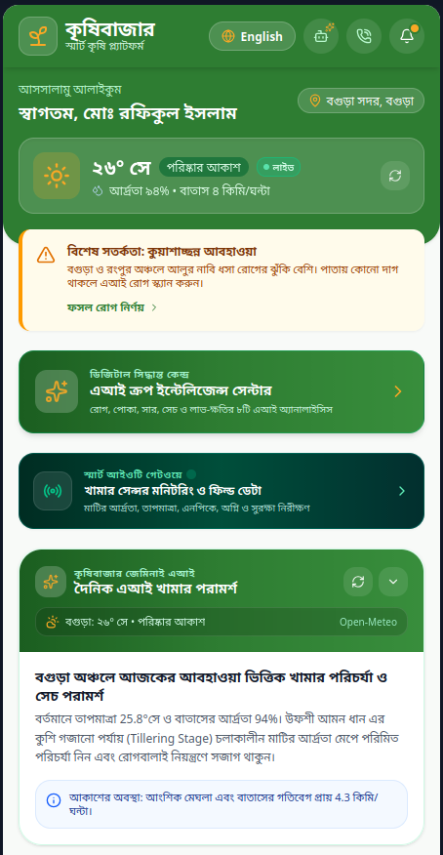
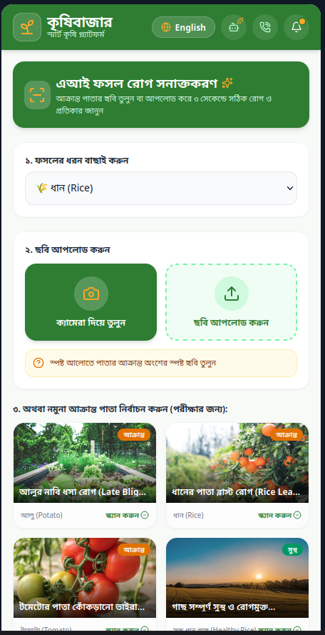
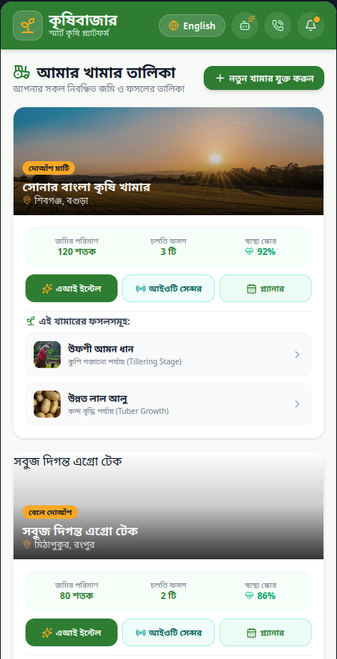
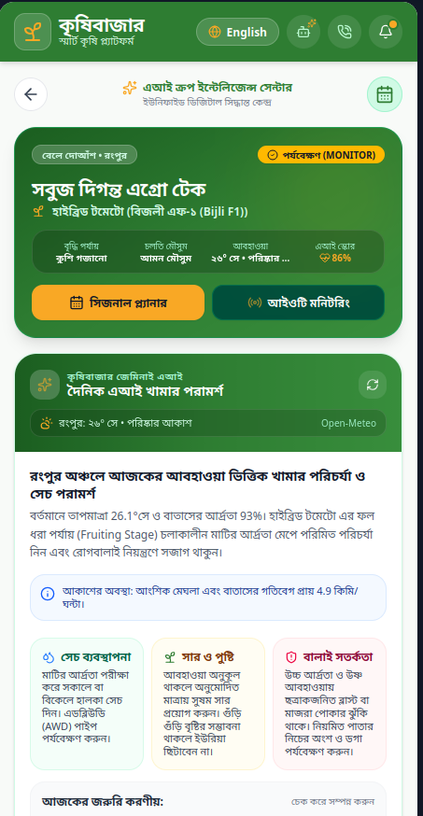
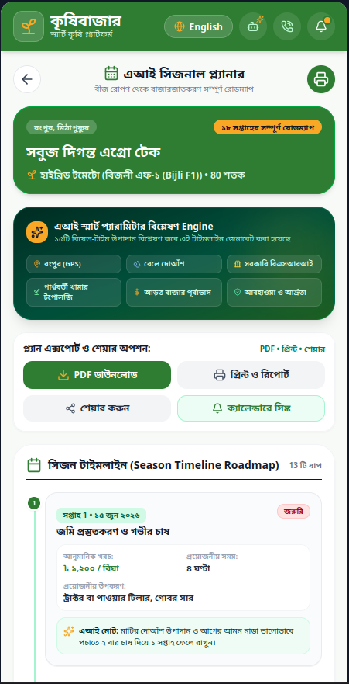
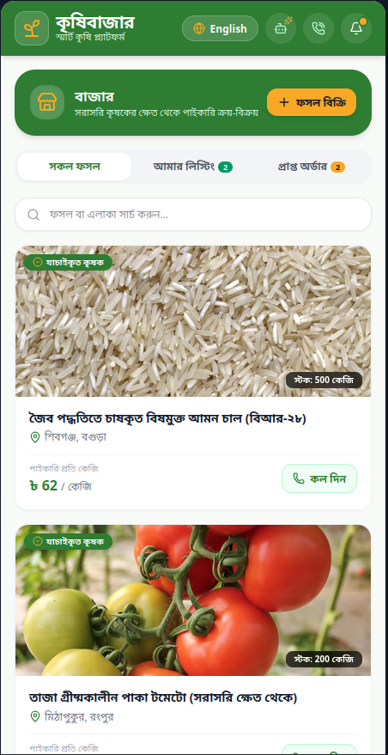
RESULTS
What We Actually Achieved
PLANNED
ACHIEVED
WITH
6
Stakeholder
Ecosystem
1
Fully-Developed
Stakeholder — FARMER
AI Guidance • Live Weather • Farm Management
Monitoring • Marketplace • Seasonal Planning
APPLICATION SCREENS
KrishiBazar — Final Project Showcase
9
Notes:
To summarize where we landed: of the six stakeholders we planned, we fully delivered one — the Farmer — but delivered it with real depth: AI guidance, live weather, farm management, monitoring, a marketplace, and seasonal planning all working together. [Walk through the inserted screenshots here — Dashboard, Crop Recommendation, AI Intelligence Center, Disease Analysis, Farm Monitoring, and Marketplace.]

Slide 10


LOOKING AHEAD
Limitations & Future Scope
CURRENT LIMITATIONS
FUTURE SCOPE
• Backend not completed — no full server layer
• Complete the application backend
• No persistent cloud database
• Add a persistent cloud database
• Five other stakeholder modules not built
• Connect all six planned stakeholders
• Integrate physical IoT sensors
• IoT telemetry is simulated, not physical hardware
• Production marketplace with payments
• Marketplace is prototype-level (no payments)
• Localized agricultural AI/ML models
• Application depends on external Open-Meteo & Gemini APIs
• Deployment & scaling
KrishiBazar — Final Project Showcase
10
Notes:
Being honest about where we stand: there's no completed backend or persistent database yet, five stakeholder modules remain unbuilt, our IoT telemetry is simulated rather than physical, and the marketplace is prototype-level without real payments. We also depend on two external APIs. None of this is implemented today, but it's a clear roadmap: complete the backend, connect the remaining stakeholders, move to real IoT sensors, add a production marketplace with payments, and eventually explore more localized AI/ML models as we scale.

Slide 11

REFLECTION
Lessons Learned
Scope management is critical to project success.
Integration is harder than isolated feature development.
External APIs require robust fallback and error handling.
AI outputs are only as reliable as the underlying data.
Testing should happen continuously, not just at the end.
Hardware concepts should be clearly separated from simulation.
Collaboration can work well even with centralized repo pushes.
Prioritizing one core workflow beats partially finishing all.
WHAT WE WILL DO DIFFERENTLY NEXT TIME
✓ Start backend/API architecture earlier
✓ Break the project into smaller milestones
✓ Define the MVP before expanding scope
✓ Allocate dedicated integration & testing time
✓ Establish clearer ownership within the team
KrishiBazar — Final Project Showcase
11
Notes:
The biggest lesson was around scope: managing it well mattered more than trying to do everything. We also learned that integrating pieces together — frontend, weather data, AI — is genuinely harder than building each feature in isolation, and that external APIs need fallback handling by design, not as an afterthought. Looking forward, next time we'd start backend architecture earlier, break work into smaller milestones, define our MVP before expanding scope, and set aside dedicated time for integration and testing rather than treating it as a final step.

Slide 12

KrishiBazar evolved from a broad, six-stakeholder concept into a substantial, working Farmer-focused prototype.
NEXT STEP
Connect the remaining ecosystem.
Thank You
Questions & Discussion
KrishiBazar — Final Project Showcase
12
Notes:
To close: KrishiBazar went from a broad, six-stakeholder concept to a substantial, working Farmer-focused prototype with real AI and weather integration. The natural next step is connecting the remaining ecosystem — Consumer, Government, Investor, Reseller and Administrator — on top of the foundation we've built. Thank you — we're happy to take any questions.

