Slide 1

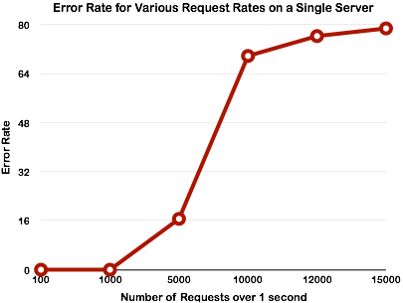
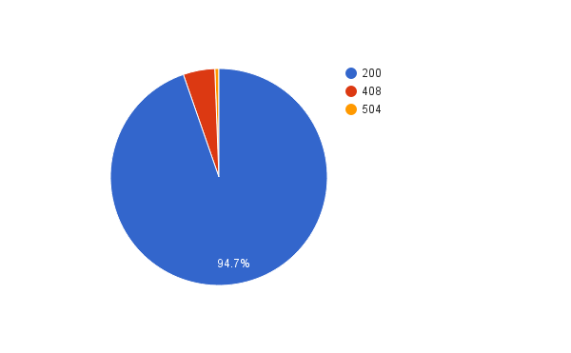
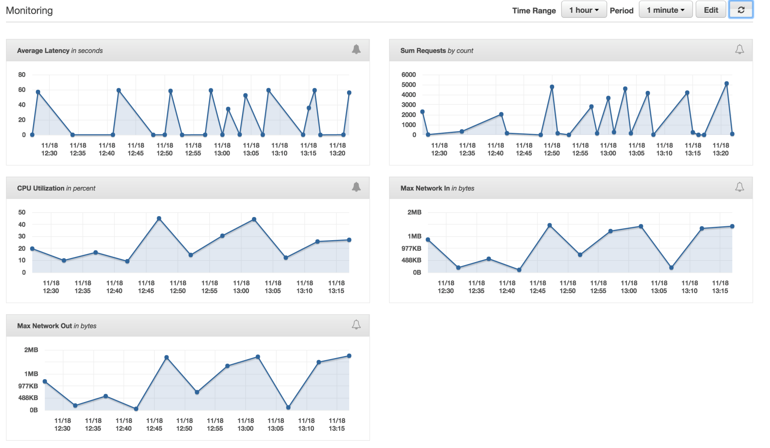

Effect of Continuous Delivery
On Fault Tolerance
Nur-A Azad, Motalib hossain bhuyan, Jennifer Strater
Introduction
In traditional Web Application Development, applications can take a long time to reach production, and the process makes it difficult to fix bugs. Continuous Integration(CI) and Continuous Delivery(CD) reduce the development time and the time to recover from software bugs. For this project, we implemented a basic rest service using continuous delivery best practices, tested against various types of faults, and measured the availability and reliability of the web service.
Discussion
To increase the system’s availability, we used continuous integration and delivery. That reduced the time to recover when the problem was a software bug. We can test the availability of our system using the tool Apache Jmeter. We tested various loads and recorded the system’s responses. As we increased the number of requests/second, the availability of system decreased. After adding more resources to the system via redundancy, the availability of the system increased again.
Tools and Technologies
Git & Github: Source code management
Jenkins: Pipeline plugin, Amazon AWSEB plugin, Gradle plugin, Grails plugin
AWS Elastic Beanstalk: Security policy, Virtual Private Cloud(VPC), Load balancer, application deployment via Tomcat, monitoring, and alarms.
Apache JMeter: Load test and performance metrics
Keywords
Fault Tolerance, Continuous Deployment, Continuous Integration, Availability and Reliability, Load balancers, Jenkins, JMeter, AWS, cloud platforms
Procedure
For this project, we created a sample web service.
The source code for the sample project was pushed to a Github repository as shown in Figure 2.
A web hook was added for Jenkins. Github will notify Jenkins when a change is detected in the source repository.
When changes are detected, the project is built on the Jenkins Server, and the result(pass/fail) is sent back to Github.
Once a change is ok to deploy, the Jenkins Job deploys the application using the AWS service called ElasticBeanstalk.
ElasticBeanstalk contains a load balanced cluster.
Some alarms were configured for example high CPU usage. Additionally, it can prompt a restart of the server when health is degraded.
Apache JMeter was used to test the server strength and analyzes overall performance under different load types.
Results
In the first graph, the rate of errors increases as the number of requests/second increases. The curve rises sharply between 5 and 10 thousand requests. In the next figure, the breakdown of requests is shown for another example test run with 5000 requests. Most of the requests were successful, but the load balancer is starting to have trouble handling the load as seen in the 408 and 504 responses. Additionally, we monitored our application while tests were running. The metrics helped us identify any problems affecting our load tests.
Response Codes for Single Server
5000 requests
Figure 2: System Diagram
Figure 1:CI/CD process
Figure 1 shows an example process for deploying web applications in Continuous Integration and Deployment. The testing steps can proceed as soon as the previous one passes. Then for Continuous Delivery, the image can be deployed as soon as the signal is green.
Figure 3 displays the features of Amazon Elastic Beanstalk including:
Server Configuration
Load balancer
Security policy
Monitoring
Figure 3: AWS Elastic
Load Balancing
modified from: http://blog.celingest.com/en/2014/01/31/aws-elb-internals-security-troubleshooting/
AWS Monitoring Console
Conclusion
Using CI/CD can improve availability and reliability of a web application in the cloud.
Fault Tolerant Systems

