Slide 1

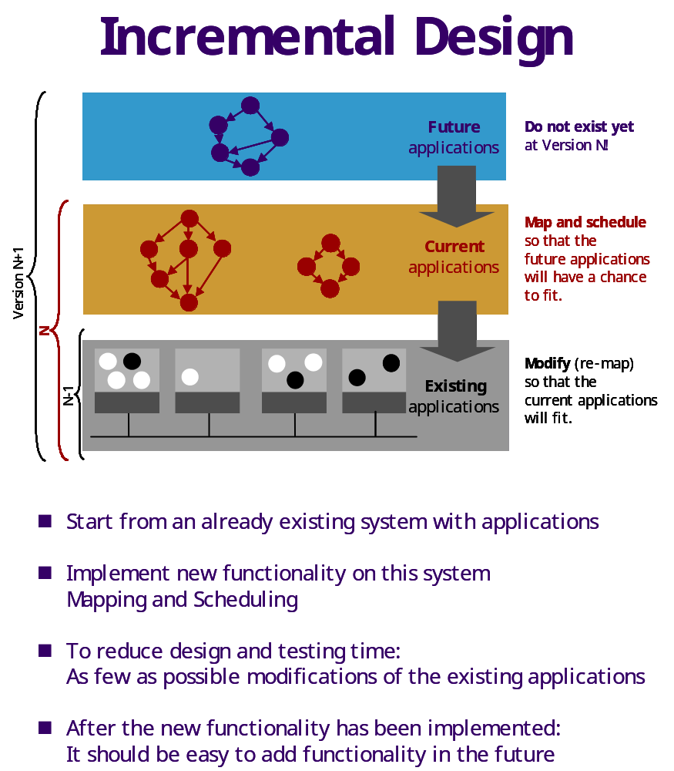
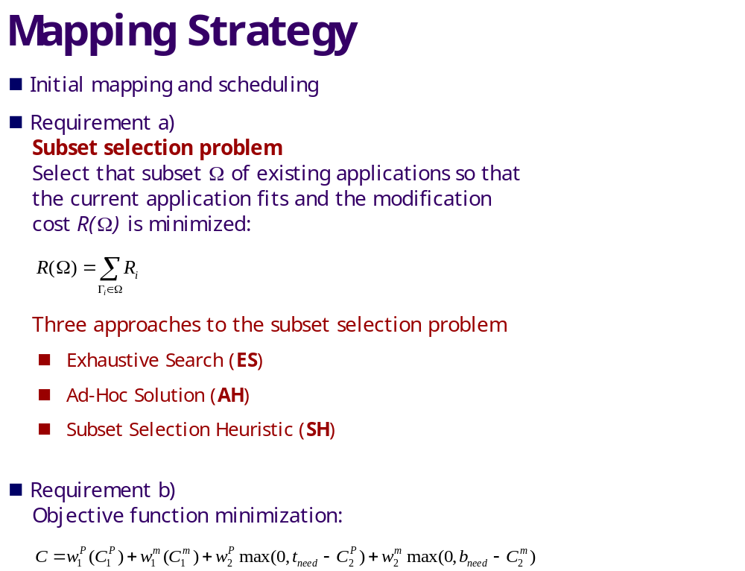
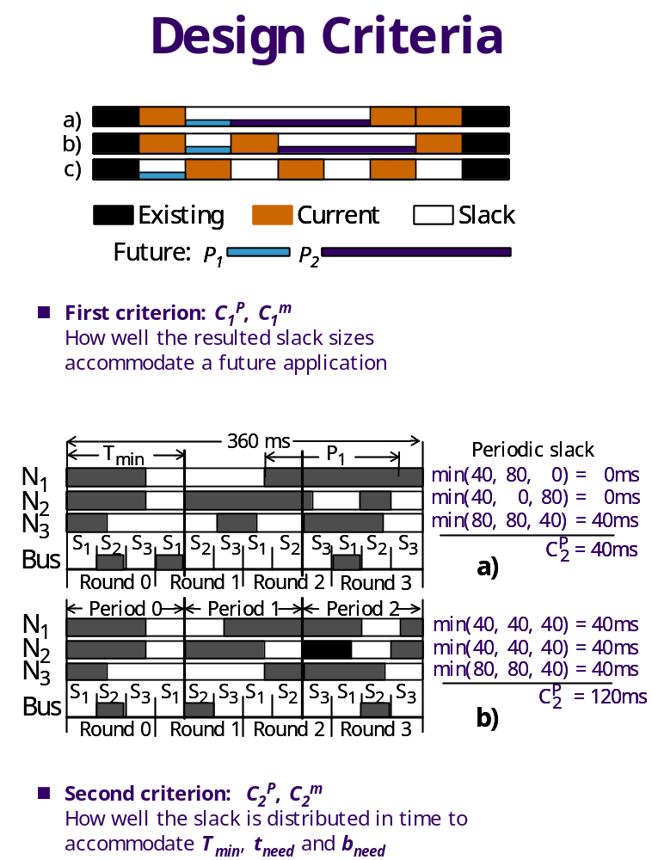
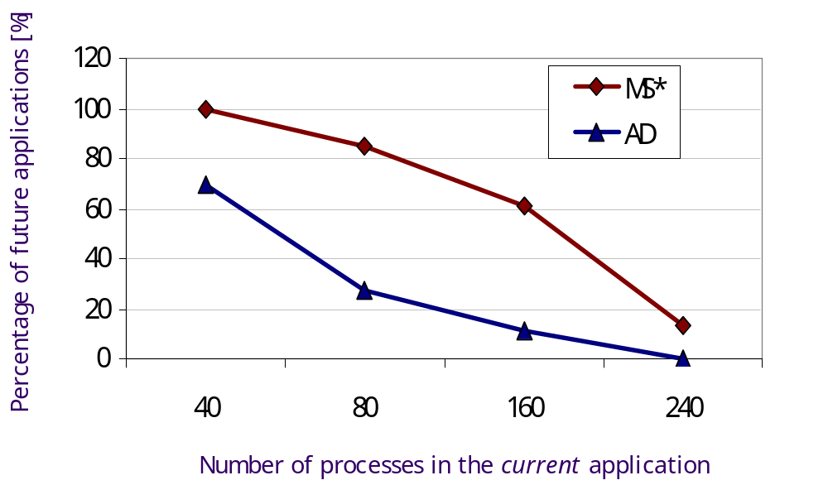

Effect of Continuous Delivery
On Fault Tolerance
Abstract
Traditional Web Application Development produces slow-moving projects that take a long time to reach production and are difficult to fix when bugs are detected. Alternative approaches to development, Continuous Integration and Continuous Delivery, promise to reduce the development time and the time to recover from software bugs. For this project, we implemented a basic rest service, tested against various types of faults, and measured how the system responded.
Discussion
Traditional Web Application Development produces slow-moving projects that take a long time to reach production and are difficult to fix when bugs are detected. Alternative approaches to development, Continuous Integration and Continuous Delivery, promise to reduce the development time and the time to recover from software bugs. For this project, we implemented a basic rest service, tested against various types of faults, and measured how the system responded.
Tools and Technologies Used
Traditional Web Application Development produces slow-moving projects that take a long time to reach production and are difficult to fix when bugs are detected. Alternative approaches to development, Continuous Integration and Continuous Delivery, promise to reduce the development time and the time to recover from software bugs. For this project, we implemented a basic rest service, tested against various types of faults, and measured how the system responded.
Keywords
types of faults, and measured how the system responded.
Fault Tolerant System

