Slide 1

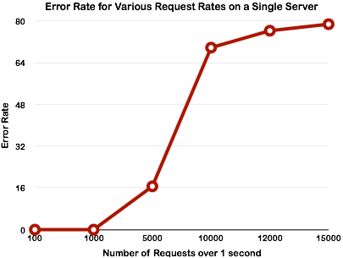
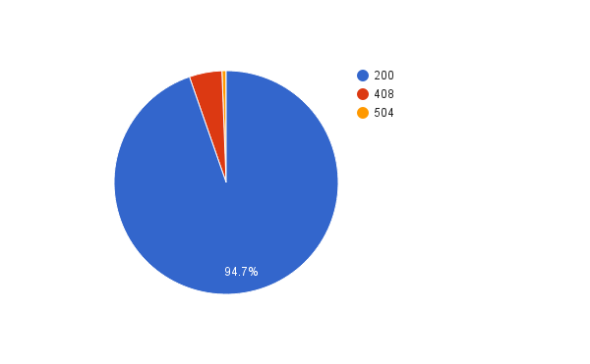
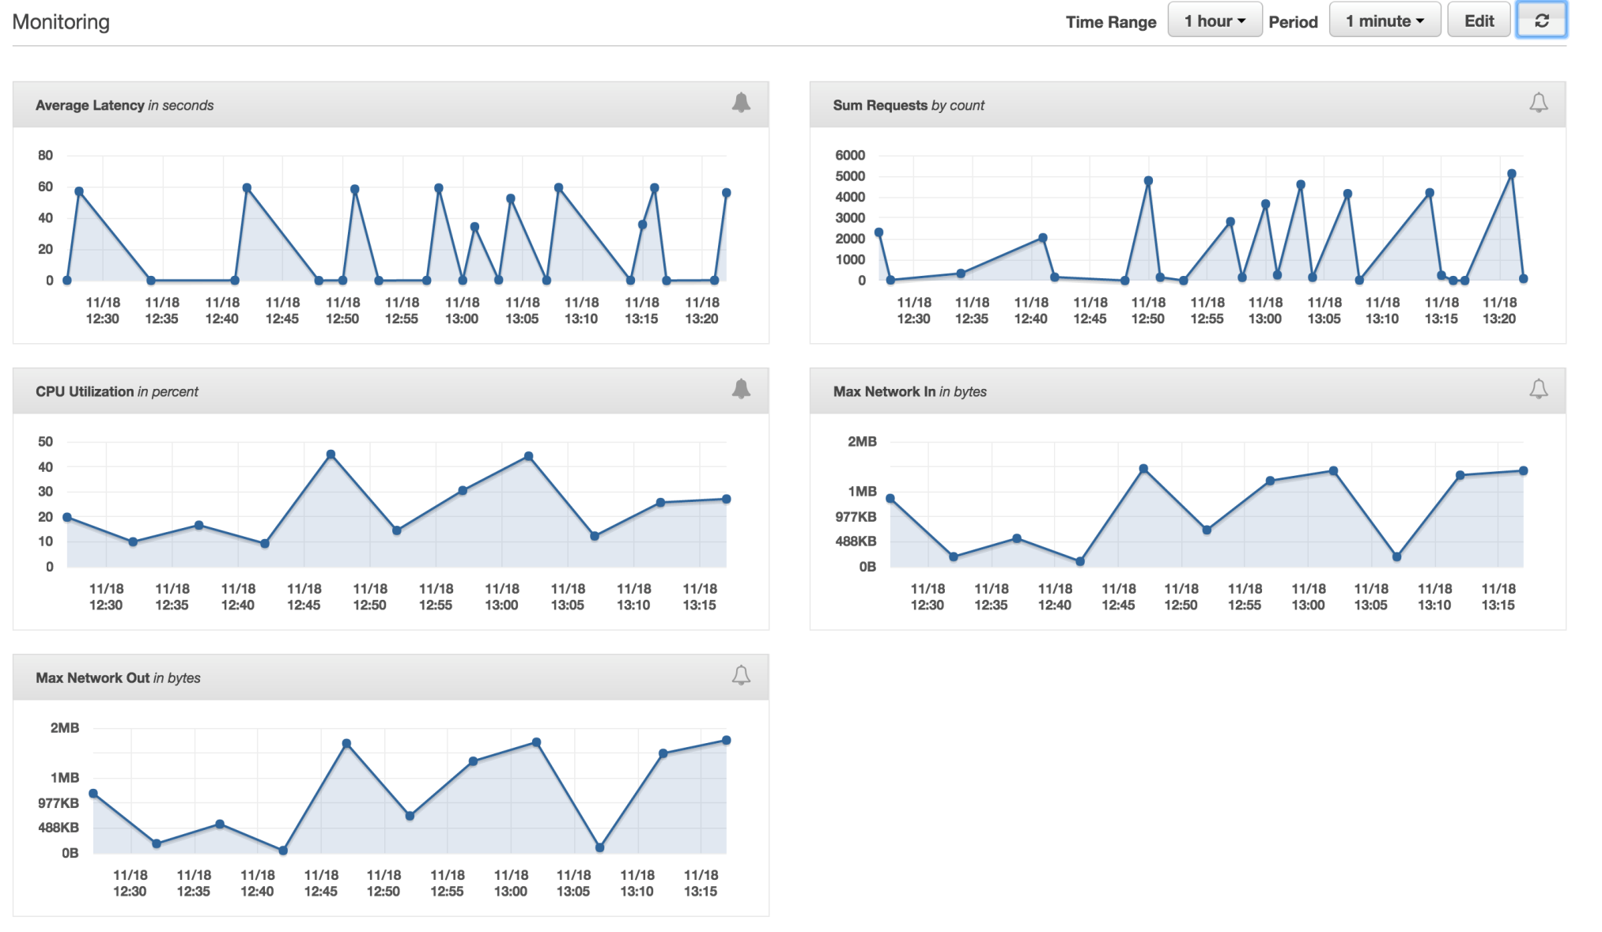

Effect of Continuous Delivery
On Fault Tolerance
Introduction
Traditional Web Application Development produces take a long time to reach production and are difficult to fix bugs. Continuous Integration and Continuous Delivery promise to reduce the development time and the time to recover from software bugs. For this project, we implemented a basic rest service, tested against various types of faults, and measured how the system responded with availability and reliability.
Discussion
To analysis and increase the system availability we use continuous integration and deployment. That reduce time time to recover. It fixed the bugs and rollover. Another method way we can improve availability by testing our system using apache jemter.Using Jmeter we test against various types of faults and how the system response with different experiments. As increase more request/second can decrease the availability of system and increase more resource give more availability of our system.
Tools and Technologies
AWS Elastic Beanstalk:Configure server, Load balancer, Security policy and Monitoring.
Jenkins:Continuous Integration tools, Pipeline plugin , Amazon EC2 Easy Installation , Scriptability , View Filters and Throttle Builds
Apache jmeter:Load test and measure performance , Test server strength,analyze overall performance under different load types.
Github:Code repositories
Keywords
Fault Tolerance, Continuous deployment, Continuous Integration, Availability and reliability, Load balancer, Jenkins, Jmeter, Repository, AWS,cloud.
Procedure
During this project we created sample web service.
The source code for sample project pushed to a github repository.
A web hook was added to Jenkins. Github will notify Jenkins when a change is detected in the source repository.
When changes are detected, the project is built on the Jenkins Server and the result(pass/fail) is sent back to Github.
Once a change is ok to deploy, the Jenkins Job deploys the application using the AWS service called Elastic Beanstalk.
Elastic beanstalk contains a load balanced cluster. It gives us recovery features such as alarms.
Some alarms were configured for example high CPU usage. Additionally, it can prompt a restart of the server when health is degraded.
Apache Jmeter tests server strength and analyzes overall performance under different load types.
Results
Traditional Web Application Development produces take a long time to reach production and are difficult to fix bugs. Continuous Integration and Continuous Delivery promise to reduce the development time and the time to recover from software bugs. For this project, we implemented a basic rest service, tested against various types of faults, and measured how the system responded with availability and reliability.
Fig: Error rate for Single Server
Figure 1: System Diagram
Continuous Delivery: Detects problem early and repair them as needed. Rollback significantly increase recovery time. Continuous Deployment : Automatically deploy every changes to production
CI/CD:Reduce time to recover time,Fixing bugs,Increase the availabilit
Figure 2:CI/CD process
AWS Elastic Beanstalk
Configure server
Load balancer
Security policy
Monitoring
Fig: AWS Monitoring Console
Conclusion
Using CI/CD and server load testing we can improve availability and reliability of our system.
Figure 3:AWS Elastic Beanstalk
Fault Tolerant System

