Slide 1

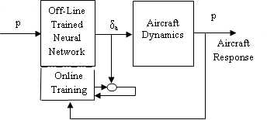
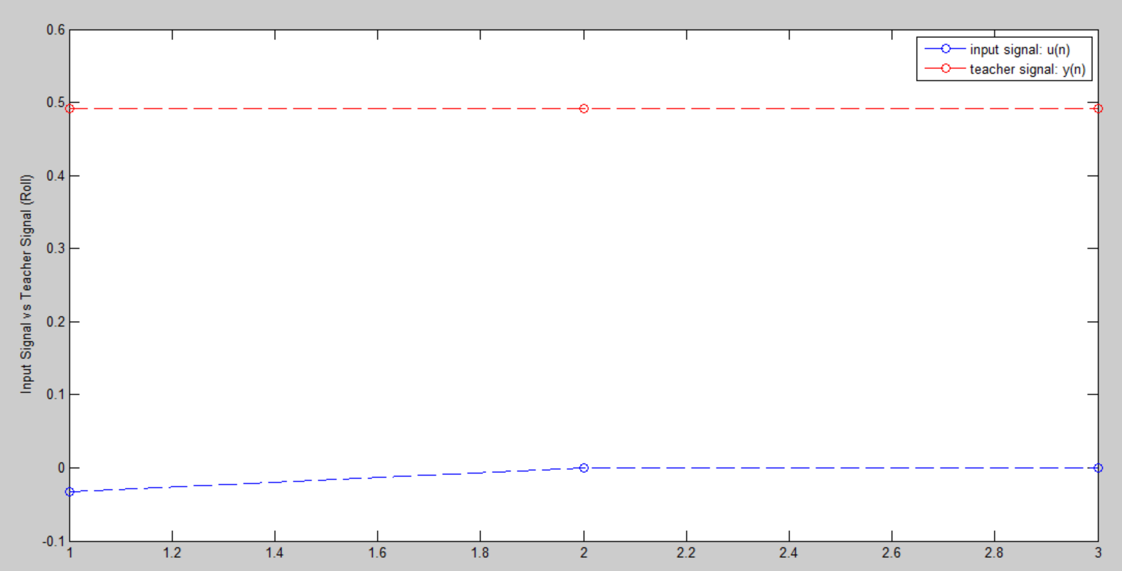
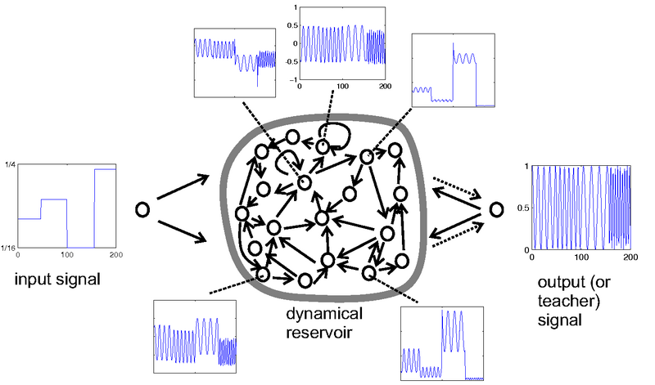
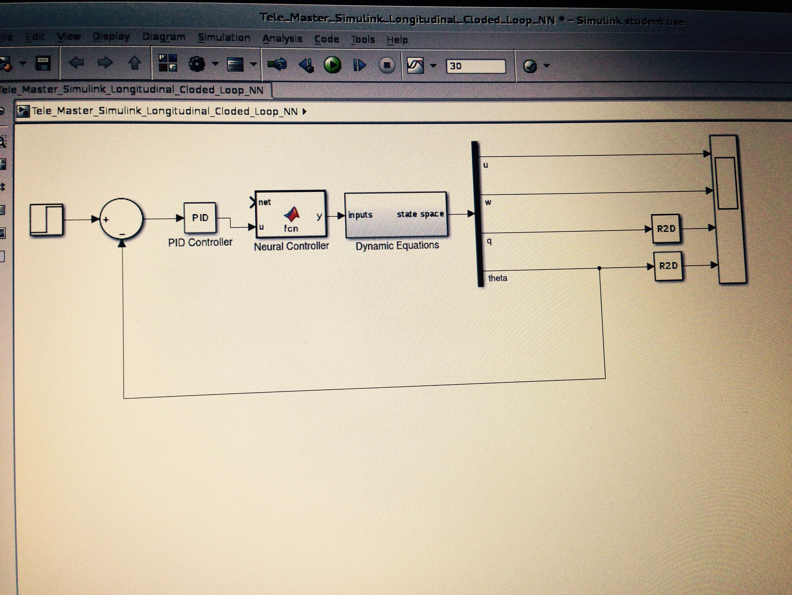
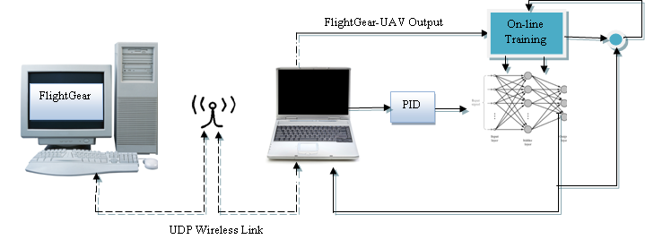
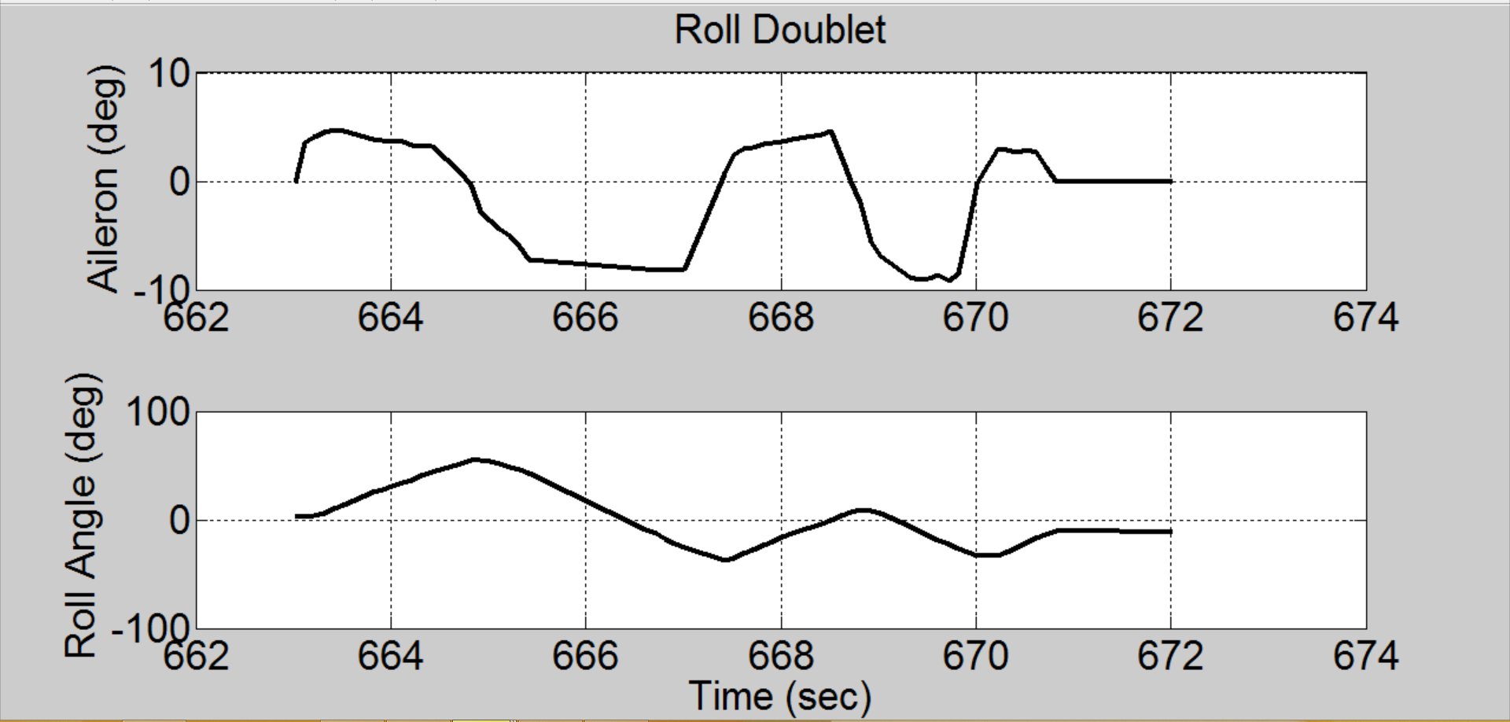

Adaptive Neural Controller for Non-Linear Flight
Ohanes Dadian, Amar Raheja, Subodh Bhandari Department of Computer Science, College of Science, Cal Poly Pomona
Introduction
The Computer Science and Aerospace Engineering departments have been conducting research on the adaptive flight control using neural networks for unmanned aerial vehicles. Two network models were developed, a multi-layer perception (MLP) and echo state network (ESN). The MLP is used for offline learning, while the ESN is used for online learning. The ESN uses a supervised temporal approach to machine learning, which makes it a choice candidate for solving problems in dynamical systems, such as flight controllers. The model is sparsely connected, holds 12 neurons in the hidden layer, and single input and output signals. The hidden layer acts as a reservoir, with a 40% leak rate of current knowledge. The neurons are activated using a hyperbolic tangent function, whose output naturally feeds into our stochastic gradient based training method. The method utilizes the least mean squares algorithm for producing the error term. The output signal is generated using an output weight matrix using a linear regression of the input signal, neurons, and teacher signal. This output signal is then driven back into the network as a means to bias the neurons in generation of an output signal closer to the target. Flight parameters (roll, pitch, raw) are passed to the network in order to perform tuning. Initial trails entailed the performing of a roll doublet with our twin engine aircraft. The prototype was developed in MATLAB and ported to C++. The model proved to be Lyapnunov stable with little to no bursting. Software-in-the-Loop testing has occurred using Flight Gear and Simulink.
Method
Network Training
• Generate a random reservoir
• Drive input signal u(n) into reservoir
• Collect the activated neuron states x(n)
• Compute linear readout weights, Wout, using Weiner- Hopf based linear regression to minimize the mean square error between the actual y(n) and target t(n) signals.
• Use the trained network on new input u(n), computing y(n) by using Wout.
Results
Initial training utilized flight data acquired from a doublet roll performed on our twin engine aircraft. The following are plots comparing the teacher signal, holding the flight data, against the input signal of the network before training has occurred.
This is after running the first epoch of training. As you can see, the input signal u veers towards from the target signal after the output signal (y) is driven back into the network.
Neural Network Implementation
The model prototype was developed in MATLAB. The model works as part of a SIMULINK model that passes flight parameters from my network. Its purpose is to perform gain scheduling on the flight parameters. The flight parameters include row, pitch and yaw.
The MATLAB prototype was developed using R2012b and recently ported to R2015a. The code is driven by a high-level MATLAB function that is wrapped in a SIMULINK block. This allows for easy inclusion into the simulation model of our control system, as seen in figure x.
This error term is averaged over the N[y] dimensions of i(input) of the output signal, which is driven back into the system. The RMSE method allows for better human interpretability. Since it packs the data into small enough values without loosing the understanding of the difference between the signals eminating from the system.
Flight data is passed to the offline network. The parameters are turned and passed to the aircraft dynamics. A response is generated and fed back into the network.
Captions set in a serif style font such as Times, 18 to 24 size, italic style.
Duis autem vel eum iriure dolor in hendrerit in vulputate velit esse molestie consequat.
Conclusions
Our research shows that neural networks can, in fact, be used in performing adaptive flight. With both our feed-forward and reccurent neural networks being able to be used to perform adaptive flight on our telemaster aircraft. At the time of this writing, we have only performed software-in-the-loop. Our intent is to successfully peform hardware-in-the-loop to preset at the conference. For future efforts, we plan on developing a plug-and-play flight controller atop of an FPGA. This will allows us to further modularize our open source avionics platform, presented at the 2013 Aerospace Sciences conference.
Aim
In order to provide autonomous flight, an adaptive controller will need to be developed. As stated previously, an echo state neural network was chosen as the desired model. The network uses a reservoir model in the hidden layer, which is non-linear and sparsely connected. This model exhibits supervised temporal behavior for performing machine learning. This allows for solving problems in dynamical systems, such as
flight controllers. The architecture is depicted to the right. The network is made of an N dimensional reservior with a K dimensonal input layer and a L dimensonal output signal.
The aerial vehicle platform being used for this research is the 12' Telemaster airplane, which is 90 inches long with wing span of 144 inches. The airplane is shown in Figure 1. The empty weight of the airplane is about 24 pounds with payload capacity of about 12 pounds. The airplane is equipped with a Piccolo II autopilot. However, we are developing a custom avionics system with open source architecture. The existing autopilots are closed source and are not suitable for the implementation of neural network based controllers.
Echo State Network Model.
Simulink model of our adaptive flight controller.
Acknowledgments
We would like to acknowledge the National Science Foundation for funding this research effort.
Software-in-the-Loop system for training neural network models..
Captions set in a serif style font such as Times, 18 to 24 size, italic style.
Duis autem vel eum iriure dolor in hendrerit in vulputate velit esse molestie consequat.

Slide 2


Commonly used logos

