Slide 1
A Recurrent Neural Network for Non-Linear Control of a Fixed-Wing UAV
Ohanes Dadian and Subdoh Bhandari
Cal Poly Pomona
American Control Conference, 2016
<number>
6/28/16

Slide 2

Topics
Research Objectives
Motivation
Artificial Neural Networks
Echo State Networks
Prototype
Implementation
Results
Conclusion
<number>
6/28/16

Slide 3
Research Objectives
Develop Neural Networks for Performing Non-Linear Control of Unmanned Aerial Vehicles.
Both Feed Forward and Recurrent Models.
A Recurrent Model will allow for closer adherence to control laws.
Provide a feedback loop, allowing for adaptive control.
Provide an open platform for on campus UAV fleet.
<number>
6/28/16

Slide 4
Motivation
Unmanned Aerial Vehicles (UAVs) require the following to be registered in the National Airspace System (NAS).
Further Autonomy.
Expand flight envelope.
Gain scheduling is a popular means of accomplishing this goal.
Computationally Expensive.
High Design and Implementation Costs.
Rapid changes in gains lead to instability.
Pre-computed predictions may lead to vehicle failure.
<number>
6/28/16

Slide 5

Motivation, contd.
A non-linear model would be better suited for this task.
Neural Networks provide a connectionist and non-linear approach to solving computational problems.
<number>
6/28/16

Slide 6
Artificial Neural Networks
Composed of several interconnected artificial neurons that work in parallel to solve a problem.
The artificial neuron is the corner stone of a neural network.
Behaves like a biological nervous system.
Neuron either fires or doesn't (0 or 1).
Multiplexes input signals into a single output signal.
<number>
6/28/16

Slide 7
Artificial Neural Networks, contd.
Connections between neurons are weighted.
Dictate the cost value of each possible path.
Weights of connections provide ability to find most fitted models.
Follow path to least cost.
Neural Networks are trained using a learning algorithm.
Uses training data which labels are acceptable and unacceptable.
Mean Square Error (MSE) used to determine if the model is fitted.
<number>
6/28/16

Slide 8
Artificial Neural Networks, contd.
Neural Nets can be used to map complex relationships between inputs and outputs or perform pattern recognition.
Adaptive nature allows for response to unexpected inputs and patterns.
Come in many forms.
Feed-forward
Recurrent
Architecture
Contain input layer, hidden layers, and output layers.
<number>
6/28/16

Slide 9
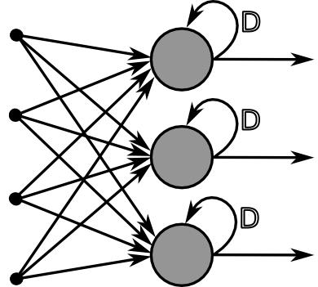
Recurrent Neural Networks
A recurrent neural network.
All connections form a directed cycle.
<number>
6/28/16
Notes:
<number>

Slide 10
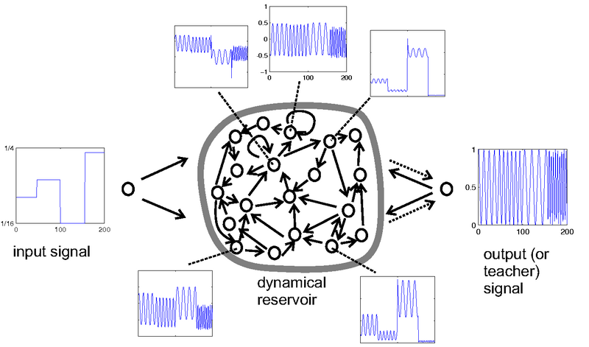
Echo State Network
Provide current knowledge with simpler implementation.
Sparsely connected neurons.
Weights are fixed.
Hidden layer behaves as a reservoir.
Implements a leak rate for current knowledge.
<number>
6/28/16

Slide 11
ESN Algorithm
Generate a large random reservoir.
Train using PID input and collect corresponding reservoir activation states.
Nonlinear transform of input signal (square wave) and the output signal (sine wave).
Compute the linear readout weights from the reservoir and using linear regression (Weiner-Hopf method).
Compute Mean Square Error (MSE).
Retrain if MSE is too high.
<number>
6/28/16

Slide 12
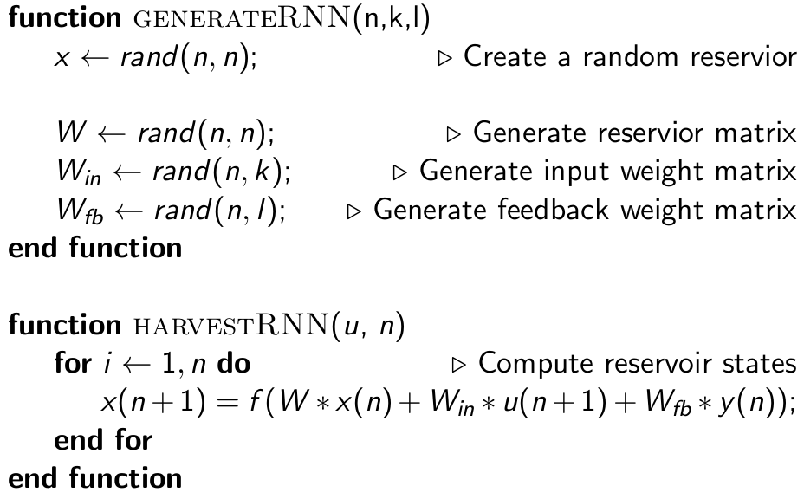
ESN Algorithm, contd.
<number>
6/28/16

Slide 13
ESN for Control and Identification
Simple Design and Implementation.
Can easily map linear systems to nonlinear form.
Nonlinear transform of input signal and to output signal.
Short-term memory aids in enhancing learning process.
Compute Mean Square Error (MSE).
Retrain if MSE is too high.
<number>
6/28/16

Slide 14
Prototype
MATLAB 2014b
50 neurons
40% leak rate
D matrix generated from Rapter50 helicopter data.
Roll, Pitch, Raw
<number>
6/28/16

Slide 15
Implementation
C++
Eigen
Modified matrix and vector classes to include pseudo-inverse computation.
D matrix generated from TwinEngine Flight Dynamics Model.
Roll, Pitch, Raw
FDM runs in FlightGear.
Roll, Pitch, and Yaw
<number>
6/28/16

Slide 16
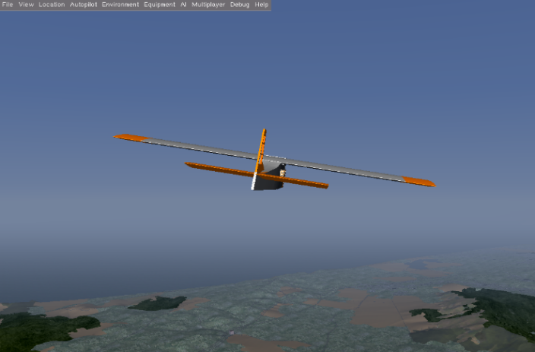
FDM in FlightGear
<number>
6/28/16
Notes:
<number>

Slide 17
Results
The recurrent model was trained with data obtained from flight tests with our TwinEngine aircraft.
Used data containing row, pitch, and yaw axes.
<number>
6/28/16

Slide 18
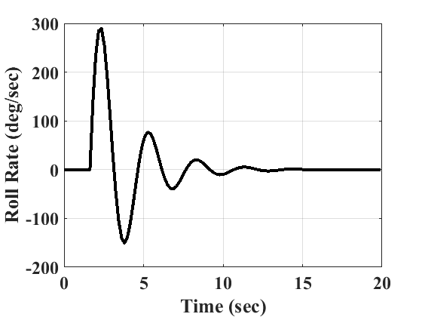
Simulated Roll Rate Used for the Training
<number>
6/28/16
Notes:
<number>

Slide 19
Simulated Aileron Deflection Used for Training
<number>
6/28/16
Notes:
<number>

Slide 20
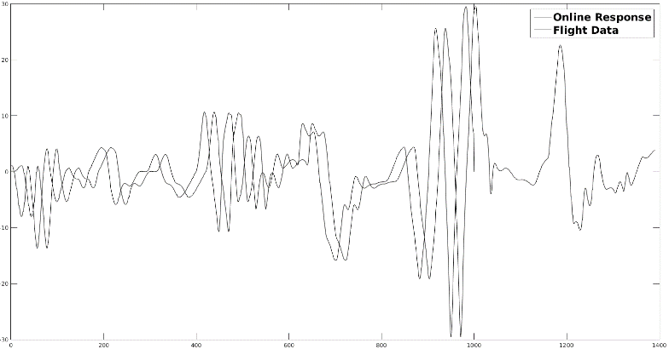
ESN Online Model vs. Sim
<number>
6/28/16
Notes:
<number>

Slide 21
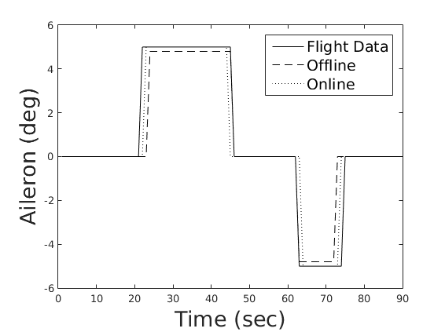
ESN Model Responses vs. Simulated Flight Data
<number>
6/28/16
Notes:
<number>

Slide 22
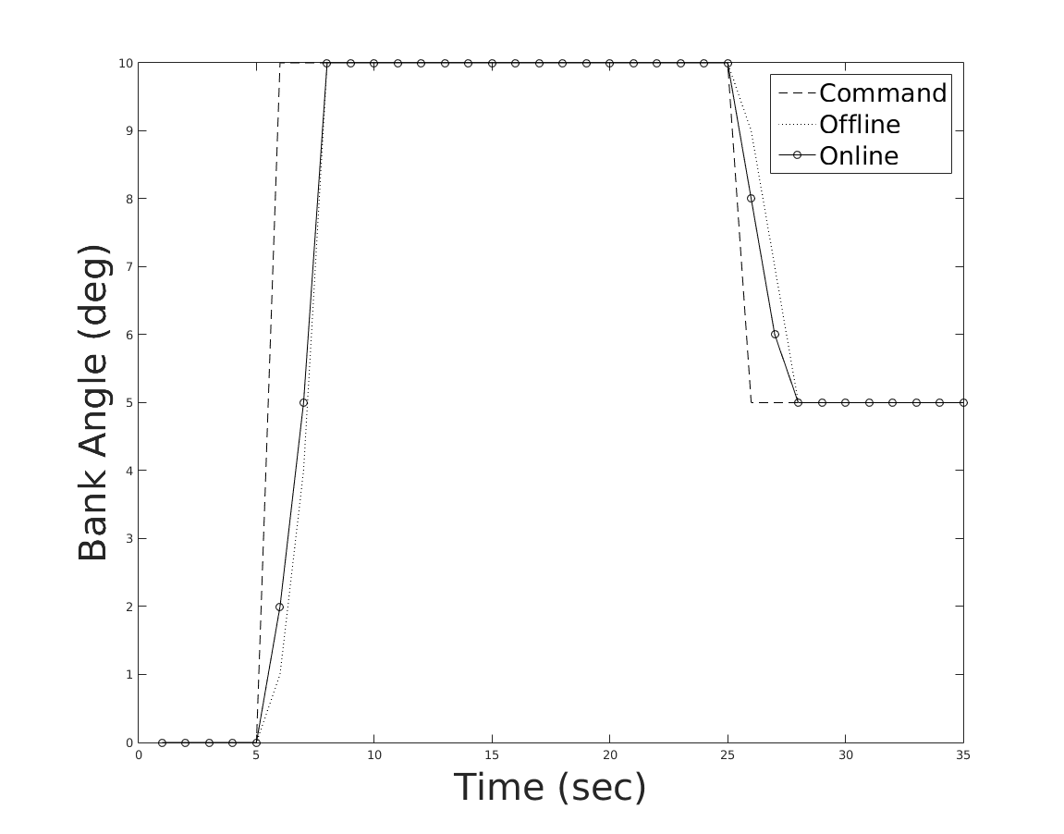
Closed-loop Response for Bank Angle
<number>
6/28/16
Notes:
<number>

Slide 23
Conclusions
ESN can successfully perform identification and nonlinear control of UAVs.
Able to perform both offline and online learning.
Offline training allows for inversion of feedback linearization to be computed.
Simulation showed controller performance significantly improved in both open and closed loop responses.
ESN facilitated adaptability with more ease than a feed forward network.
Able to decrease delta of MSE with less training iterations.
Shorter bursts and Lyapunov sable.
<number>
6/28/16

