Slide 1

FutureTech - Hiring Strategy
Prepared by
Fausto Lira
Anslem Okeke

Slide 2
Agenda
FutureTech
Hiring Process Outcomes
Hiring Programs: ABXL, ARC, EMA, REP, and QB
Final Considerations

Slide 3
FutureTech
With more than 15 years in the analytics consultancy business, the company FutureTech faces the need to adapt to modern trends of inclusivity, work flexibility, continuous learning culture, among others. With respect to inclusivity, the company has established five hiring programs: ABXL, ARC, EMA, REP, and QB. The goal is to start balancing the different types of talent in the company. It establishes an initial target of 25% of vacancies for women and 40% of vacancies for the diversity group (ethnic female and male and non-ethnic female). The analysis and its outcomes, conclusions and recommendations will be presented in the next slides.

Slide 4
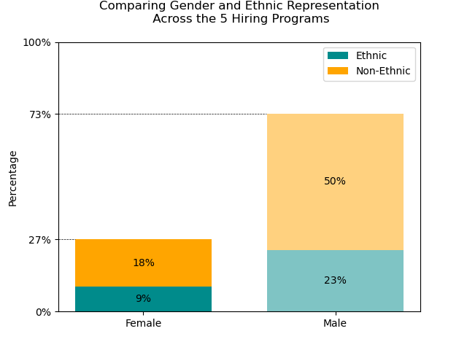
Hiring Process Outcomes
The graph alongside shows the proportion of men and women in the 5 selection processes divided between ethnic and non-ethnic groups. The main message the graph presents is the proportion of women hired. It is also possible to extract from the graph that the proportion of people hired from ethnic groups is 50%. The idea is to immediately transmit positive outcomes to stakeholders. Observe that the bar representing women has a highlighted color compared to the bar for men. Also, only the words “female” and diversity are in bold (10% rule). The choice of the percentages 27% and 73% in the y-axis is reinforce the proportion, the other percentages were eliminated to avoid distractions. The visual is proposed to clean. We also opted by basic language in all texts.
OUTCOMES
Achieved 27% of female hiring
50% of jobs filled by diversity candidates

Slide 5
Hiring Programs: ABXL, ARC, EMA, REP, and QB
The present graph has the sole intention of conveying the message that ARC's hiring process has achieved the expected result of almost 40% in the process of hiring people from the diverse group. The message aims to convey the message that the average for the diverse group was 50%, higher than expected. We highlight the ARC bar to convey the message more quickly. Only the "41%" is greater than the others following the 10% rule, there are only percentages of 0% and 100% on the y-axis to avoid distractions. In general, the graph is as summarized as possible with only what matters. There are two pieces of information in the text box. The first uses the simple text technique developed in class 3. The information is straightforward with an emphasis on percentages. Again, the idea is to quickly convey the message.
Out of all available positions, were allocated
50% to the diversity group.
ARC hiring program achieves 41% of diversity.

Slide 6
Final Considerations
Key takeaways
All five hiring programs were highly successful
Positive feedback from candidates
Improvement in diversity group ratio
Better adaptation to global markets
Recommendations
Keep the initiative
Identify and eliminate bias
Feedback from ethnically diverse candidates who declined the offer
Review the process for improvement

Slide 7

THANK YOU

