Slide 1

Artificial Intelligence

Slide 2
What is AI?
Artificial Intelligence (AI) is a way to make machines think and behave intelligently. These machines are controlled by software inside them, so AI has a lot to do with intelligent software programs that control these machines. It is a science of finding theories and methodologies that can help machines understand the world and accordingly react to situations in the same way that humans do.

Slide 3





Linguistic
Perception
Reasoning
INTELLIGENCE
Learning
Problem Solving

Slide 4
Research Areas
Fuzzy Logic
Natural Language Processing
Expert Systems
Robotics
Neural Networks

Slide 5

FUZZY LOGIC

Slide 6
What is Fuzzy Logic?
Fuzzy Logic (FL) is a method of reasoning that resembles human reasoning. The approach of FL imitates the way of decision making in humans that involves all intermediate possibilities between digital values YES and NO.
The conventional logic block that a computer can understand takes precise input and produces a definite output as TRUE or FALSE, which is equivalent to human’s YES or NO.
It can be implemented in systems with various sizes and capabilities ranging from small micro-controllers to large, networked, workstation-based control systems.
It can be implemented in hardware, software, or a combination of both.

Slide 7
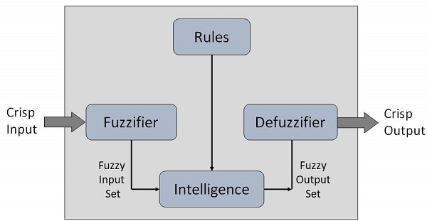
Architecture

Slide 8
Architecture
Fuzzification Module − It transforms the system inputs, which are crisp numbers, into fuzzy sets. It splits the input signal into five steps such as −
LP | x is Large Positive
MP | x is Medium Positive
S | x is Small
MN | x is Medium Negative
LN | x is Large Negative

Slide 9
Architecture
Knowledge Base − It stores IF-THEN rules provided by experts.
Inference Engine − It simulates the human reasoning process by making fuzzy inference on the inputs and IF-THEN rules.
Defuzzification Module − It transforms the fuzzy set obtained by the inference engine into a crisp value.

Slide 10
Algorithm
Define linguistic variables and terms.
Construct membership functions for them.
Construct knowledge base of rules.
Convert crisp data into fuzzy data sets using membership functions. (fuzzification)
Evaluate rules in the rule base. (Inference Engine)
Combine results from each rule. (Inference Engine)
Convert output data into non-fuzzy values. (defuzzification)

Slide 11
Natural Language Processing

Slide 12
What is NLP?
Natural Language Processing (NLP) refers to AI method of communicating with an intelligent systems using a natural language such as English.
Processing of Natural Language is required when you want an intelligent system like robot to perform as per your instructions, when you want to hear decision from a dialogue based clinical expert system, etc.
The field of NLP involves making computers to perform useful tasks with the natural languages humans use. The input and output of an NLP system can be −
Speech
Written Text

Slide 13
Components
There are two components of NLP as given −
Natural Language Understanding (NLU)
Understanding involves the following tasks −
Mapping the given input in natural language into useful representations.
Analyzing different aspects of the language.
Natural Language Generation (NLG)
It is the process of producing meaningful phrases and sentences in the form of natural language from some internal representation.
It involves −
Text planning − It includes retrieving the relevant content from knowledge base.
Sentence planning − It includes choosing required words, forming meaningful phrases, setting tone of the sentence.
Text Realization − It is mapping sentence plan into sentence structure.
The NLU is harder than NLG.

Slide 14
Difficulties
NL has an extremely rich form and structure.
It is very ambiguous. There can be different levels of ambiguity −
Lexical ambiguity − It is at very primitive level such as word-level.
For example, treating the word “board” as noun or verb?
Syntax Level ambiguity − A sentence can be parsed in different ways.
For example, “He lifted the beetle with red cap.” − Did he use cap to lift the beetle or he lifted a beetle that had red cap?
Referential ambiguity − Referring to something using pronouns. For example, Rima went to Gauri. She said, “I am tired.” − Exactly who is tired?
One input can mean different meanings.
Many inputs can mean the same thing.

Slide 15
Steps in NLP
Lexical Analysis − It involves identifying and analyzing the structure of words. Lexicon of a language means the collection of words and phrases in a language. Lexical analysis is dividing the whole chunk of txt into paragraphs, sentences, and words.
Syntactic Analysis (Parsing) − It involves analysis of words in the sentence for grammar and arranging words in a manner that shows the relationship among the words. The sentence such as “The school goes to boy” is rejected by English syntactic analyzer.
Semantic Analysis − It draws the exact meaning or the dictionary meaning from the text. The text is checked for meaningfulness. It is done by mapping syntactic structures and objects in the task domain. The semantic analyzer disregards sentence such as “hot ice-cream”.
Discourse Integration − The meaning of any sentence depends upon the meaning of the sentence just before it. In addition, it also brings about the meaning of immediately succeeding sentence.
Pragmatic Analysis − During this, what was said is re-interpreted on what it actually meant. It involves deriving those aspects of language which require real world knowledge.

Slide 16
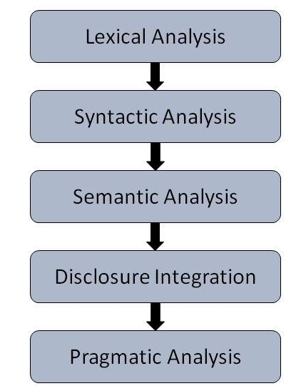
Steps in NLP

Slide 17
Natural Language Processing

