Slide 1
Bucketlist
Done By
Mohammed Irfan R

Slide 2
OBJECTIVE
The objective of this project is to create an application where users can register, sign in and create their bucket list.
This application helps the users to keep track of their Wishes, Goals or Tasks.
The Application is developed by using Html, CSS, JavaScript, Python, Flask framework, with PostgreSQL as the Database.

Slide 3
Application architecture
Frontend
Backend
Database

Slide 4
DATABASE ARCHITECTURE
Bucketlist
TBL_USER
user_id
user_name
*user_email
user_password
TBL_WISH
*wish_id
wish_title
wish_description
wish_user_email
wish_date
wish_accomplished

Slide 5
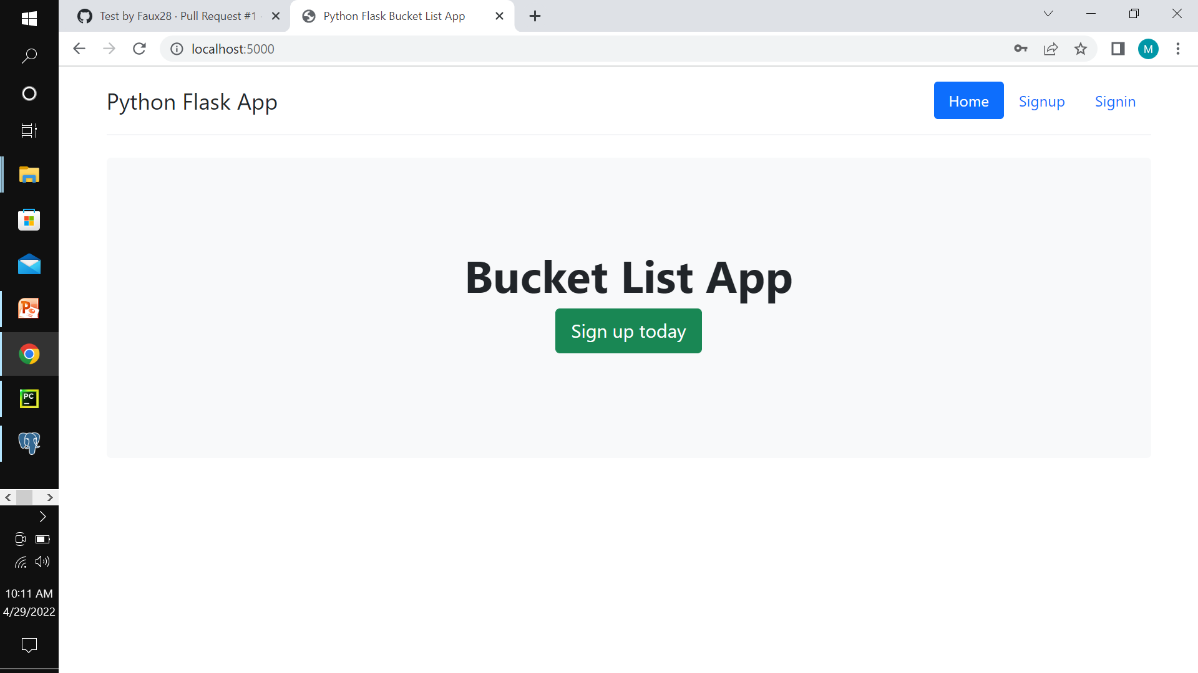
Index page

Slide 6
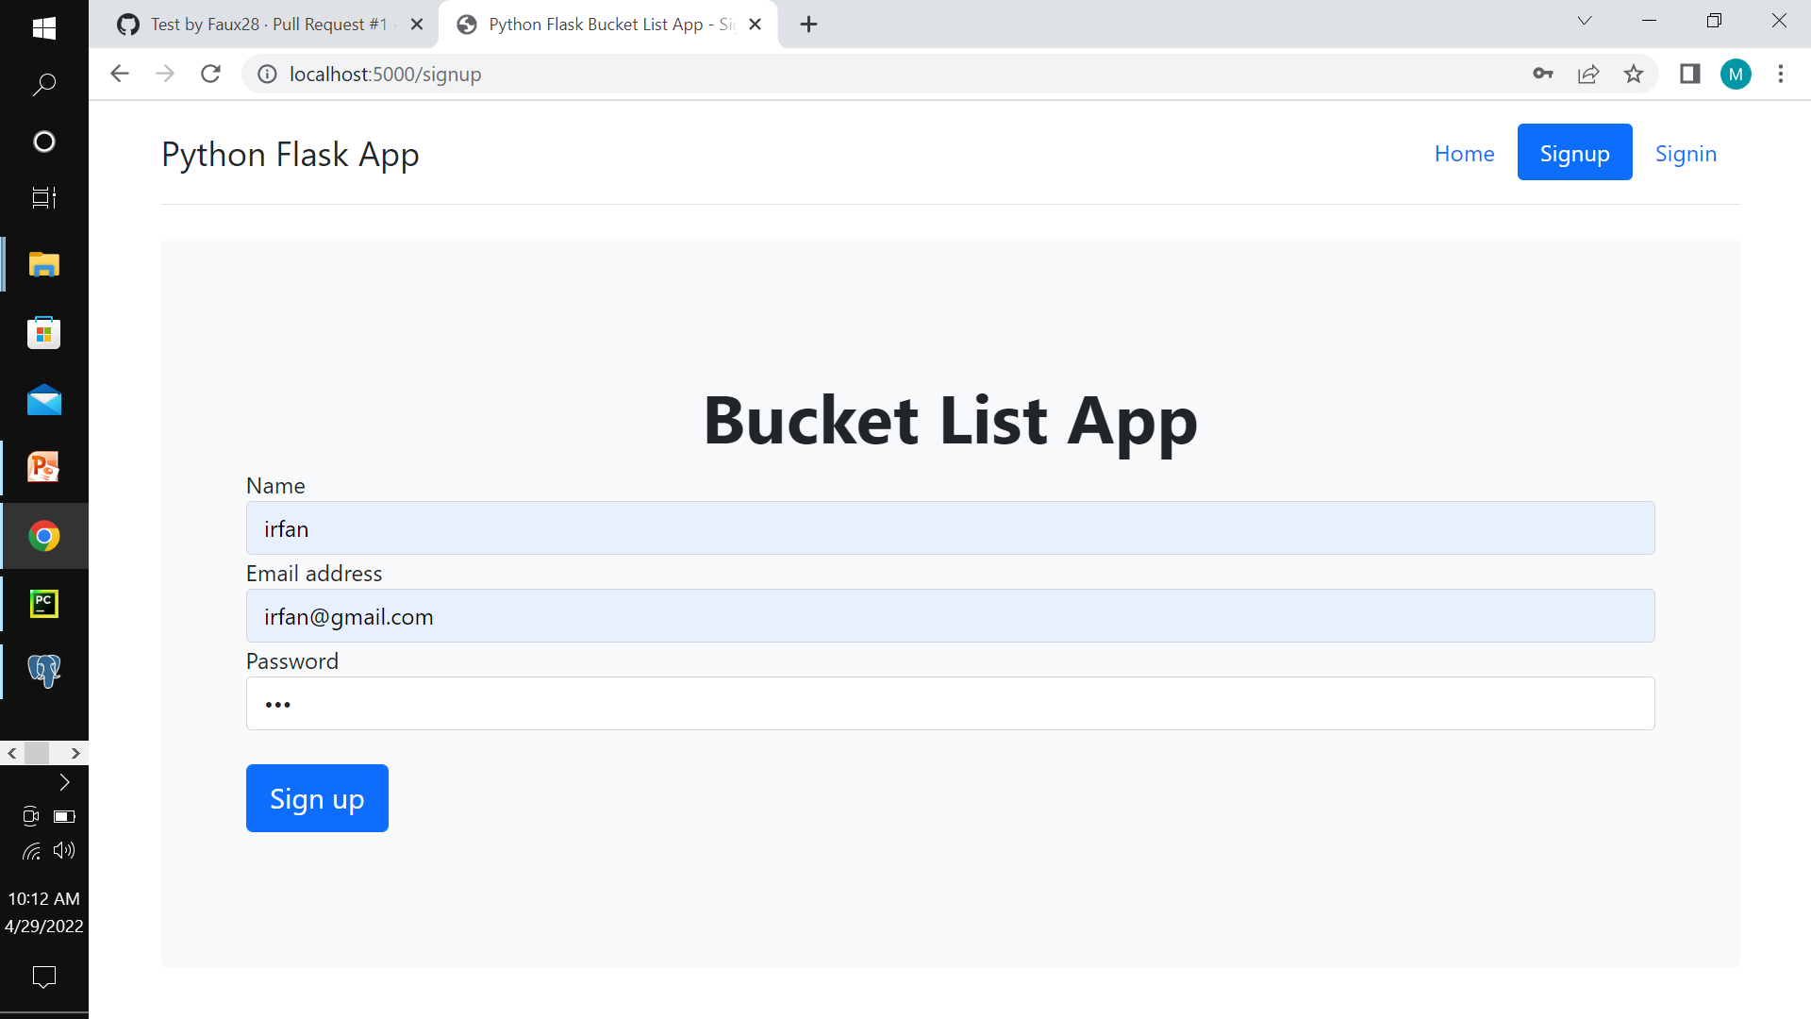
Signup page

Slide 7
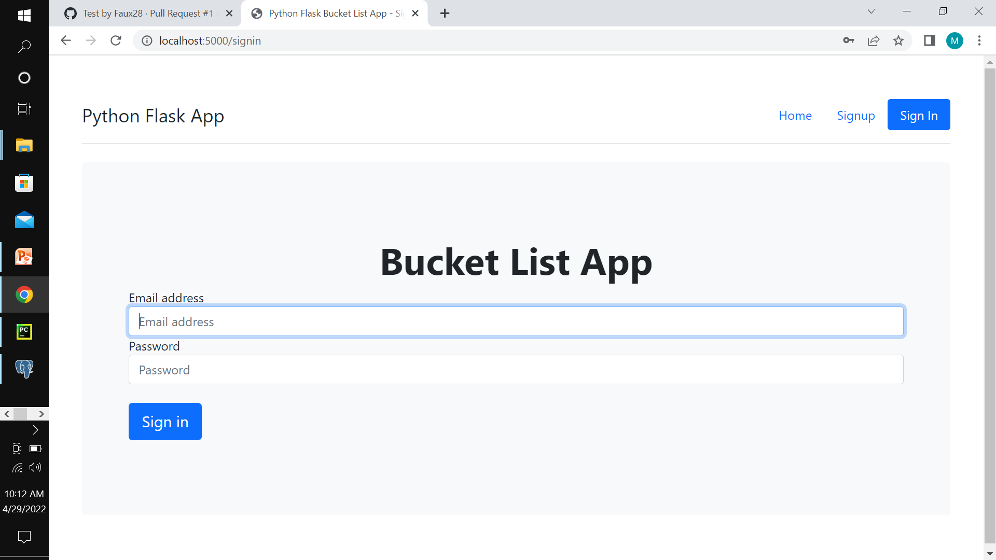
Sign in page

Slide 8
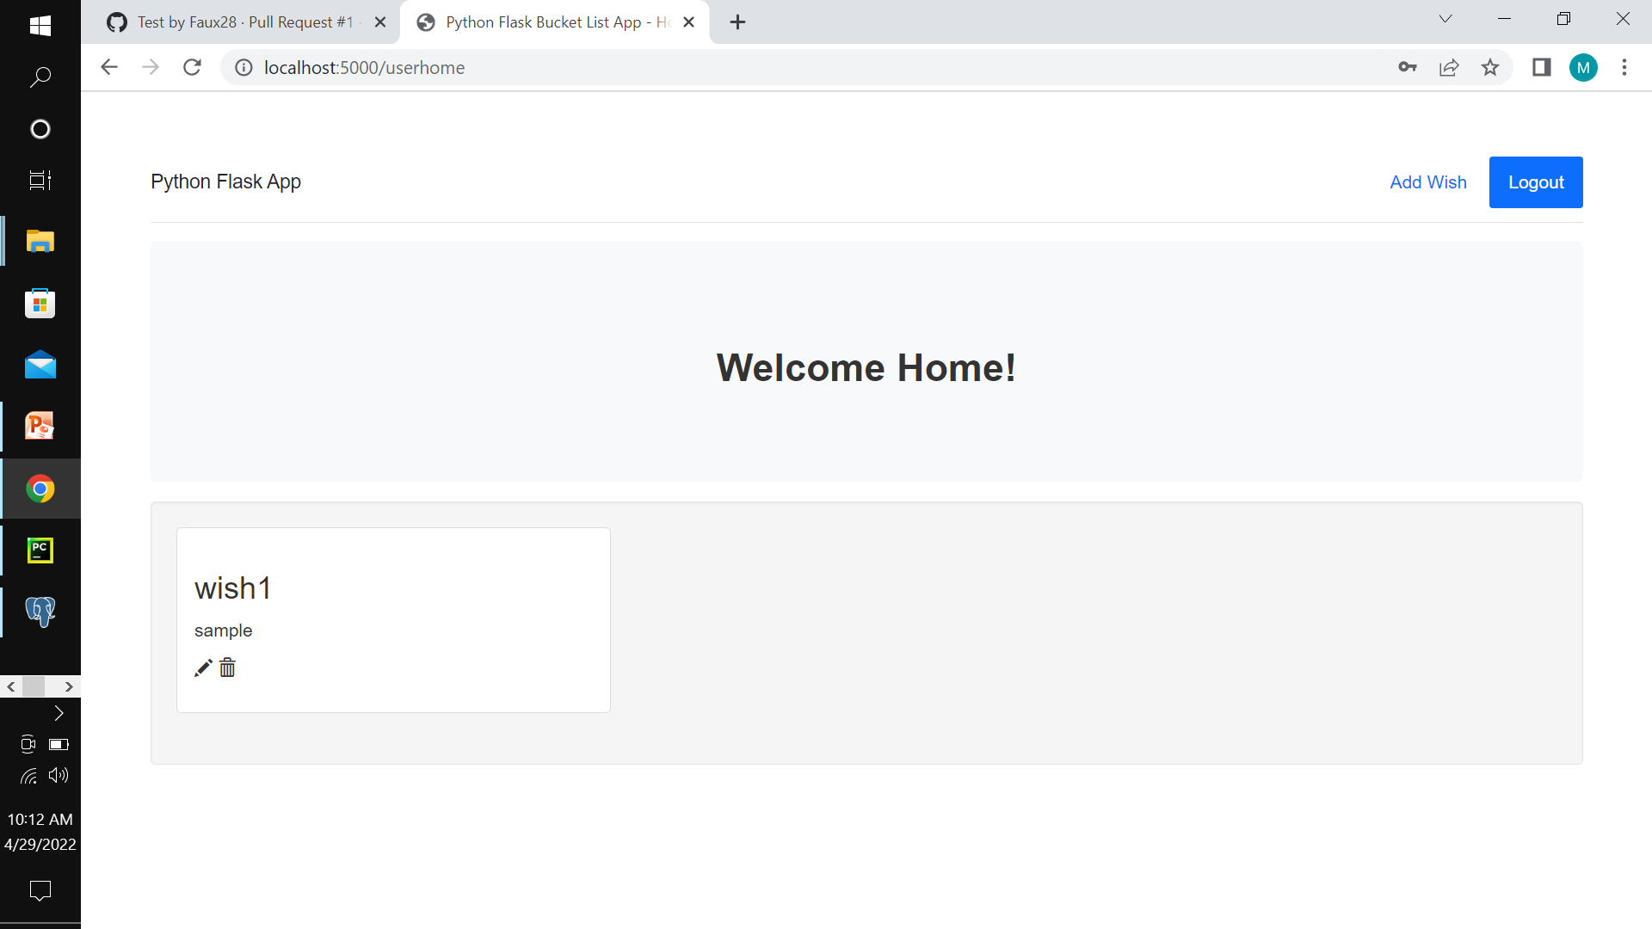
User home page

Slide 9
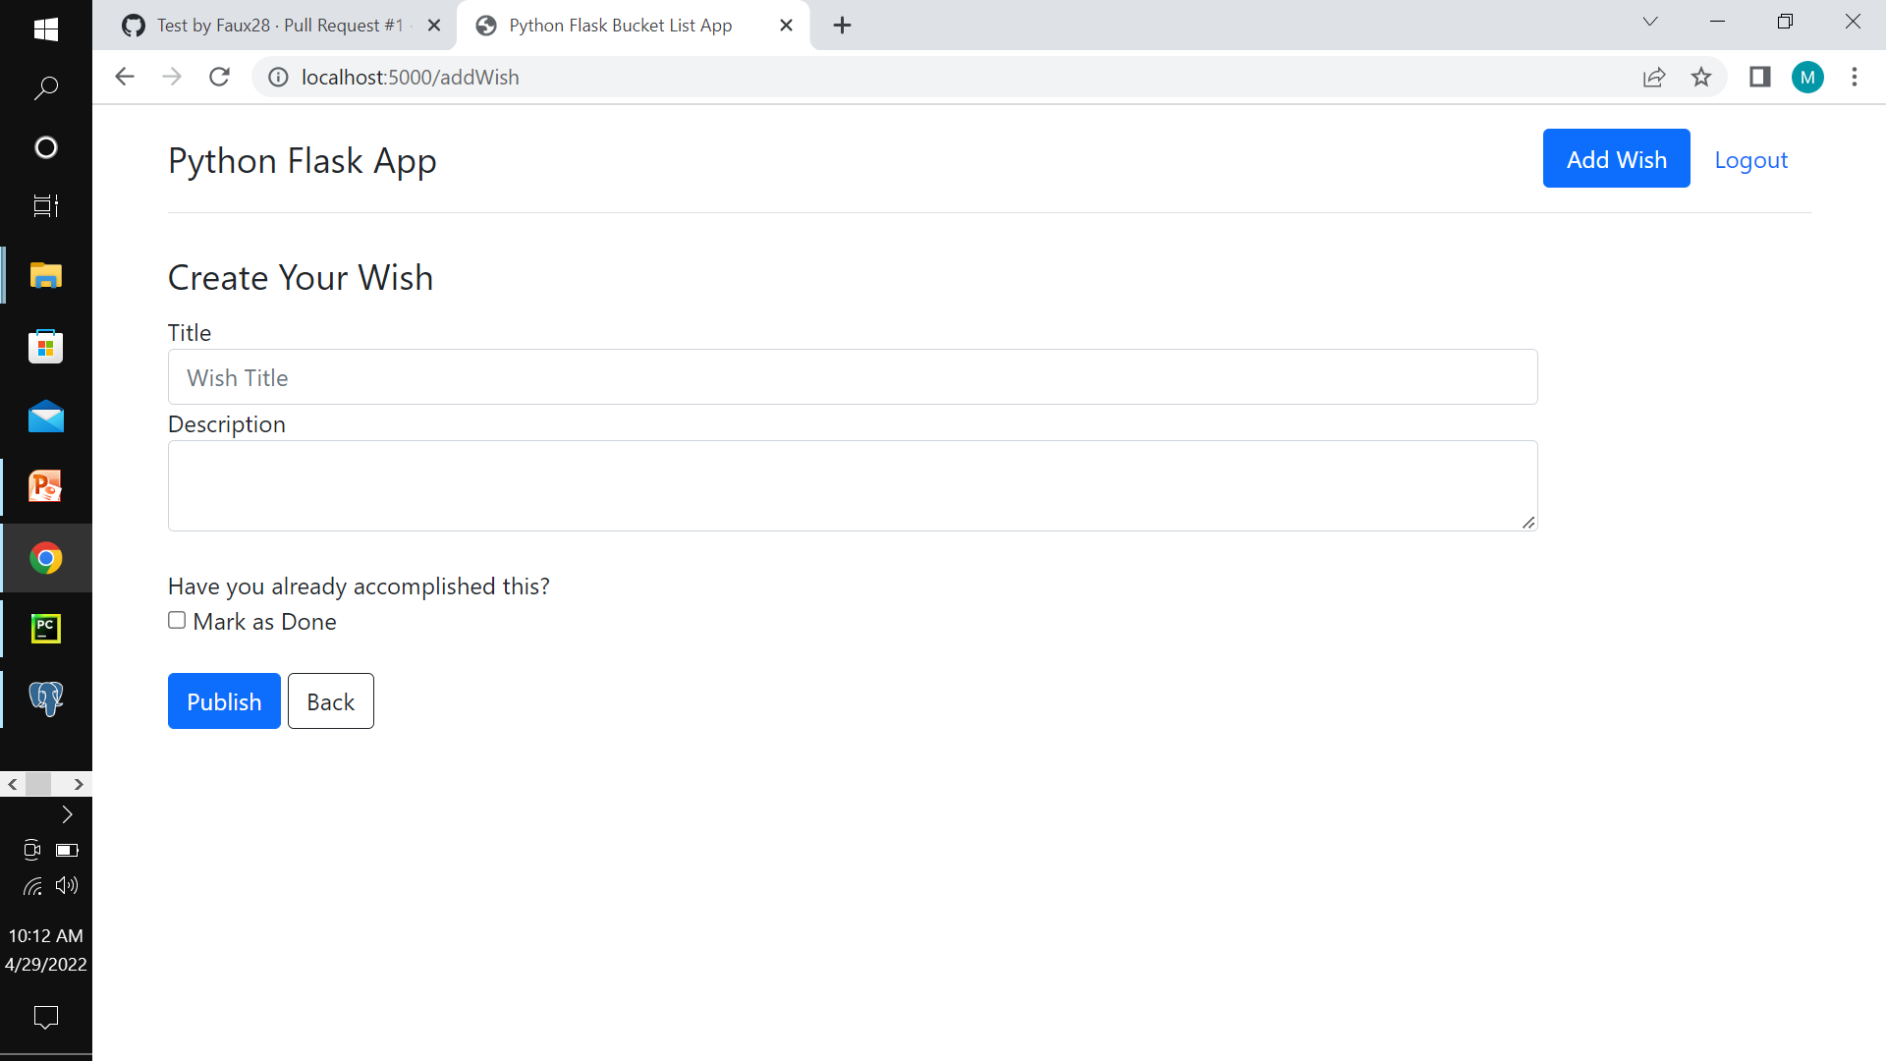
Add wish page

Slide 10
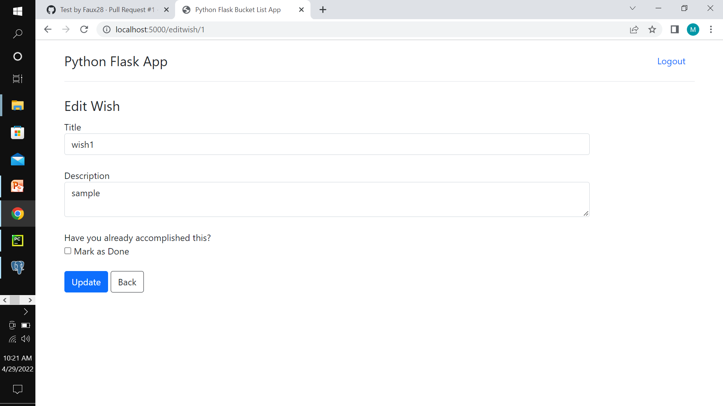
Edit wish page

