Slide 1



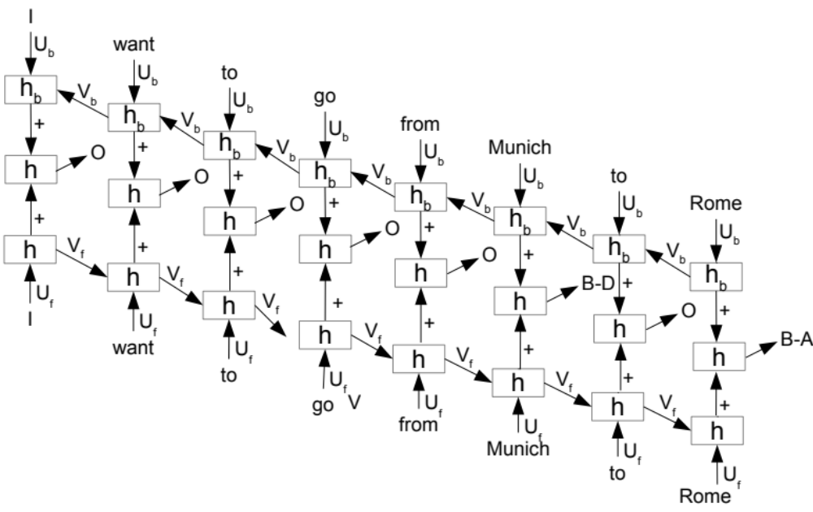
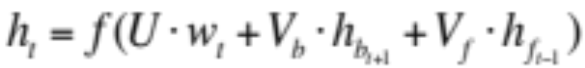
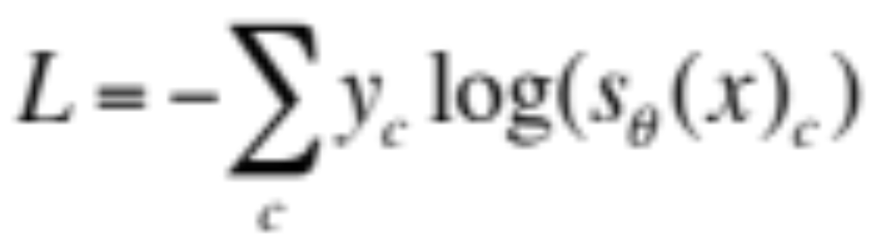
BI-DIRECTIONAL RECURRENT NEURAL NETWORK WITH RANKING LOSS FOR
SPOKEN LANGUAGE UNDERSTANDING
Ngoc Thang Vu, Pankaj Gupta, Heike Adel, Hinrich Schütze
thangvu@ims.uni-stuttgart.de
University of Stuttgart
LMU Munich
1. Overview
2. Bi-directional Recurrent Neural Netwok
Revisit bi-directional Recurrent Neural Network for slot filling task
Propose to use ranking loss function to train the model
i.e. it does not force the mode to learn pattern for ‚O‘ class
95.56% F1-score: state-of-the-art result on ATIS benchmark data without using any additional knowledge or data sources
RNN input: Not just the current word but also the surrounding context
Combined hidden layer:
- Add:
- Concatenation:
Text | I | want | a | flight | from | Rome | to | Stuttgart
Slots | O | O | O | O | O | B-fromloc.city_name | O | B-toloc.city_name
Parameters | Value
Activation function | Sigmoid
Hidden layer size | 100
Regularization | L2
L2 weight | 1e-7
Initial learning rate | 0.02
3. Learning Objective Function
Cross entropy
Ranking loss function
(proposed by Dos Santos et al. in 2015 for relation classification using CNN)
5. Experimental Results
During training:
Train a matrix whose columns contain vector representations for each class
Only calculate the second summand of the loss function for ,O‘ class
During testing:
we will predict class ‚O‘ if the score of all the other classes is lower than 0
Advantages:
Does not force the model to learn the pattern for class ‚O‘ which does not exist
Only two classes are computed, the training is quite fast with a large number of classes
Methods | F1-score (%)
Uni-directional RNN w. forward pass | 94.11
Uni-directional RNN w. backward pass | 93.78
Bi-directional RNN (add) | 94.92
Bi-directional RNN (concat) | 94.85
Bi-directional RNN (add) w. ranking loss | 95.47
Bi-directional RNN (concat) w. ranking loss | 95.40
Include ‚O‘ | Ignore ‚O‘
94.85 | 95.47
English trigger POS
State-of-the art results
Methods | F1-score (%)
CRF | 92.94
Simple RNN | 94.11
CNN | 94.35
LSTM | 94.5
RNN-EM | 95.25
biRNN | 94.92
R-biRNN | 95.47
5 x R-biRNN | 95.56
4. Data
ATIS data set: air travel domain
All the words are labeled with semantic labels in BIO format
- e.g. ‚New York‘ : B-fromloc.city_name I-fromloc.city_name
127 semantic labels including ‚O‘
Positive margin | 2 | 2.5 | 3 | 3.5 | 4
F1-score | 95.05 | 95.14 | 95.47 | 95.08 | 94.89
Evaluation using the script provided in text chunking CoNLL shared task 2000
Sets | #sentences | #words
Train | 4,978 | 56,590
Test | 893 | 9,198
Scaling factor | 1 | 1.5 | 2 | 2.5 | 3
F1-score | 95.04 | 95.15 | 95.47 | 95.17 | 95.11
The 41st IEEE International Conference on Acoustics, Speech and Signal Processing, 20-25 March 2016 – Shanghai, China

