Slide 1

ROAD ACCIDENT ANALYSIS FOR STATISENSE
NAME: FAVOUR IBEZIM I.
2-05-2024

Slide 2
EXECUTIVE SUMMARY
The dataset is made up of data collated in accidents that occurred in the 36 state of Nigeria and the FCT(Federal Capital Territory)Abuja during for the year 2023.
It includes data on causatives that caused the accidents in each of the states.
We aim at anayzing this data and drawing insights such as patterns, trends and contributing factors to the cause of accidents from this data analysis project.

Slide 3
INTRODUCTION
The analysis was done using various tools such as python and some python libraries such as pandas, matplolib, numpy etc were used in the analysis.
We desire to look into the problem of road accidents in Nigeria, which lead to severe loss. We hope to discover patterns, trends and insights that we help prevent and mitigate accidents in Nigeria and help develop strategies to promote and implement them.

Slide 4
QUESTIONS FOR ANALYSIS
What are the Major causes of road accidents in Nigeria for the year 2023 ?
What are the results and implication of the accident cases in Nigeria for the year 2023?
What are the survival rates for accidents in each state for the year 2023?
What are the Death rates for accidents in each state for the year 2023?
How do we Mitigate and reduce accidents in each state?

Slide 5
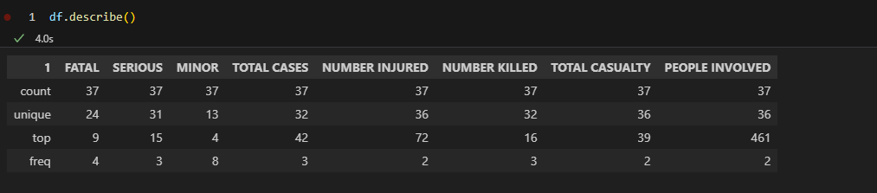
METHODOLOGY
The dataset was gotten from the National bureau of Statistics website, https://nigerianstat.gov.n/elibrary.
The Data was cleaned and preprocessed , and the dataset as analyzed to understand the distribution and characteristics of the data as shown below;

Slide 6
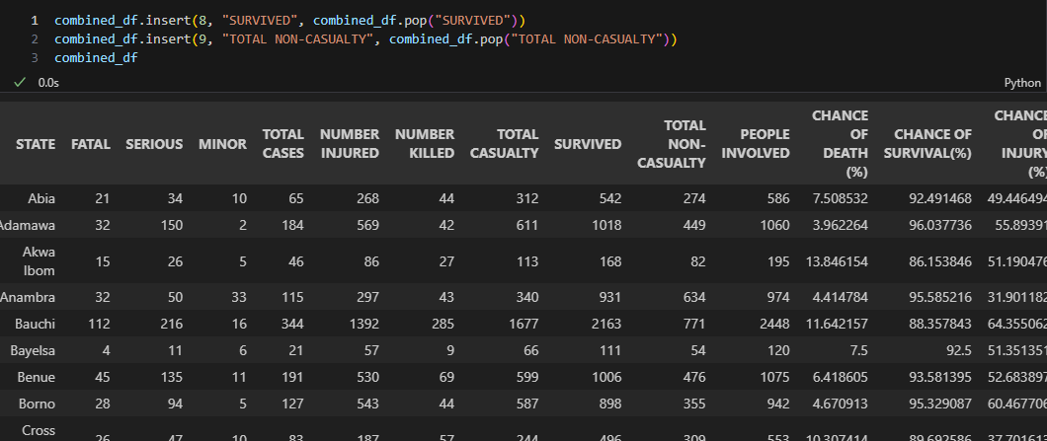
New data was generated inform of new columns from the analysis of the data as shown above

Slide 7
RESULTS
From the analysis some results were discovered as shown below.

Slide 8
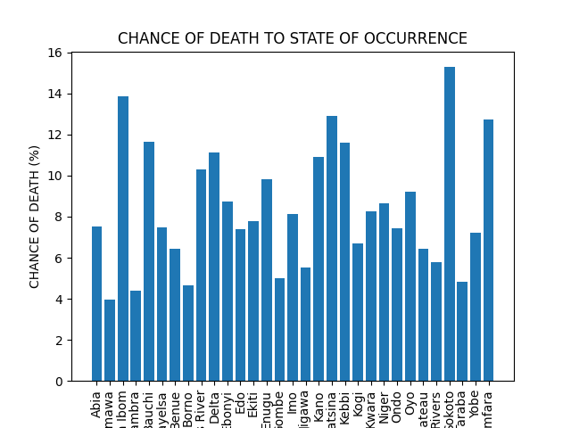
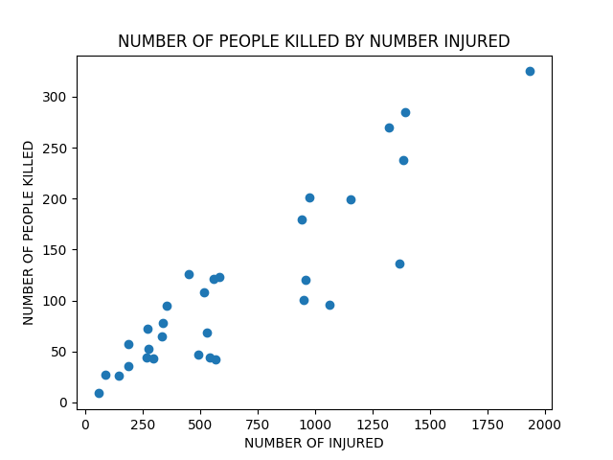
GRAPH
The state with highest chance of death when accident occurs is Sokoto while the state with the lowest chance of survival when accident occurs is Adamawa.

Slide 9
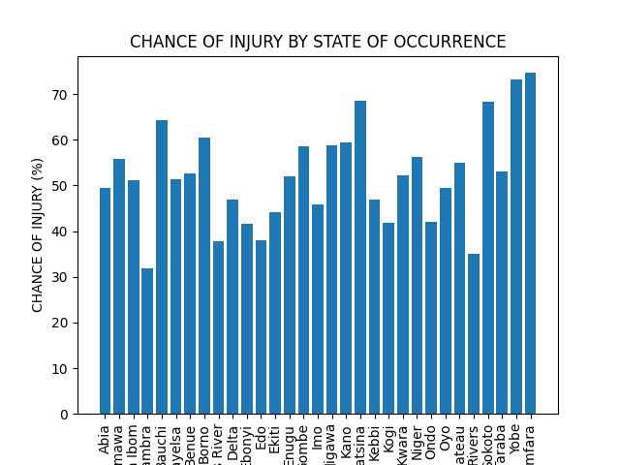
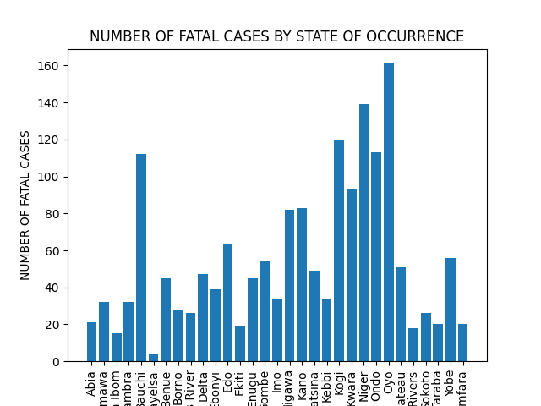
Oyo has the Highest number of Fatal case with over 150 fatal cases while Beyelsa has the lowest number of fatal cases in the year 2023 .
Zamfara has the Highest number of injury with while Anambar has the lowest number of injury in the year 2023 .

Slide 10
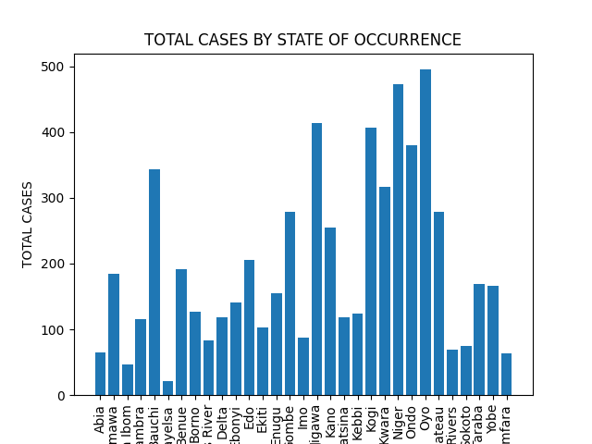
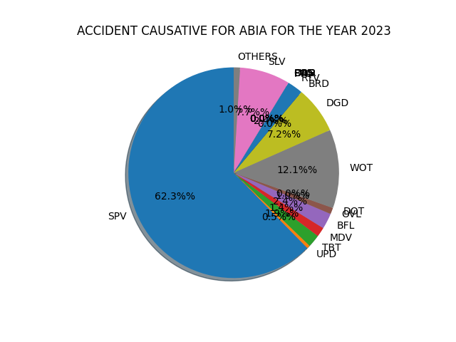
SPV is the highest cause of accident in Abia state with about 62.3% cause.
Bayelsa has the lowest number of accident cases while Oyo has the highest number of accident cases.

Slide 11
DISCUSSION
Accident occurred in the year 2023, and the result of these accidents were due to various causes with each state having a one or two of the cause as a major cause.
Recommendations
States which have over-speedings(SPV) as the major cause can be mitigated by applying speed limits on the roads where those accidents occur.
States which have Bad Road (BRD) as the major cause can be mitigated by repair of the roads where those accidents occur. etc

