Slide 1
SPE AFRICA GEOTHERMAL DATATHON 2026
Integrated Geothermal District Heating
& Cooling System for Utrecht, Netherlands
10.5 MWth
5.0 MWth
€74/MWh
Heating
Cooling
LCoE
TEAM GeoLogic Analytics
Uadia Moses Imoukhedeh SPE ID 5174626
Project Lead · Subsurface & Resource Assessment
Ogundimu Samuel Oluwaseun SPE ID 5408045
Surface Facilities & Thermodynamic Design
Akanmu Oluwaseun Emmanuel SPE ID 5436014
Presentation, Storytelling & Visualisation
Adejor Friday Emmanuel SPE ID 5510461
Well Scouting & ThermoGIS Characterisation
Favour Ifeanyichukwu Ogboi SPE ID 5898562
Data Engineering & Economic Modelling
Team_GeoLogicAnalytics_PPT_V1

Slide 2





PROBLEM FRAMING
The Challenge & Our Central Insight
The brief demands a coherent system — not a single well — delivering firm heating and cooling, sustainably and economically, from a medium-temperature aquifer.
10 MWth Heating
5 MWth Cooling
OUR CENTRAL INSIGHT
From a low-enthalpy reservoir (70–77 °C).
Year-round, balanced seasonally.
Transmissivity beats temperature.
For a low-enthalpy resource, the fluid volume the reservoir delivers matters more than how hot it is. A hot but tight well produces no usable power.
Low-Carbon
Flexibility
Minimise fossil & grid electricity.
Bridge constant supply vs seasonal demand.
PKP-01: 88 °C but 0.1 Dm → not viable
GeoLogic Analytics · SPE Africa Geothermal Datathon 2026
2

Slide 3



METHODOLOGY
From Raw Logs to a Bankable System
01
02
03
04
→
→
→
Data Engineering
Resource Screening
System Design
Economics & Risk
Ingest & QC four well logs; validate depths; engineer petrophysical features
Rank candidates on transmissivity; scout ThermoGIS corridors
Size heat exchanger, heat pump, chiller, ATES & storage
Depth-based CAPEX, LCoE & 10,000-run Monte Carlo
Data-driven screening reduced four candidate wells to a transmissivity-ranked portfolio, identifying BLT-01 and GLA-01 as the highest-value production pair while reserving GLA-02 as a contingency target.
Engineering rigour and evaluation discipline come before architectural complexity — every parameter is traceable to data or the surface design report.
GeoLogic Analytics · SPE Africa Geothermal Datathon 2026
3

Slide 4
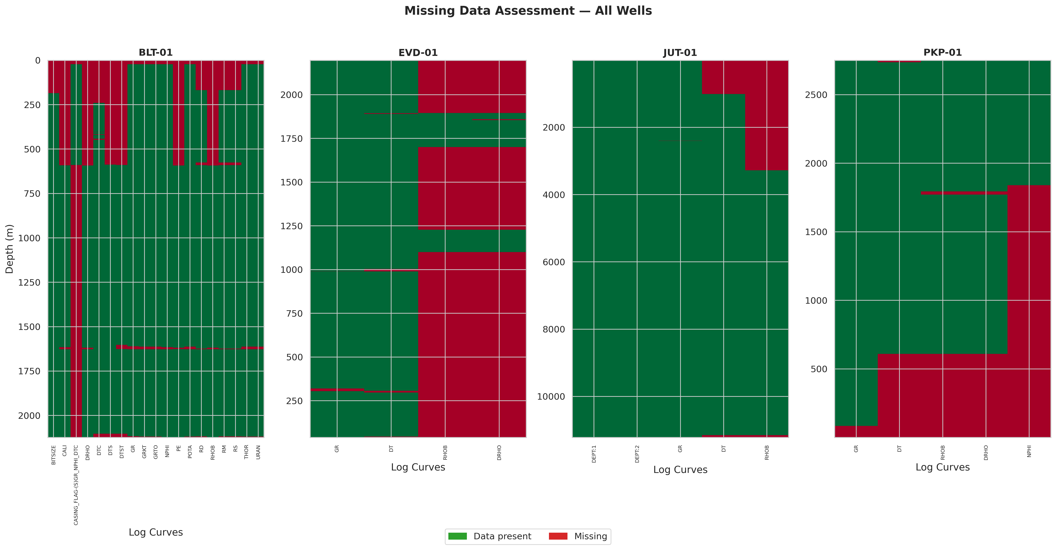
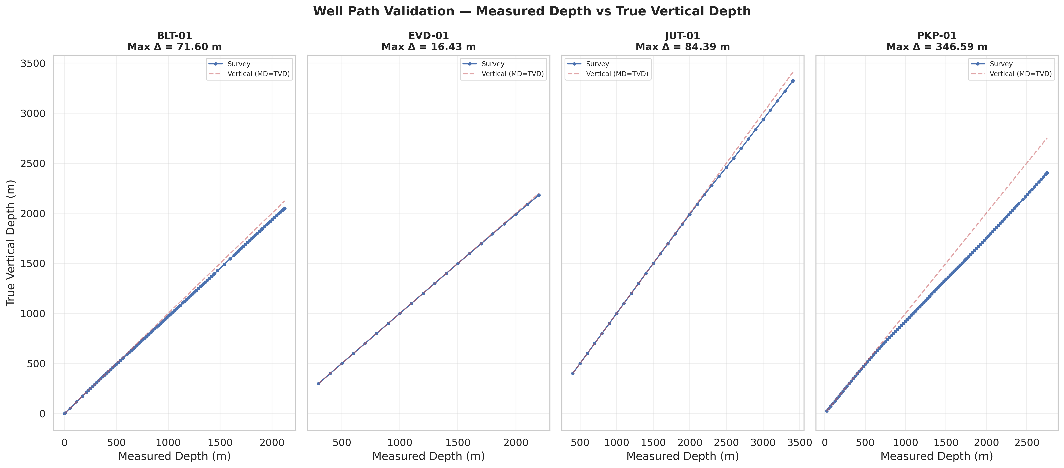
EDA · FINDING 01
Data Engineering: Getting the Basics Right
Three quiet errors most teams will carry forward:
Caught a hidden null code
The −999.25 sentinel was mapped to true missing values before any statistics were computed.
Caught a labelling error
Missing-data audit — −999.25 null sentinel detected & flagged
A ThermoGIS sheet headed “PKP-01” carried BLT-01 coordinates — flagged and corrected before screening.
Caught the depth trap
Target depths in along-hole MD were converted to TVD via the well-path survey — or every temperature estimate would be wrong.
MD vs TVD — depth correction for the deviated well
GeoLogic Analytics · SPE Africa Geothermal Datathon 2026
4

Slide 5
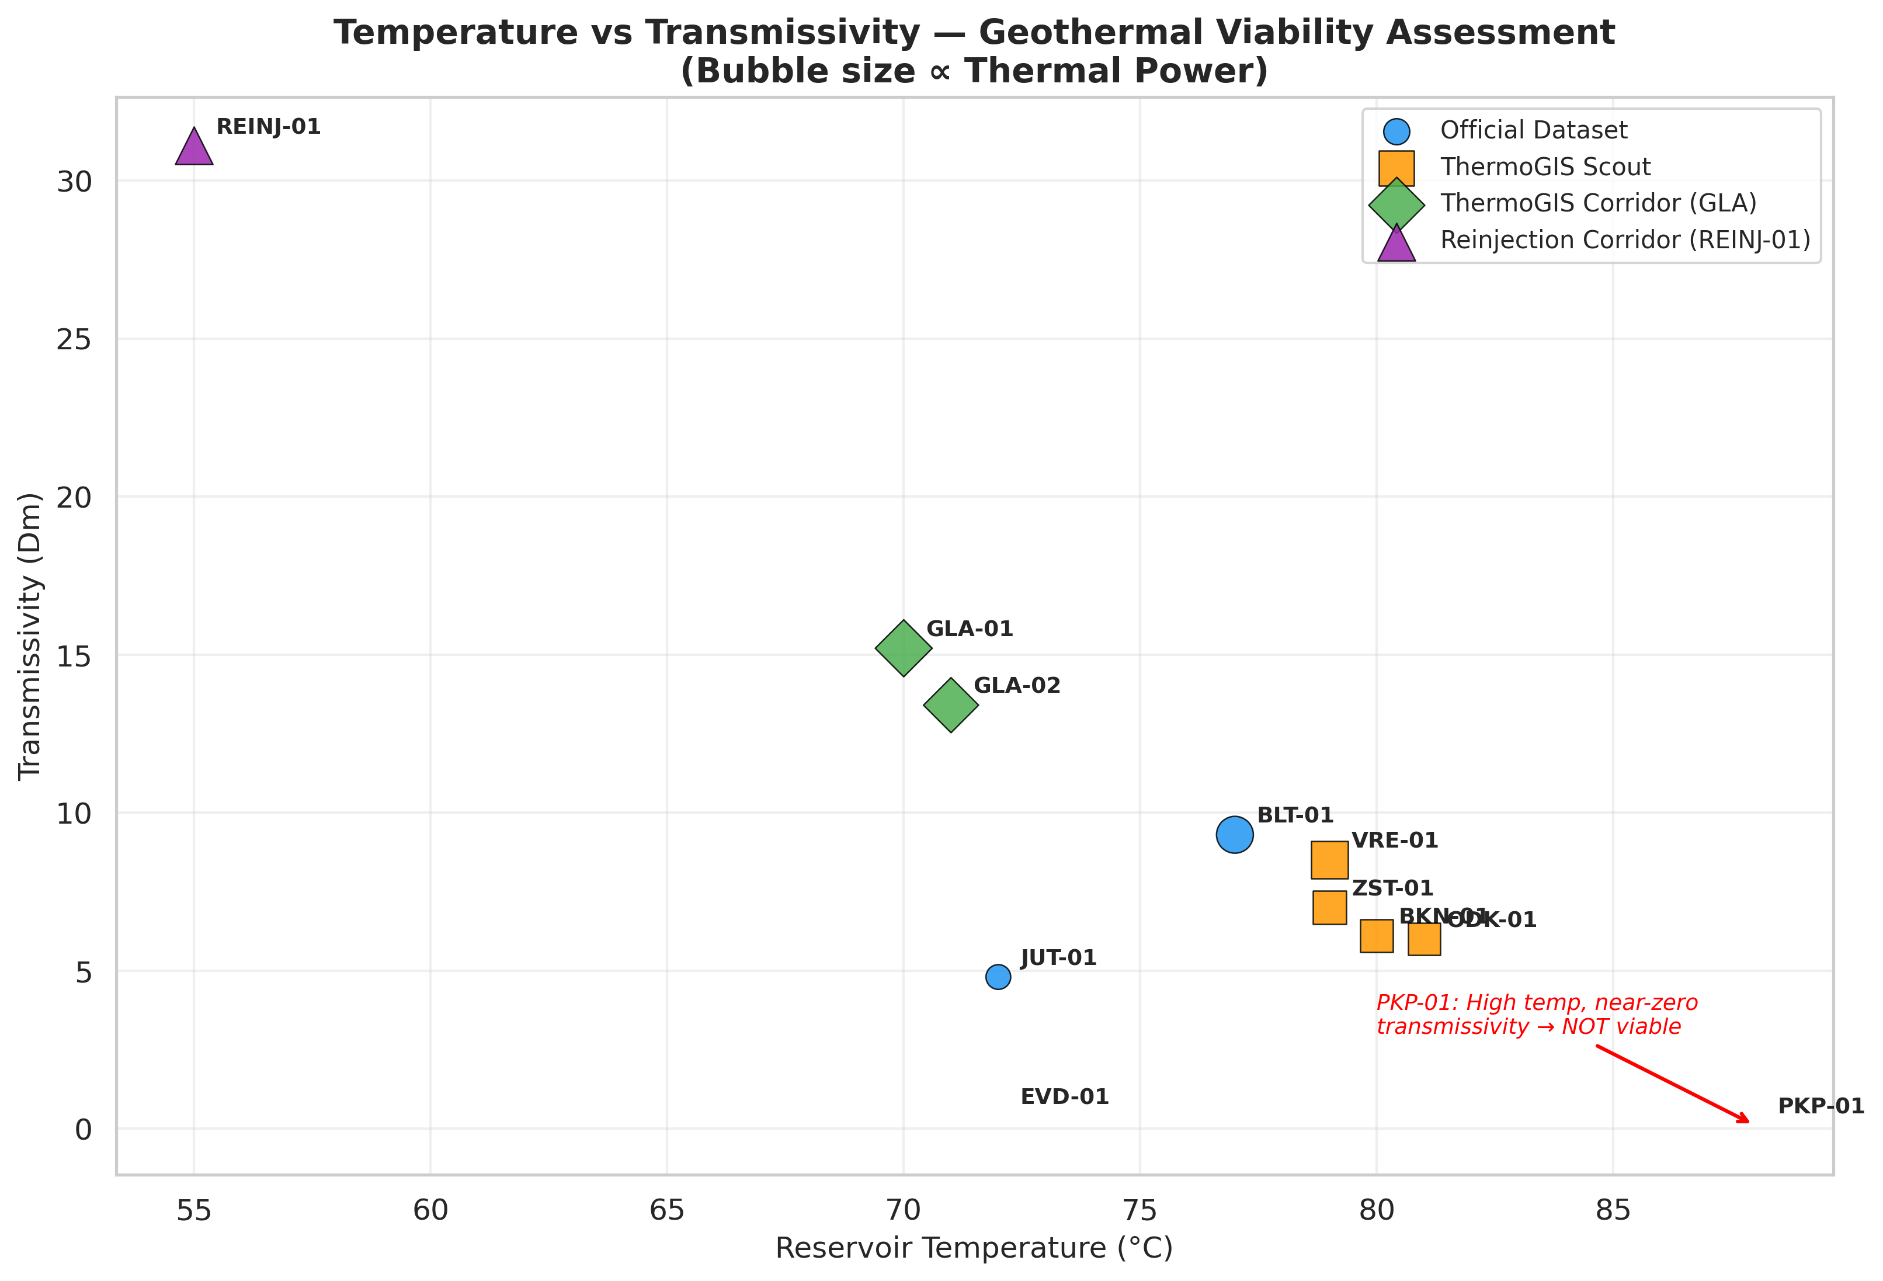
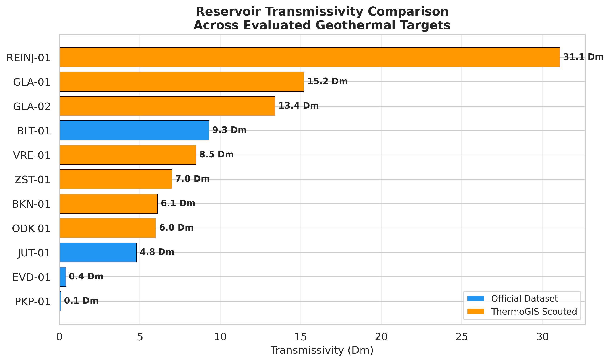
EDA · FINDING 02
Transmissivity Drives Viability
Viability trade-space — bubble size ∝ thermal power
31.1 Dm
PKP-01
REINJ-01 — best in class
88 °C but 0.1 Dm → useless
Transmissivity ranking across all targets
GeoLogic Analytics · SPE Africa Geothermal Datathon 2026
5

Slide 6
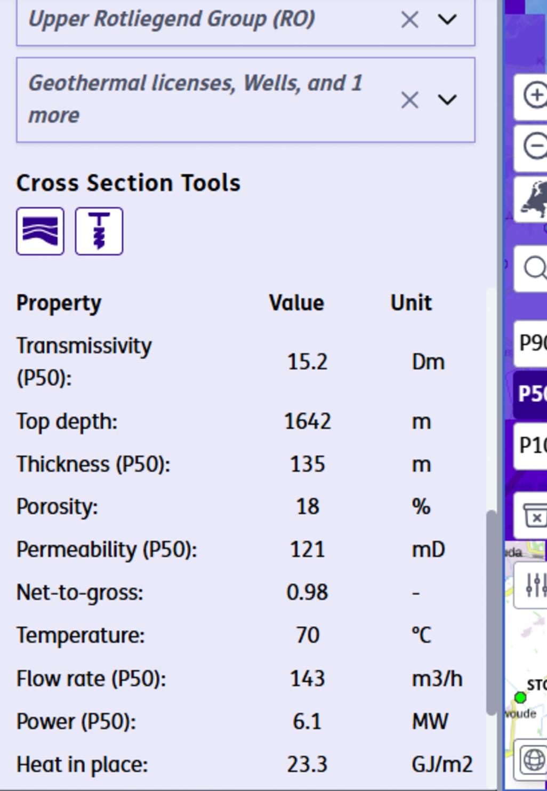
EDA · FINDING 03
Final Subsurface Architecture
Well
Role
Temp °C
Flow m³/h
Trans. Dm
GLA-01 — ThermoGIS Evidence
BLT-01
Validated Production
77
105
9.3
GLA-01
Optimised Corridor
70
140
15.2
GLA-02
Backup / Contingency
71
132
13.4
REINJ-01
Reinjection Corridor
55
192
31.1
Production doublet: BLT-01 + GLA-01 deliver 245 m³/h of blended 73 °C brine. GLA-02 is held in reserve. REINJ-01 — the highest-injectivity corridor at 31.1 Dm — safely accepts the cooled brine and maintains reservoir pressure.
GeoLogic Analytics · SPE Africa Geothermal Datathon 2026
6

Slide 7
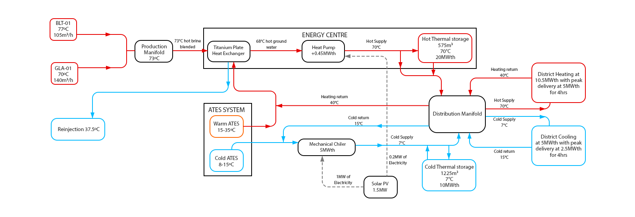



SYSTEM DESIGN · FINDING 04
System Architecture at a Glance
Hot brine / heating
Cooling / aquifer
Electricity (solar)
Geothermal Doublet
Energy Centre
Thermal Storage
Solar Powered
BLT-01 + GLA-01 → 245 m³/h of 73 °C brine
Heat exchanger + heat-pump upgrade to 70 °C
ATES seasonal wells + hot & cold buffer tanks
1.5 MW PV drives the heat pump & chiller
GeoLogic Analytics · SPE Africa Geothermal Datathon 2026
7

Slide 8

SYSTEM DESIGN · FINDING 05
Thermodynamics of the Production Loop
BLT-01
30.33 kg/s
Total geothermal power
77 °C · 105 m³/h
Q = ṁ · Cp · ΔT = 70.78 × 4.0 × (73 − 37.5)
Q ≈ 10.05 MWth
+
GLA-01
40.44 kg/s
70 °C · 140 m³/h
Geothermal
+ Heat pump
= Delivered
BLENDED PRODUCTION
10.05 MWth
→
0.45 MWth
→
10.5 MWth
73 °C · 70.78 kg/s
Honest engineering: geothermal supply (10.05 MWth) and the heat-pump upgrade (0.45 MWth) together meet the 10.5 MWth heating target — comfortably above the 10 MW minimum. The heat pump is the engineered bridge from a low-enthalpy aquifer to a usable district supply temperature.
GeoLogic Analytics · SPE Africa Geothermal Datathon 2026
8

Slide 9

SYSTEM DESIGN · FINDING 06
Energy Centre, Storage & Renewable Integration
Titanium Heat Exchanger
Heat Pump (COP ≈ 2.25)
ATES Seasonal Wells
Separates corrosive brine from the clean district loop.
Upgrades 68→70 °C; +0.45 MWth on 0.2 MW electric.
Hydraulically balanced seasonal heat/cold storage.
Buffer Tanks
Mechanical Chiller
1.5 MW Solar PV
Hot 575 m³/20 MWh + cold 1,225 m³/10 MWh shave 4-hr peaks.
5 MWth cooling at 7/15 °C; rejects to ATES cold well.
Offsets a significant fraction of auxiliary electricity demand.
Two-tier storage (seasonal ATES + daily buffer tanks) lets the wells run near-constant at their efficient point, decoupling continuous supply from seasonal demand.
GeoLogic Analytics · SPE Africa Geothermal Datathon 2026
9

Slide 10
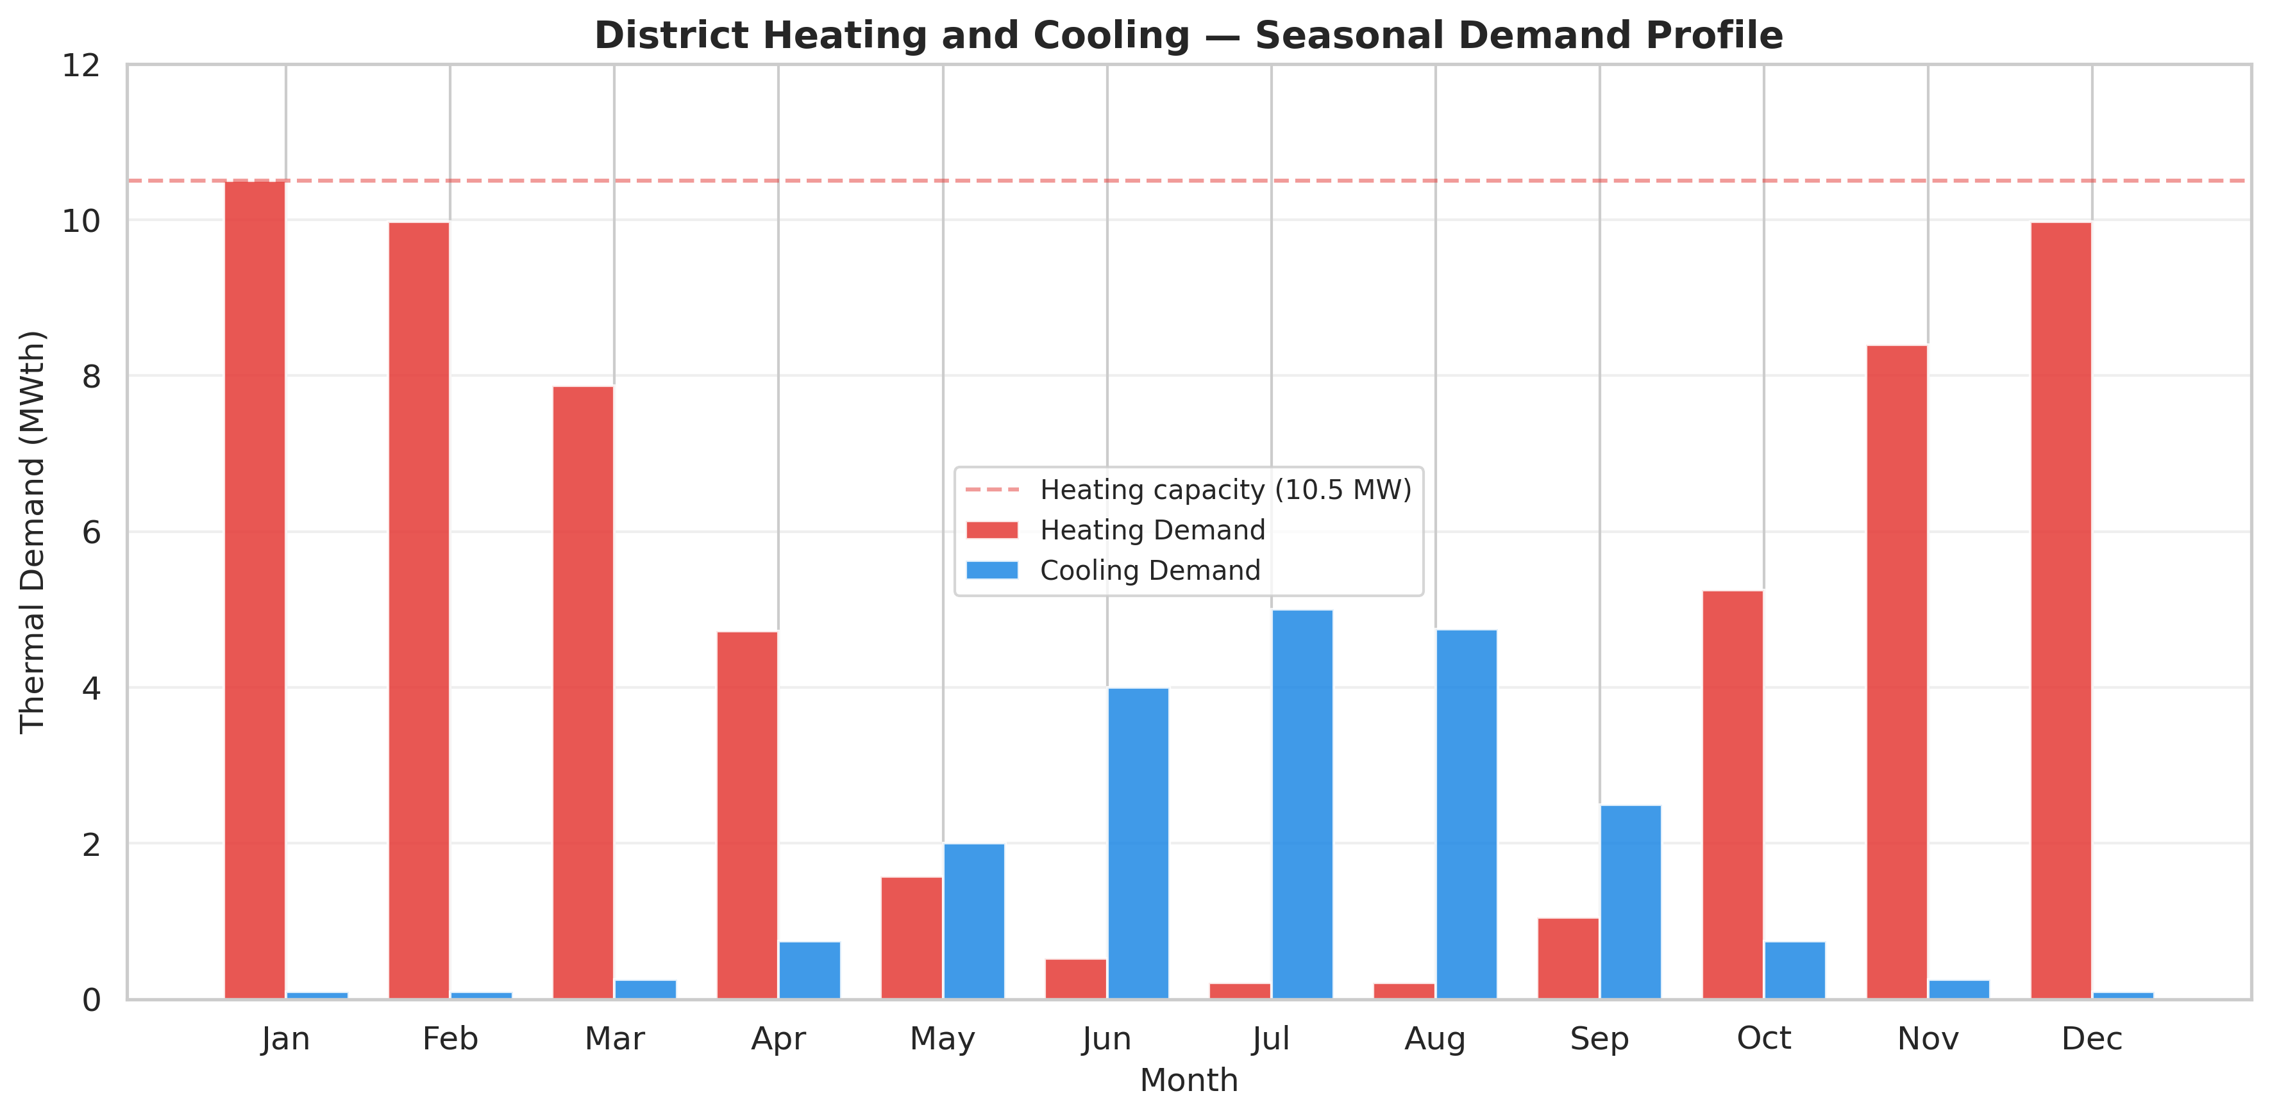
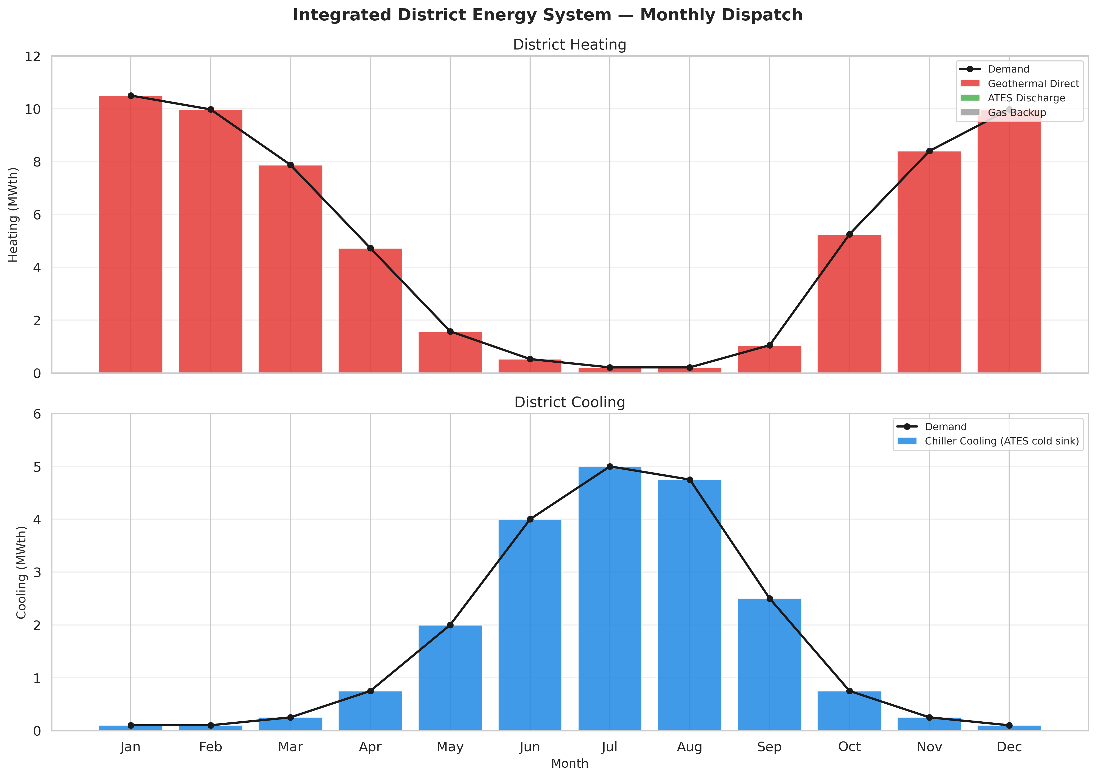
SYSTEM DESIGN · FINDING 07
Seasonal Demand & Annual Dispatch
Monthly heating & cooling demand vs capacity
Integrated monthly dispatch — geothermal + storage + minimal backup
>95 %
10.5 MWth
5.0 MWth
Demand met by geothermal + storage
Firm heating, every winter month
Firm cooling through summer peak
GeoLogic Analytics · SPE Africa Geothermal Datathon 2026
10

Slide 11
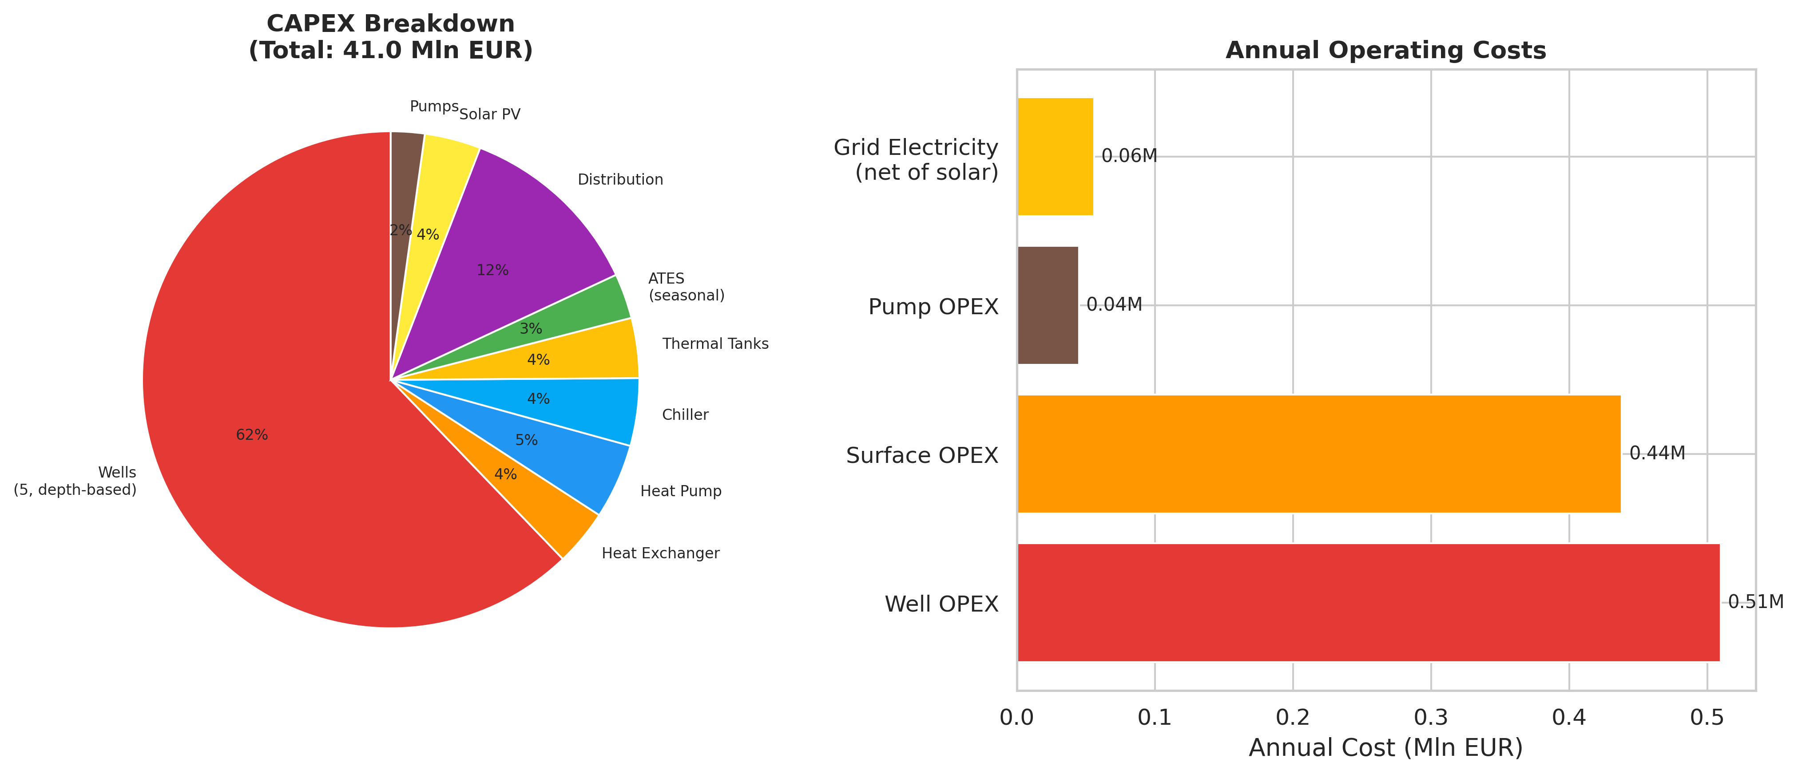
ECONOMICS · FINDING 08
Capital Cost & Levelised Cost of Energy
€41.0 M
Total capital expenditure
€74.4/MWh
Base-case LCoE (EU range)
€1.23 M/yr
CAPEX composition (left) and annual operating costs (right)
Depth-based drilling: each of 5 wells costed by its own depth — BLT-01 (1,700 m), GLA-01 (1,642 m), REINJ-01 (1,211 m), 2 ATES wells (150 m). Total drilling €25.5 M.
Annual operating cost
GeoLogic Analytics · SPE Africa Geothermal Datathon 2026
11

Slide 12
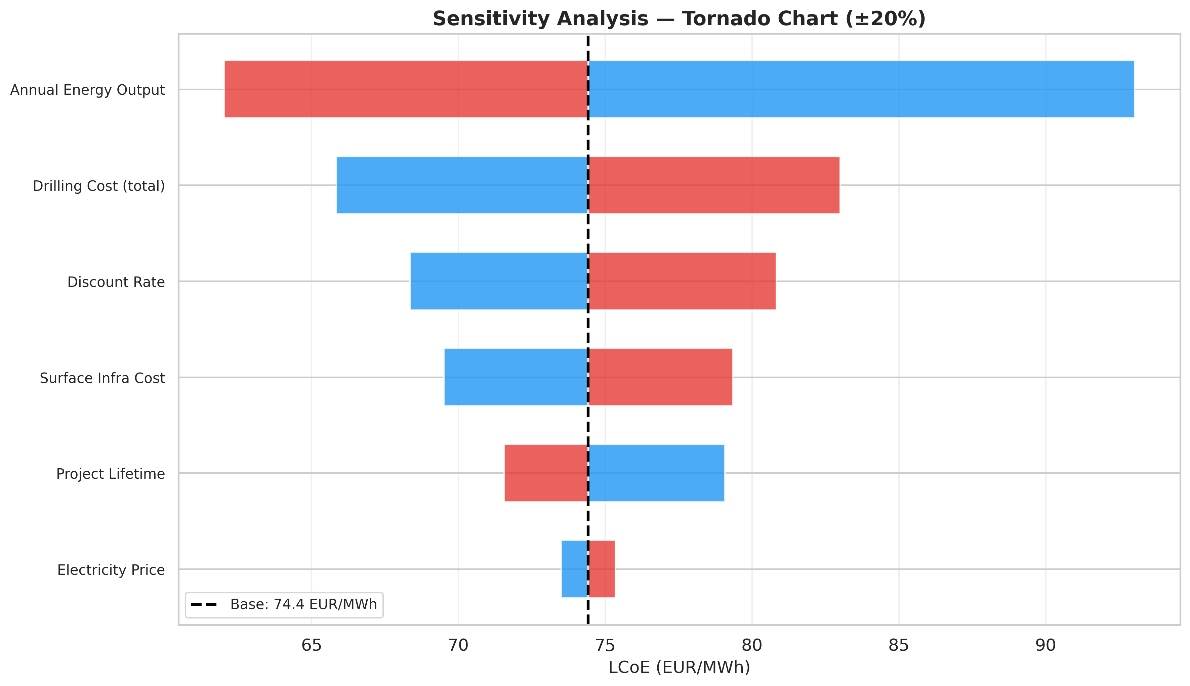
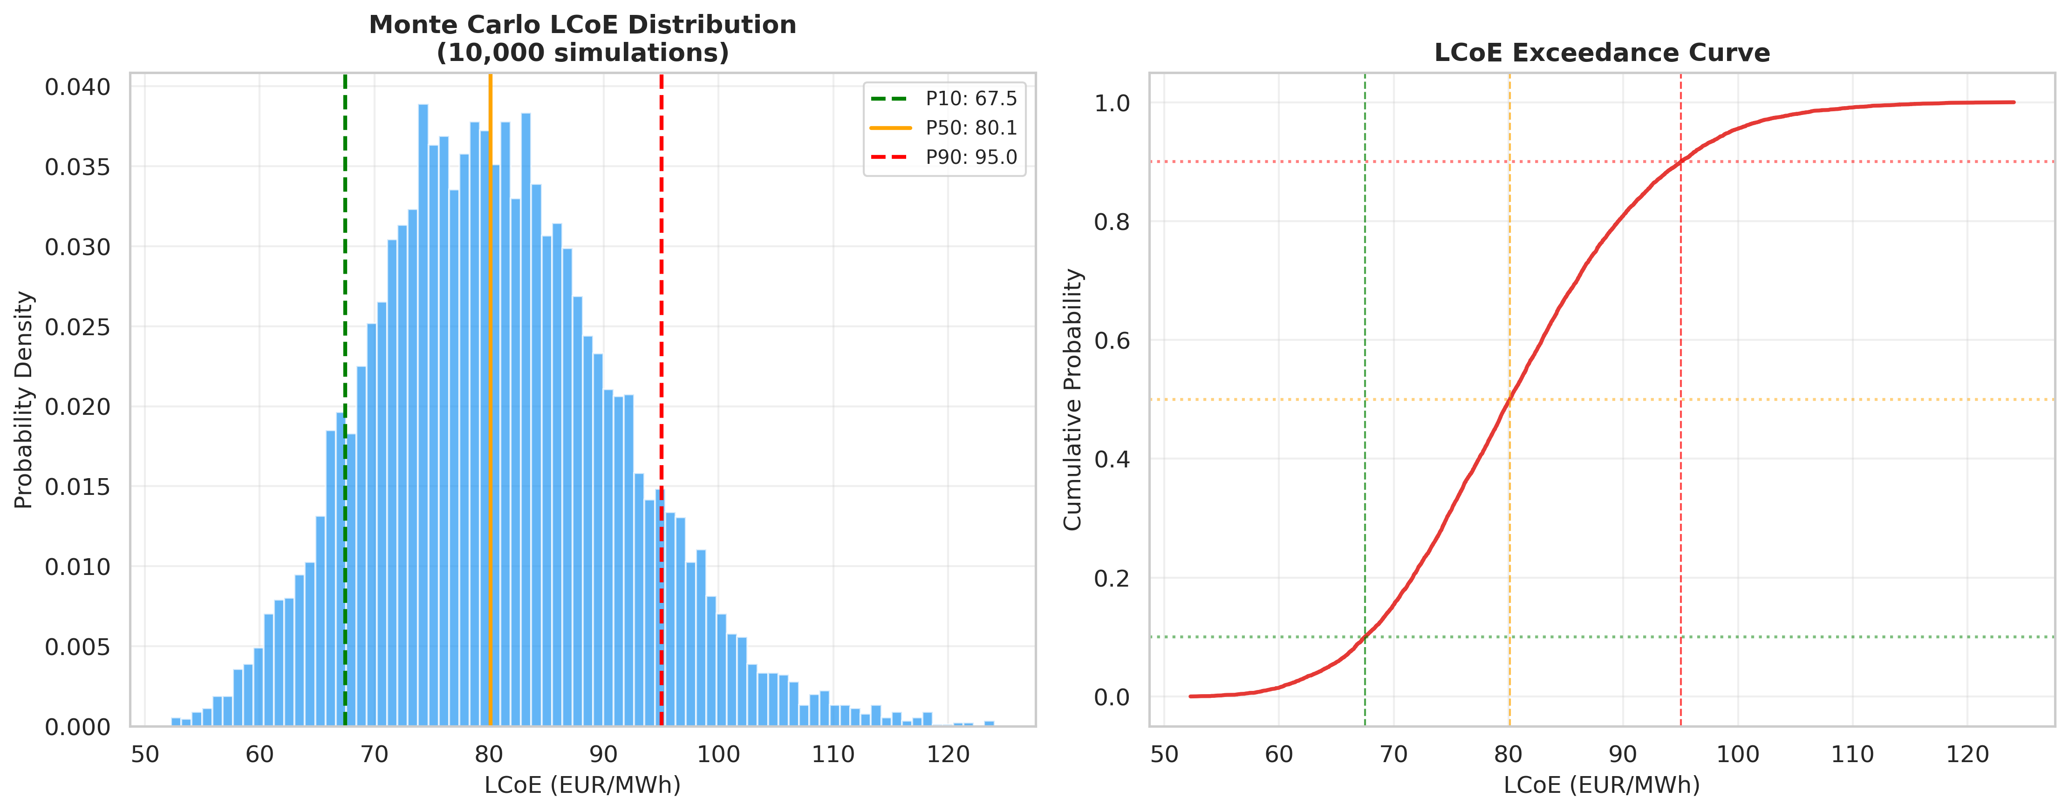
ECONOMICS · FINDING 09
Uncertainty: 10,000-Run Monte Carlo
Probabilistic LCoE distribution (10,000 simulations)
Tornado sensitivity — ±20 % on each parameter
P10
P50
P90
Why this matters: a single LCoE hides risk. Even at P90 the system stays within the EU district-heating range — robust, not just optimistic.
€67
€80
€95
/MWh
/MWh
/MWh
GeoLogic Analytics · SPE Africa Geothermal Datathon 2026
12

Slide 13

CRITICAL APPRAISAL · FINDING 10
Limitations & Key Assumptions
We state our boundaries plainly — a credible design is one whose limits are understood.
Known Limitations
Key Assumptions
• No coupled reservoir simulation — steady-state flow assumed; thermal drawdown over time not modelled.
Brine properties: ρ = 1040 kg/m³ · Cp = 4.0 kJ/kg·K
• GLA-01 is a hypothetical target — not an existing well — new drilling carries delivery uncertainty.
Reinjection temperature: 35–40 °C after heat extraction
District regime: 70 °C supply / 40 °C return
• Simplified demand profiles — no hourly district consumption data within the challenge framework.
Heat pump COP: 2.25 (68→70 °C upgrade)
• ThermoGIS P50 used deterministically — full probabilistic reservoir coupling not implemented.
Economic lifetime: 15 years, 6 % discount rate
• ATES integration is conceptual — no groundwater-flow simulation performed.
Demand basis: 10 MWth heat / 5 MWth cool (minimums)
GeoLogic Analytics · SPE Africa Geothermal Datathon 2026
13

Slide 14


DIFFERENTIATION
Why This Submission Stands Out
Data-engineering rigour
TVD depth correction, hidden-null detection and a caught label error — quiet mistakes most teams carry forward.
True system integration
Geothermal + reinjection + heat pump + chiller + ATES + buffer tanks + solar — a complete energy system, not a single well.
Uncertainty-aware economics
A full Monte Carlo risk profile (P10/P50/P90), not a single hopeful LCoE — the language investors trust.
Honest, defensible engineering
We state plainly that geothermal + heat pump together meet 10.5 MWth, framing the margin as deliberate efficient design.
GeoLogic Analytics · SPE Africa Geothermal Datathon 2026
14

Slide 15


Conclusions & Recommendations
Utrecht can be supplied with firm, low-carbon district heating and cooling from a low-enthalpy aquifer — delivered by rigorous data engineering, integrated thermal design, and economics that survive scrutiny under uncertainty.
Drill an appraisal well at GLA-01 — Convert the hypothetical corridor to a proven producer before final investment — the single biggest uncertainty.
10.5 / 5.0
MWth heat / cool
Acquire hourly demand data — Replace the simplified seasonal profile with metered consumption to refine storage sizing.
€74/MWh
Base-case LCoE
Run a coupled reservoir, groundwater and ATES model — Quantify thermal drawdown and groundwater interaction over the 30-year life.
>95 %
Geothermal share
Team GeoLogic Analytics · SPE Africa Geothermal Datathon 2026

