Slide 1
PRIVACY ISSUES IN IOT (HEALTH CARE SYSTEMS)
Group Members:
K112116 Mohammad fawad jawaid malik
K112114 Zohaib masood
K112016 shoaib ahmed
K112181 mohammed zohair

Slide 2
Hospital Scenario
Hospital have different departments, each department have wireless sensor devices attach in it.
Each wireless sensor device connected with a internet network, which connects it to the other wireless sensor device.
All the wireless sensor devices fetch data from the patients, and send it to the gateway.

Slide 3
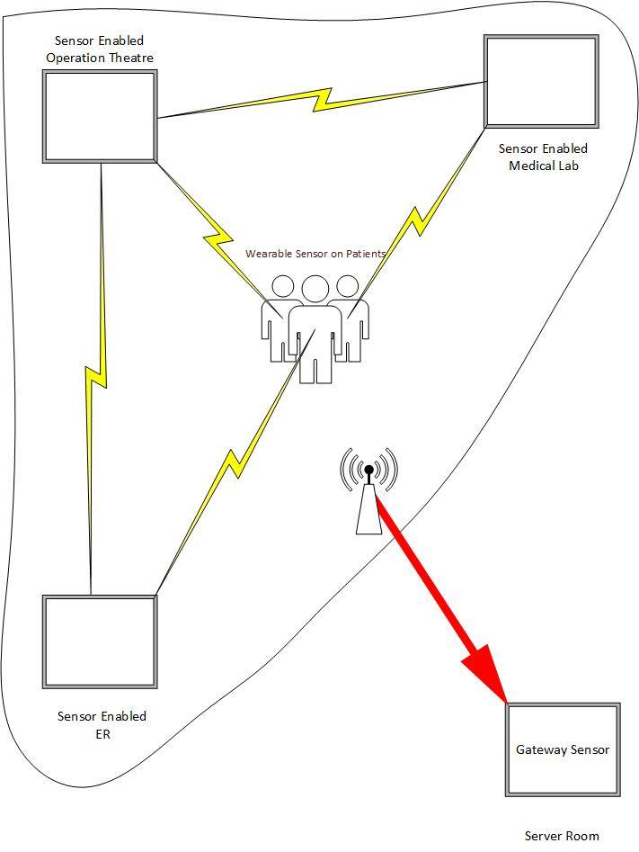

Slide 4
Physical Attack: Node Jamming
Any intruder can enter into the network and can physically attack.
By running some script attacker can physically jam the network.
Attacker can shutdown the nodes or can break the connections of the nodes.
by the communication gap between nodes no nodes can send data to the other node hence data cant reach to the gateway.
No new data update to the database.

Slide 5
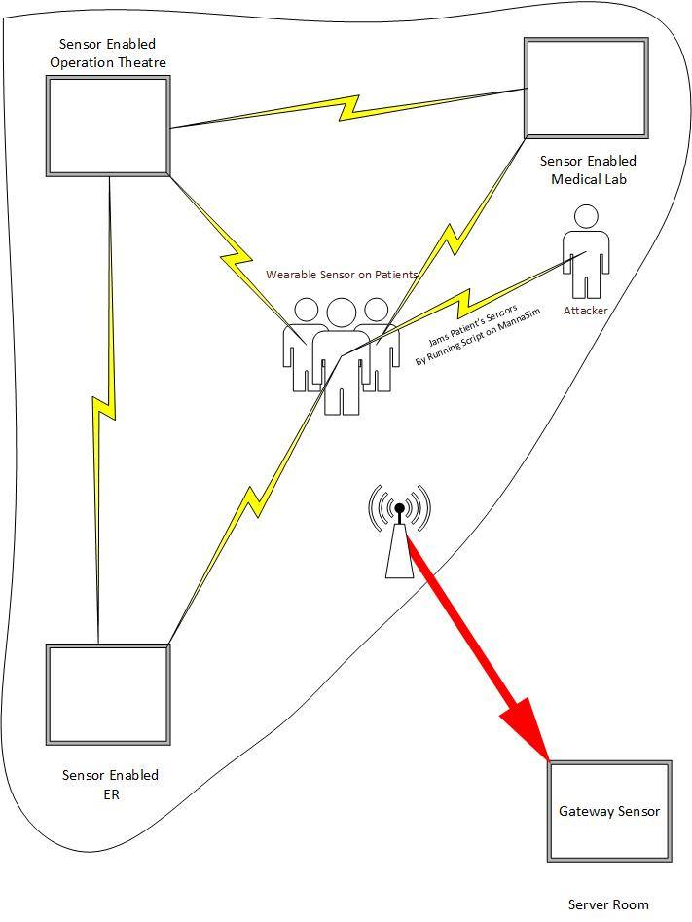

Slide 6
Node Tamper
Attacker can move into the network and by running some script access the data of the nodes.
By the availability of the data attacker has the choice to temper the data.
Attacker can alter the critical data , the data of patients which is very critical .

Slide 7
