Slide 1



STUDYMATE.AI
FYP PROPOSAL

Slide 2

Table Of Content
Project Objectives
Problem Statement
Introduction
Literature Review
Solution/Key
Features
Methodologies
System Diagram
Project Planning

Slide 3


Introduction
StudyMateAI an AI-powered educational platform designed to enhance the learning experience for students, parents, and teachers. By automating key tasks such as
Notes generation, quiz creation, and video summarization.

Slide 4







Project Objectives
Automate Educational Processes
Develop AI-driven tools to automatically generate educational materials like notes and quizzes, reducing the workload for teachers and students.
Enhance Learning Efficiency
Improve students' learning experience by providing faster and more effective study materials and tools, enabling them to grasp concepts quickly.
Facilitate Parental Involvement
Empower parents to stay informed and actively involved in their child's academic journey through comprehensive dashboards.
Improve Student Performance Tracking
Develop a system that effectively monitors and tracks student progress, helping both students and teachers identify areas for improvement.

Slide 5

Problem Statement
Traditional methods of creating educational materials are time-consuming and lack customization. Students struggle to access tailored content. Students and teachers face challenges in managing personalized learning, progress tracking. Parents often lack real-time insights into their child's progress.
Current applications are often paid and not open source.

Slide 6

AI in education automates tasks like quiz generation and video summarization, saving teachers time and providing students with tailored assessments and concise video summaries. Personalized learning systems use machine learning to adapt study materials to individual progress, improving learning outcomes. Additionally, AI platforms enhance parental involvement by offering real-time monitoring of student performance, fostering collaboration between parents, teachers, and students for better academic results.
LITERATURE
REVIEW

Slide 7





KEY
FEATURES
Notes
Generation
Recommender
System
Quiz
Generation
Video
Summarization

Slide 8


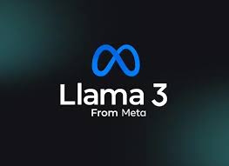

Methodologies
Model Training
Fine-tune NLP models for extracting key information from documents and videos, ensuring accurate and relevant content generation.
Full Stack
Development
The user interface is built with Next.js and TypeScript, and TailwindCss. The backend is developed using Flask
Flask
System Integration
Develop a seamless connection between the frontend and backend using Flask, with APIs to power the AI features.
Testing & Validation
Test the system with real users to refine features such as quiz generation, video summarization, and personalized learning.

Slide 9
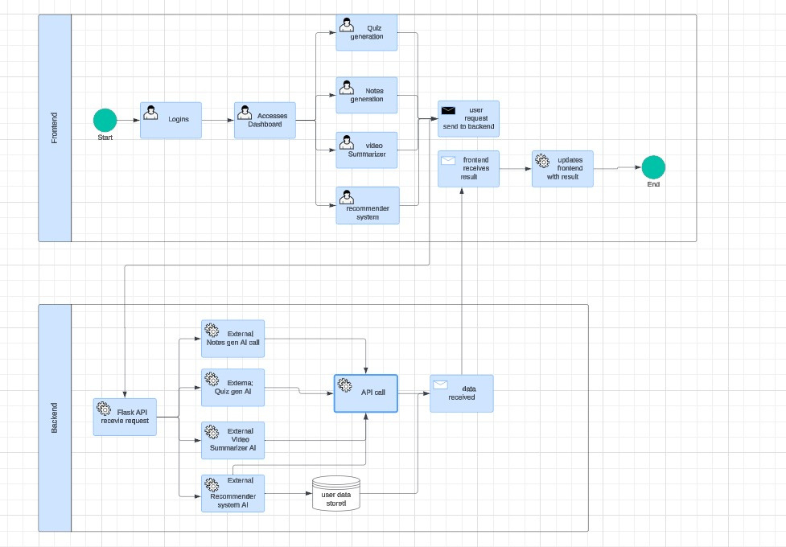
System Diagram

Slide 10
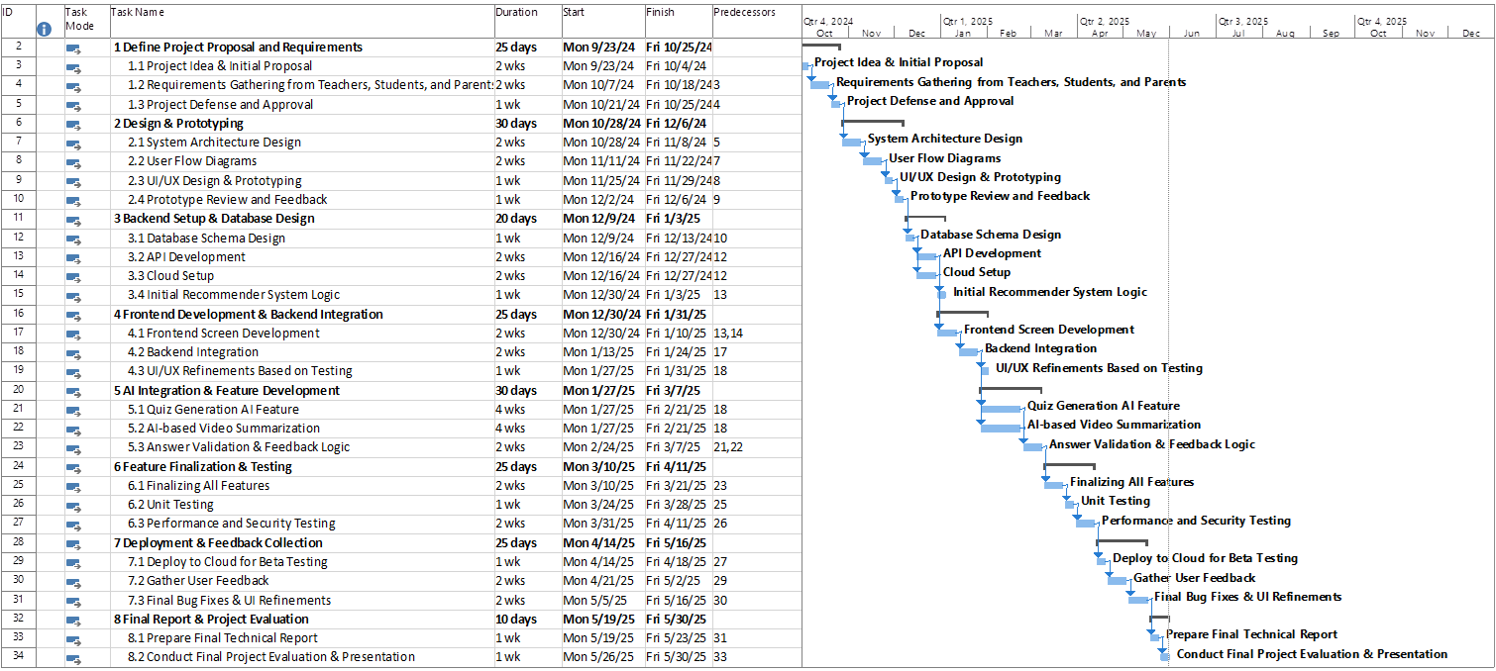
Project Planning

Slide 11






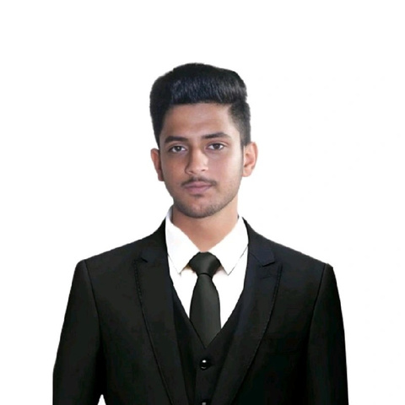
Our
FYP Group
Ms Saeeda Kanwal
Supervisor
Shahzaib Mirza
Fawaz Ahmed
Muhammad Daniyal
21k-3819
21k-4717
21k-4723

Slide 12
THANK YOU

