Slide 1

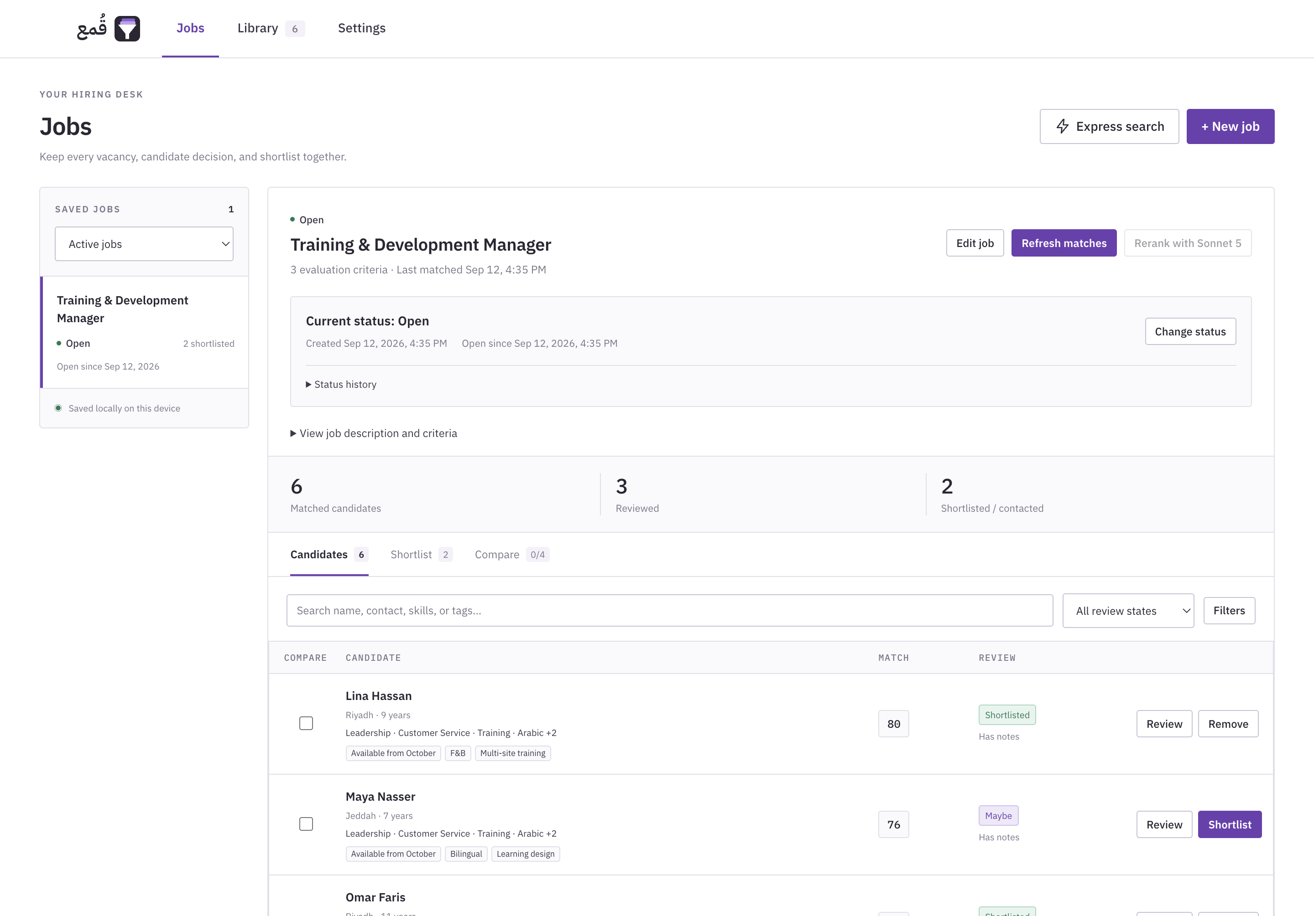
QUMAA
Qumaa: application and recruiter guide
Purpose, workflows, and operating guidance
Application purpose
Search a local CV library against job requirements, review supporting evidence, and maintain recruiting decisions.
Demonstration scenario
Training & Development Manager
Riyadh food and beverage group
Fictional candidates and screening records
Actual application · Fictional demo data
Qumaa v0.1.0-beta.2 / 01
Notes:
Qumaa is a desktop application for recruiters working with an existing CV library. This guide explains how to import CVs, search a saved or temporary job, assess candidates, and record hiring outcomes. Standard matching and recruiting records are local. Optional AI reranking sends a reviewed request to the selected provider. The example vacancy and all candidate information are fictional. Recruiters verify evidence and make the hiring decision.

Slide 2
QUMAA
Table of contents
Sections follow the sequence of a recruiting assignment.
Workspace and CV library
03–05
Job records
16–18
Navigation, workflow, and importing CVs
Refreshing matches, status history, and hiring outcomes
Jobs and search
06–09
Optional AI reranking
19–21
Saved jobs, Express search, criteria, and filters
Providers, data review, and result interpretation
Candidate assessment
10–15
Operations and reference
22–24
Evidence, reviews, profiles, comparison, and shortlists
Watched folders, backups, and record scope
Recruiter guide
Qumaa v0.1.0-beta.2 / 02
Notes:
Use the page ranges to locate a topic. In the editable presentation, each section card links to its first page. Pages 3 to 5 introduce the workspace and library; 6 to 9 cover job searches; 10 to 15 cover assessment; 16 to 18 cover job records; 19 to 21 explain optional AI; and 22 to 24 cover operations and reference information.

Slide 3
QUMAA
Workspace navigation
Jobs contains both saved vacancies and Express search.
Jobs
Search vacancies; retain reviews, shortlists, and hiring records.
Library
Import CVs, inspect candidate details, and link CV versions.
Settings
Set preferences, AI providers, watched folders, and backups.
Actual application · Fictional demo data
Qumaa v0.1.0-beta.2 / 03
Notes:
The application has three main tabs: Jobs, Library, and Settings. Jobs includes Express search next to New job. Both saved and temporary searches use the same local matching workflow and optional AI reranking. Candidate profiles apply across jobs; vacancy criteria, reviews, shortlists, status history, and hiring outcomes belong to a saved job.

Slide 4
QUMAA
Recruiting workflow
Example: screening a Training & Development Manager vacancy.
1
Import CVs
2
Define requirements
3
Find matches
Build the local candidate library.
Create a saved job or an Express search.
Review results from the local library.
6
Record the outcome
5
Prepare the shortlist
4
Assess candidates
Update status, hired candidate, and backups.
Choose candidates, set order, and export.
Check evidence, compare, and record reviews.
When CVs or requirements change, refresh the saved job and review the updated results.
Recruiter workflow · Editable diagram
Qumaa v0.1.0-beta.2 / 04
Notes:
The numbered sequence runs across the upper row, then down and back across the lower row. An Express search can support the initial search without creating a vacancy record. Save it as a job when you need persistent reviews or a hiring record. Recruiter outreach and interviews take place through the organization's usual tools. After new CVs arrive, refresh the saved job; existing reviews and notes remain available.

Slide 5
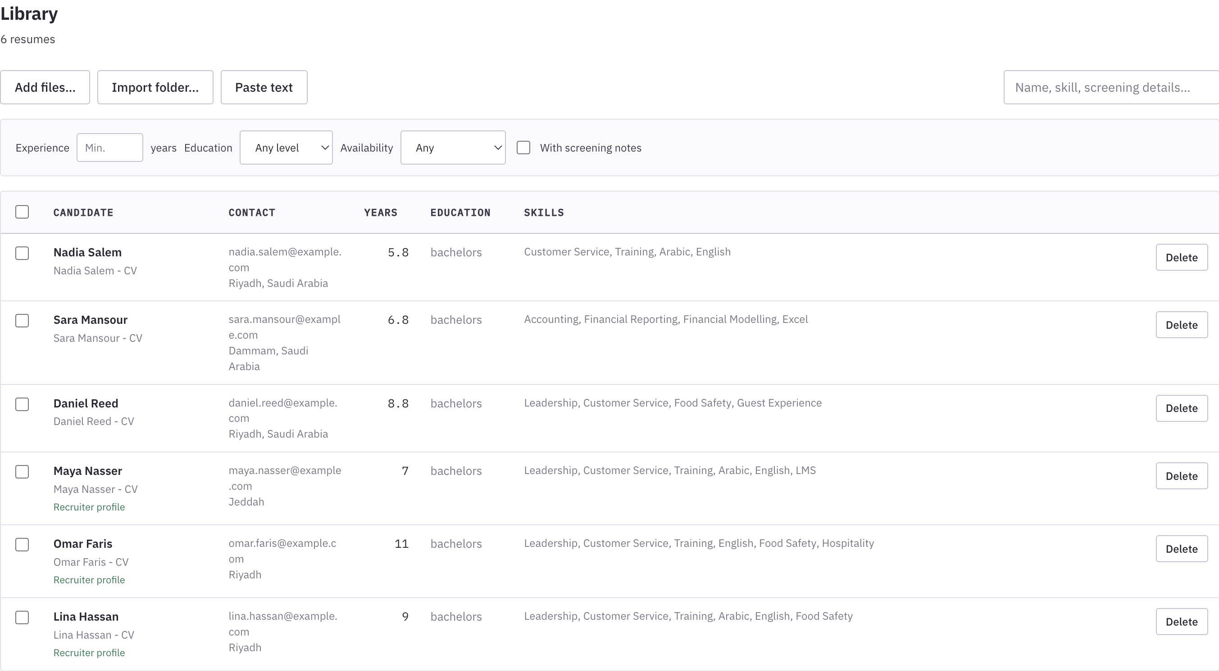
QUMAA
Importing the CV library
Supported inputs: digital PDF, DOCX, Markdown, and pasted text.
1
Open Library
Choose Add files or Import folder.
2
Import the CVs
Select documents or use Paste text.
3
Check processing
Review import notices and candidate details.
Local matching requires no API key.
Actual application · Fictional demo data
Qumaa v0.1.0-beta.2 / 05
Notes:
Files can also be dragged into the application. Arabic and English CVs can be searched with postings in either language. PDFs require a usable text layer; image-only scans need conversion outside Qumaa. Exact duplicate imports may be skipped. Inspect possible duplicates before linking records. The demonstration uses fictional CV text entered into an isolated library.

Slide 6
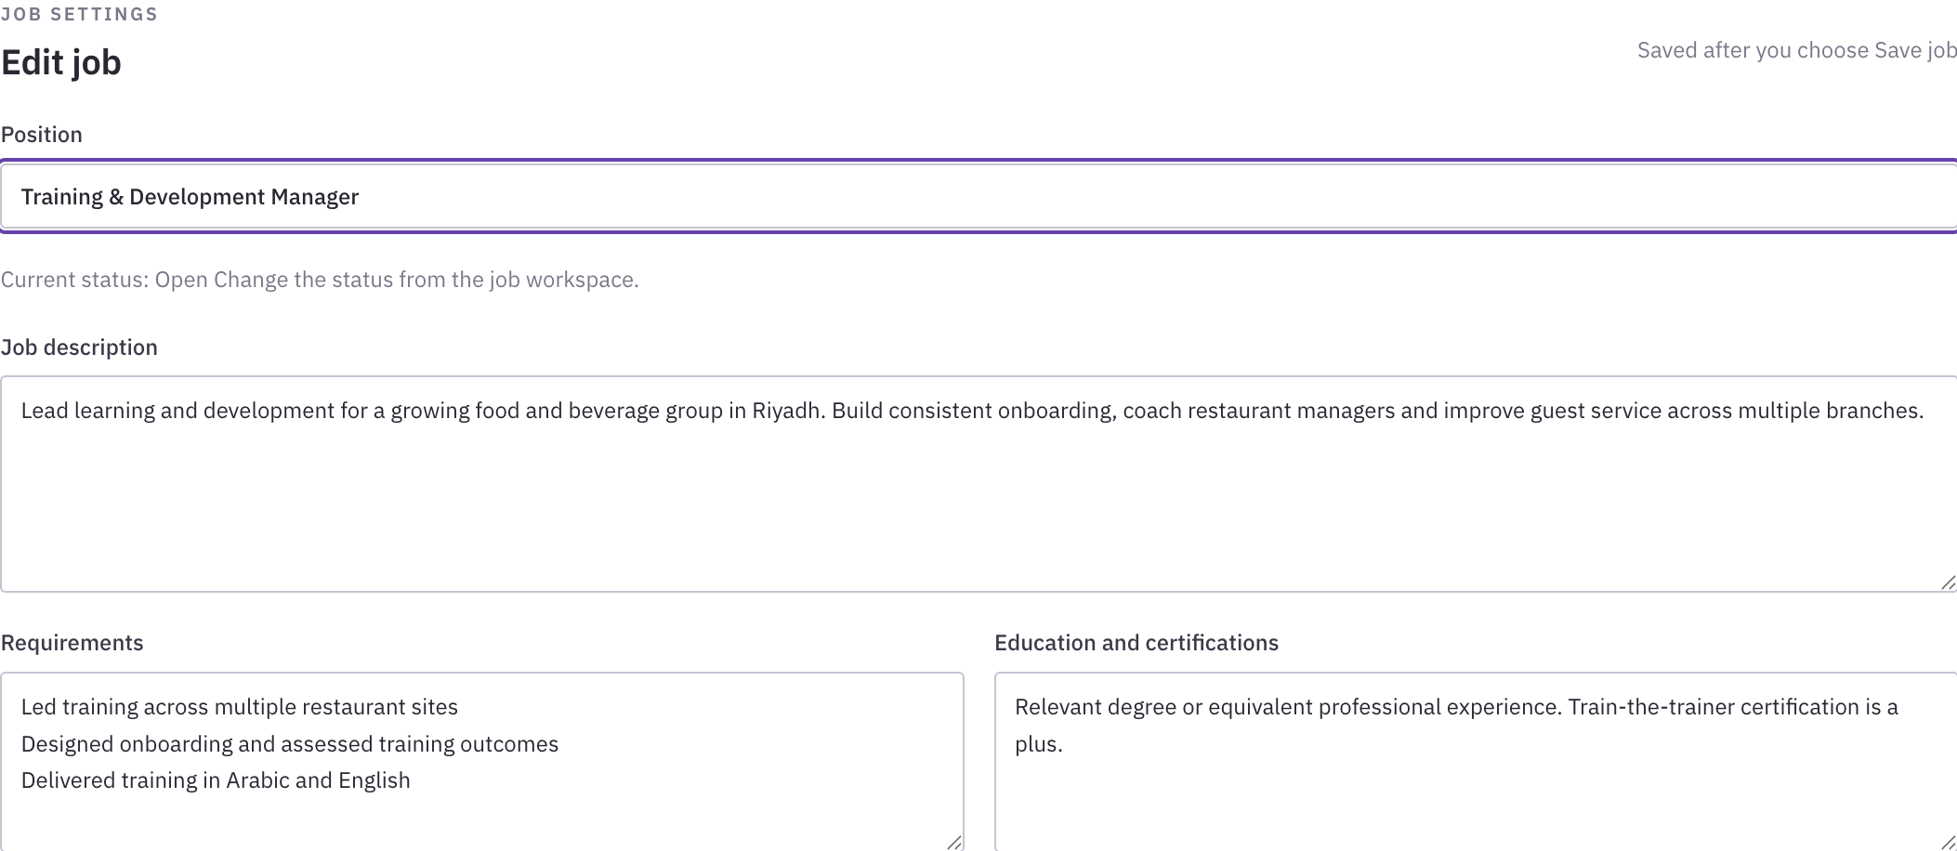
QUMAA
Creating a saved job
Use a saved job for an assignment that requires ongoing records.
1
Select New job
Open Jobs and choose + New job.
2
Enter the posting
Add the role, requirements, and qualifications.
3
Save the job
The new job starts as Open with a timestamp.
Status changes use the Change status control.
Actual application · Fictional demo data
Qumaa v0.1.0-beta.2 / 06
Notes:
The editor separates Position, Job description, Requirements, and Education and certifications. Add criteria before saving or return through Edit job. Newly created jobs start Open and record their creation time. Use Change status after creation to put a job On hold, mark it Filled, or archive it. A saved job retains its posting, search results, reviews, shortlist, and status history on this device.

Slide 7
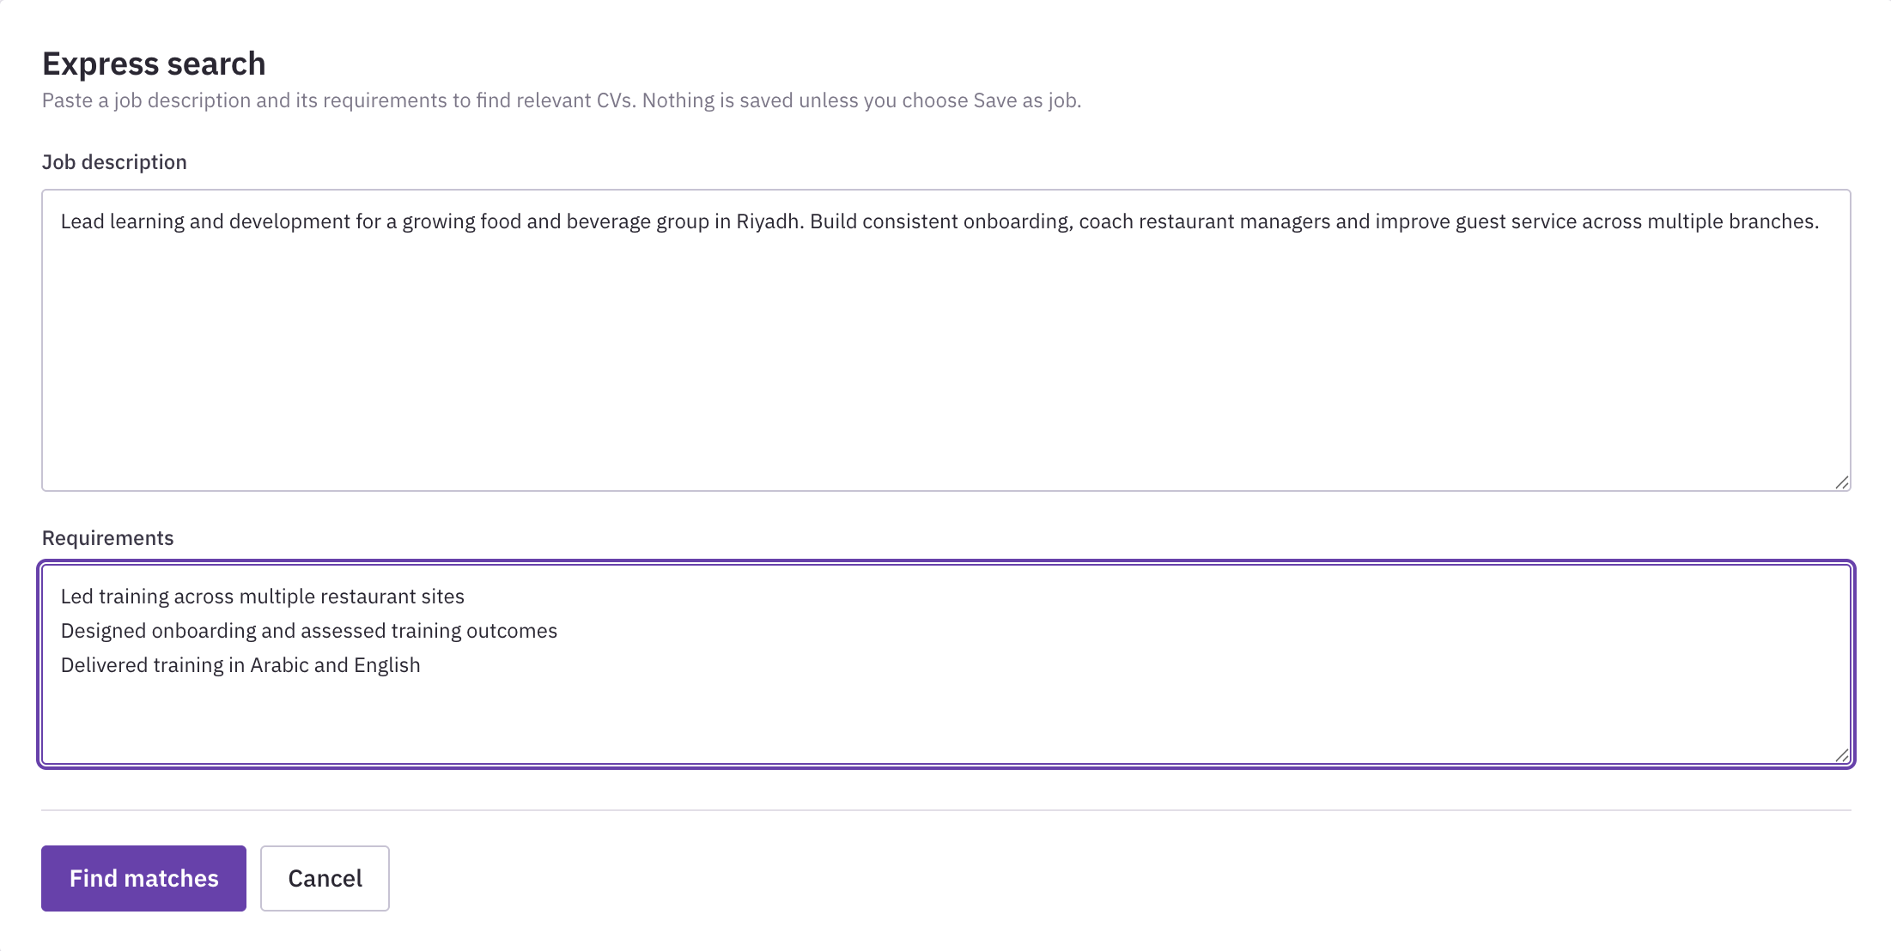
QUMAA
Express search
Paste a job and its requirements for a temporary search of the CV library.
Temporary search form
1
Open Express search
In Jobs, use the button beside + New job.
2
Paste the details
Enter a description and requirements; find matches.
3
Review the results
Discard the session or choose Save as job.
Nothing is saved unless you choose Save as job.
Actual application · Fictional demo data
Qumaa v0.1.0-beta.2 / 07
Notes:
Express search is in Jobs next to New job. Paste the job description and requirements, then select Find matches. The search uses CVs already in the local library; it does not fetch applicants from external services. The temporary posting and results stay in memory. You can view candidate details or export the top three matches. Reviews, shortlists, and comparison become available after Save as job. Navigating between tabs can retain the current session, but it is not a saved vacancy. Discard or close the application to remove it. Save as job explicitly creates a persistent job. Optional AI reranking is available here under the same settings and data-review controls as a saved job.

Slide 8
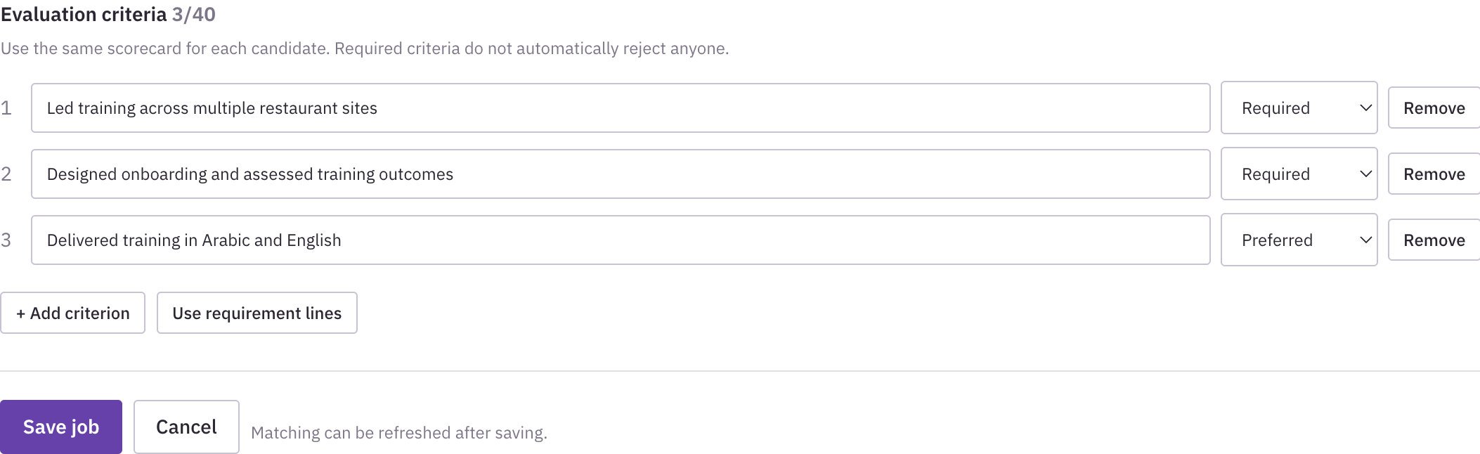
QUMAA
Defining assessment criteria
Separate essential requirements from preferred qualifications.
1
Create criteria
Use requirement lines or select Add criterion.
2
Set importance
Choose Required or Preferred for each item.
3
Use clear evidence
Example: led training across restaurant sites.
Required criteria do not automatically reject candidates.
Actual application · Fictional demo data
Qumaa v0.1.0-beta.2 / 08
Notes:
Criterion text contributes to the matching query. Required and Preferred organize recruiter assessment; they do not automatically exclude a candidate. The demonstration criteria cover multi-site training, onboarding design and measurement, and bilingual delivery. Save the job after editing. If criterion wording changes, revisit earlier assessments to ensure they still address the requirement.

Slide 9
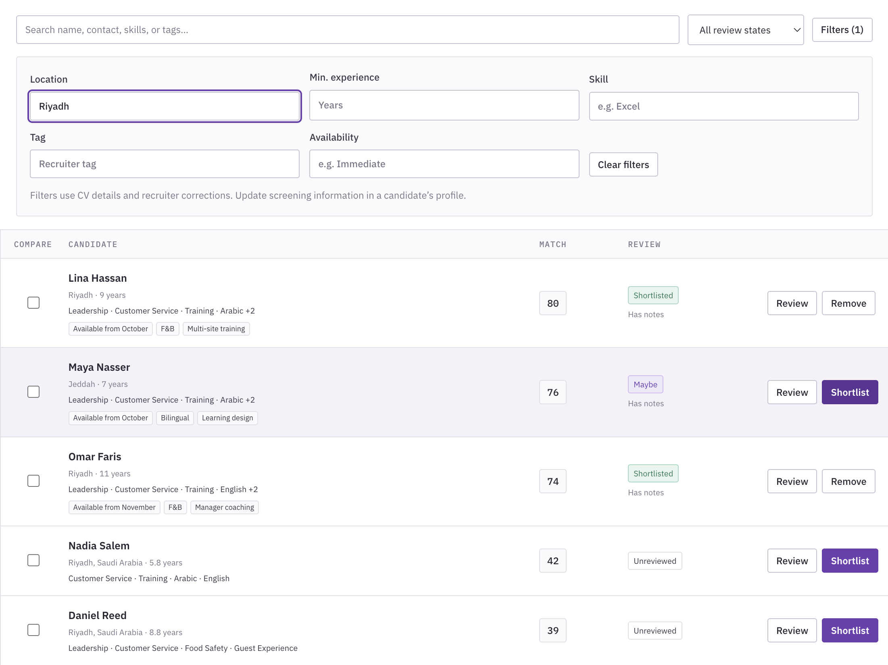
QUMAA
Finding and filtering candidates
Use the posting to search, then narrow the displayed results.
1
Find matches
Search from the selected job.
2
Inspect the ranking
Use scores to prioritize evidence review.
3
Apply filters
Filter by location, skills, and more.
Profile corrections are used by screening filters.
Actual application · Fictional demo data
Qumaa v0.1.0-beta.2 / 09
Notes:
After the first search, Find matches becomes Refresh matches. Filters use extracted CV information plus recruiter profile corrections. Options include current or preferred location, experience, skills, tags, and availability. A text search can locate names, contact details, skills, and tags. Review-state filters help organize work. Filters change what is displayed; they do not verify candidate claims or change saved decisions.

Slide 10
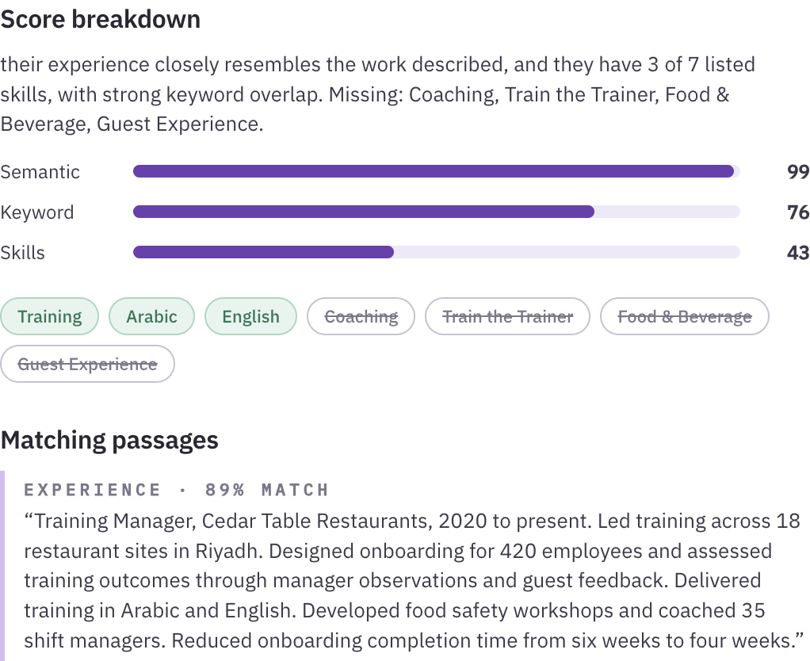
QUMAA
Interpreting scores and evidence
Inspect the underlying CV passages before making an assessment.
1
Open a candidate
Select the candidate name in the results.
2
Inspect the evidence
Read Score breakdown, Matching passages, and CV text.
3
Identify questions
Record relevant gaps for screening or interview.
A match score is a screening aid, not a hiring decision.
Actual application · Fictional demo data
Qumaa v0.1.0-beta.2 / 10
Notes:
Local scores combine semantic similarity, keyword overlap, and detected skills. They describe fit within the current search context and are not a probability of success. A high score still requires a review of scope, relevance, and supporting evidence. Missing words may reflect wording or omitted details. Scores can change when the posting or library changes.

Slide 11
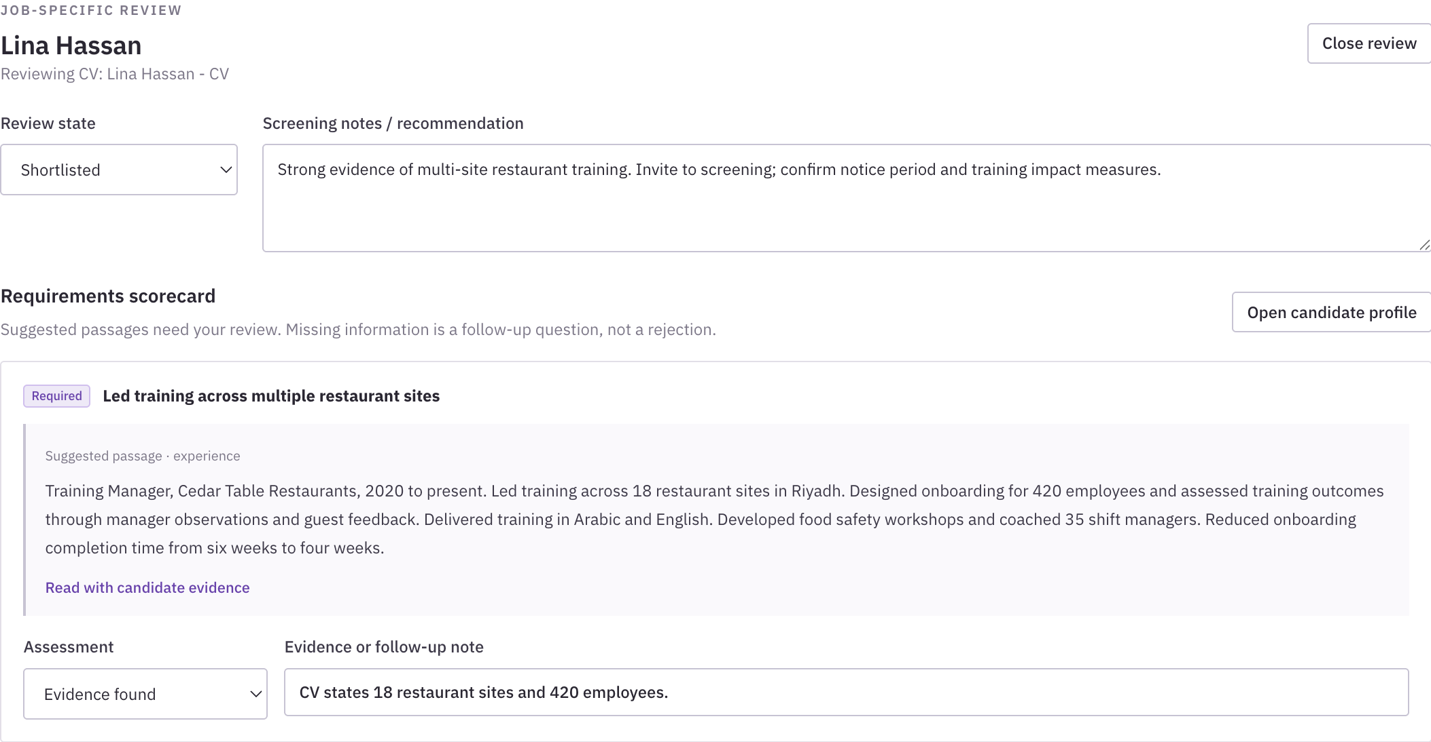
QUMAA
Recording candidate reviews
Job-specific reviews preserve assessments and follow-up questions.
1
Open Review
Choose a review state and enter job notes.
2
Assess each criterion
Record evidence, confirmation, or clarification.
3
Save the review
Save changes before reviewing another person.
Job notes remain attached to this vacancy.
Actual application · Fictional demo data
Qumaa v0.1.0-beta.2 / 11
Notes:
Review states are Unreviewed, Maybe, Shortlisted, Contacted, and Not proceeding. Criterion assessments are Unreviewed, Evidence found, Needs clarification, Not stated, and Recruiter confirmed. Evidence found records supporting CV text; Recruiter confirmed records the recruiter's verification. Contacted is set manually after outreach through other tools. Keep decision reasons specific to the job.

Slide 12
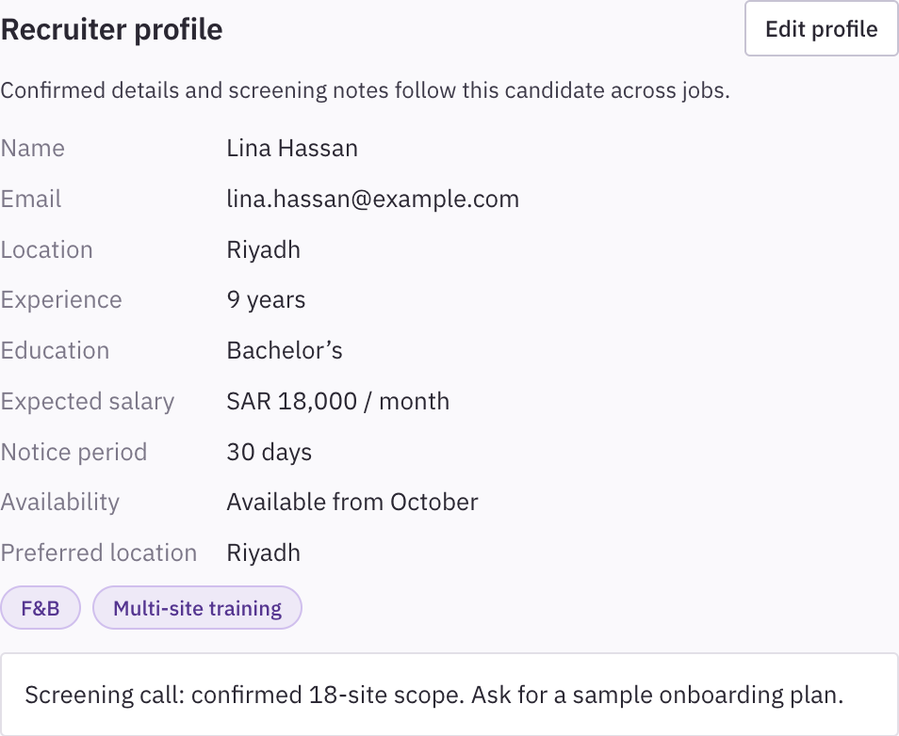
QUMAA
Maintaining candidate profiles
Profiles retain screening information across saved jobs.
1
Open the profile
Choose Add details or Edit profile.
2
Record verified details
Add corrections, salary, notice, availability, and tags.
3
Save the profile
Use job reviews for vacancy-specific decisions.
Profile notes apply across jobs.
Actual application · Fictional demo data
Qumaa v0.1.0-beta.2 / 12
Notes:
Recruiter corrections are stored separately from CV extraction. A blank correction uses the extracted value. The profile can hold expected salary, notice period, availability, preferred location, tags, and general notes. Profile changes apply across jobs. Job-specific recommendations and assessments belong in a job review. Verify information before relying on it for screening.

Slide 13
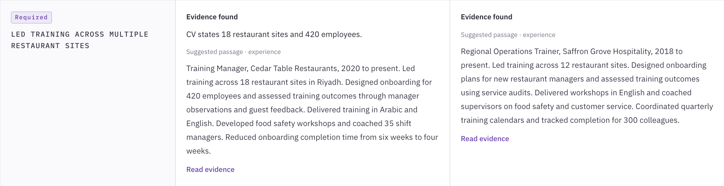
QUMAA
Comparing candidates
Select two to four candidates and choose Compare candidates.
Criteria and supporting evidence from the same comparison
Review the same criteria, screening details, and unresolved questions for each person.
Actual application · Fictional demo data
Qumaa v0.1.0-beta.2 / 13
Notes:
Use Compare checkboxes in Candidates or Shortlist, then open Compare candidates. The comparison includes criterion assessments, suggested passages, recruiter profiles, and notes. Salary, notice, and availability appear after they are recorded. Not confirmed identifies information to verify. Use Read evidence for context. The two images are separate excerpts from the same actual comparison view.

Slide 14
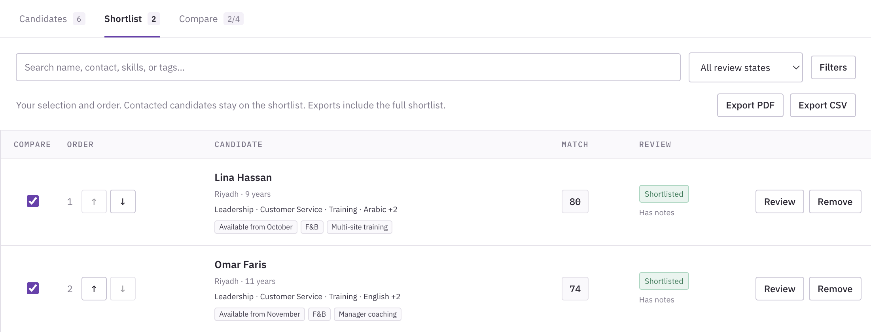
QUMAA
Preparing and exporting a shortlist
Choose candidates and set the order for the hiring review.
1
Choose candidates
Set relevant candidates to Shortlisted.
2
Arrange the shortlist
Use the up and down arrows in Shortlist.
3
Export the record
Select Export PDF or Export CSV.
Exports include the full ordered shortlist.
Actual application · Fictional demo data
Qumaa v0.1.0-beta.2 / 14
Notes:
Exports contain the full ordered shortlist, including candidates hidden by a current display filter, together with job-specific recruiter notes. Contacted candidates remain on the shortlist. Refresh stale matches before exporting. PDF supports a review conversation; CSV can be opened in a spreadsheet. Exporting creates a file and does not send outreach.

Slide 15
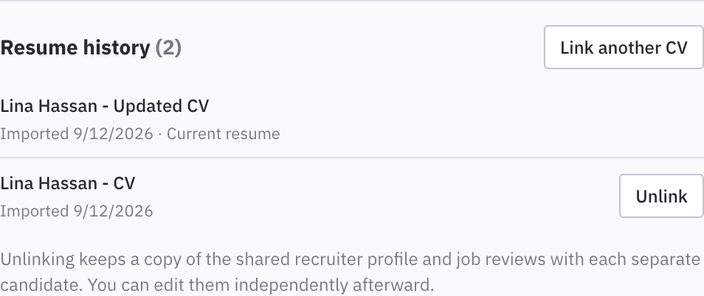
QUMAA
Linking updated CV versions
Confirm identity before linking two records as the same person.
1
Import the new CV
Add the updated document to Library.
2
Open Resume history
Select Link another CV in the candidate panel.
3
Confirm the link
Choose the record and select Link as same person.
Linked versions retain the candidate's recruiting context.
Actual application · Fictional demo data
Qumaa v0.1.0-beta.2 / 15
Notes:
Linking connects recruiter context across CV versions. Check the identity before linking; similar experience alone is insufficient. Resolve conflicting recruiter details when prompted. Unlinking retains a copy of shared profile information and job reviews with each resulting candidate, allowing independent editing afterward. Search results may need refreshing after library changes.

Slide 16
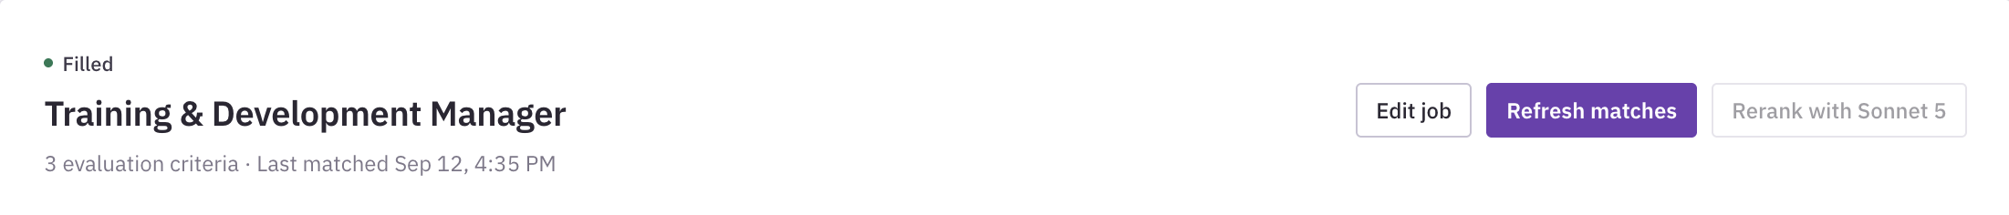
QUMAA
Refreshing saved matches
Refresh when the library or job requirements change.
1
Reopen the job
Return after importing or updating CVs.
2
Read the notice
Check whether the saved matches are out of date.
3
Refresh matches
Review the updated ranking and evidence.
Saved reviews and notes remain available after refresh.
Actual application · Fictional demo data
Qumaa v0.1.0-beta.2 / 16
Notes:
New CVs, updated library information, and edited job requirements can make saved matches stale. Refresh recalculates local matches while retaining saved decisions and notes. Reassess criteria when their wording has changed. Restoring a backup also requires fresh searches after indexing finishes. If AI reranking was previously used, a local refresh creates a new local ranking that can be reranked again.

Slide 17
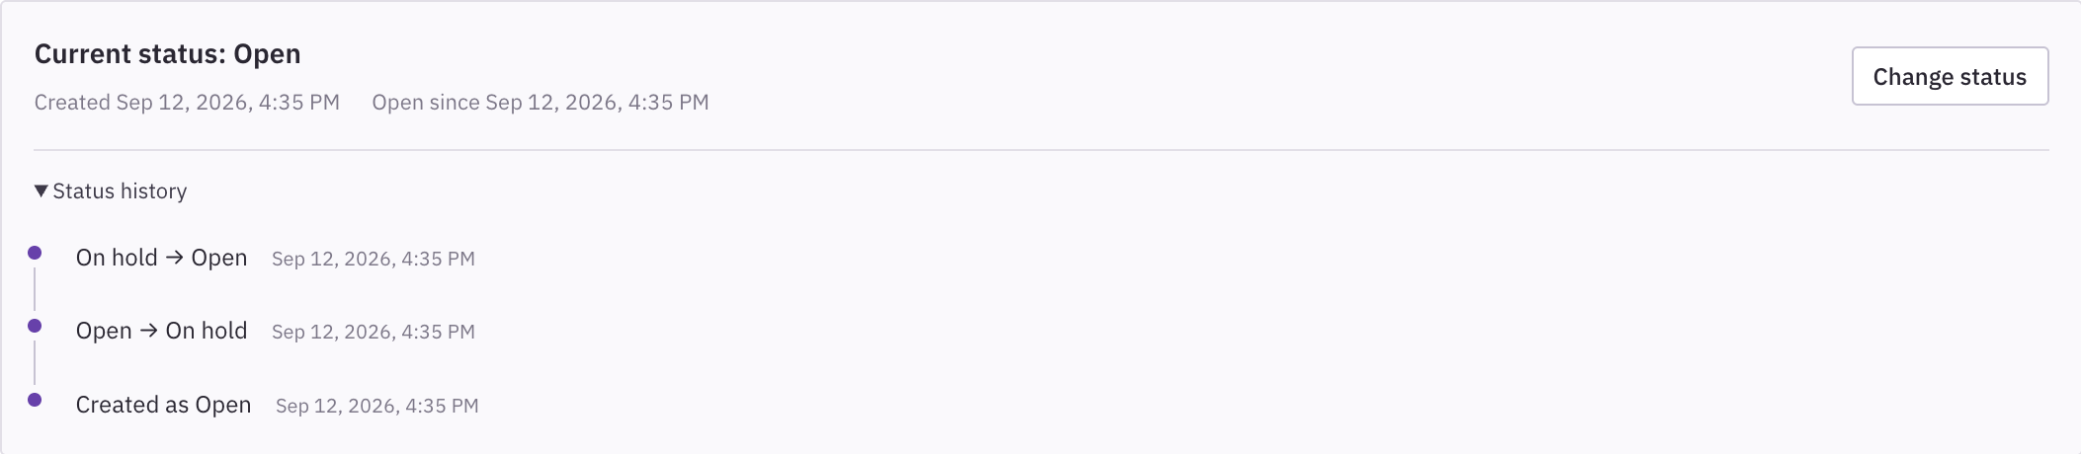
QUMAA
Changing job status
Each recorded status change includes a date and time.
1
Open Change status
Use the control in the selected job.
2
Choose the status
Open, On hold, Filled, or Archived.
3
Check the history
Review the creation and status-change timestamps.
Archived jobs retain their recorded hiring outcome.
Actual application · Fictional demo data
Qumaa v0.1.0-beta.2 / 17
Notes:
New jobs begin Open with a creation event. A saved status change appends a timestamped entry to the job history. Selecting Filled also requires a hired candidate. Archiving or reopening a job retains its last recorded hiring outcome. Older jobs may have no historical events from before the feature existed; the application does not invent those dates. Use this record to understand when the vacancy changed state.

Slide 18
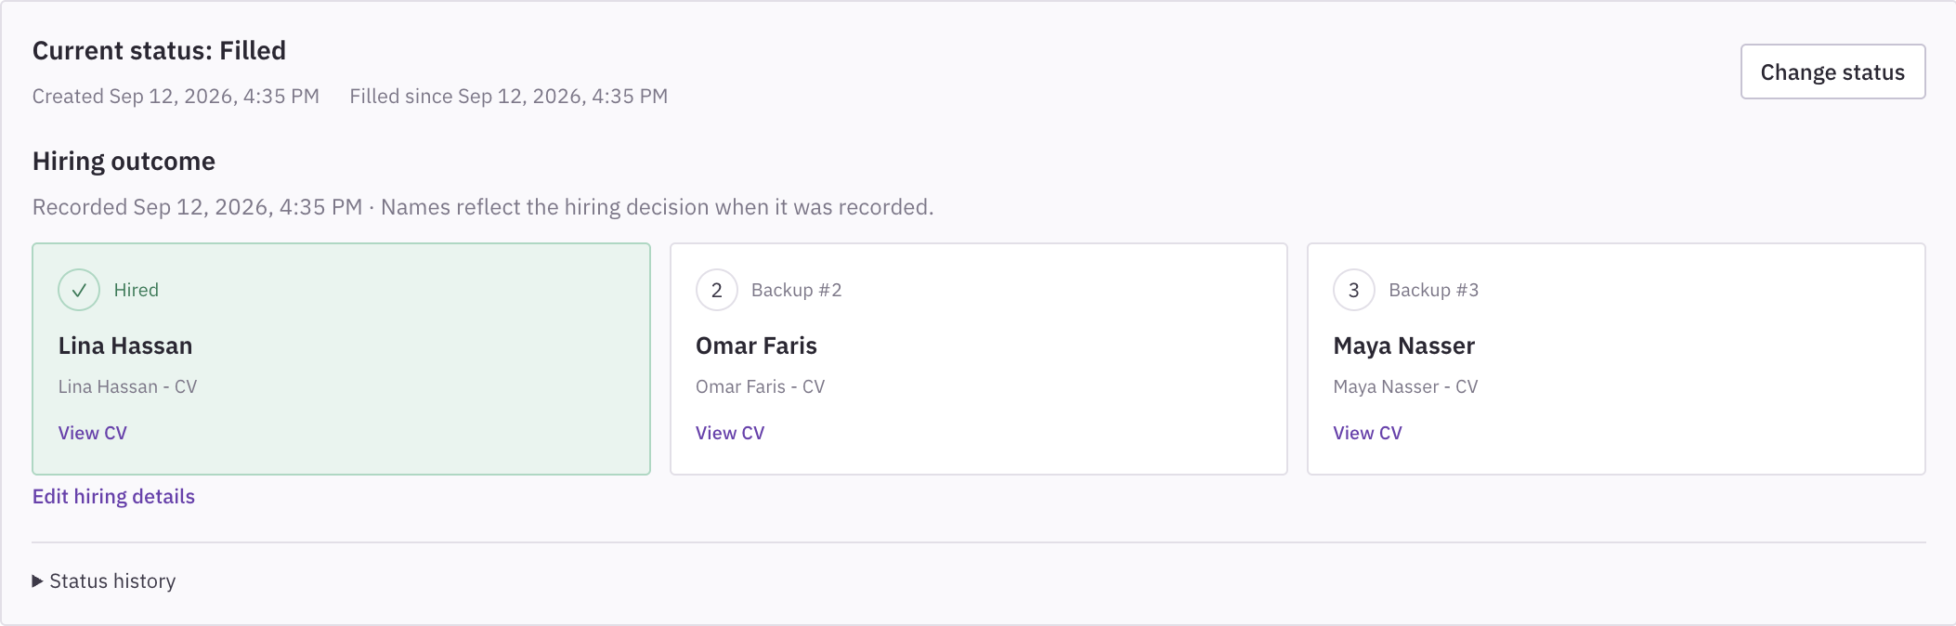
QUMAA
Recording a hiring outcome
A filled job identifies the hired person and optional backup candidates.
1
Select Filled
Change the job status after confirming the outcome.
2
Choose the candidates
Select the hired person and backups.
3
Save and inspect
Review the recorded cards, timestamp, and linked CVs.
Backup #3 requires backup #2.
Actual application · Fictional demo data
Qumaa v0.1.0-beta.2 / 18
Notes:
Choose candidates already present in Library. A filled job requires a hired candidate. Up to two backup candidates can be recorded, in order: #2 and #3. Choose #2 before #3, and use a different person in each position. The saved cards display the recorded names and provide View CV links. Changes to hiring details receive their own history entry. Reopening or archiving preserves the last hiring outcome. Deleted CV records are shown as unavailable rather than exposing removed candidate details.

Slide 19
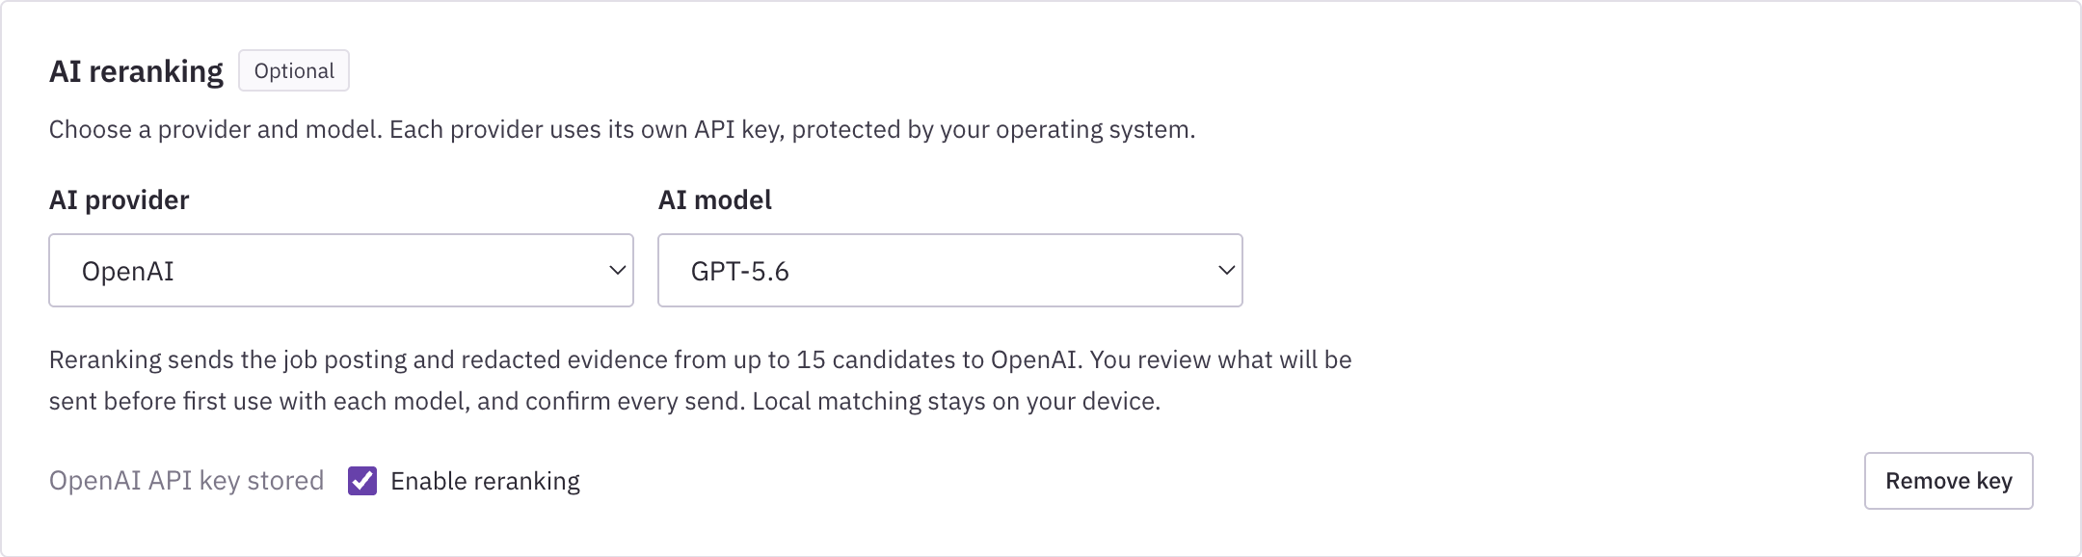
QUMAA
Selecting an AI provider and model
AI reranking is optional and configured in Settings.
Anthropic
Sonnet 5
Opus 5
Fable 5.1
OpenAI
GPT-4o mini
GPT-5.6
GPT-6 Astra
Choose AI provider and AI model, add your own provider key, then enable reranking.
Actual application · Fictional demo data
Qumaa v0.1.0-beta.2 / 19
Notes:
Settings provides separate provider and model selectors. Anthropic choices are Sonnet 5, Opus 5, and Fable 5.1. OpenAI choices are GPT-4o mini, GPT-5.6, and GPT-6 Astra. Each provider has its own protected API key and remembered model selection. A key is not supplied with the installer. Switching to a provider without a key disables reranking until configured. Local matching remains available without either provider. This screenshot uses a fictional fixture; no live provider request was made.

Slide 20
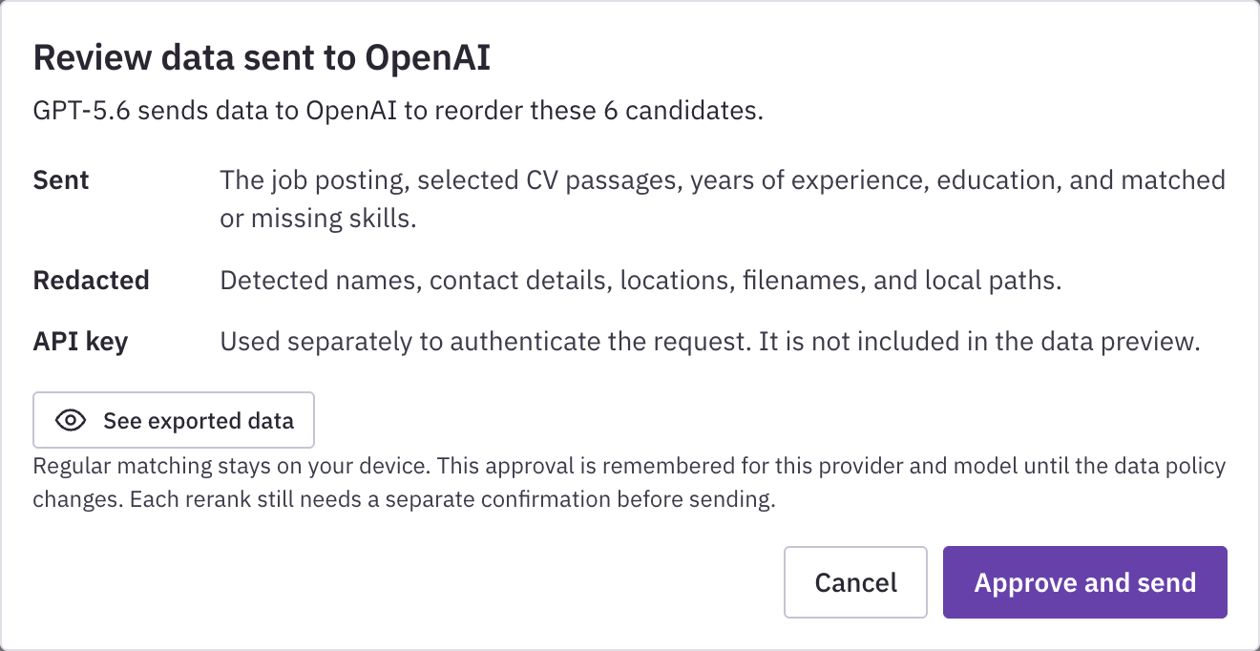
QUMAA
Reviewing data before AI reranking
The notice identifies the selected provider and the data to be sent.
1
Start from results
Choose Rerank with the selected model.
2
Read the summary
Open the eye icon, See exported data, for request details.
3
Confirm the request
Approve only after reviewing the information.
Each rerank requires confirmation before sending.
Actual application · Fictional demo data
Qumaa v0.1.0-beta.2 / 20
Notes:
The application first explains the data policy for the selected provider and model. The exact outbound JSON is collapsed under See exported data. Policy approval is remembered for that provider and model until the policy changes; each rerank still requires a separate native confirmation before sending. The reviewed request includes the posting and redacted matching passages from up to 15 candidates. Common contact details are masked, but redaction may not remove every identifying detail. Canceling the review leaves the local matches available.

Slide 21
QUMAA
Understanding an AI rerank
The selected model reorders a limited candidate set using the supplied evidence.
Local results
Reviewed request
Returned assessment
The application prepares up to 15 candidates from the local search.
After confirmation, the selected provider receives the posting and redacted passages.
The model returns an order and a short evidence-based reason for each candidate.
Assessment basis
Reading the result
Relevant experience, demonstrated responsibility, and evidence for job requirements.
Candidate membership and local scores remain unchanged. The model label identifies who produced the order.
AI reranking · Editable diagram
Qumaa v0.1.0-beta.2 / 21
Notes:
All configured models use the same system instructions. They rank every supplied candidate, judge only the provided passages, preserve opaque candidate IDs, treat the payload as evidence rather than instructions, and return one reason of at most 25 words per candidate. The instructions emphasize demonstrated scope and relevance over confident wording. The request contains up to 2,500 characters of redacted passages per candidate. Reranking does not add candidates or replace local scores. Check the supporting CV evidence and verify missing information. An AI explanation is a screening aid; the recruiter remains responsible for the assessment.

Slide 22
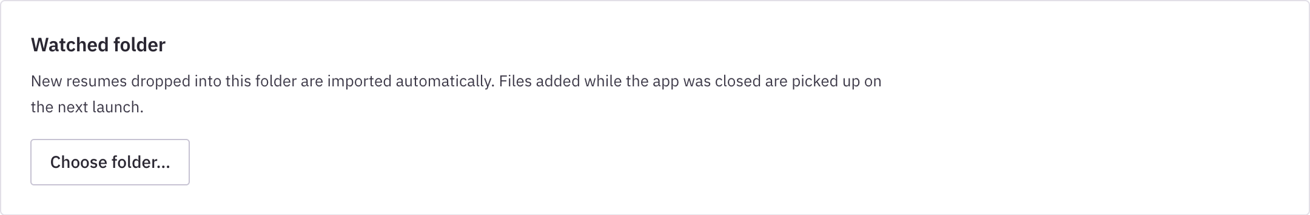
QUMAA
Using a watched folder
Import incoming CVs from a selected local folder while Qumaa is running.
1
Open Settings
Find the Watched folder section.
2
Choose the folder
Select the local folder used for incoming CVs.
3
Review imports
Check Library and refresh relevant saved jobs.
Refresh saved matches after new imports.
Actual application · Fictional demo data
Qumaa v0.1.0-beta.2 / 22
Notes:
The watched folder monitors incoming supported documents while the application is running. Keep original documents organized separately. Import notices and duplicate handling still apply. New imports do not automatically update every saved ranking; refresh the relevant job. Watched-folder configuration is specific to this device and is not included in a portable backup.

Slide 23
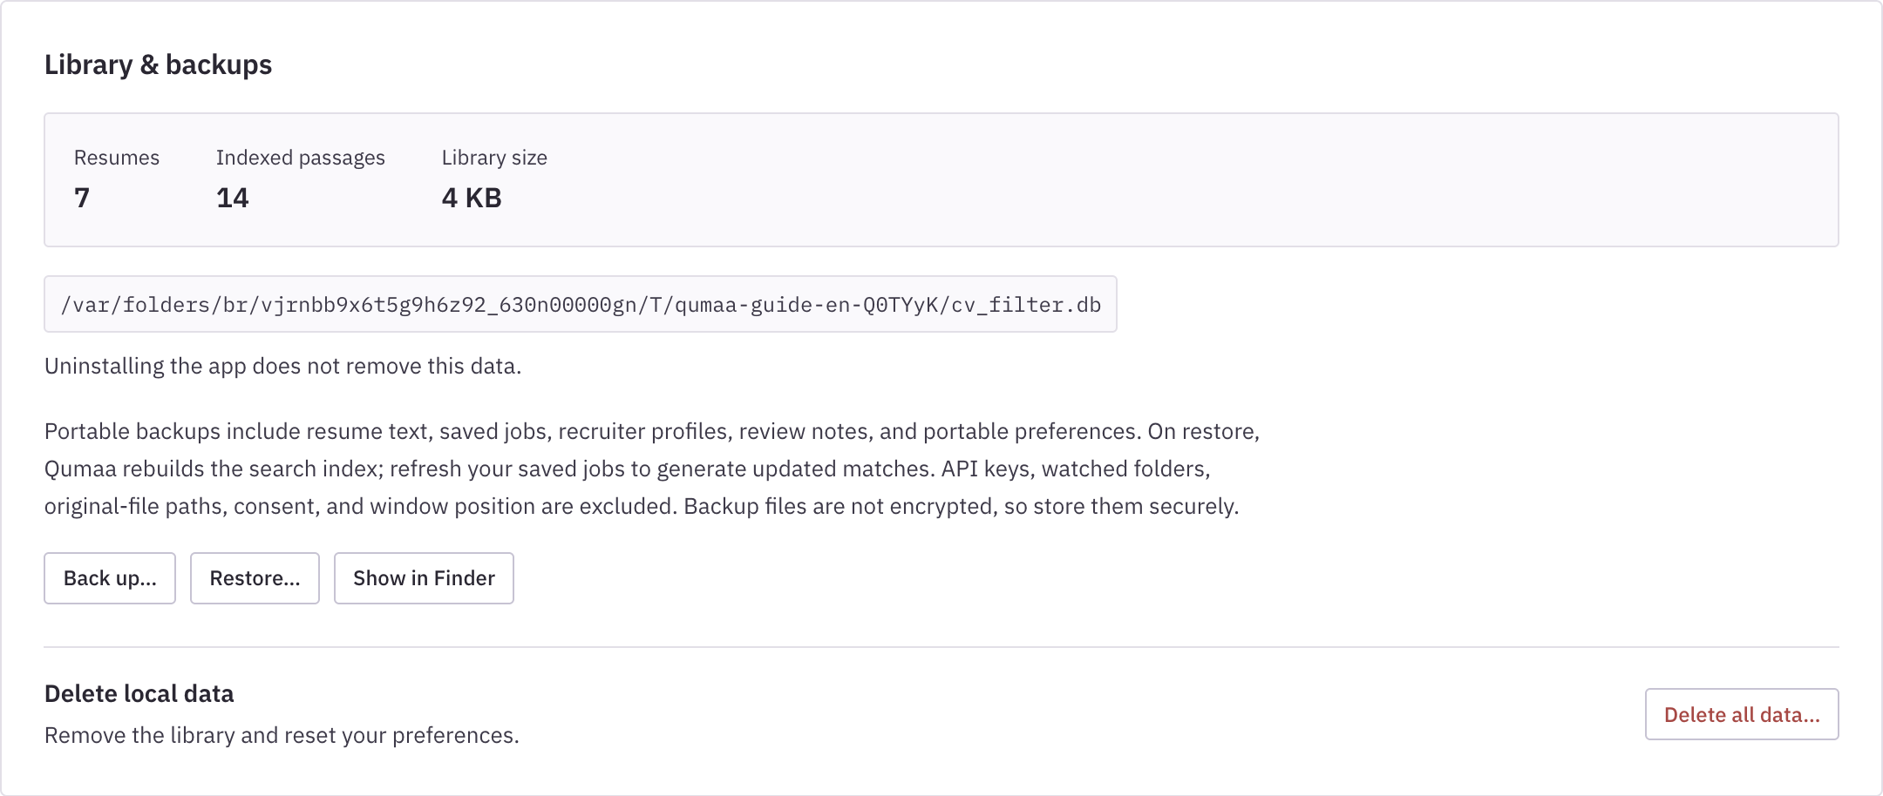
QUMAA
Backing up and restoring records
Use Settings to create or restore a portable library backup.
1
Create a backup
In Library & backups, select Back up.
2
Store it securely
Backups contain candidate records.
3
Restore when needed
After indexing finishes, refresh saved matches.
Backups exclude API keys and original CV files.
Actual application · Fictional demo data
Qumaa v0.1.0-beta.2 / 23
Notes:
Portable backups include resume text, saved jobs, profiles, reviews, hiring records, and portable preferences. They exclude API keys, consent approvals, watched-folder configuration, original-file paths, and window position. They are not encrypted. Keep backups in an appropriate secure location and retain original CV files separately if needed. Restoring replaces the current local library after confirmation and rebuilds the search index. Reconfigure device-specific settings afterward.

Slide 24
QUMAA
Reference: where information is kept
Use the appropriate record for the information you need to retain.
Library and candidate profile
CV text, linked versions, corrected details, and general screening notes.
Saved job
Posting, criteria, results, candidate reviews, shortlist, status history, and hiring outcome.
Express search
Temporary posting and search work; retained only if you choose Save as job.
Optional provider request
Reviewed posting and redacted passages, sent only after confirmation.
Prepared by Fawaz Aljathnan
LinkedIn profile
Recruiter guide
Qumaa v0.1.0-beta.2 / 24
Notes:
This table distinguishes information attached to a candidate, information attached to a saved vacancy, a temporary search session, and an optional external request. Use profile notes for information relevant across jobs and review notes for vacancy-specific decisions. All application images in this guide use fictional demonstration records. Prepared by Fawaz Aljathnan. LinkedIn: https://www.linkedin.com/in/fawazsalehq/.

