Slide 1
Secure Data Hiding In Images Using Steganography
CAPSTONE PROJECT
Presented By: FAWAZ HUSSAIN R
Student Name: FAWAZ HUSSAIN R
College Name: Madras Institute of Technology
Department : Computer Science and Engineering

Slide 2
OUTLINE
Problem Statement
Technology used
Wow factor
End users
Result
Conclusion
Git-hub Link
Future scope

Slide 3
Problem Statement
Conventional encryption techniques can be easily detected, potentially attracting unwanted attention.
There's a growing need for a covert method to embed confidential messages within images securely.
The objective is to ensure robust data protection without compromising the visual integrity of the image.

Slide 4
Technology used
Programming Language: Python
Image Processing Library: OpenCV
File Handling & Security: Basic encryption logic for password protection
Additional Libraries: argparse (for passing commands in CLI)
Platform: Windows 11

Slide 5
Wow factors
Employs steganography to conceal messages within images without visible alterations.
Implements lossless data embedding by adjusting pixel values instead of relying on traditional cryptography.
Compatible with any standard image format, with PNG recommended for optimal results.

Slide 6
End users
Cybersecurity Enthusiasts: Investigating advanced techniques for secure communications.
Government & Defense: Transmitting confidential messages in a manner that avoids drawing attention.
Journalists & Activists: Embedding sensitive data within images to evade surveillance.
Software Developers: Exploring steganography principles and their practical implementations.

Slide 7
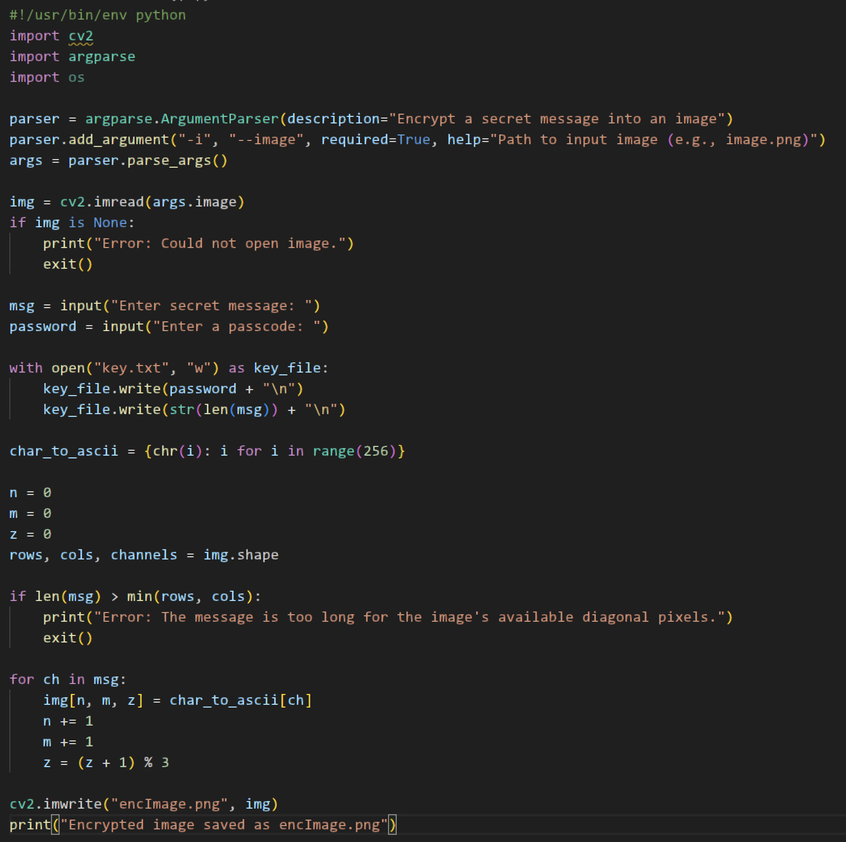
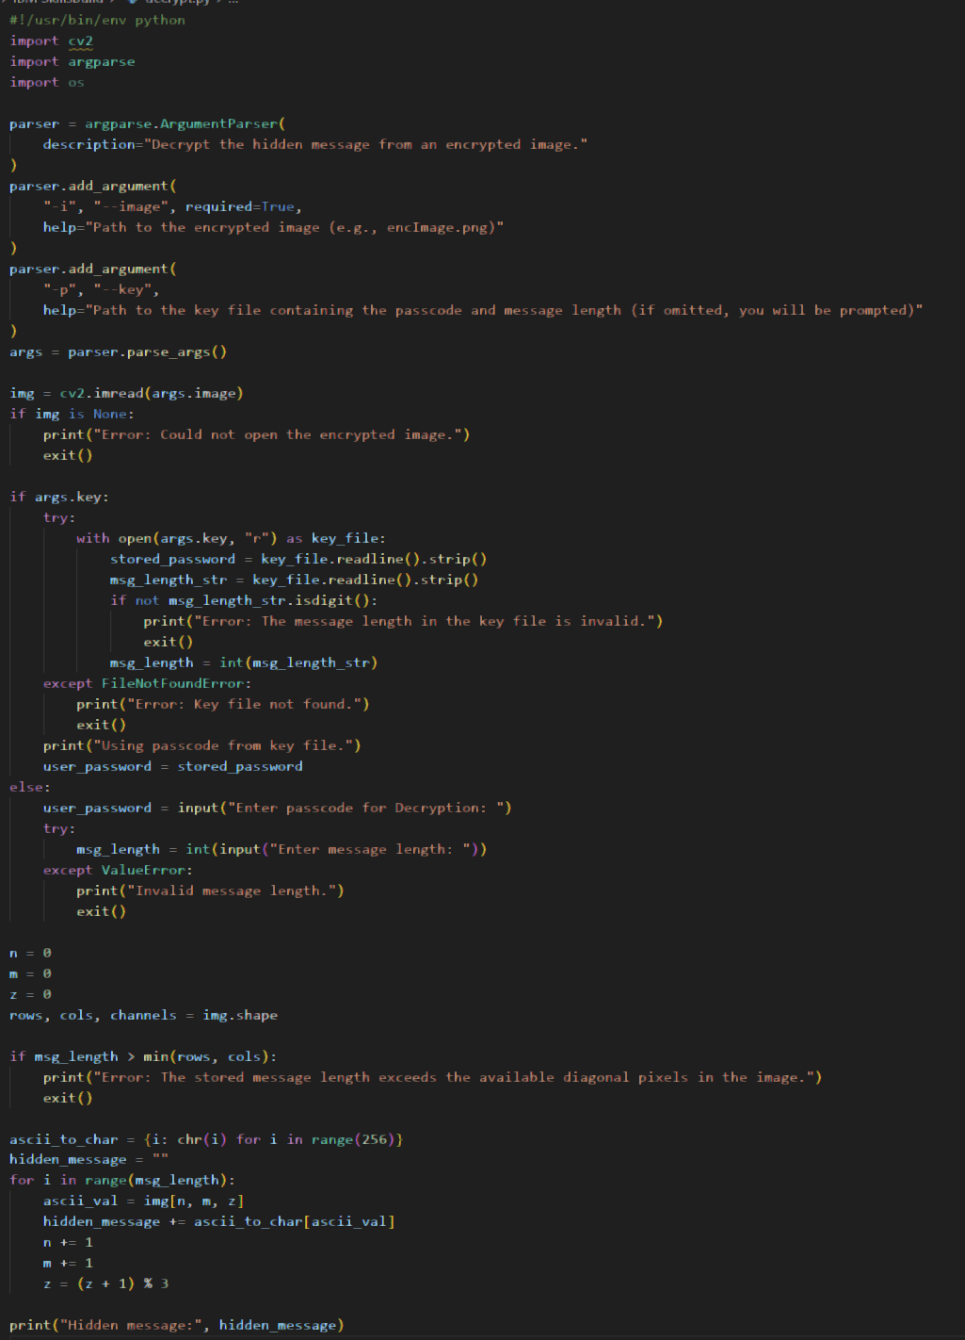



Results
Image-encryption.py:
Image-decryption.py:
Key.txt file:
Image:
encImage:

Slide 8
Conclusion
Steganography offers a discreet method for sharing sensitive information.
This project demonstrates a straightforward yet effective approach to embedding messages within images.
Future enhancements could make the solution even more robust, secure, and scalable.

Slide 9
GitHub Link
https://github.com/Fawazhussain8/Steganography

Slide 10
Future scope
Advanced Encryption Techniques – Incorporate AES encryption prior to embedding text in images for enhanced data protection.
Support for Audio & Video Steganography – Broaden the scope beyond static images, enabling hidden data within multimedia files.
AI-Based Detection Prevention – Employ countermeasures to remain undetectable under modern forensic scrutiny.
Mobile App & Web Versions – Extend accessibility by delivering solutions across multiple platforms.
Multi-Layer Security – Fuse steganography with blockchain technology for a highly secure, layered communication channel.

Slide 11
THANK YOU

