Slide 1
Predicting Milk Futures Price Movements
Bryce Fawcett
DSI Capstone - October 5, 2017

Slide 2
What are Futures?
A futures contract is an agreement to buy or sell commodities at a fixed price to be delivered on a future date.
These contracts are then bought and sold on organized exchanges.

Slide 3
Goal
Predict up or down movement of Milk Futures Prices
Give Milk Producers an idea of whether to increase or decrease production

Slide 4
Data Sources
quandl.com - Historic Futures Prices
NASS.usda.gov - Monthly Milk Production

Slide 5
Technologies Used

Slide 6
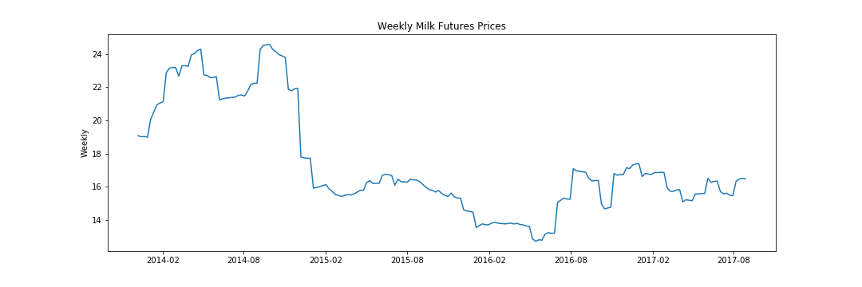
Weekly Milk Futures Prices

Slide 7
Baseline Prediction
Predict that the price will move in the same direction as it moved in the previous period
Accuracy for dataset: 57.4%

Slide 8
ARIMA
Autoregressive Integrated Moving Average
Autoregressive (AR): Look at previous values
Integrated (I): Difference the values
Moving Average (MA): Look at previous errors

Slide 9
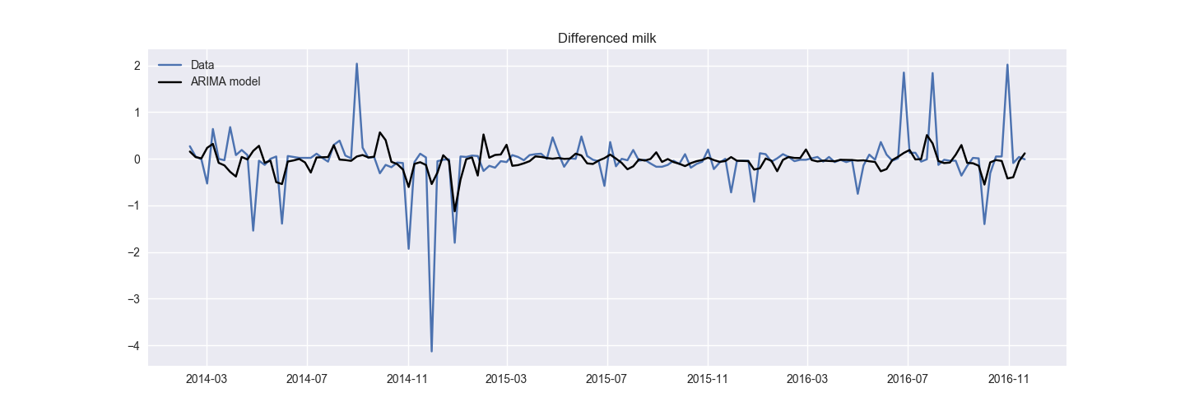
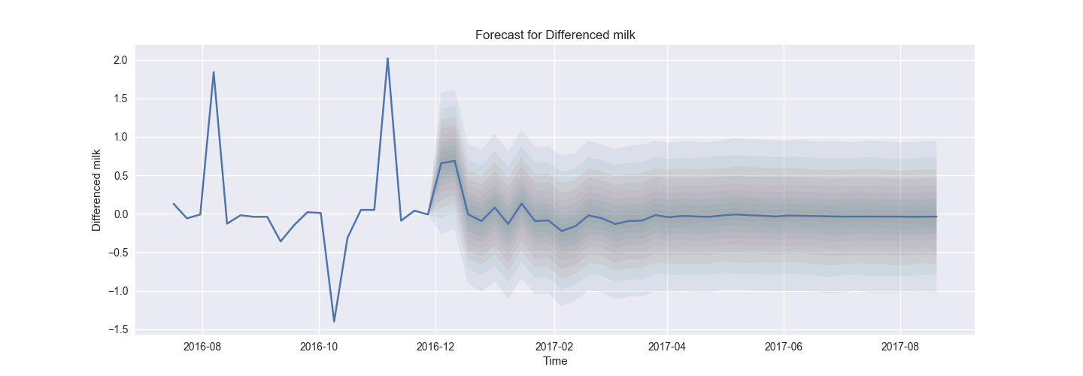
ARIMA
Accuracy: 50.0%
Model | Accuracy
Baseline | 57.4%
ARIMA | 50.0%

Slide 10
ARIMAX
ARIMA with additional exogenous (X) values
Milk production values
Additional futures prices
Cheese
Dry Milk
Corn

Slide 11
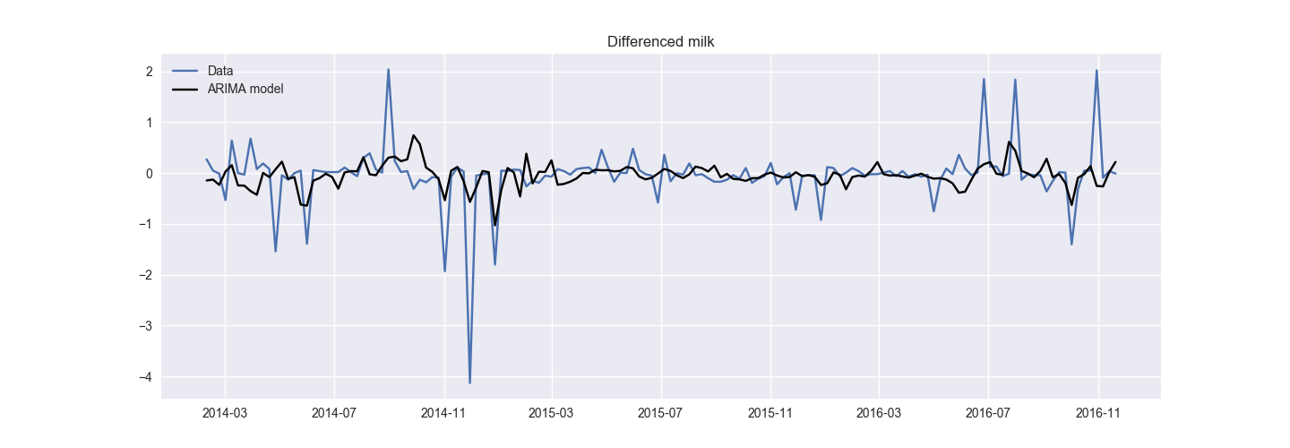

ARIMAX
Accuracy: 57.9%
Model | Accuracy
Baseline | 57.4%
ARIMA | 50.0%
ARIMAX | 57.9%

Slide 12
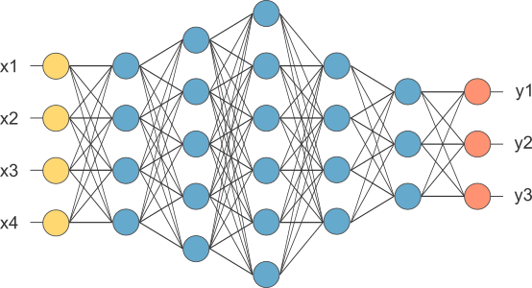
Recurrent Neural Network
Long Short-Term Memory (LSTM)

Slide 13
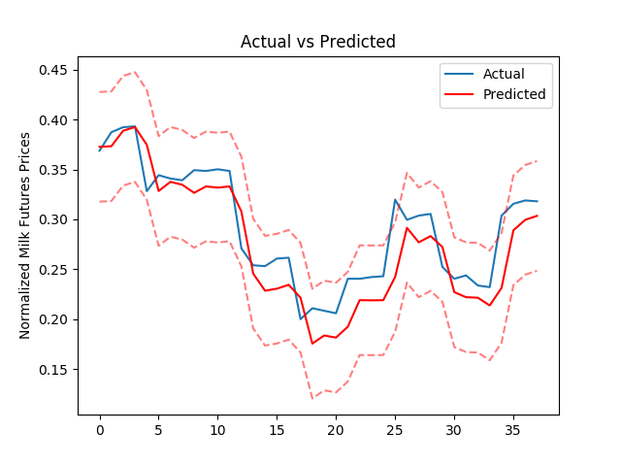
LSTM Results
Accuracy: 63%
Model | Accuracy
Baseline | 57.4%
ARIMA | 50.0%
ARIMAX | 57.9%
LSTM | 63.0%

Slide 14
Next Steps
Find additional variables
Feed Prices
Weather

Slide 16
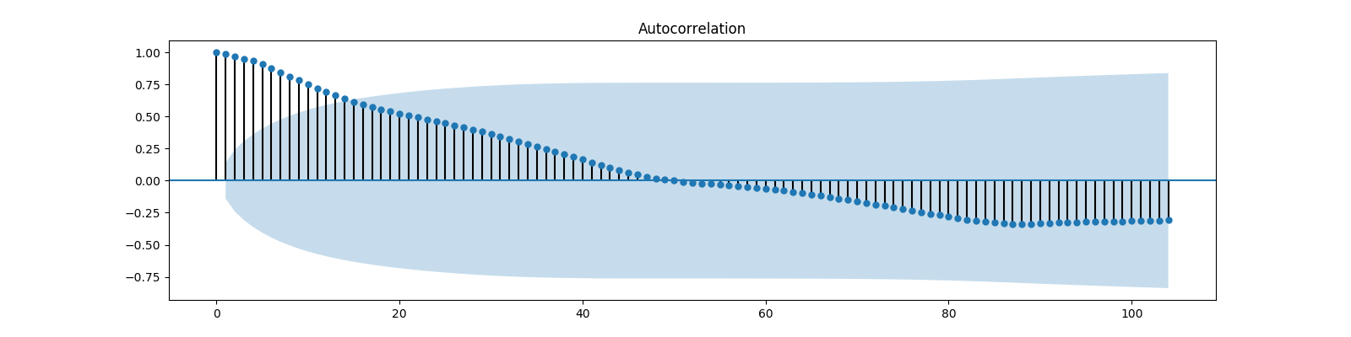
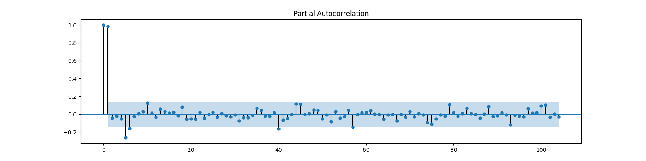
Time Series

Slide 17
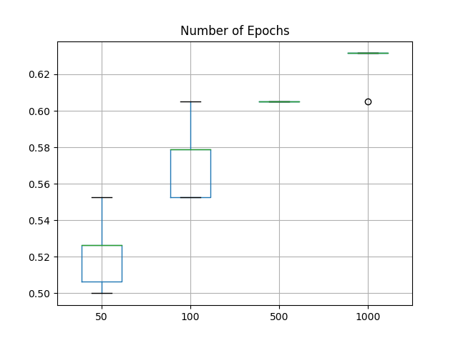
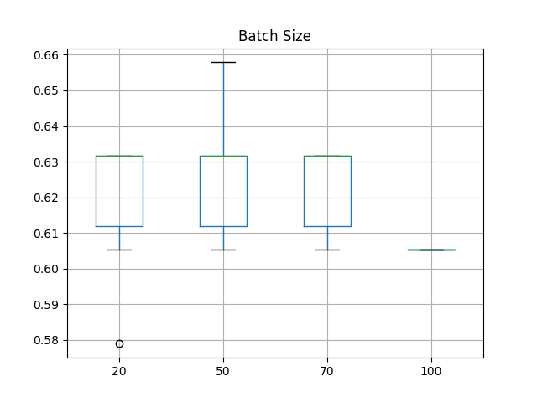
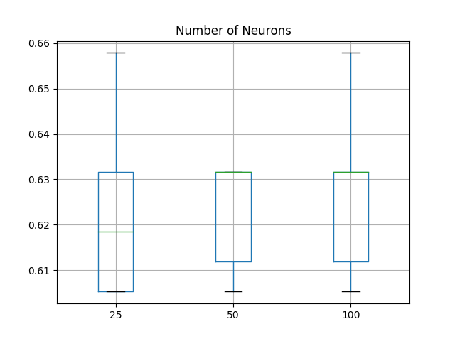
Parameter Tuning

