Slide 1
EduConnect: A Web-Based Academic Request Management System.
IS499 Senior Project at Prince Sultan University
Dr. Suliman Mohamed Fati and Dr. Bayan AlGhofaily
Group Names
Date

Slide 2
Abstract
EduConnect is an electronic platform designed to automate the handling of academic requests at PSU.
The system reduces administrative workload, human mistake, and request handling delays.
It provides functionalities for submitting and tracking academic promises and registry surplus requests.
EduConnect was developed using the Laravel framework to provide secure and scalable performance.
The platform maximizes institutional efficiency and student experience as a whole.

Slide 3
Introduction
Institutions get a vast majority of academic queries on a day-to-day basis.
The conventional processing of academic requests tends to result in inefficiencies and delay.
EduConnect seeks to automate academic functions and maximize administrative processes.
The system reduces paperwork and provides simplicity in communication among students and faculty members.
EduConnect adheres to PSU's vision for becoming digital-centric in education.

Slide 4
Problem Statement
Academic requests are handled manually today, and this leads to delays and mistakes.
Students waste a lot of time waiting for approvals and responses.
Staff members find it difficult to handle and track more and more requests.
There is no single platform to offer transparency and accountability.
There is a requirement for a digital platform to handle requests efficiently and securely.

Slide 5
Objectives
The objective is to build a secure, web-based system for handling academic requests.
The system has to allow students to submit and monitor academic pledges and excess forms.
It has to allow staff to view, authorize, and manage submissions efficiently.
EduConnect aims to cut paperwork and processing time by a vast amount.
The system has been designed to be scalable, user-friendly, and secure for data.

Slide 6
Scope
EduConnect specializes in managing academic promises and surplus requests to the registry only.
The platform supports various types of users: students, advisors, and registry staff.
Administrators can monitor system usage and manage user roles and permissions.
The system is web-based and can be accessed on desktop and mobile browsers.
Integration with existing university systems is expected but not yet achieved.

Slide 7
Relevance
The project is in line with PSU's strategic goal of digitalization of education.
EduConnect enables communication between students and academic departments.
The system enables the alleviation of administrative burden and improved service delivery.
Transparency and accountability are improved through request tracking features.
Students and staff both benefit from an efficient, user-friendly platform.

Slide 8
Constraints
The most recent release only supports two types of scholarly requests.
Stable internet connectivity is required in order to access the system through the internet.
Role-based strict access control is required in order to maintain user security.
There is no interfacing directly with PSU internal database systems.
Development was limited to the timeframe of the Spring 2025 semester.

Slide 9
Literature Review
Different case studies of university academic systems were reviewed for best practices.
Laravel was used because it has strong MVC architecture support and security features.
Other similar platforms were researched to identify workflows and user interface needs.
Interviews and surveys of PSU students and staff helped identify system needs.
The research re-affirmed the requirement for an integrated academic request platform.

Slide 10
System Design
It uses the Model-View-Controller (MVC) design pattern with Laravel.
There is a module for login that validates users as students, advisors, or administrators.
The dashboard includes submission status, history, and vital alerts.
Request forms have validation rules and allow for document upload.
The backend processes request creation, routing, approval, and storage securely.

Slide 11
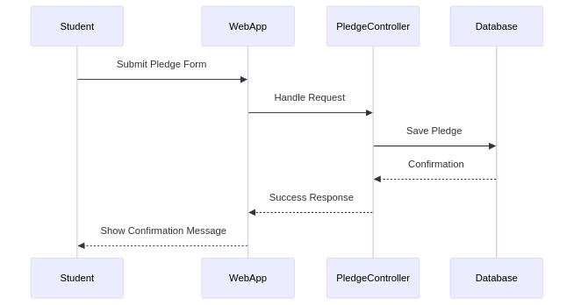
Sequence Diagram

Slide 12
System Architecture
Frontend was implemented with Blade templates, Bootstrap, and jQuery for responsiveness.
Backend relies on Laravel's native functionality and communicates with a MySQL database.
User authentication is secured with Laravel Sanctum for token-based authentication.
Middleware manages only authorized roles accessing specific system modules.
The modular pattern allows easy expansion and maintenance of features.

Slide 13
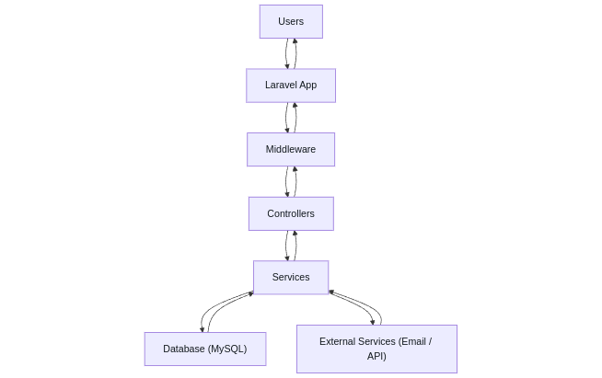
Architecture

Slide 14
Implementation
Version control and collaboration were done with Git.
Development was initially tested on a local server through XAMPP.
Demo accounts and test data were created to simulate real-world usage.
Functionality and performance were tested with diverse user input and actions.
The user interface was kept simple, easy to use, and mobile optimized.

Slide 15
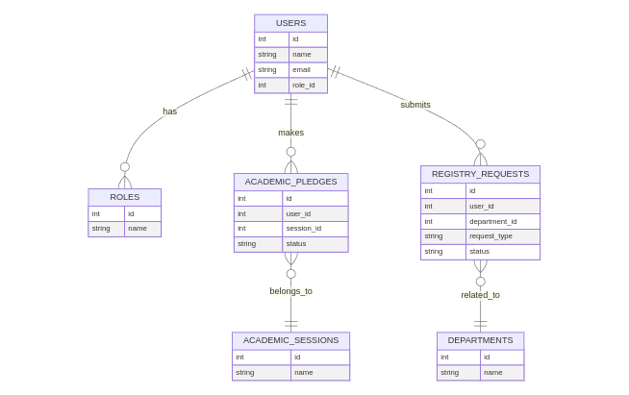
Database Design

Slide 16
Testing and Evaluation
Functional testing was done for form submission, request tracking, and login.
Students and instructors gave usability testing feedback.
Reported bugs were tracked and fixed in future development cycles.
The system demonstrated stability under mock multi-user loads.
Positive feedback ensured the correctness of the platform design and usability.

Slide 17
Gantt Chart
The project began with planning and requirement analysis in the first two weeks.
Design phase and UI mockups were completed by the fifth week.
Development was carried out from Week 6 to Week 12 with regular reviews.
Testing and debugging were done from Weeks 13 to 15.
Documentation and presentation were carried out from Weeks 16 to 18.

Slide 18
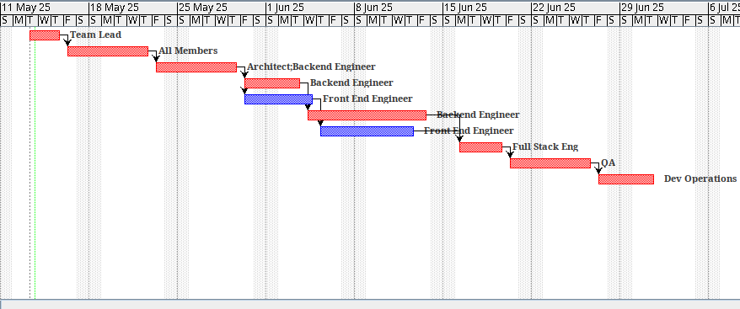
Gantt

Slide 19
Conclusion
EduConnect effectively achieves the goal of automating student request processing.
The system improves the clarity and efficiency of student-staff interaction.
All the project goals were accomplished within the given time and constraints.
The platform offers an expandable solution for online academic support.
Feedback from stakeholders implies high satisfaction and preparedness of the system.

Slide 20
Future Work
Support for other kinds of requests like course waivers and complaints will be provided.
Integration with PSU's Student Information System (SIS) will be envisioned.
A mobile app version will also be developed for convenient access.
Admin dashboards with analytics and reporting functions will be provided.
The system will be tested at a wider scale for implementation across the university.

Slide 21
References
Ahrens, V. (2025). Systems engineering & management : a generic approach to the design and control of socio-technical systems. Springer Vieweg. https://doi.org/10.1007/978-3-658-46875-0
Bierer, D., Evans, C., O’Reilly for Higher Education (Firm), & Safari, an O’Reilly Media Company. (2021). PHP 8 Programming Tips, Tricks and Best Practices (1st edition). Packt Publishing. https://ezproxy.torontopubliclibrary.ca/login?url=https://learning.oreilly.com/library/view/-/9781801071871/?ar
Cheng, Y. C. (2022). School effectiveness and school-based management: A mechanism for development. Routledge.
Damian, D., Blincoe, K., Ford, D., Serebrenik, A., & Masood, Z. (2024). Equity, diversity, and inclusion in software engineering : best practices and insights. Apress. https://doi.org/10.1007/978-1-4842-9651-6
Goslin, K., & Hofmann, M. (2021). Applied user data collection and analysis using JavaScript and PHP. Chapman & Hall/CRC. https://doi.org/10.1201/9781003163541

