Slide 1
CIS2303-SysTEMS ANALYSIS and DESIGN
Chapter 4
SYSTEM REQUIREMENTS Documentation- IDENTIFYING USE CASEs & USER STORIES
CHAPTER 4 | CLO2: Create behavioral models to document system requirements, both independently and in collaboration with peers

Slide 2
Document Revision CONTROL (DRC)
Version | Author | Effective Date | Change Description | DRC No
1.0 | Dr. Nourchene Benayed | June 7, 2020 | Define the first version | 001
1.1 | Dr. Belsam Attallah | June 16, 2020 | Editing text, and resizing and adjusting images | 001
1.2 | Sharmila Siddartha | Dec 2022 | Edited slide 13 | 001
X.Y
X: Major change
Y: minor change

Slide 3
Lecture Notes
Contents of lectures are based on the textbook, recommended text, and supplementary material
Please read Chapter 3 of “Systems Analysis and Design in changing the world” from page 71 to 73
Please read Appendix 7A of “Modern Systems Analysis and Design” from page 217 to 222

Slide 4
Lecture OUTLINE
KEY TERMS
CORE PROCESS 3 ACTIVITY 2
PRODUCT BACKLOG
USE CASE DIAGRAMS

Slide 5
LECTURE OBJECTIVES
At the end of lecture, the student should be able to:
Explain why identifying user stories and use cases is the key to defining functional requirements
Write user stories and define product backlogs
Describe the notations and purpose for the use case diagram
Create use case diagrams

Slide 6
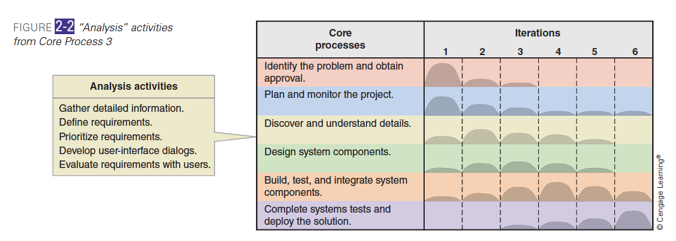
SDLC Core PROCESS 3 and Its ACtivitIeS
Core process 3: Analysis activities
Activity 1: Gather system requirements
Activity 2: Define requirements
Activity 3: Prioritize requirements
Activity 4: Develop user-interface dialogs
Activity 5: Evaluate requirements with users
Notes:
Although we concentrate only on analysis activities in this chapter, keep in
mind that they are usually intermixed with design, implementation, and other
activities during the system development life cycle. For example, as shown in
Figure 2-2, analysis activities are most intensive in the second iteration but occur
in varying degrees during all project iterations except the last.
In this chapter, we are going to cover only activity 2 which is define/or document the requirements

Slide 7
CORE PROCESS 3 Activity 2: Define the requirements…
 | Stuctured Development | Iterative Development | Agile Developmet
 |  |  | Unified Process | Scrum
Traditional Modelling approach | DFD | Not applied | Not applied | Not applied
Object Oriented Approach | UML Diagrams | UML Diagrams | UML Diagrams | Product Backlog+Some UML Diagrams
How to document the requirements?
Many factors dictate the way to document the requirements: the adopted development methodology, the modelling approach… etc.

Slide 8
CORE PROCESS 3 Activity 2: Define the requirements…
 | Business Process | Functional Requirements | Non-Functional Requirements
Use Case Diagram /Product Backlog |  | X (Chapter 4)
Sequence Diagram |  | X (Chapter 5)
Activity Diagram | X (Chapter 3) | X
Class Diagram |  | X (Chapter 6)
Package Diagram |  | X (Chapter 6)
Which UML diagrams to model the functional requirements?
Notes:
Different UML diagrams can be used to model the FR. From behavioral viewpoint, UCD, SD, and AD can be used. From structural viewpoint, CD and PD are used to model the FR.
With UP, UCD, SD or AD, CD are used
With Scrum, product backlog, SD or AD, CD are used

Slide 9
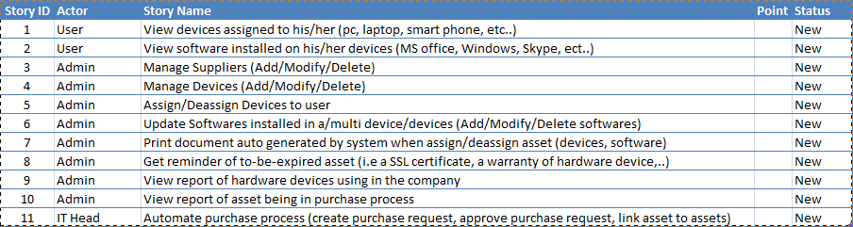
USER STORIES AND PRODUCT BACKLOG
A product backlog is a set of user stories
A user story describes a goal the user has when using the system
Template
“As a <role played>, I want to <goal or desire> so that <reason or benefit>
Example
As a student, I want to drop a course, so that I could maintain/improve my CGPA
As a teller, I want to make a deposit, so that I quickly serve more customers

Slide 10
CORE PROCESS 3 Activity 2: Define the requirements
MODEL THE FUNCTIONAL REQUIREMENTS USING UML USE CASE Diagram

Slide 11
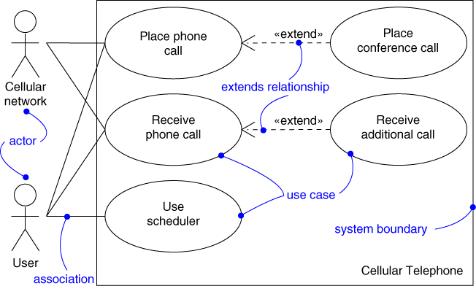
UML USE CASE DIAGRAM CONCEPTS
Concepts | Description
System Boundary | A named box that depicts the scope of the system
Actor | Represent a set of roles that a user or any other system plays when interacting with the to-be system
Use case | Represent a single system functionality/service of the to-be system
Association | Show that the actor is involved in a system functionality
Generalization | Represent inheritance principle
Extend | Enable to factor variants
Include | Enable to factor common behavior

Slide 12
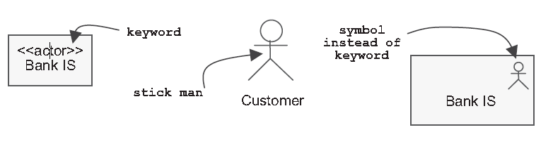
Actor
Actor is an external entity. It is not a part of the to-be system
Databases of the to-be system are internal and CANNOT BE an actor
Actor can be a human user or another external software or external system that interacts with the to-be system
Categories
Primary Actor is an entity that interacts with the system to gain direct benefit
Secondary actor is entity involved in achieving a use case yet, it does not gain direct benefit from the system
Very often, secondary actor is someone who assists the primary actor to achieve a use case
Primary actor is usually found on the left side, while the secondary actor on the right side of the system

Slide 13
CORE PROCESS 3 Activity 2: Define the requirements
Document THE FUNCTIONAL REQUIREMENTS USING A PRODUCT BACKLOG

Slide 14
Relationships between actors
The use of generalization/specialization relationship between actors is useful in modeling overlapping behaviors between actors
Example :
student
graduate
student
non-graduate
student

Slide 15
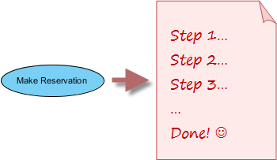
Use CaseS
Use case specifies the desired behavior. It is intended to provide an overview of what the user wants without knowing how to achieve the goal
Naming convention is action verb + noun
Example:
Make reservation is undoubtedly a use case
Look up a hotel isn’t a use case because it is only a part of the reservation process instead of an objective

Slide 16
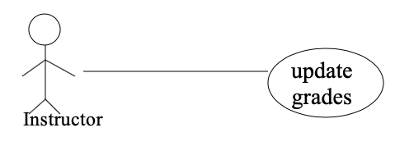
RELATIONSHIPS BETWEEN USE CASES AND ACTORS
Actors may be connected to use cases by associations, indicating that the actor and the use case communicate using messages

Slide 17
RELATIONSHIPS BETWEEN USE CASES
Generalization
Use cases that are specialized versions of other use cases
Include
Use cases that are included as parts of other use cases
Extend
Use cases that extend the behavior of other core use cases

Slide 18
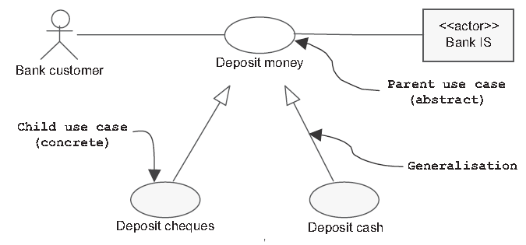
Generalization
The child use case inherits the behavior and meaning of the parent use case
The child may add to or override the behavior of its parent

Slide 19
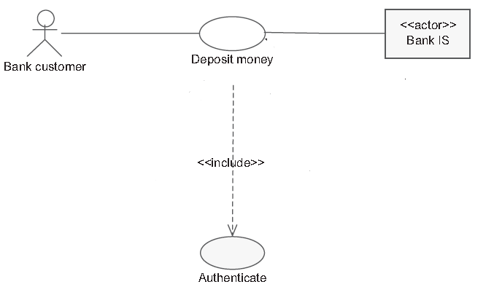
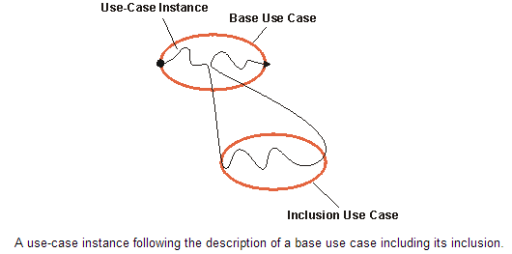
Include
The base use case explicitly incorporates the behavior of another use case at a location specified in the base
The included use case never stands alone. It only occurs as a part of some larger base that includes it
You can use the include-relationship to factor out behavior:
From the base use case that is not necessary for the understanding of the primary purpose of the use case, only the result of it is important
That is in common for two or more use cases
base
<<include>>
included

Slide 20
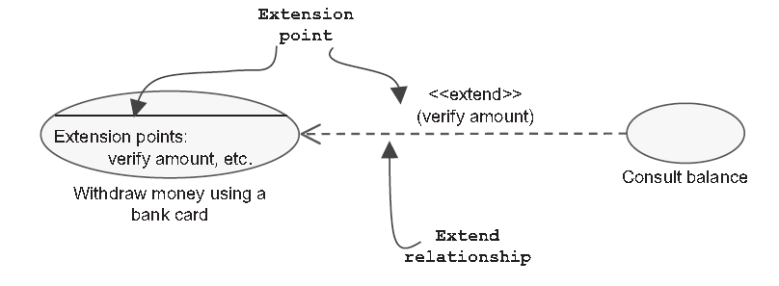
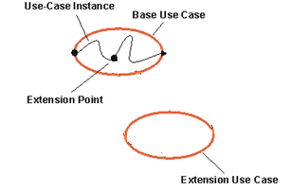
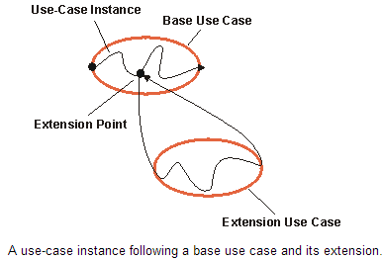
EXtEND
The base use case implicitly incorporates the behavior of another use case at certain points called extension points
The base use case may stand alone, but under certain conditions its behavior may be extended by the behavior of another use case
You can use the extensions for several purposes:
To show that a part of a use case is optional, or potentially optional, system behavior. In this way, you separate optional behavior from mandatory behavior in your model
To show that a subflow is executed only under certain (sometimes exceptional) conditions, such as triggering an alarm
<<extend>>
base
extending

Slide 21
How to create a Use Case Diagram?
Use actor-based method to identify use cases:
Identify the actors related to a system or organization
For each actor, identify the services they initiate or participate in
The following questions may be used to help identify the use cases for a system:
What are the main tasks performed by each actor?
Will the actor read or update any information in the system?
Will the actor have to inform the system about changes outside the system?
Does the actor have to be informed of unexpected changes?

Slide 22
UML USE CASE Description
Describe the flow of events within the use case
Can be done in natural language, formal language or pseudo-code

Slide 23
UML USE CASE Description TeMPLATE
Overview
Name, ID Number, Type, Primary Actor, Brief Description, Importance Level, Stakeholder(s), Trigger(s)
Preconditions
Flow of events
Normal flow: the usual set of activities
Alternative flows: those not considered the norm
Error flows
Postconditions
Notes:
Use case:طرق الاستخدام

Slide 24

Case study
Automatic Teller M ACHINE (ATM)

Slide 25
ATM System…
Case study
Questions
This case study concerns a simplified system of the automatic teller machine (ATM). The ATM offers the following services:
1. Distribution of money to every holder of a smartcard via a card reader and a cash dispenser
2. Consultation of the account balance, cash, and cheque deposit facilities for bank customers who hold a smartcard from their bank
Do not forget either that:
3. All transactions are made secure
4. It is sometimes necessary to refill the dispenser, etc
Q1. Build a use case diagram by following these steps
Step 1: Identify the actors,
Step 2: Identify the use cases,
Step3: Construct a use case diagram,
Step 4: Organize and structure the use cases
Step5: Write a textual description of the use cases,
Q2. Define a product backlog for the system

Slide 26
Q1: CREATING UML USE CASE DIAGRAM
Step 1: Identify the actors,
Step 2: Identify the use cases,
Step3: Construct a use case diagram,
Step 4: Organize and structure the use cases
Step5: Write a textual description of the use cases,

Slide 27
Step 1: Identifying the ATM actors…
Sentence 1: Distribution of money to every holder of a smartcard via a card reader and a cash dispenser
Every “holder of a smartcard”. He or she will be able to use the ATM to withdraw money using his or her smartcard
What about the card reader and the cash dispenser ?
Trap: The card reader and cash dispenser constitute a part of the ATM. They can therefore not be considered as actors!
What about the smartcard? Is the smartcard itself an actor?
Another trap: The card is certainly external to the ATM, and it interacts with it... Yet, we do not recommend that you list it as an actor, as we are putting into practice the following principle:
Eliminate “physical” actors as much as possible to the advantage of “logical” actors
The actor is the who or what that benefits from using the system. It is the card holder who withdraws money to spend it, not the card itself!

Slide 28
Step 1: Identifying the ATM actors…
Sentence 2 : Consultation of the account balance, cash and cheque deposit facilities for bank customers who hold a smartcard from their bank
This sentence identifies additional services that are only offered to bank customers who hold a smartcard from this bank
This is therefore a different profile from the previous one, which we will acknowledge as a second actor called Bank customer

Slide 29
Step 1: Identifying the ATM actors…
Sentence 3 encourages us to consider the fact that all transactions are made secure
But who makes them secure? There are therefore other external entities, which play the role of authorization system and with which the ATM communicates directly
An interview with the domain expert is necessary to allow us to identify two different actors:
The Visa authorization system (VISA AS) for withdrawal transactions carried out using a Visa smartcard (we restrict the ATM to Visa smartcards for reasons of simplification);
The information system of the bank (Bank IS) to authorize all transactions carried out by a customer using his or her bank smartcard, but also to access the account balance

Slide 30
Step 1: Identifying the ATM actors…
Sentence 4 reminds us that an ATM also requires maintenance work, such as refilling the dispenser with bank notes, retrieving cards that have been swallowed, etc.
These maintenance tasks are carried out by a new actor: Maintenance operator

Slide 31
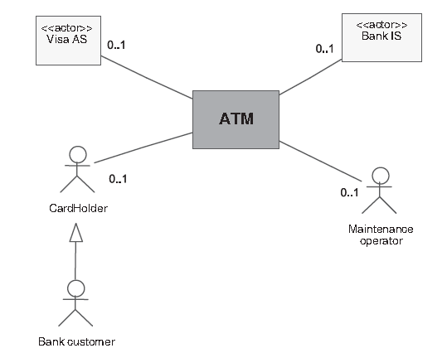
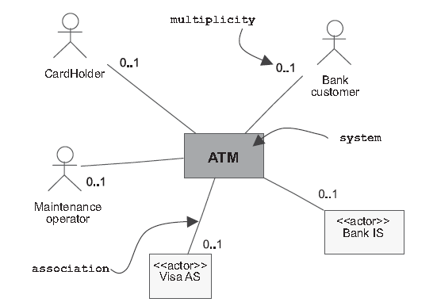
Step 1: Identifying the actors of the ATM
Static Context Diagram (First Version)
Static Context Diagram (Final Version)

Slide 32
STep 2: Identifying use cases
Card Holder
Withdraw money
Bank customer
Withdraw money
Consult the balance of one or more accounts.
Maintenance operator
None
Deposit cash
Deposit checks
Refill dispenser
Retrieve cards that have been swallowed
Retrieve cheques that have been deposited
Visa authorization system (AS)
None
Bank information system (IS)
Notes:
Let’s take the five actors one by one and list the different ways in which they can use the ATM:

Slide 33
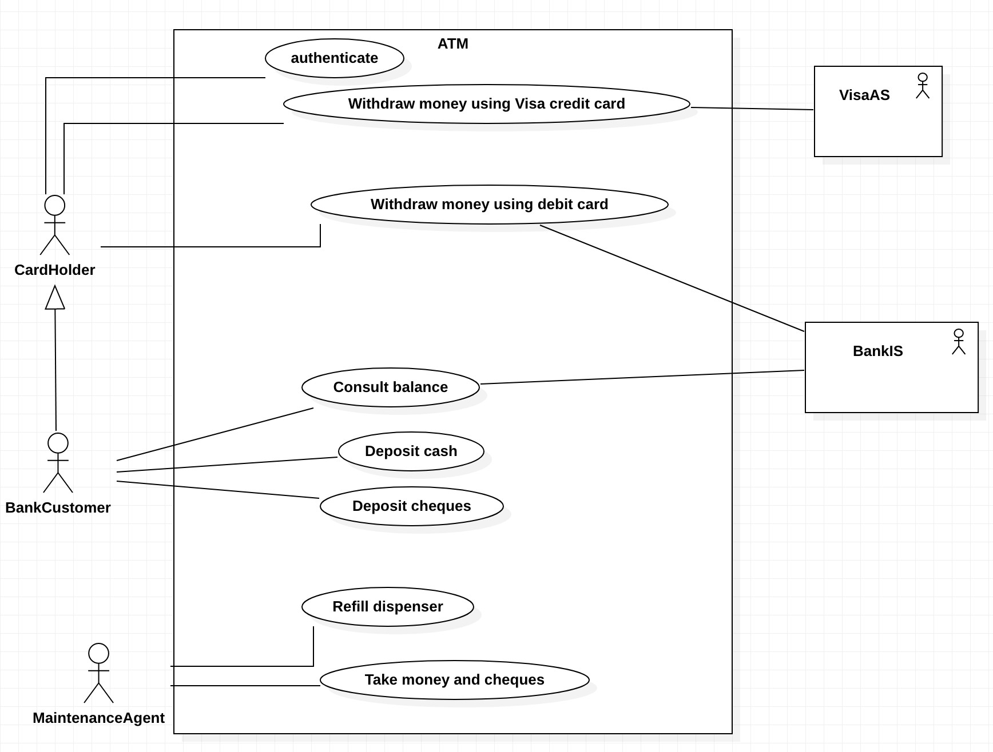
Step 3: Creating use case diagraM

Slide 34
Step 4: Organizing use case diagram…
With UML, it is possible to detail and organize use cases in two different and complementary ways:
by adding include, extend and generalization relationships between use cases;
by grouping them into packages to define functional blocks of highest level.

Slide 35
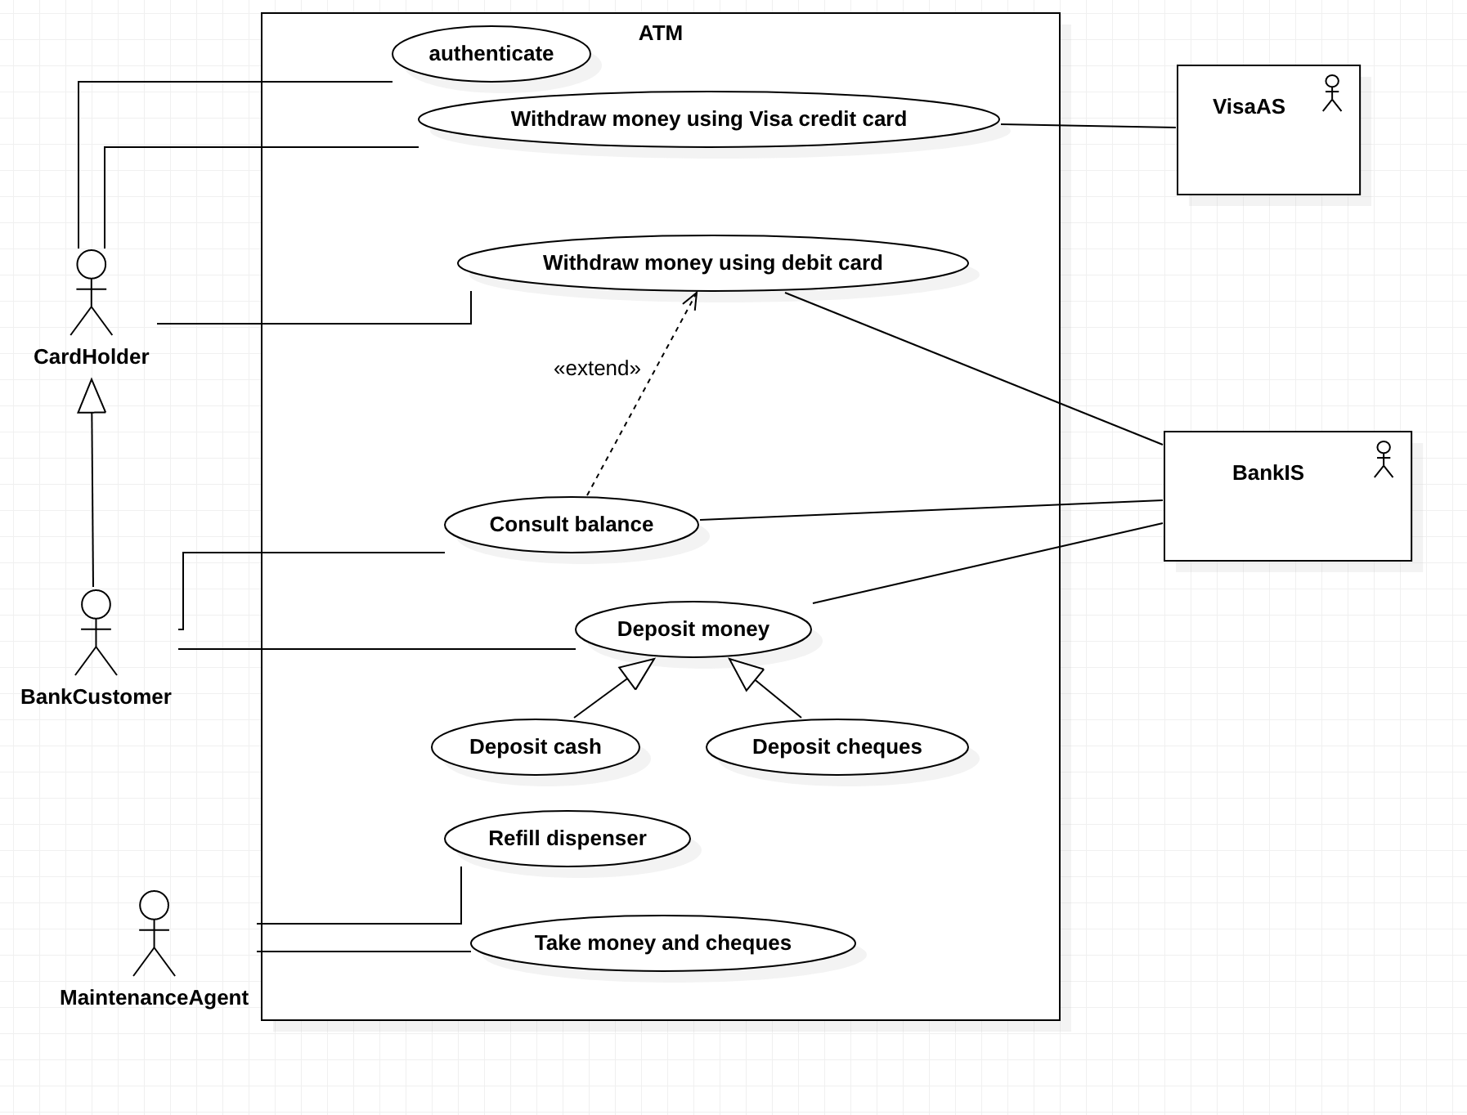
Step 4: Organizing use case diagraM

Slide 36
Step 5: Textual description of use cases…
Use Case: Withdraw Money using a visa card
Overview: this use case allows a Visa card holder, who is not a customer of the bank, to withdraw money if his or her daily limit allows it
Actors: CardHolder (primary), Visa AS (secondary).
Creation date: 24-SEP-2018 Date of update: 08-June-2020
Version: 2.2
Person in charge: Nourchene Benayed
Preconditions:
The ATM must be in a state ready to accept transactions (There is no card in the reader)
The ATM must have at least some cash on hand that it can dispense (The ATM cash box is well stocked)
Perform the use case “Authenticate”
Overview & Preconditions

Slide 37
Step 5: Textual description of use cases…
Actors: the Visa CardHolder | ATM
 | 1. The ATM asks the Visa CardHolder to enter the desired withdrawal amount
2. The Visa CardHolder enters the desired withdrawal amount
 | 3. The ATM checks the desired amount against the daily balance
 | 4. The ATM asks the Visa CardHolder if he or she would like a receipt
5. The Visa CardHolder requests a receipt
 | 6. The ATM returns the card to the Visa CardHolder
7. The Visa CardHolder takes his or her card
 | 8. The ATM issues the money and a receipt
9. The Visa CardHolder takes the money and the receipt
Normal Scenario

Slide 38
Step 5: Textual description of use cases…
A1: Requested amount is greater than the daily withdrawal limit
A1 sequence starts at point 3 of the main success scenario
4. The ATM informs the CardHolder that the amount requested is greater than the daily withdrawal limit
A2: Visa CardHolder won’t a receipt
A2 sequence starts at point 4 of the main success scenario
5. The Visa CardHolder declines the offer of a receipt
The scenario goes back to point 1
6. The ATM returns the smartcard to the Visa CardHolder
7. The Visa CardHolder takes his or her smartcard
8. The ATM issues the banknotes
9. The Visa CardHolder takes the banknotes
Alternative Scenarios

Slide 39
Step 5: Textual description of use cases…
E1: the card is not taken back by the holder
E1 sequence starts at point 6 of the main success scenario
7. After 15 seconds, the ATM confiscates the smartcard
E2: banknotes are not taken by the holder
E2 sequence starts at point 8 of the main success scenario
9. After 30 seconds, the ATM takes back the banknotes
The VISA authorization system is notified; the use case fails.
10. The VISA authorization system is informed; the use case fails
Error Scenarios
Notes:
E1:

Slide 40
Step 5: Textual description of use cases…
The current amount of cash in the user account is the amount before the withdraw minus the withdraw amount
A receipt was printed on the withdraw amount
The withdraw transaction was audited in the Visa AS
Postconditions

Slide 41
Q2: Defining the product backlog
“As a card Holder, I want to withdraw cash and feel confident the stack of cash I get is the correct amount.”
“As a bank customer, I want to withdraw cash and feel confident the stack of cash I get is the correct amount.”
“As a bank customer, I want to deposit a check and feel confident the deposit is recorded correctly.”
“As a bank customer, I want to deposit banknotes and feel confident the deposit is recorded correctly.”
“As a bank customer, I want to consult the balance of my account and feel confident the balance is accurate.”
“As a maintenance agent, I want to refill dispenser.”
“As a maintenance agent, I want to retrieve cards and checks.”

Slide 42
Q2: Defining the product backlog - tasks
“As a bank customer, I want to withdraw cash and feel confident the stack of cash I get is the correct amount.”
Tasks:
Create an ATM to dispense cash
Build the ATM with sensors, protector
Install ATM
Program to UI/Ux count cash, receive pin, amount etc., receive money
Create security policy, install CC TVs
“As a maintenance agent, I want to refill dispenser.”
Program ATM to send a notification
Program to verify role of agent
Program to update a log of the trans
As a bank customer, I want to consult the balance of my account and feel confident the balance is accurate
Program to read card and account details and verify user.
Program to display balance and give options to print statement/digital message
Program to send a notification

Slide 43
KEY TERMS
CORE PROCESS 3: SYSTEM ANALYSIS ACTIVITIES
USER STORIES
PRODUCT BACKLOG
USE CASES
EXTEND
INCLUD
GENERALIZATION/SPECIA:IZATION
ACTOR
TEXTUAL DESCRIPTION

Slide 44
Formative assessment
Kahoot! CHAPTER4QuiZ2
Notes:
You can find the kahoot!Quiz under the following link: The Higher Colleges of Technology→CIS→Curriculum Development→CIS2303
Please duplicate it in your space and share it with your students.

Slide 45


