Slide 1
CIS2303-SysTEMS ANALYSIS and DESIGN
Chapter 5
SYSTEM REQUIREMENTS Documentation- Modelling the behaviour of USE CASEs
CHAPTER 5 | CLO2: Create behavioral models to document system requirements

Slide 2
Document Revision CONTROL (DRC)
Version | Author | Effective Date | Change Description | DRC No
1.0 | Dr. Nourchene Benayed | June 9, 2020 | Define the first version | 001
1.1 | Dr. Belsam Attallah | June 16, 2020 | Editing text, and resizing and adjusting images | 001
X.Y
X: Major change
Y: minor change

Slide 3
Lecture Notes
Contents of lectures are based on the textbook, recommended text, and supplementary material
Please read Chapter 5 of “Systems Analysis and Design in changing the world” from page 139 to 146
Please read Appendix 7C of “Modern Systems Analysis and Design” from page 237 to 239

Slide 4
Lecture OUTLINE
SEQUENCE DIAGRAM
SDLC CORE PROCESS 3 ACTIVITY 2
LECTURE OBJECTIVES
REVIEW (Previous Lecture)
KEY TERMS

Slide 5

Case study (REVIEW)
Automatic Teller M ACHINE (ATM)

Slide 6
ATM System…
Case study
Questions
This case study concerns a simplified system of the automatic teller machine (ATM). The ATM offers the following services:
1. Distribution of money to every holder of a smartcard via a card reader and a cash dispenser
2. Consultation of the account balance, cash, and cheque deposit facilities for bank customers who hold a smartcard from their bank
Do not forget either that:
3. All transactions are made secure
4. It is sometimes necessary to refill the dispenser, etc
Q1. Build a use case diagram by following these steps
Step 1: Identify the actors,
Step 2: Identify the use cases,
Step3: Construct a use case diagram,
Step 4: Organize and structure the use cases
Step5: Write a textual description of the use cases,

Slide 7
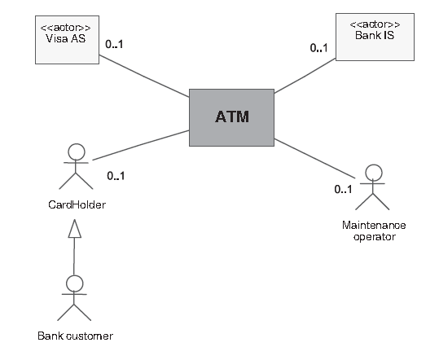
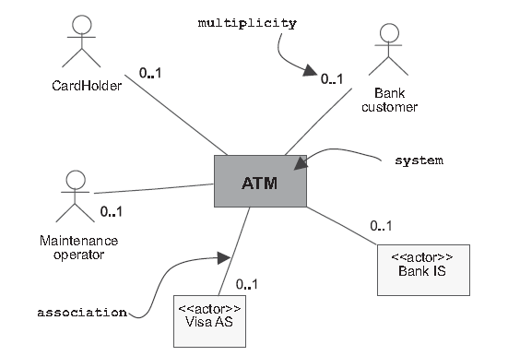
Step 1: Identifying the actors of the ATM
Static Context Diagram (First Version)
Static Context Diagram (Final Version)

Slide 8
STep 2: Identifying use cases
Card Holder
Withdraw money
Bank customer
Withdraw money
Consult the balance of one or more accounts.
Maintenance operator
None
Deposit cash
Deposit checks
Refill dispenser
Retrieve cards that have been swallowed
Retrieve cheques that have been deposited
Visa authorization system (AS)
None
Bank information system (IS)
Notes:
Let’s take the five actors one by one and list the different ways in which they can use the ATM:

Slide 9
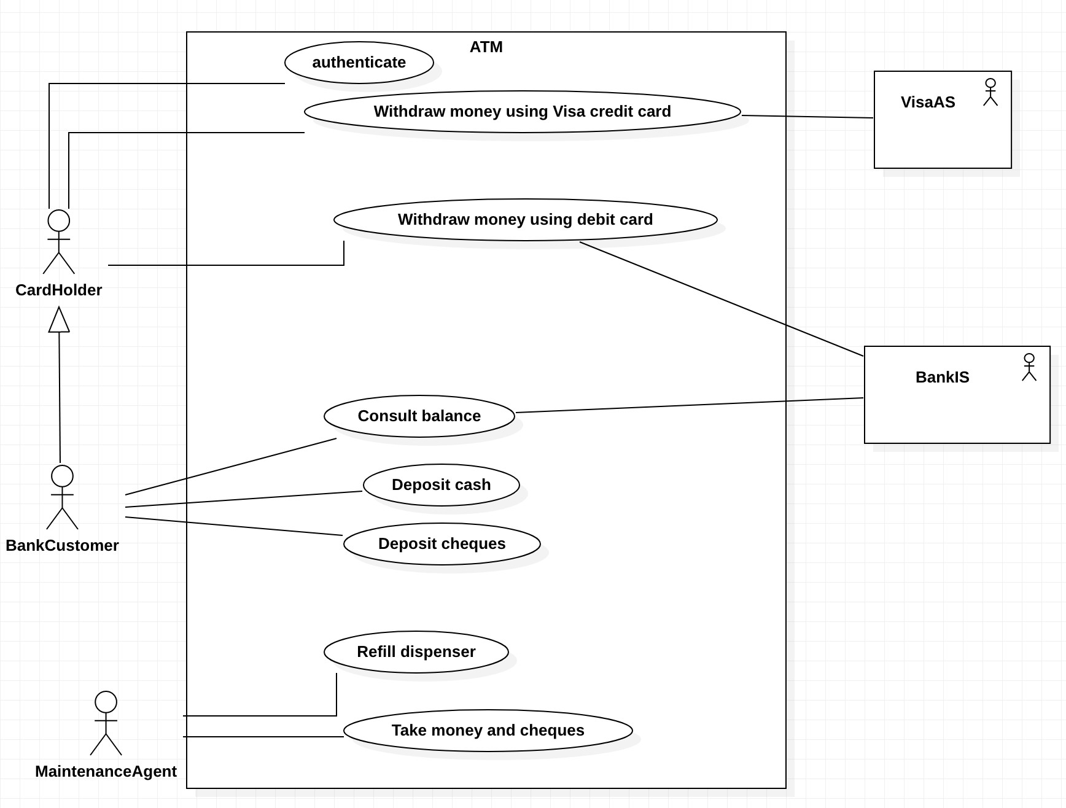
Step 3: Creating use case diagraM

Slide 10
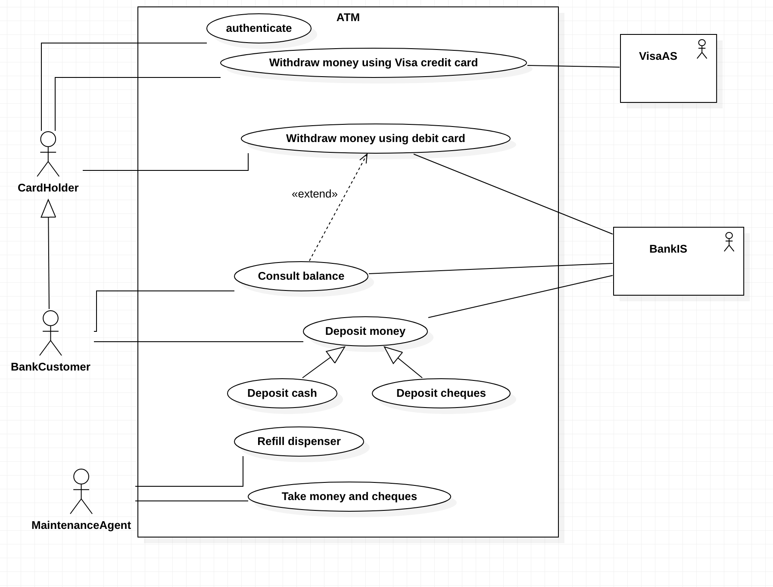
Step 4: Organizing use case diagraM

Slide 11
Step 5: Textual description of use cases…
Actors: Visa CardHolder and Visa AS | ATM
1. The Visa CardHolder inserts his/her card in the ATM’s card reader
 | 2. The ATM asks the Visa CardHolder to enter his/her PIN number
3. The Visa CardHolder enters his/her PIN number
 | 4. The ATM requests an authorization from the VISA authorization system
5. The Visa Authorization System authorizes and indicates the daily limit
 | 6. The ATM asks the Visa CardHolder to enter the desired withdrawal amount
7. The Visa CardHolder enters the desired withdrawal amount
 | 8. The ATM checks the desired amount against the daily balance
 | 9. The ATM asks the Visa CardHolder if he or she would like a receipt
10. The Visa CardHolder requests a receipt
 | 11. The ATM returns the card to the Visa CardHolder
12. The Visa CardHolder takes his or her Card
 | 13. The ATM issues the money and a receipt
14. The Visa CardHolder takes the money and the receipt
Normal Scenario

Slide 12
LECTURE OBJECTIVES
At the end of lecture, the student should be able to:
Explain how use case descriptions and UML diagrams work together to define the behavior of functional requirements
Describe the notations and purpose of the sequence diagram
Create system sequence diagrams

Slide 13
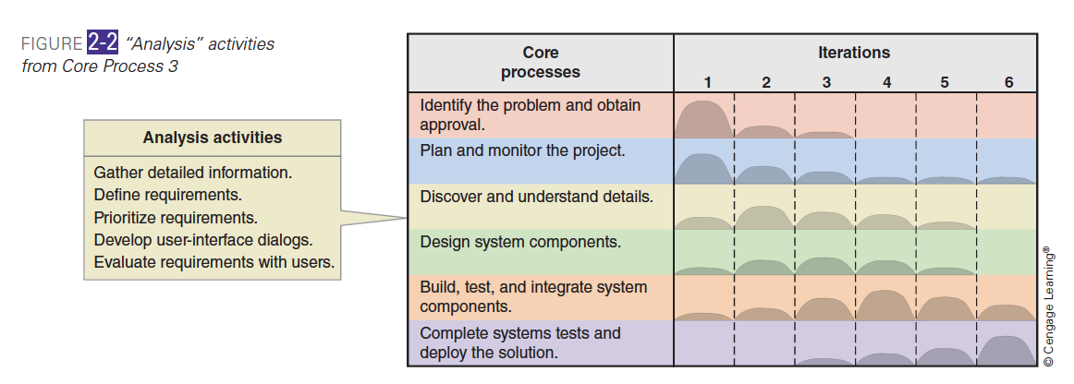
SDLC Core PROCESS 3 and Its ACtivitIeS
Core process 3: Analysis activities
Activity 1: Gather system requirements
Activity 2: Define requirements
Activity 3: Prioritize requirements
Activity 4: Develop user-interface dialogs
Activity 5: Evaluate requirements with users
Notes:
Although we concentrate only on analysis activities in this chapter, keep in
mind that they are usually intermixed with design, implementation, and other
activities during the system development life cycle. For example, as shown in
Figure 2-2, analysis activities are most intensive in the second iteration but occur
in varying degrees during all project iterations except the last.
In this chapter, we are going to cover only activity 2 which is define/or document the requirements

Slide 14
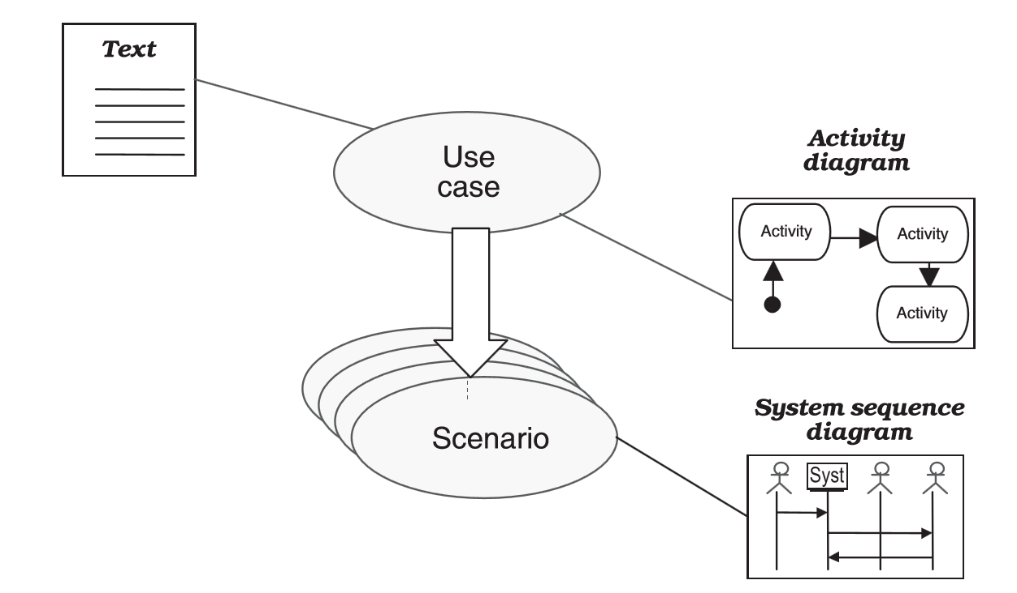
CORE PROCESS 3 Activity 2: Define the requirements…
How to describe the behaviour of use cases?
Textual description (Chapter4)
Sequence Diagram or Activity Diagram

Slide 15
CORE PROCESS 3 Activity 2: Define the requirements
MODEL THE BEHAVIOUR OF USE CASES USING UML SEQUENCE Diagram

Slide 16
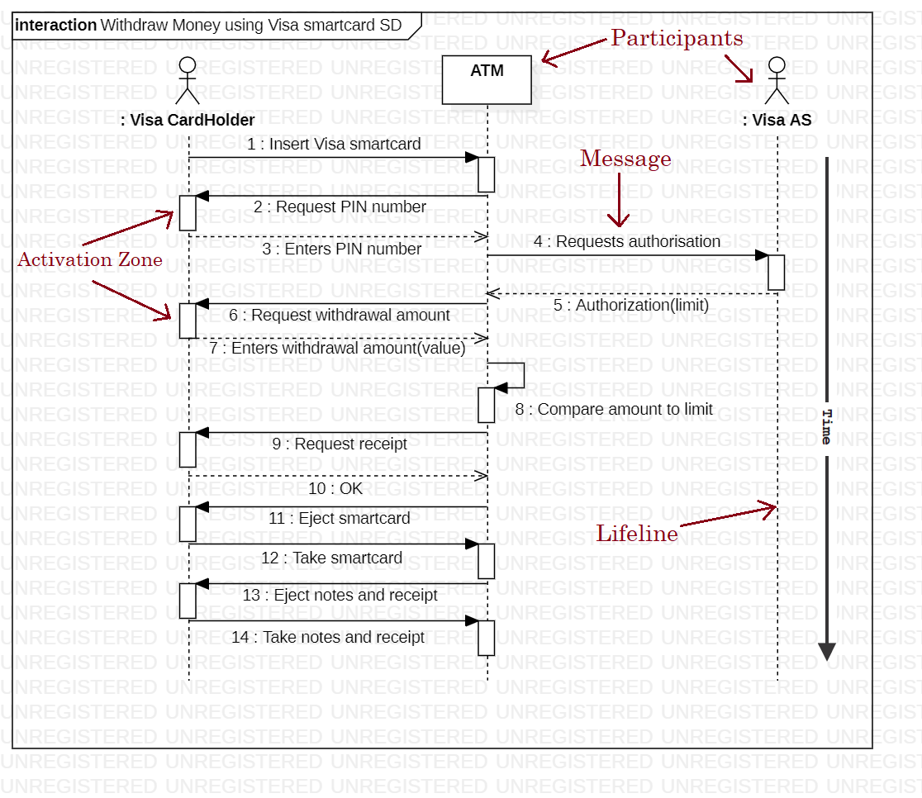
Textual Description of Use Case (Withdraw Money using Visa smartcard)
System Sequence Diagram for Use Case
Actors: Visa CardHolder and Visa AS | ATM
1. The Visa CardHolder inserts his/her card in the ATM’s card reader
 | 2. The ATM asks the Visa CardHolder to enter his/her PIN number
3. The Visa CardHolder enters his/her PIN number
 | 4. The ATM requests an authorization from the VISA authorization system
5. The Visa Authorization System authorizes and indicates the daily limit
 | 6. The ATM asks the Visa CardHolder to enter the desired withdrawal amount
7. The Visa CardHolder enters the desired withdrawal amount
 | 8. The ATM checks the desired amount against the daily balance
 | 9. The ATM asks the Visa CardHolder if he or she would like a receipt
10. The Visa CardHolder requests a receipt
 | 11. The ATM returns the card to the Visa CardHolder
12. The Visa CardHolder takes his or her Card
 | 13. The ATM issues the money and a receipt
14. The Visa CardHolder takes the money and the receipt

Slide 17
UML SEQUENCE DIAGRAM CONCEPTS
Concepts | Description
Participant | Represent an object or an actor or the to-be system
Message | Convey Information from one participant to another one
Time | Is represented as a vertical progression
Combined Fragment | Describe the control flow. It is one or more processing sequence enclosed in a frame and executed under specific named circumstances

Slide 18
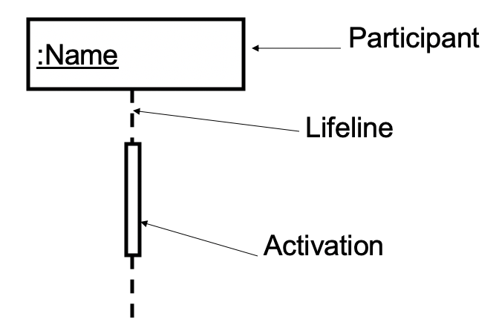
PARTICIPANT
A participant can be an object or an actor or the system itself
A lifeline illustrates what is happening to a participant in a chronological way
An activation zone (a.k.a, execution zone) denotes when a participant is sending or receiving a message

Slide 19
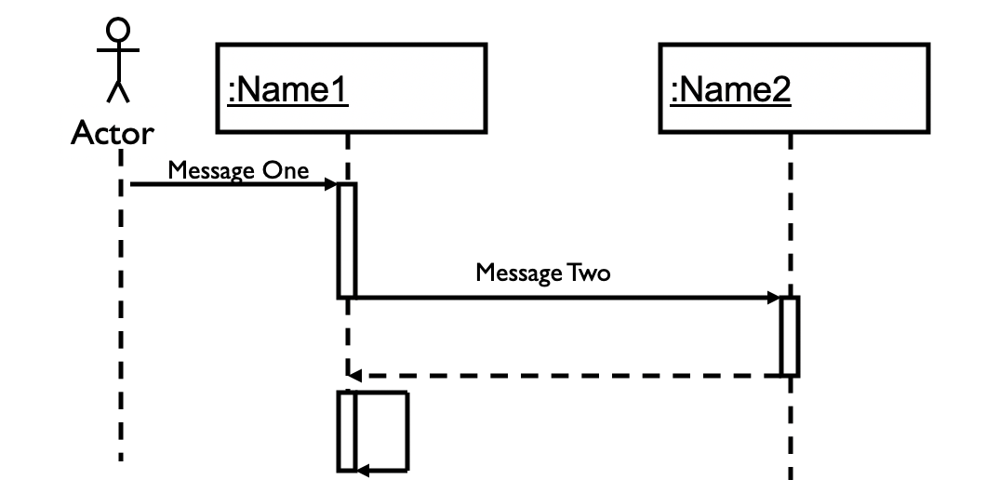
Time and MESSAGE
Messages are used to illustrate communication between different active participants

Slide 20





Types OF MESSAGES…
Synchronous messages
Create Message
Asynchronous messages
Destroy Message
Return Message
Flow interrupt until the message has completed
Don’t wait for response
A message that creates a participant
A message that destroys a participant
The return part of a synchronous message
Notes:
Synchronous (flow interrupt until the message has completed)
The sender waits for a response to a synchronous message before it continues. The diagram shows both the call and the return
Asynchronous (don’t wait for response)
A message that does not require a response before the sender continues. An asynchronous message shows only a call from the sender
Create Message - an instance creation message
A message that creates a participant. If a participant receives a create message, it should be the first it receives
Destroy Message - an instance creation message
A message that destroys a participant. Represents the point at which the object is deleted or no longer accessible. Appears at the bottom of every lifeline. X
Return – the return part of a synchronous message

Slide 21
How to create a SEQUENCE Diagram?
Set the SD context and purpose
Identify participants that interact in the use-case scenario :
actors and to-be system
Set the lifeline for each participant
Add messages by drawing arrows
Show how they are passed from an object to another
Include any parameters in parentheses
Validate the sequence diagram
Ensure that it depicts all the steps in the textual description of a use case
What are the main tasks performed by each actor?

Slide 22
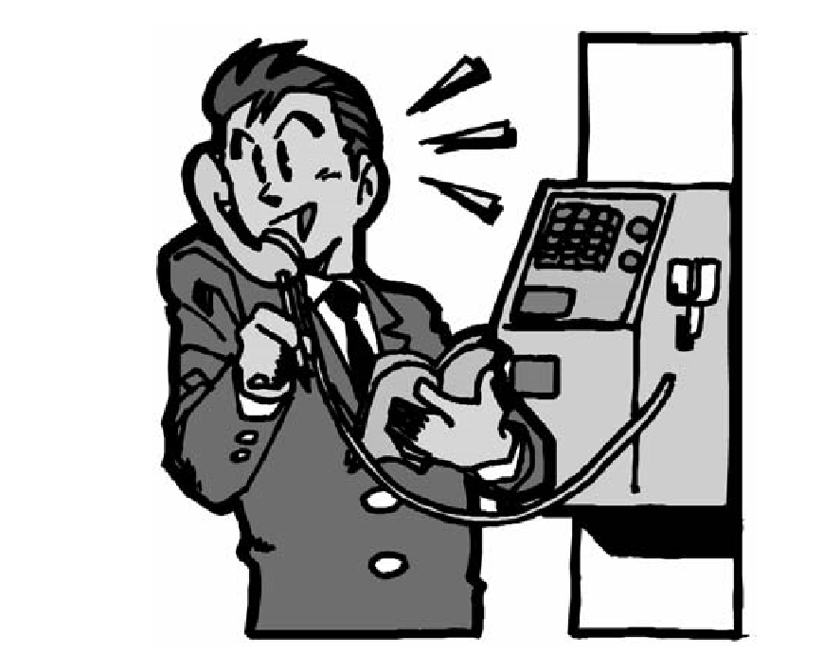
Case study
coin-operated pay phone

Slide 23
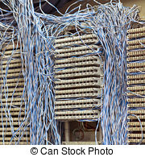
Case study…
Description
Questions
The minimum cost of a call is 20 pence
After inserting the coins, the user has 2 minutes to dial a number (this time limit is enforced by the switchboard)
The line may be free or engaged
The caller may hang up first
The pay phone uses up money as soon as the callee picks up the receiver and with each unit of time (UT) generated by the switchboard
The caller can add more coins at any time
After hanging up, any unused change is returned
Define the use case diagram of the coin-operated pay phone
Define the system sequence diagram of the main use case
Use StarUML CASE tool to draw system sequence diagram

Slide 24
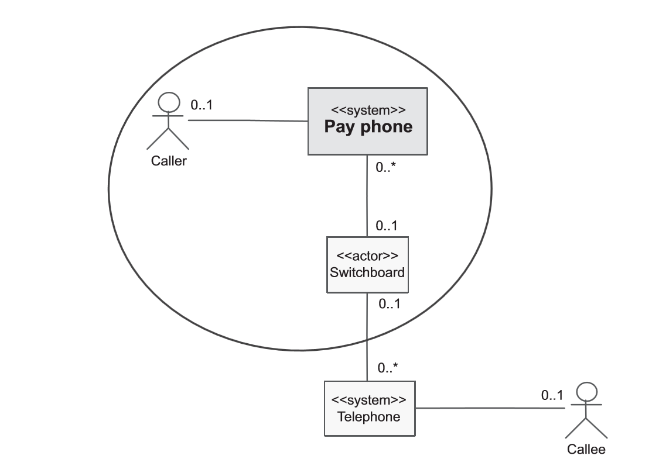
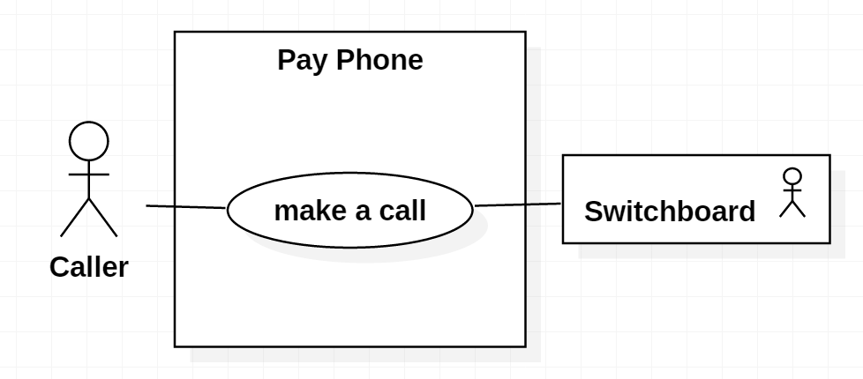
Use case diagram
List of actors
Use Case Diagram
Notes:
Consider only the direct actors in the definition of UCD

Slide 25
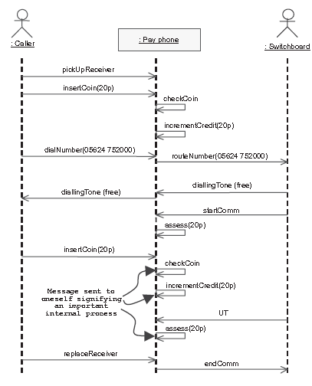
Sequence Diagram

Slide 26
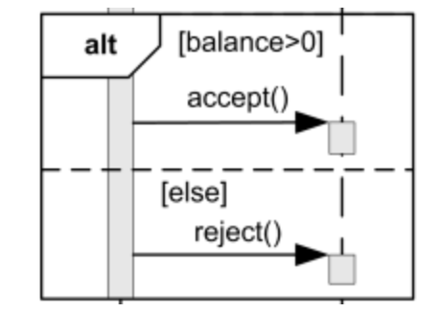
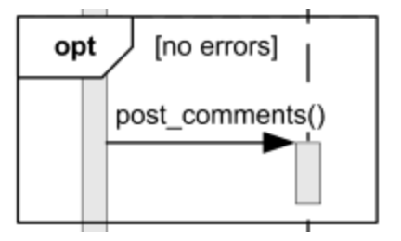
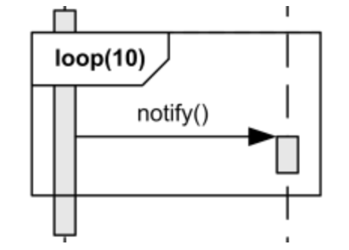
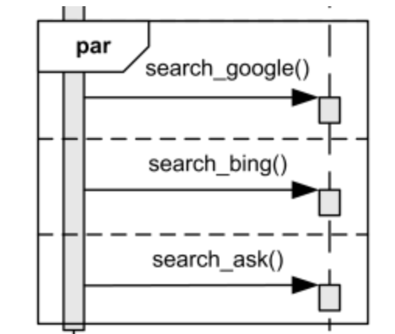
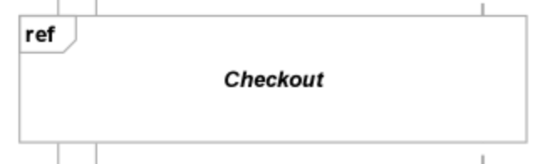
FRAGMENTS
ALTERNATIVE
OPTION
LOOP
PARALLEL
REFERENCE
Notes:
ALT: implements if ….then ….else…
OPT: implements if… then…
LOOP: implements for or while
REF: refers to another Sequence diagram

Slide 27
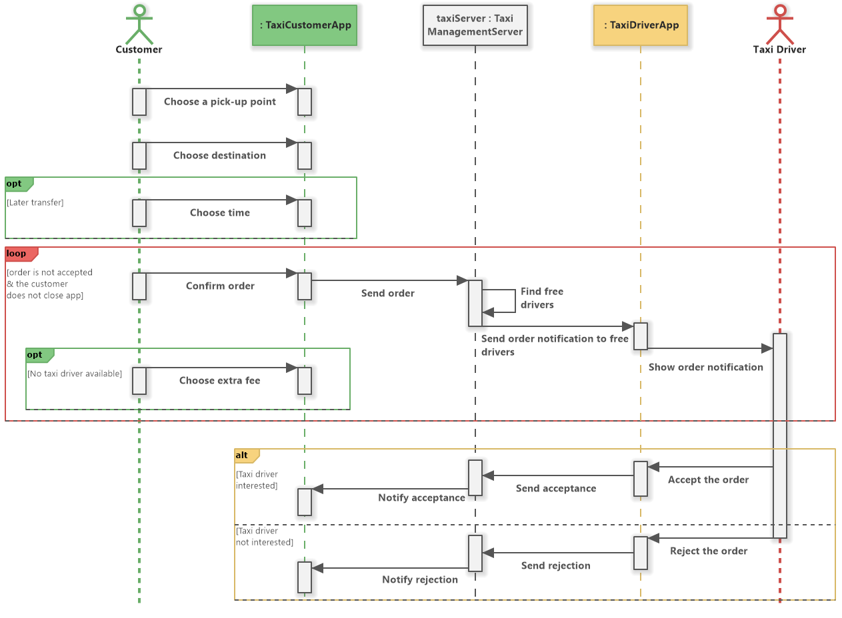
A SYSTEM SEQUENCE DIAGRAM USING FRAGMENTS…
Book a Taxi
Sequence Diagram

Slide 28
KEY TERMS
CORE PROCESS 3: SYSTEM ANALYSIS ACTIVITIES
SYSTEM SEQUENCE DIAGRAM
DESIGN SEQUENCE DIAGRAM
SYNCHRONOUS MESSAGE
ASYNCHRONOUS MESSAGE
CREATE MESSAGE
DESTROY MESSAGE
REPLY MESSAGE
OPT
ALT
LOOP
PAR
REF
PARTICIPANT

Slide 29

“Education is not the learning of the facts, but the training of the mind to think.” - Albert Einstein

