Slide 1
CIS2303-SysTEMS ANALYSIS and DESIGN
Chapter 8
Bridging from Analysis to Design ThROUGH A case study
CHAPTER 8 | All CLOs: Apply analysis and design techniques to a real-world mid-sized system following an agile development methodology

Slide 2
Document Revision CONTROL (DRC)
Version | Author | Effective Date | Change Description | DRC No
1.0 | Dr. Nourchene Benayed | June 19, 2020 | Define the first version | 001
X.Y
X: Major change
Y: minor change

Slide 3
Lecture OUTLINE
ANALYSIS MODEL
HIGH-LEVEL DESIGN MODEL
BUSINESS MODEL
CASE STUDY

Slide 4
LECTURE OBJECTIVES
At the end of lecture, the student should be able to:
Select an appropriateness system development methodology for a given real-world mid-sized system
Identify iterations/sprints from use cases/product backlog analysis
Create behavioral models to specify system requirements
Create structural models to specify system requirements
Create a high-level system architectural design model with layers and partitions

Slide 5

Case study
Training MANAGEMENT SYSTEM

Slide 6
Case study
Let's suppose that an organization wants to build an information system to automate the employees training process
The training process is initialized when the training manager receives a training request on behalf of an employee. This request is acknowledged by the person in charge who qualifies it and then forwards his or her agreement or disagreement to the person who is interested
In the case of agreement, the person in charge looks in the catalogue of registered courses for a training course, which corresponds to the request. He or she informs the employee of the course content and suggests a list of subsequent sessions to him or her. When the employee has reached a decision, the training manager enrolls the entrant in the session with the relevant training body
If something crops up, the employee must inform the training manager as soon as possible in order to cancel the enrolment or application
At the end of the employee’s training, he or she must submit an assessment to the training manager on the training course that he or she completed, as well as a document proving his or her attendance
The training manager then checks the invoice that the training body has sent him or her before forwarding it to the bookkeeper of purchases
TRANING MANAGEMENT SYSTEM

Slide 7
Case study
Read the case study and answer the following questions
Create a business model describing the training process using an activity diagram
Let’s suppose that the Unified Process (UP) is chosen to build the system,
Create an analysis model of the to-be system
Create a high-level architectural design model of the to-be system
TRANING MANAGEMENT SYSTEM

Slide 8
Case Study
CIS 4913
Business model
Step 1: Business Modeling
Implementation Model
Design Model
Analysis Model
Step 2: Defining system requirements using a UCD and a TD
Step 3: Defining system requirements using a SSD
Step 4: Defining system requirements using a DCD
Deployment Model
Step 5: Defining iterations
Step 6: Defining the system architecture
Step 7: Defining system operations (iteration by iteration
Step 8: Refining Interaction diagrams
Step 9: Design class diagrams
Step 10: Back to architecture
Step 11: Transition to OO code
Step 12: Use component and deployment diagrams
CIS 4923

Slide 9
Step 1: Business Model…
A good understanding of business processes is important for building the right systems
Business process: Training process
Actors:
Employee
Training manager
Training body
Bookkeeper of purchases
Describe the dynamics of the training process
Which diagrams can be chosen (activity or sequence diagrams)?
The training process is composed of a set of activities, which have already been organized and assigned to one of the actors identified previously. This sequence is represented perfectly using an activity diagram
Notes:
The Business process analysis will allow us to establish more easily the specifications of the IS that will support these processes

Slide 10
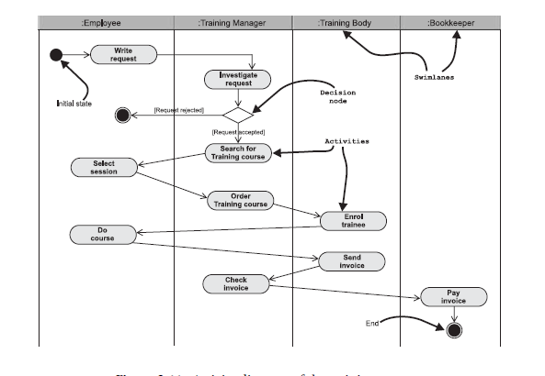
Step 1: Business ModeL
Describe the dynamics of the training process
Which diagrams can be chosen (activity or sequence diagrams)?
The training process is composed of a set of activities, which have already been organized and assigned to one of the actors identified previously. This sequence is represented perfectly using an activity diagram
Notes:
The resulting diagram is very interesting as it acts as a bridge between the three
modelling axes: functional (activities), dynamic (transitions) and static (object
flows and swimlanes)!

Slide 11
Analysis Model Step 2: Defining system requirements…
Notes:
Are we going to automate the whole business process or just a part?
One benefit of Business model is that it clearly shows what is outside the scope of the information system: we do not need to interview the bookkeeper or handle invoices

Slide 12
Analysis Model Step 2: Defining system requirements…
The system for managing training requests must therefore allow the following business activities to be automated:
Submit a training request (employee)
Treat a training request (training manager)
Maintain training catalogue (training manager)
Select a session (employee)
Furthermore, we must not forget that an employee is able to
Cancel a training request
Cancel an enrolment in a session

Slide 13
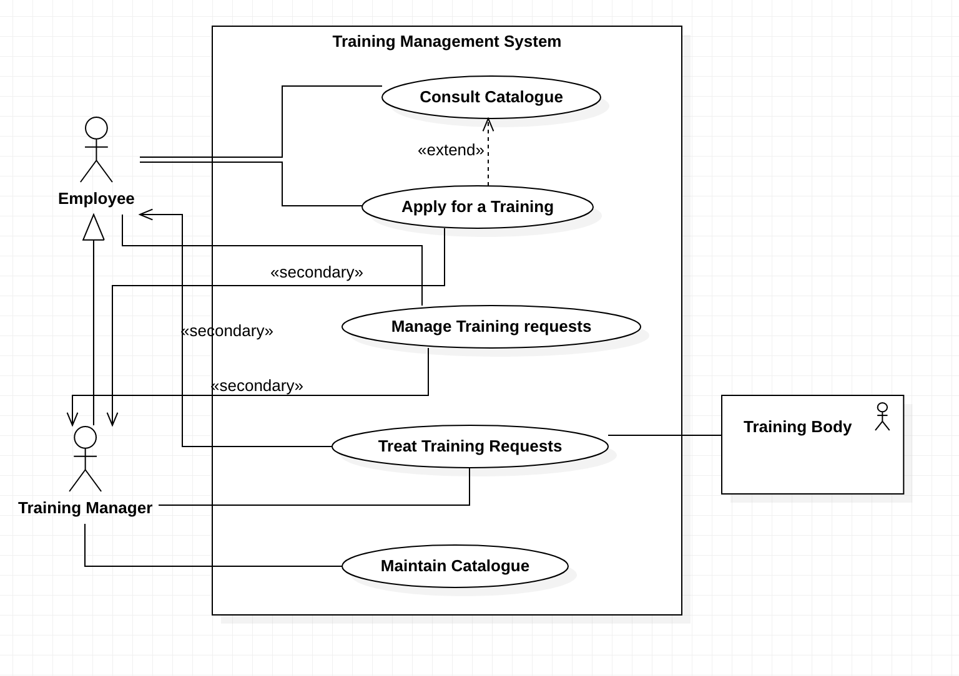
Analysis Model Step 2: Defining system requirements using a UCD…

Slide 14
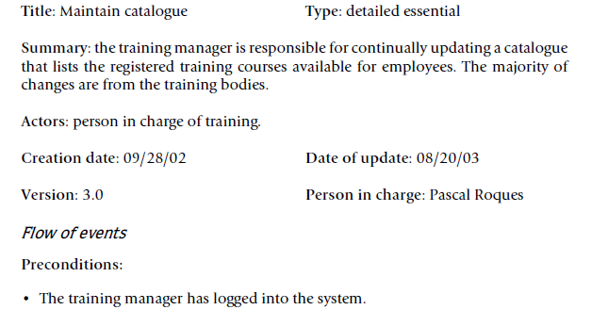
Analysis Model Step 2: Defining system requirements using a TD…

Slide 15
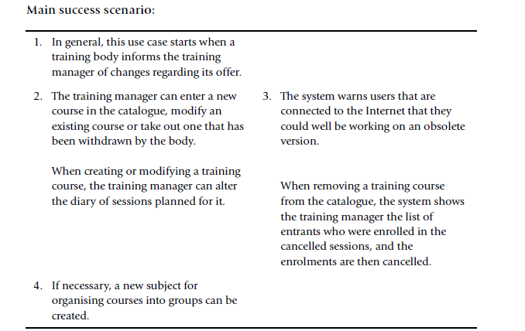
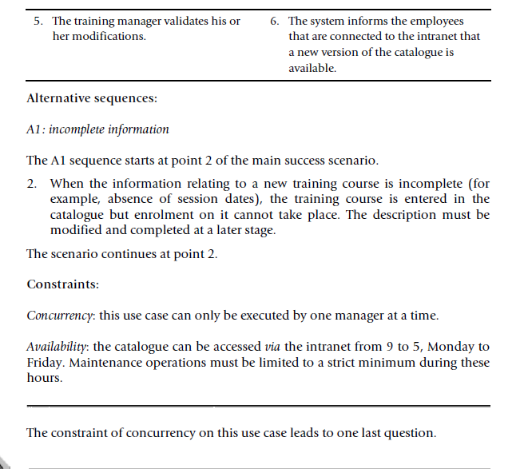
Analysis Model Step 2: Defining system requirements using a TD

Slide 16
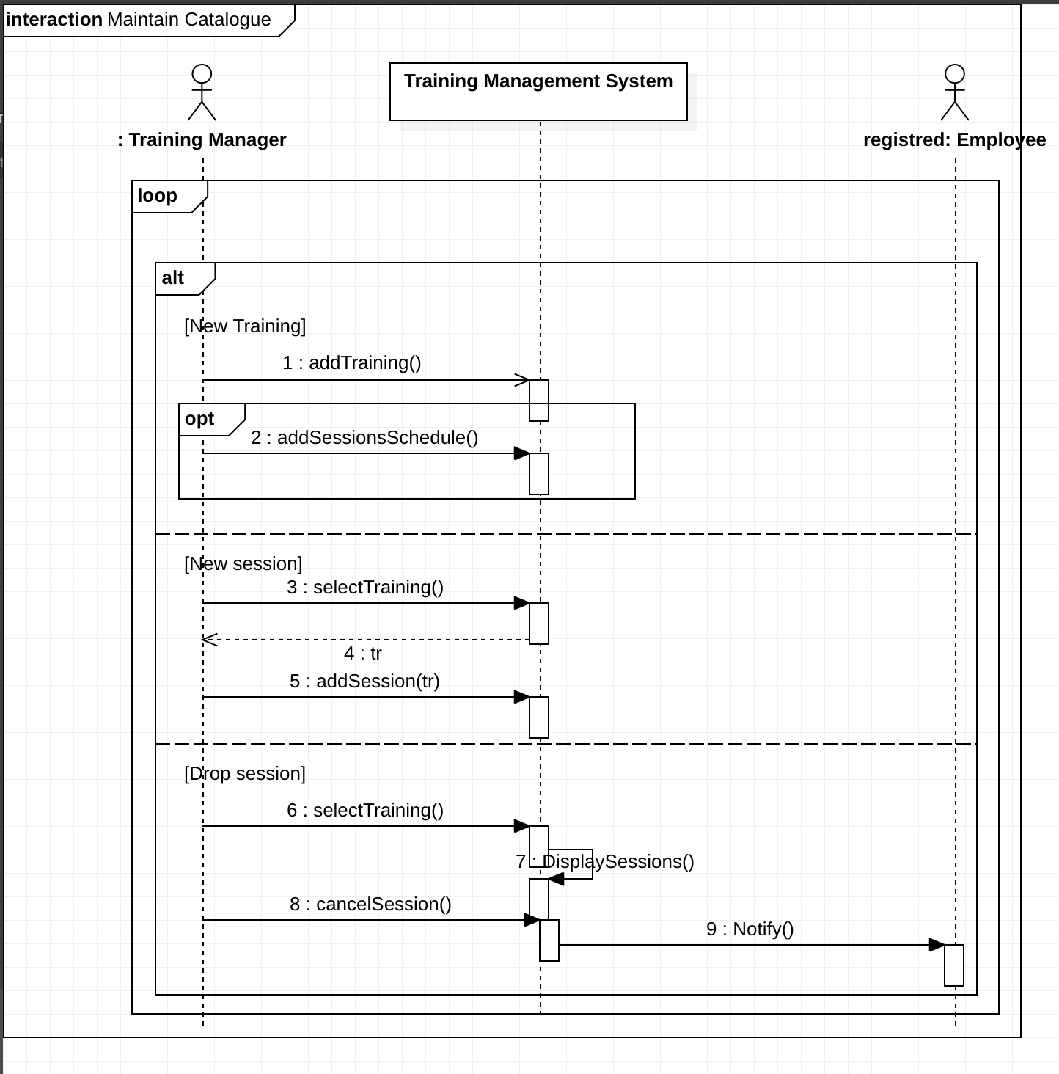
Analysis Model Step 3: Defining system requirements using a SSD

Slide 17
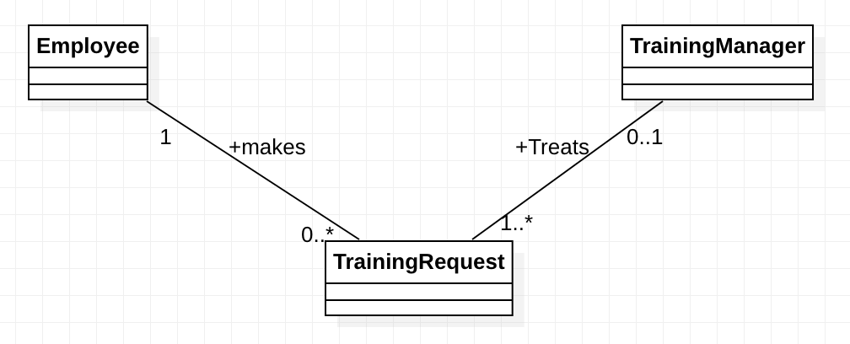
Analysis Model Step 4: Defining system requirements using a DCD…
The training process is initialized when the training manager receives a training request on behalf of an employee
Training process has already been identified in Step 1 as a business process: it will not appear on the class diagram
On the other hand, training manager and employee will feature on it, as they have been identified as business workers
Articles “a” or “the” can indicates “one and only one”. In this case, we obtain a multiplicity of 1 on an association

Slide 18
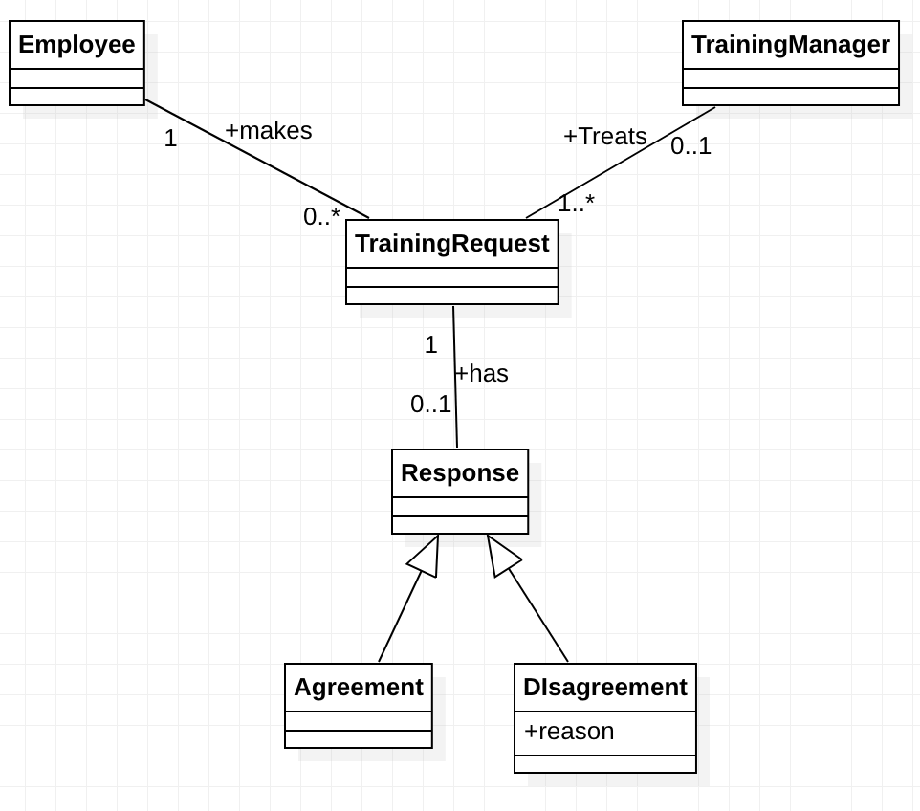

Analysis Model Step 4: Defining system requirements using a DCD…
This request is acknowledged by the person in charge, who qualifies it and then forwards his or her agreement or disagreement to the person who is interested
A simplistic analysis of nouns and noun phrases, we obtain the following entities
request, person in charge, agreement, disagreement, person who is interested

Slide 19
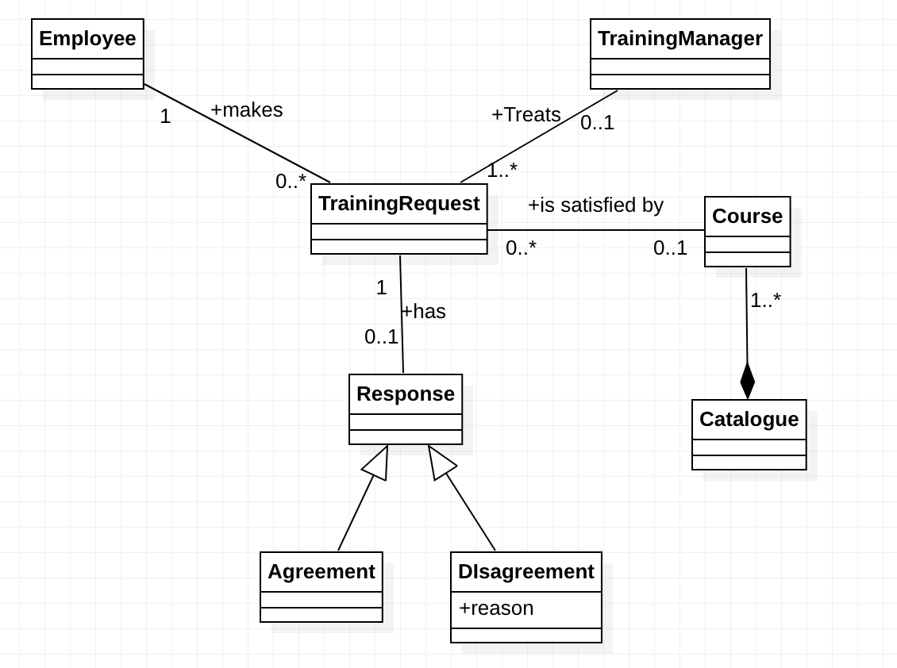

Analysis Model Step 4: Defining system requirements using a DCD…
In the case of agreement, the person in charge looks in the catalogue of registered courses for a training course corresponding to the application

Slide 20
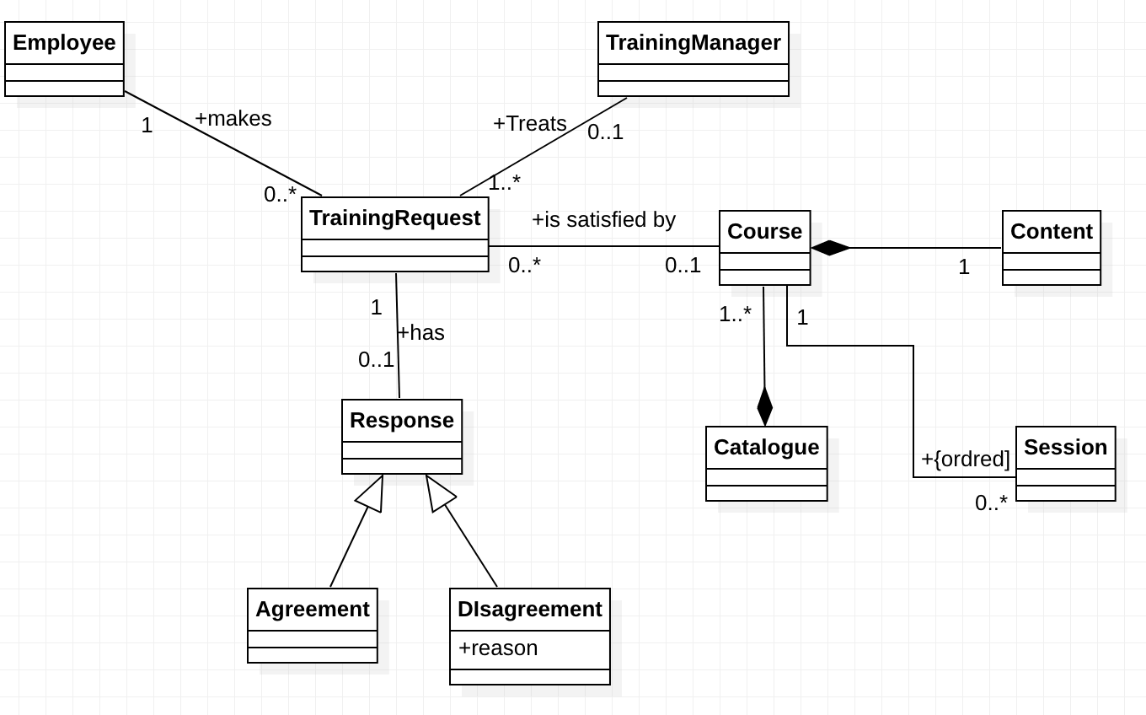

Analysis Model Step 4: Defining system requirements using a DCD…
He or she informs the employee of the course content and suggests a list of subsequent sessions to him or her

Slide 21
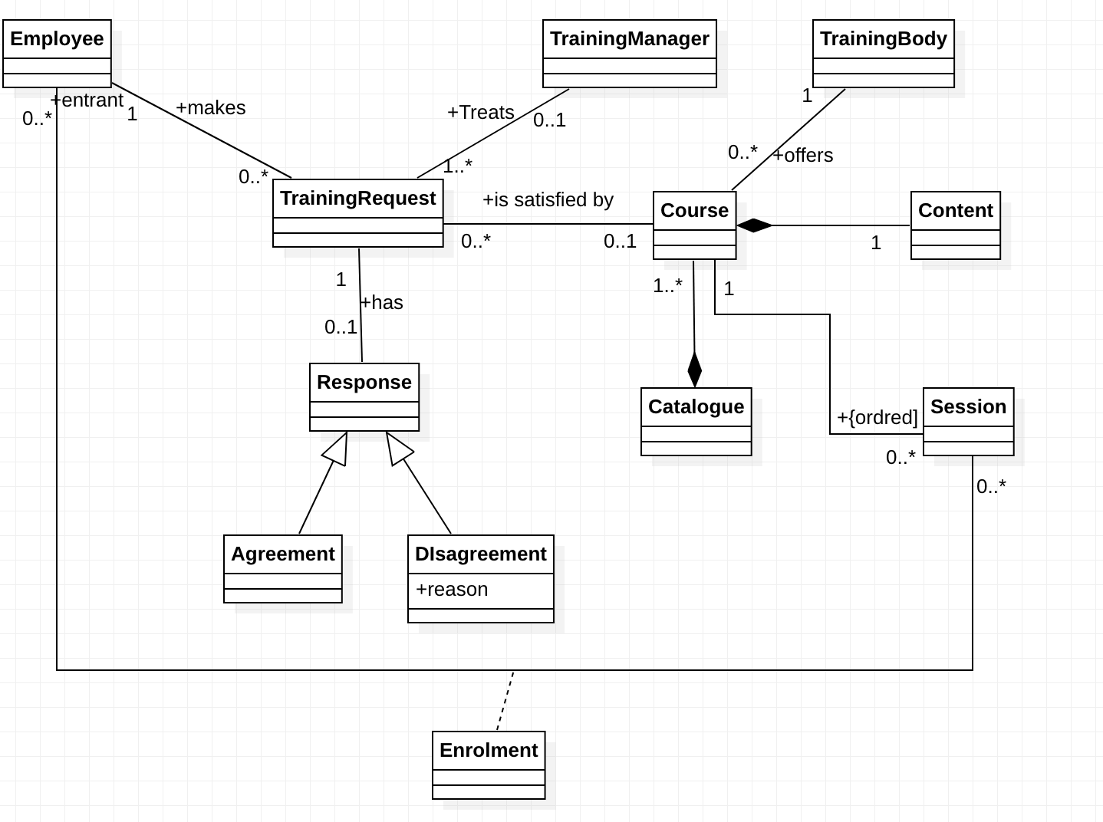


Analysis Model Step 4: Defining system requirements using a DCD…
When the employee sends back his or her choice, the training manager enrolls the entrant in the session with the relevant training body

Slide 22
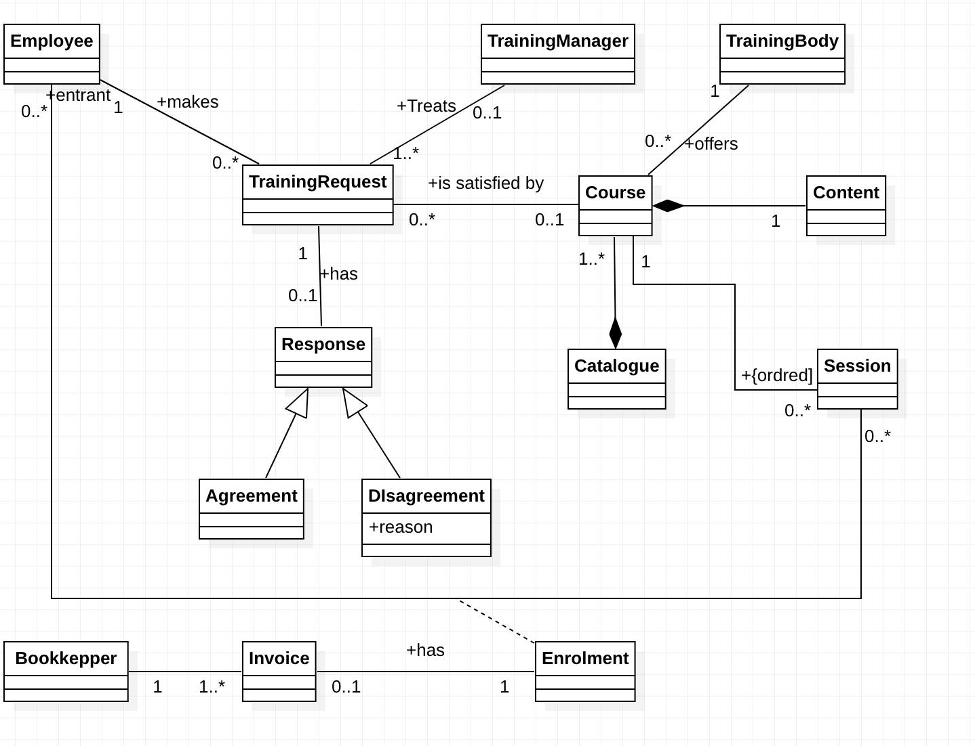

Analysis Model Step 4: Defining system requirements using a DCD…
The training manager subsequently checks the invoice that the training body has sent him or her before forwarding it to the bookkeeper of purchases

Slide 23



Analysis Model Step 4: Defining system requirements using a DCD
Notes:
BLUE: catalogue management package
Red: training request management package
Green: bookkeeping

Slide 24
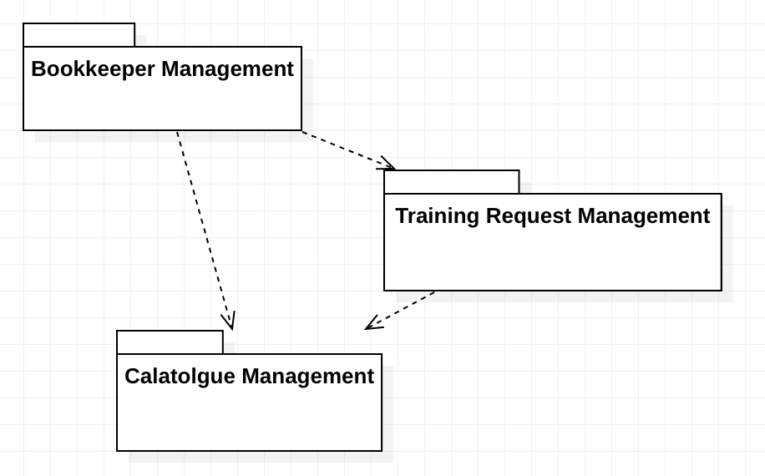
Analysis Model Step 4: Defining system requirements using a DCD…
Rules
No mutual dependencies
No circular dependencies
These rules imply a constraint on the navigability of the assocations

Slide 25
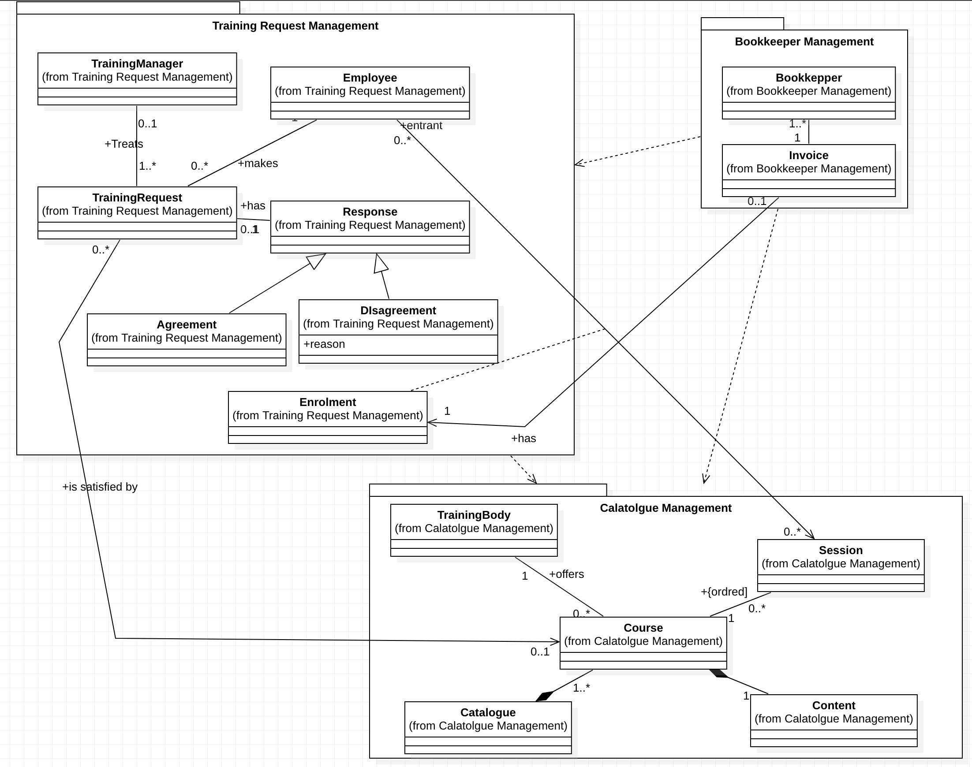
Analysis Model Step 4: Defining system requirements using a DCD

Slide 26
Analysis Model

Slide 27
How to define A HIGH-LEVEL design model?
Step 5: Defining iterations
Apply the Unified Process (UP) design phase
Define iterations from use case and package diagrams
Step 6: Defining the system architecture
Choose an architectural style (MVC, 3 tiers,…)

Slide 28
High-LEVEL DESIGN Model Step 5: Defining ITerATIONs
Looking at the dependencies among the use case packages:
Iteration 1: Course Catalogue management
Iteration 2: Training requests
Iteration 3: Book keeping
3
2
1

Slide 29
High-Level DESIGN Model Step 5: Defining Iterations and INCREMENTS
1.a
2.a
2.b
3
1.b
Notes:
Iteration1 has 2 increments
Iteration 2 has 2 increments
Iteration3 has one increment

Slide 30
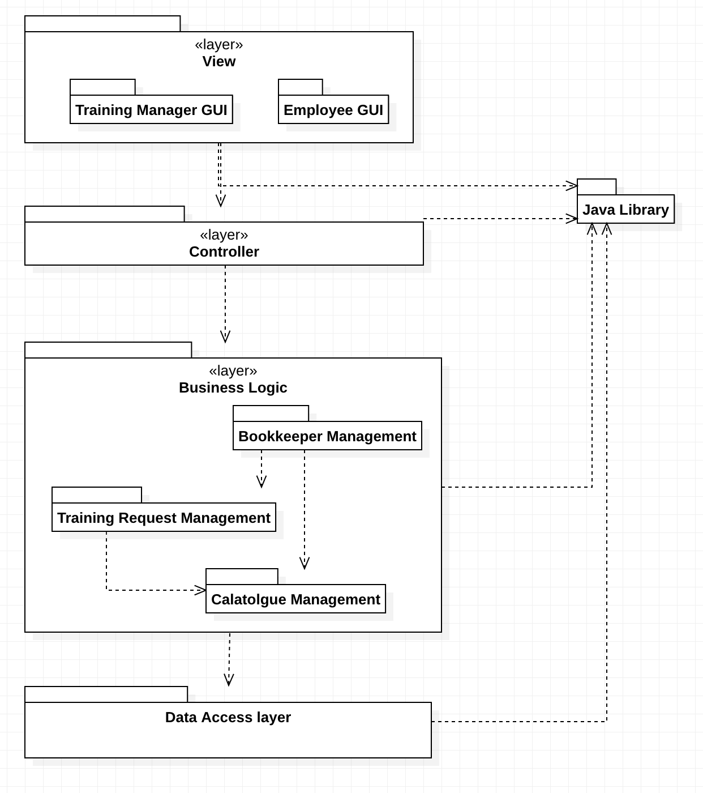
High-Level DESIGN Model Step 6: DEFINING A high-level software architectural design model according to MULTILAYERED pattern

Slide 31
KEY TERMS
HIGH-LEVEL ARCHITECTURAL DESIGN MODEL
MULTILAYERED PATTERN
UP
ANALYSIS MODEL
BUSINESS MODEL
USE CASE DIAGRAM SYSTEM SEQUENCE DIAGRAM DOMAIN CLASS DIAGRAM
ITERATIONS & INCREMENTS
SOFTWARE ARCHITECTURE

Slide 32

“Education is not the learning of the facts, but the training of the mind to think.” - Albert Einstein

