Slide 1
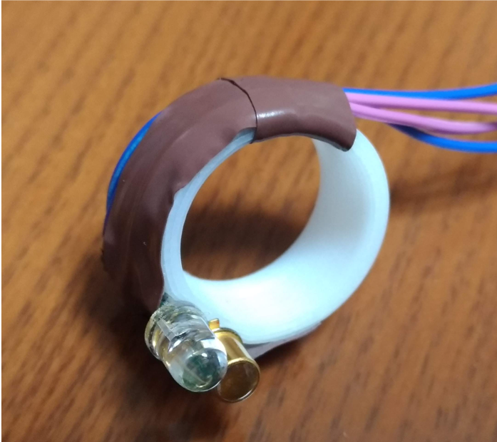
LED
Phototransistor

