Slide 1
BICS 2304 | Computer Architecture & Assembly Language | Section 04
JUPITER
Wearable Heat Stroke &
Dehydration Prevention System
Adam Fawwaz Bin Sazalizam (2416969) Ahmad Fawwaz Bin Abdul Kadir (2418497) Wan Abdullah Mikhaiel Bin Wan Shamsuddin (2416229) Alfyan Shawn Bin Jasni Shirlin (2417841)
Lecturer: Yasir Mehmood

Slide 2
System Overview
What is Jupiter?
3+
4
A simulated wearable IoT device designed for outdoor workers and athletes in tropical climates like Malaysia.
The system continuously monitors physiological data and environmental conditions, triggering alerts before a heat stroke or dehydration event occurs.
Sensors monitored
per cycle
Actuator responses
simulated
4
5
Priority levels
in decision engine
Test cases
all passing
Implementation
Simulated in MIPS Assembly Language using MARS IDE.
Sensor inputs entered via console each monitoring cycle.
Actuator responses printed as console output.

Slide 3
Hardware Components
SENSORS
ACTUATORS
MAX30205
A1
Haptic Vibration Motor
Body Temperature Sensor
Physical alert — brief pulse or continuous
0–50°C, ±0.1°C accuracy
MAX30102
A2
Hydration Reminder LED
Pulse Rate / Heart Rate
Blinks when drink water trigger fires
30–250 BPM, I2C interface
MPU6050
A3
Cooling Vest Fan
Accelerometer & Gyroscope
Activates on heat stress condition
Fall detection via G-Force spike
Timer S4
A4
GPS Broadcast (SIM800L)
Sustained Motion Timer
SOS signal on fall/critical detection
Tracks active minutes (software)

Slide 4
Priority Decision Logic
Conditions evaluated in order — highest priority first. First match wins.
P1 — Fall Detection
Condition: Accel > 100G AND Motion Timer = 0
Output: [Status: CRITICAL] → GPS SOS transmitted, program exits with code 10
P2 — Heat Stress Index
Condition: Heart Rate > 130 BPM AND Body Temp > 38°C
Output: [Status: Take a break] → Haptic motor continuous + Cooling fan active
P3 — Hydration Reminder
Condition: Motion Timer ≥ 15 minutes
Output: [Drink Water] → LED blinking + Haptic brief pulse + Timer reset to 0
P4 — Safe (default)
Condition: None of the above conditions are met
Output: [Status: Safe] → All actuators OFF

Slide 5
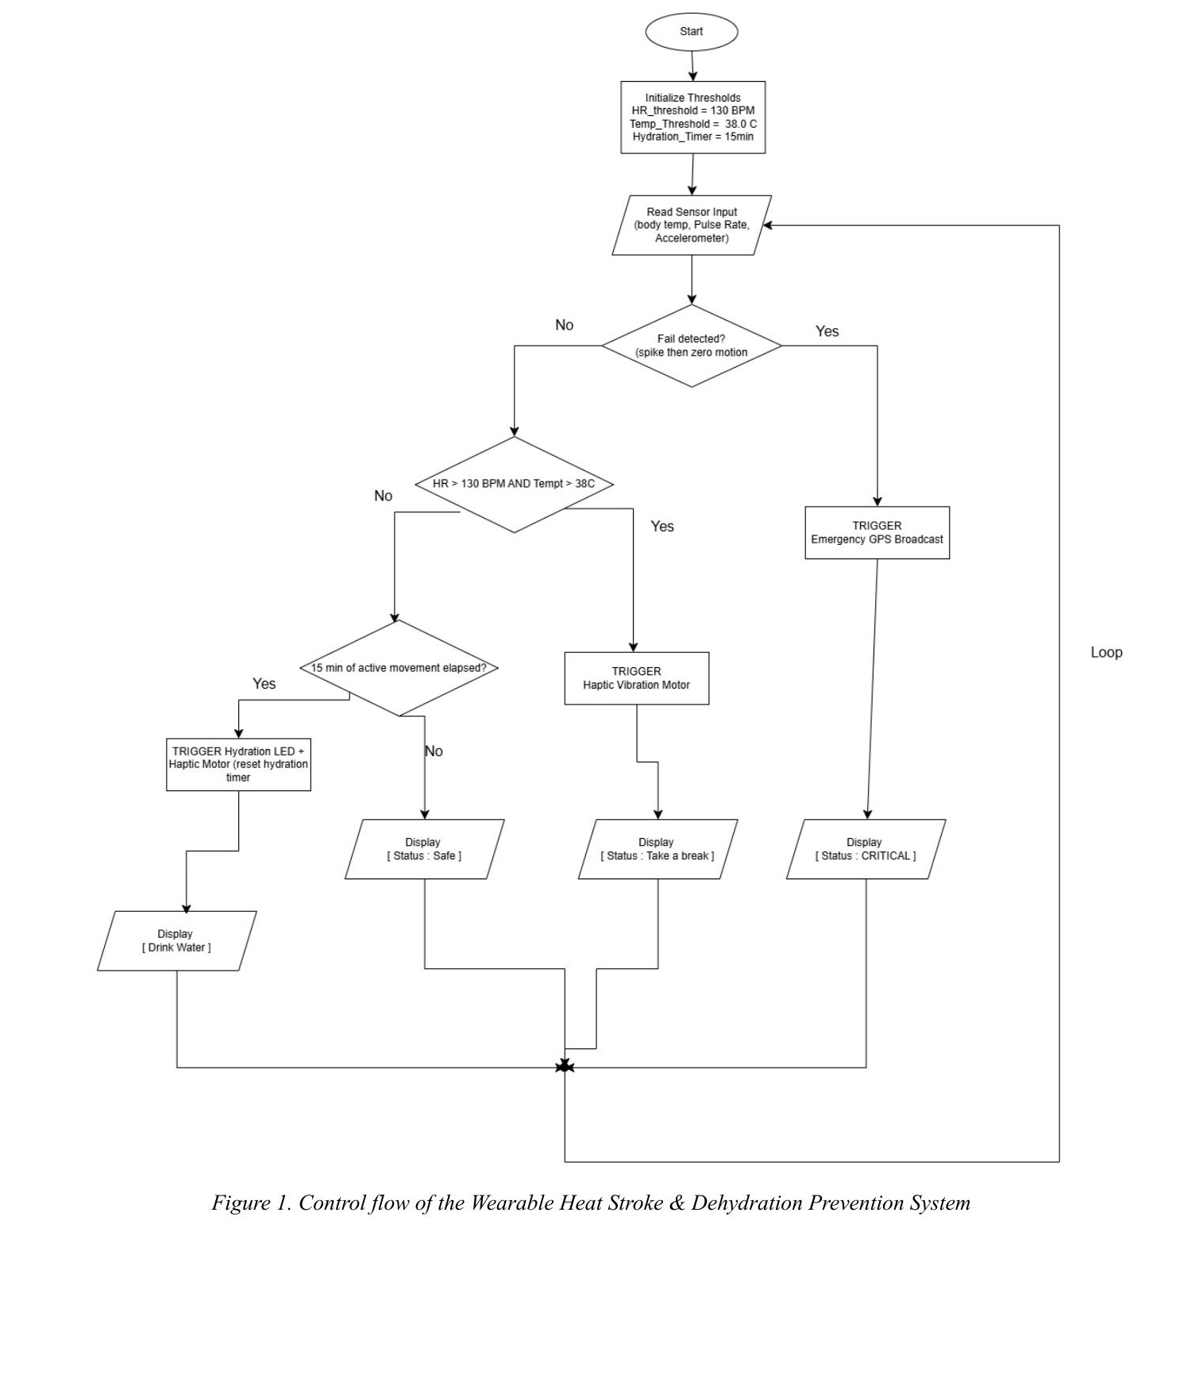
System Flowchart

Slide 6
Input Validation & Error Handling
How It Works
Console Output (TC-05)
Only body temperature is validated (physiological bound).
Valid range: 0 to 50°C.
Any value outside this range triggers an error message and re-prompts the user.
The program loops internally until a valid value is entered — it never crashes or skips.
[SENSOR S1] Enter Body Temperature (0-50 C): 120 [ERROR]: Out of human physiological bounds! Enter 0 to 50. [SENSOR S1] Enter Body Temperature (0-50 C): 37 [SENSOR S2] Enter Heart Rate (BPM): ...

Slide 7
Test Case Results
Test Case
Inputs
Expected Output
✓
TC-01
Temp=36, HR=80, Accel=15, Timer=2
[Status: Safe] — All actuators OFF
PASS
Normal Safe
TC-02
Temp=39, HR=140, Accel=10, Timer=4
[Status: Take a break] — Haptic + Fan active
PASS
Heat Stress
TC-03
Temp=37, HR=85, Accel=12, Timer=15
[Drink Water] — LED blink + Haptic + Timer reset
PASS
Hydration Alert
TC-04
Temp=36, HR=75, Accel=110, Timer=0
[Status: CRITICAL] — GPS SOS + exit code 10
PASS
Fall / Critical
TC-05
Temp=120 (invalid) → retry with 37
[ERROR] message + re-prompt, then normal flow
PASS
Input Validation

Slide 8
Work Distribution
Adam Fawwaz Bin Sazalizam
Ahmad Fawwaz Bin Abdul Kadir
2416969 | Group Leader
2418497
Project coordination · Flowchart design · Body Temperature sensor module · Final integration
Use case diagram · Pulse Rate sensor module · Heat Stress Index decision logic · Unit testing
Wan Abdullah Mikhaiel Bin Wan Shamsuddin
Alfyan Shawn Bin Jasni Shirlin
2416229
2417841
Hardware mapping table · Accelerometer sensor module · Fall detection logic · Decision & control testing
Display & status output module · Actuator subroutines (Haptic, LED, GPS) · Error handling · Code review

Slide 9
Conclusion
✓
3 sensors + 4 actuators — all project requirements met
✓
Priority decision engine with 4 conditions — P1 (critical) through P4 (safe)
✓
Input validation with error handling and recovery loop
✓
Modular code — 9 procedures/subroutines with clear register convention
✓
All 5 test cases pass as documented in the test cases submission
Thank You

