Slide 1
Front-end development and design
Fawzi Nastas

Slide 2
Social messaging application
Introduction
Literature Review
Methodology
Project Implementation
Testing and Evaluation
Conclusion and Future Work

Slide 3
INTRODUCTION
The advent of social messaging applications has been a revolution in the way individuals communicate in the age of digital globalization.
These platforms have had a transformative effect on personal communication and the dynamics of social interaction and digital connectivity.

Slide 4
Research GOALS
This thesis focuses on the front-end development of an Android-based social messaging application, drawing inspiration from the globally acclaimed WhatsApp.
The aim of this research is to explore and apply sophisticated front-end methodologies and functionalities to set a new standard in user experience and performance for mobile applications.

Slide 5
Can the front end of an android application be created by a development team with minimal experience? How are android mobile applications developed and tested? Can the design practices be optimal and efficient and lead to a clear and functional UI/UX?
Research Questions

Slide 6
Scope
The scope consisted of designing and implementing the application user interface (UI) and user experience (UX) using the latest Android development tools and methodologies
Feature Implementation
Describing the development of core social messaging application functionality, including chat interfaces, multimedia message exchange and user status updates
Performance
Optimization
Ensuring smooth operation and responsive app performance across a range of Android devices, addressing challenges like screen size diversity and app functionality
UI/UX design
Involving the creation of an intuitive and attractive interface that improves user engagement and facilitates navigation within the application

Slide 7
Limitations
The research does not go in-depth in back-end development aspects, such as server-side operations, database management, and network security.
Back-End Development
iOS Compatibility
The focus is specifically on Android; thus, full, and extensive cross-platform compatibility with other operating systems like iOS is not within the scope.
Limited User Testing
Given the project scale and resources, user testing may be limited in scope, affecting the diversity and depth of user feedback.
Resource Constraints
As a solo project, there are inherent limitations in terms of manpower and time, which might impact the extent of feature implementation and testing.

Slide 8
Significance of the study
Intuitive UI/UX Design
By focusing on simple but targeted UI/UX design principles, this project contributes new insights into creating user-centric interfaces that can enhance user engagement and satisfaction.
Application of Modern Android Development Tools
The project provides a practical application of up-to-date Android development tools and frameworks, serving as a valuable reference for developers in this field.
Solo Development Insights
Documenting the process of developing a complex application as a solo developer offers unique perspectives on project management, time allocation, and problem-solving strategies in mobile app development.

Slide 9
Literature review

Slide 10
Historical context
The evolution of social messaging applications has been a remarkable one, marking a major shift in the digital communication landscape.
The earliest forms of online communication can be traced back to the 1960s with the advent of email, which evolved into Internet Relay Chat (IRC), born in 1988 in Finland.
Fast forward, the launch of smartphones and the subsequent explosion of mobile app development marked a significant turning point. The emergence of applications such as WhatsApp, Telegram and WeChat truly revolutionised the messaging landscape.

Slide 11
Market analysis
As a result of subsequent improvements, the launch of smartphones, and the subsequent explosion of mobile app development, social messaging apps became more and more commonplace in the world of digital communication. WhatsApp, has over 2 billion active users globally.
The main reason for this is because WhatsApp/Viber/WeChat have UI/UX designs that prioritize simplicity, intuitiveness, and ease of navigation. The interfaces are clean and uncluttered, and the design is responsive, enhancing user engagement. Accessibility features are also considered, ensuring that the application is usable by a wide range of users, including those with disabilities.

Slide 12
Front-end development
Since its inception, Android has undergone significant changes and each new version has brought new features, design elements and development capabilities.
The aesthetics and usability of Android applications have been greatly influenced by Google's Material Design guidelines. These guidelines provide a comprehensive framework for designing intuitive, scalable, and aesthetically appealing user interfaces.

Slide 13
Front-end development: key principles
Key UX Principles for Messaging Apps
A focus on simplicity and intuitiveness
Consistency in design elements
Swift responsiveness and speed
Case Studies on Front-End Development
WhatsApp
Praised for its minimalist design
Focuses on core functionalities and refines them
Massive user base

Slide 14
Development trends and benefits
Future Trends in Messaging Apps
Integration of augmented reality and virtual reality
Improved accessibility through AI-driven AR
Real-time sign language interpretation
Benefits of future AI Integration into messaging
Personalization of interfaces and platform content
Enhanced retail and marketing experiences
Recognition and response to user emotions

Slide 15
The future of messaging apps
Changes in User Behavior
Social media user base increasing exponentially
Social media being shaped by emerging technologies
AI tools being used for content creation and user engagement
Messaging Apps as Future Platforms
Evolving beyond communication tools
Personalized and immersive experiences are being offered that are shaped by AI and VR technologies

Slide 16
Methodology

Slide 17
Methodology
Tools and Languages
React Native: React Native is a JavaScript-based framework for developing native apps. It was chosen partly for its efficiency in creating user-friendly menus and interfaces. The component-based architecture of React Native allowed for the creation of dynamic and responsive user interfaces.
JavaScript: The primary programming language used in the project. JavaScript's compatibility with React Native allowed for seamless development of the app's functionality and created a streamlined process.
Expo Go App: Open-source sandbox for experimenting with React Native on Android.
Android Studio: The emulator was used for testing and debugging the app. It was particularly useful for allowing the emulation of Android devices to test the app's performance and user experience.

Slide 18
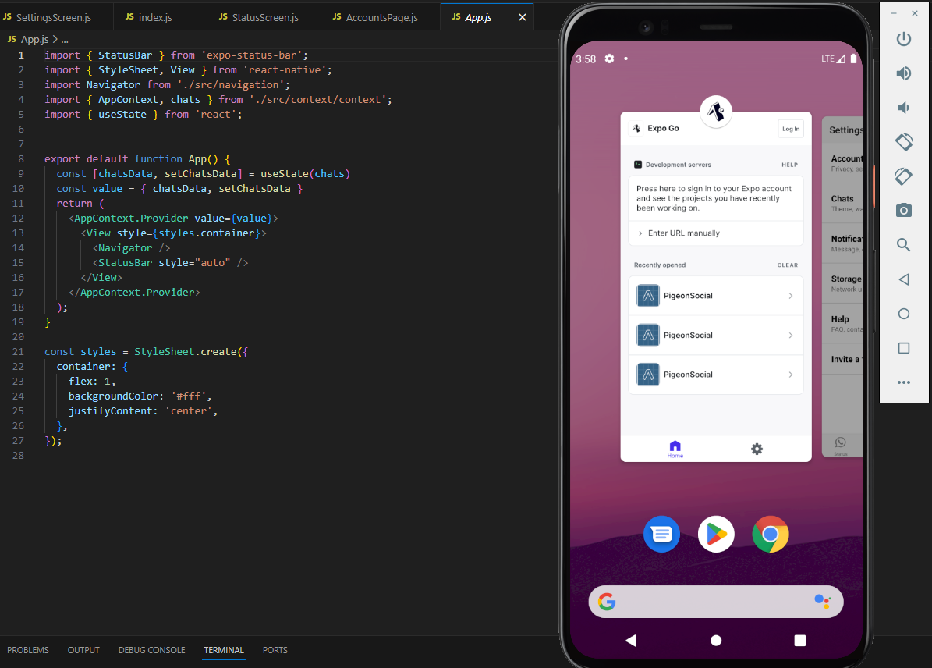
Methodology
Integration of Tools
Development Environment
React Native for Front-end Development
Android Studio for Device Emulation
Integration of React Native and Android Studio
Benefits of Integration
Efficient JavaScript Coding
Immediate Testing in Android Studio Emulator

Slide 19
Methodology
Design Process
Phases of Development
Requirement Analysis:
Identify the Core Functionalities (Text Messaging, Multimedia Sharing, Integrated Calling)
Prototype Design:
Developed the Basic Prototype Based on Requirements
A Visual and Interactive Representation of Design and Functionality
User Feedback:
Presented the Prototype to a Focus Group (5 People)
Feedback was mostly centered on Design Appeal and Usability
Iterative Refinement:
The prototype was iterated based on the Feedback
Refined the Design, Adjusted Features, Improved Overall UX
Final Implementation:
Translated the Refined Prototype into a Fully Functional App
Ensured the App is Ready for Deployment
Design Process:
Comprehensive and User-Centric
Phases were iterative in nature
A keen focus on functional requirements and user experience
Iterative Process:
Continuous Refinements Based on Feedback
Flexibility to Address User Needs
High Degree of Polish and User-Centricity

Slide 20
Methodology
User Experience and Interface Design
UX/UI Principles:
Clarity and Efficiency
User-Centeredness and Aesthetic Simplicity
Challenges and Solutions
Challenge: Integrating Diverse Features
Solution:
Modular Design Approach
Challenge: Cross-Platform Compatibility
Solution:
Emulation on hardware and software, Galaxy Tablet and Android Studio
Design Approach
Combination of Agile and Lean UX Methodologies
Emphasis on Rapid Prototyping, Iterative Design, and Continuous Feedback
Grounded in Minimalism and User-Centered Design

Slide 21
Methodology
User Testing and Feedback
Initial testing with small group
Prototypes for gathering feedback
Continuous user testing for alignment with user needs
Played a pivotal role in finalizing a functional, user-friendly, and visually engaging design

Slide 22
Pre-implementation

Slide 23
React Native architecture
Three Major Pillars
The JavaScript Thread
This is where all the JavaScript code is placed and compiled.
When the application is bundled for production, the JavaScript core executes the bundle when the user launches the application.
The Native Thread
This component executes the native code and manages the user interface.
It ensures smooth communication with the JS thread for UI updates, running native functions, and more.
The Shadow Thread
This section of the application calculates the layout.
The cross-platform framework utilizes Facebook's layout engine, Yoga, to transform and calculate flexbox layouts before sending them to the app's interface.

Slide 24
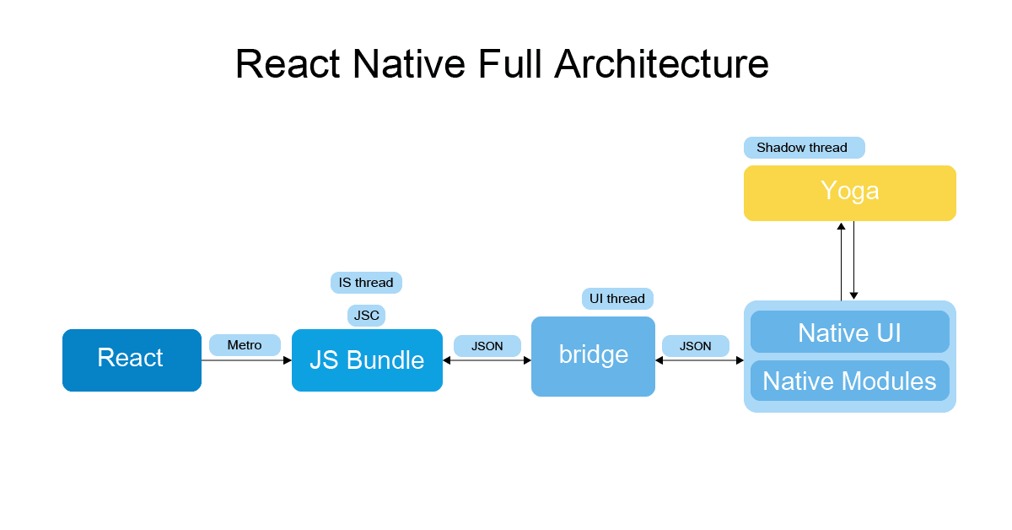
React Native architecture
Three Major Pillars

Slide 25
Project implementation

Slide 26
initialization
Prerequisites:
Environment Setup:
Project Initialization Steps:
Downloaded Correct Software and Framework
Obtained Asset Files
Prepared Development Environment
Installed NodeJS and NPM Package Manager
Installed React Native CLI
Installed Android Studio and SDK for Emulation
Downloaded and Installed Visual Studio Code
Created Project Directory
Entered 'npx create-expo-app ChatApp'
Automatically Downloaded and Extracted React Native Project Files
Installed JavaScript Dependencies with NPM
Result:
Metro Bundler Starts
Project is ready for development!

Slide 27

Chatlist item component
File Creation
New File: index.js
Location: src/components/ChatListItem/index.js
Component Definition
The initial component is defined to begin the task
Integration with App.js
Chatlist item is imported into App.js
Thus, rendered on the screen
Main Container
Avatar Image
Content Container
Component Structure
Row with Username and Time
Text with Last Message
Time Formatting
Dev team faced Initial Issues with Time Display (00:00:00)
Implemented the dayJS Library along with RelativeTime plugin
Result: Display of Time in '2 months’ format

Slide 28
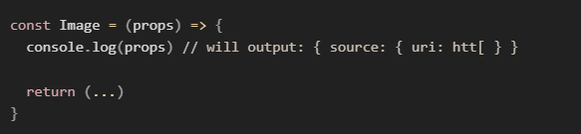
Working with props
Effective Use of Props
Props are utilized for a dynamic and interactive chatlist item component
Dynamic Rendering
The image component is rendered dynamically
The Prop determines the image to display
Chat Object Passed as Prop
Contains:
Props from Parent Component
User's Name
User's Image
Last Message in the Chat
User’s name: ‘chat.user.name’
User’s image: ‘chat.user.image’
Last Message: ‘chat.lastMessage.text’
Timestamp: ‘chat.lastMessage.createdAt’
Accessing Chat Object Properties
UI Elements Populated using Properties
Enhanced Reusability
Props facilitate component adaptability
Versatile construction for different chat data

Slide 29
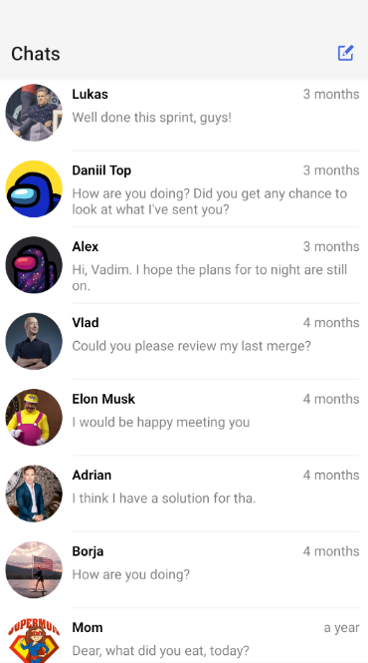
Chats list screen
File Creation
New file ‘ChatsScreen.js’ is created
Data Import
The chats are imported from our assets folder
Rendering with FlatList
A FlatList is utilized to render each chat as a ChatListItem
Date Display
The DayJS library is implemented for the correct time format
The RelativeTime Plugin is used to grab the time ‘from now’
Display the dates in a human-readable format

Slide 30
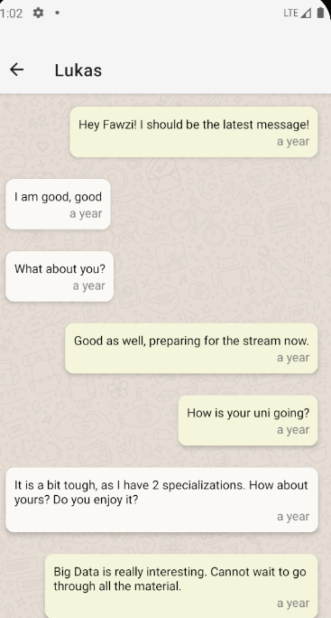
Chat screen
File Creation
New file ‘ChatScreen.js’ is created
Screen definition for sending/receiving messages
Navigation Implementation
Import the new Chat Screen into ‘App.js’
Replace rendered screen for viewing
Background Image
Import background image from assets
Add to Chat Screen
Message Component Rendering
Imported the message component
Rendered a FlatList of messages
Message Sending (Current State)
Currently, messages are hard-coded for testing purposes and the actual message handling will be added later
Displays 'Message Sent’ confirmation message just to check

Slide 31

Input box part 1
Creating the input box
Elements
Styling
Handling Keyboard Overlapping
‘KeyboardAvoidingView’
The elements that are imported to design the input box include:
Plus Icon (+) from AntDesign (vector-icons)
Text Input (React Native)
Send Icon from MaterialIcons (vector-icons)
StyleSheet used to achieve the modern messaging app look and feel
Wrapped the ChatScreen inside the ‘Keyboard Avoiding View’ for better visibility

Slide 32
Input box part 2
How can we manage user input?
User Input is managed using React Native State:
Multiline text input is enabled to allow users to enter multiple lines of text comfortably.
An OnPress event is attached to the send button, specifying that the onSend function should be executed when the send button is pressed.
React Native's State, a dynamic internal component, is utilized to store the value of user input.
The State variable acts as the bridge between the input and UI, ensuring that any changes in the user input are immediately reflected in the component's re-rendering.
This real-time update mechanism enhances user interaction by maintaining synchronization between the UI and the user's input, providing a responsive experience.

Slide 33
Navigation Implementation: part 1
Dependency Installation and Navigation Component Setup:
Created a new file for navigation logic, wrapping all screens inside the NavigationContainer component.
Stack Navigator Implementation:
Imported the Stack Navigator helper function.
Defined screens and wrapped them inside Stack.Navigator for screen navigation.
Set up OnPress functions to navigate back to the previous screen.

Slide 34

Navigation Implementation: part 2
3. Main Tab Navigator Creation:
Created a new file for the Main Tab Navigator and imported the ‘createBottomTabNavigator’ helper function.
Defined the screens using ‘Tab.Screen’ and wrapped them inside ‘Tab.Navigator’ for tab navigation.
4. Integration and Customization of Main Tab Navigator:
Imported the Main Tab Navigator into the navigation logic file (index.js) and rendered it as the first screen on the stack.
Customized the Main Tab Navigator by setting up icons for each tab and adjusting the tab bar's background color, font, and font size.

Slide 35
Contacts screen
Dependencies and State Management:
Necessary dependencies are imported for state management and accessing device contacts, leveraging Expo's "Contacts" library.
React Hooks such as 'useState' and 'useEffect’ are utilized for managing state variables related to contacts data, loading status, and accessing the 'AppContext’.
3. Contact Selection and Chat Integration:
A pressable component is used for contact items in the 'FlatList' to enable contact selection.
When a contact is pressed, the selected contact is added as a new chat item to the 'AppContext’.
The ability to navigate back to the previous screen is enabled with a “go back” navigation function making the newly added contact visible in the chat list.
2. Contact Retrieval and UI Rendering:
Once the component mounts, permission is requested to access device contacts using a permissions function.
If permission is granted, device contacts are fetched with the “get contacts” function and the 'contacts' state variable is updated.
UI rendering includes an activity indicator for loading indication (if 'loading' is 'true') and a 'FlatList’ is used to display contacts in a scrollable list.
4. Styling for Aesthetics and Consistency:
Styles were applied to the container views, contact images, contact names, and contact rows to ensure a visually appealing and consistent presentation of UI elements.

Slide 36
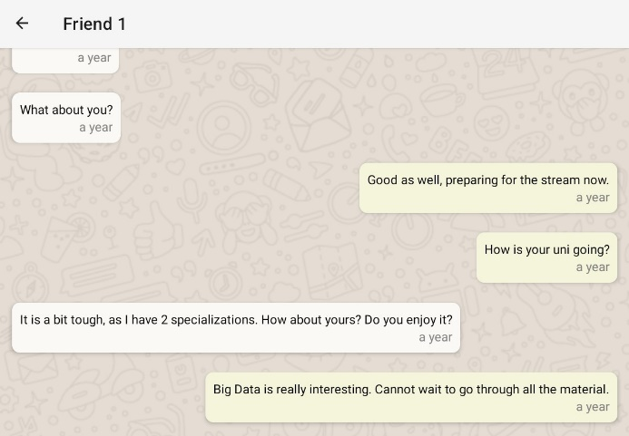
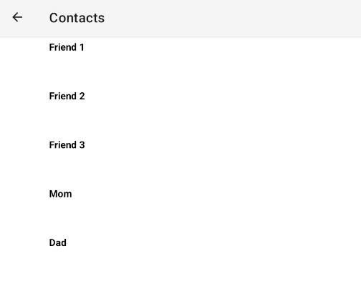

Contacts screen
Starting chat with an imported contact
Opening Contacts Screen with all device contacts showing
Imported contact visible in chat history

Slide 37
Chat Screen expansion part 1
Message Component
The Chat Screen needs to be expanded more, we need the ability to send messages and showcase a reply function alongside reply generation. Previously, the messages were hard coded, and we imported a message component, but it was not utilized.
The message component represents an individual message in the chat, and it includes a function that checks if the message is sent by the current user.
It will then proceed to render a message bubble with a style depending on the sender (i.e dynamic styling).

Slide 38
Chat Screen expansion part 2
Message Handling
The ‘onSend’ function is responsible for handling the sending of new messages.
It checks if the ‘newMessage’ is not empty before proceeding. If it’s empty, the function returns early.
When a valid message is present, a new message object is created and added to the ‘newMessages’ state array.
The input box is cleared, and a function called ‘reply’ is triggered to simulate a response from the other user.
The ‘FlatList’ is scrolled to the end to display the new message.

Slide 39
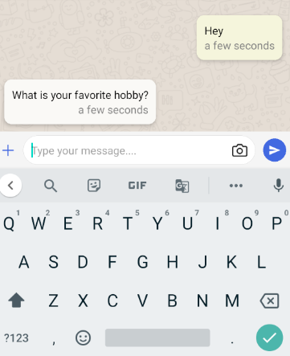
Chat Screen expansion part 3
Reply Generation
The reply function generates a random reply after a delay of 5 seconds (simulating the other user typing).
It selects a random reply from an array of predefined responses and adds it to the ‘newMessages’ state array.
The ‘FlatList’ is scrolled to the end to display the reply.

Slide 40
Camera implementation
1. Initialization and State Management:
Necessary modules like '@expo/vector-icons' and 'expo-camera’ are imported.
State variables are initialized for camera permissions, camera reference, camera on/off state, and captured images.
3. Camera Rendering and Navigation Options:
Conditional rendering is implemented to display either the captured image or the camera view based on the cameras ‘on’ state.
A layout hook is utilized to dynamically update navigation options, which hides the header when the camera is on.
2. Camera Permissions and Lifecycle Hooks:
A RN hook is used to manage the camera permissions.
Another hook is used to request camera permissions when the component mounts.
4. Focus Effect and Image Capture:
A focus effect hook is implemented to ensure the camera is active when the component gains focus, maintaining camera state during navigation.
The take picture function is created for capturing images using the camera, which stores the image and switches the specific camera state to false for transitioning between camera and captured image views.

Slide 41
Status screen
Initial Data Setup:
An array of initial statuses is initialized with users and their statuses.
Creation of Status Item:
Individual status item are rendered.
User’s name and status text is displayed.
How the list of statuses is created:
Maintain state for list of statuses and current user's new status.
Render ‘FlatList’ of status items using Status Item.
How do we update the status?
Map over existing statuses array.
If current user doesn't have a previous status, create a new entry.
Triggered when "Update Status" button is pressed.

Slide 42
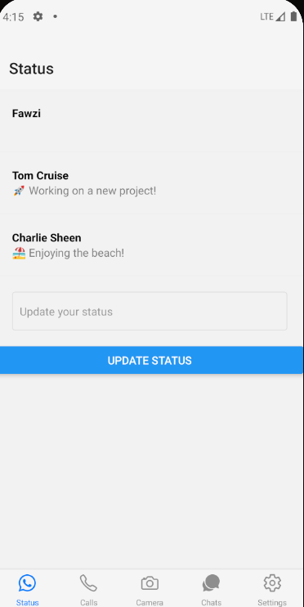
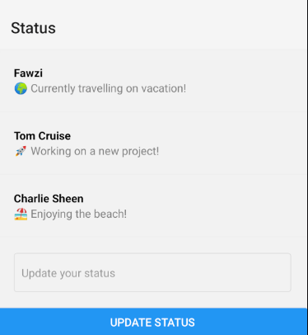
Status screen

Slide 43
Remaining screens
Call Log Screen
Settings Screen
CallItem Component:
Formats a call card.
Includes profile picture, name, call type, and time.
CallList Component:
Utilizes ‘CallItem’ component.
Renders call items in a ‘FlatList’.
Placeholder Screen:
Serves as a temporary interface.
Represents distinct parts of settings.
Information Display:
Each part has a name and an accompanying description.
Backend API Integration:
Placeholder to be replaced with actual settings content once the backend API is connected and configured.
The Settings Screen currently provides a preview of potential settings sections, each with identifiable names and descriptions, pending backend integration.

Slide 44
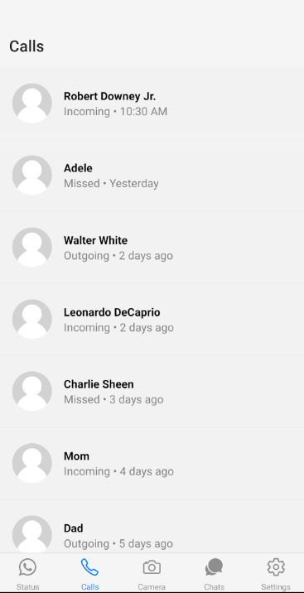
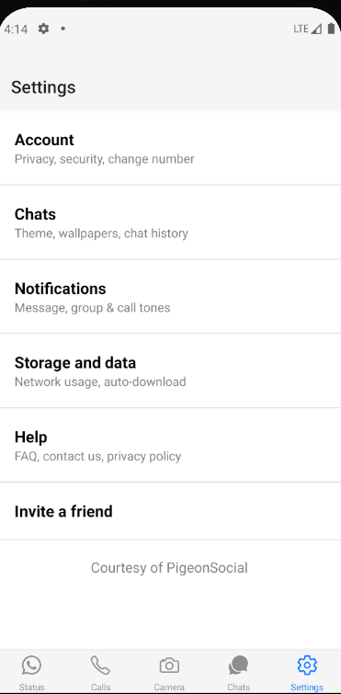
Remaining screens

Slide 45
Testing and evaluation
Goal Alignment
Methodology and literature review facilitated thorough testing.
Front-end development completed before handoff to back-end team
Testing Success
Comprehensive testing of features.
Successful testing of sending messages, importing contacts, and camera screen functionality.
Resolved Issues
Camera screen issue resolved by switching to Expo's camera.
Imported contacts tested on real device (Samsung Galaxy Tab A8) due to limitations in Android Studio.
Missed Feature
Initially missed the ability to start a new chat with imported contacts.
Resolved a few days later, enabling users to start a new chat with any imported contact.

Slide 46
Conclusion and future work
Insights into UI/UX Design
Relationship between effective UI/UX design and advanced front-end development practices.
Emphasis on the need for further research in this area.
Pushing Innovation in Development
Striving to establish a new benchmark for user experience and performance in social messaging applications.
Implementation of sophisticated front-end methodologies.
Development Process Overview
Started with a chat list component.
Expanded to a complete chat list screen, chats screen, input box, contacts screen, camera screen, and status screen.
Goal: Deliver a fully fleshed out front end for a social messaging application prototype.
Contribution to Mobile App Development
Valuable contribution to the existing body of research.
Advocacy for ongoing exploration and advancements in mobile application development.
Future Work
Connect back-end databases and APIs to the front-end UI.
Utilize Firebase for database management and Node.js for scalable back-end services.
Aim for a fully functional application with global usability.

Slide 47
THANK YOU for listening
Fawzi Nastas
fawzi.nastas@gmail.com

Slide 48
sources
The future of AI-driven AR and VR: Transforming digital experiences – Dartmouth Digital
Mobile messaging and social media - Pew Research Center
A brief history of instant messaging – Loop Email
Understanding the Strategic Consequences of Customer Privacy Concerns: A meta-analytic review - Okazaki, S., et al
Smartphones Worldwide - Statista

Slide 49
Appendix

Slide 50
Application architecture
Modular Architecture With Three Key Components
Front-End Interface
Built with React Native
Back-End Services
Server-Side Logic
(Not Covered in this Project)
Database Management
Consideration for Future Use: Firebase
Responsive and User-Friendly
Seamless Across Different Devices and Platforms
Interaction with Front-End through RESTful APIs
Real-Time Data Synchronization
Essential for Messaging App’s User Experience
Implementation Consideration: Node.js

Slide 51
objectives
Familiarize ourselves with React Native, Android Studio, and other tools.
Research the best and most efficient practices and create a plan to implement them.
Create an intuitive front-end of a social messaging application with limited time.
Overcome the difficulties and challenges especially considering solo development.

Slide 52
Feature analysis
Text messaging: Enables users to send and receive real-time text messages.
Multimedia sharing: Allows users to share images, videos, audio files, and documents.
Integrated calling features: Voice and video calls have become commonplace.
Status Updates: Offers users the ability to share status updates or stories with their contacts for a limited time.

Slide 53
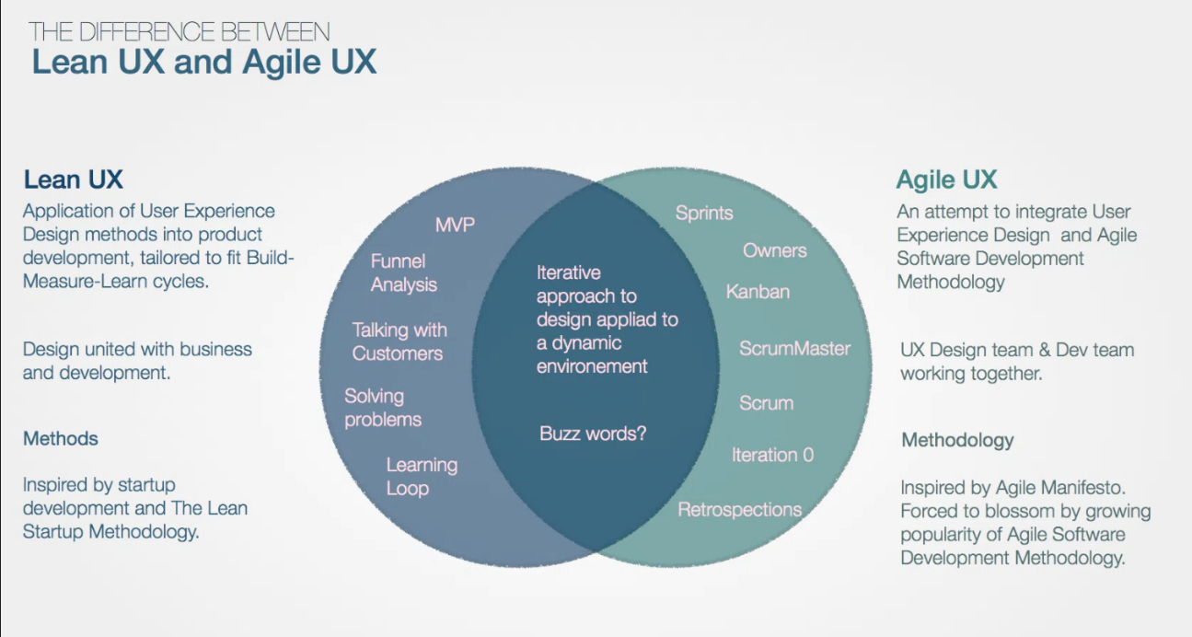
Methodology
User Experience and Interface Design
Agile is focused on users, managing uncertainty, and delivering working software.
Lean is focused on eliminating waste, managing processes, and delivering value.

Slide 54
Mobile architecture pattern
Mobile application architecture patterns, the way in which an app is structured, is typically one of three pattern models.
Typically, it will be:
MVC (Model-View-Controller)
MVP (Model-View-Presenter)
MVVM (Model-View-ViewModel)
This project’s pattern is most closely resembling the MVP (Model-View-Presenter) architecture.
A software development design pattern that promotes maintainability and scalability by organizing code into three main components.

Slide 55
Mobile architecture pattern
Model
View
Presenter
Describes the data layer of the application, which is responsible for managing data, business logic, and rules.
The Model retrieves, stores, and processes data according to the logic and rules of the application.
Responsible for presenting data to the user and receiving user actions.
It displays data provided by the Model and sends user actions, such as button clicks, to the Presenter to handle.
Mediator between the Model and the View. It retrieves data from the Model and formats it for display in the View.
It reacts to user input, updating the Model as necessary and determining how the data should be presented.

