Slide 1

Travel Insurance
Presented by: Fawzy Almatary
DataCamp, September 2022

Slide 2
Background
Travel Assured is a travel insurance company. Due to the COVID pandemic, they have had to cut their marketing budget by over 50%. It is more important than ever that they advertise in the right places and to the right people.
This case study is will analyze the data Travel Assured has on their current customers as well as people who got quotes but never bought insurance. With the objective of answering the customer’s two questions:
1. Are there differences in the travel habits between customers and non-customers?
2. What is the typical profile of customers and non-customers?

Slide 3
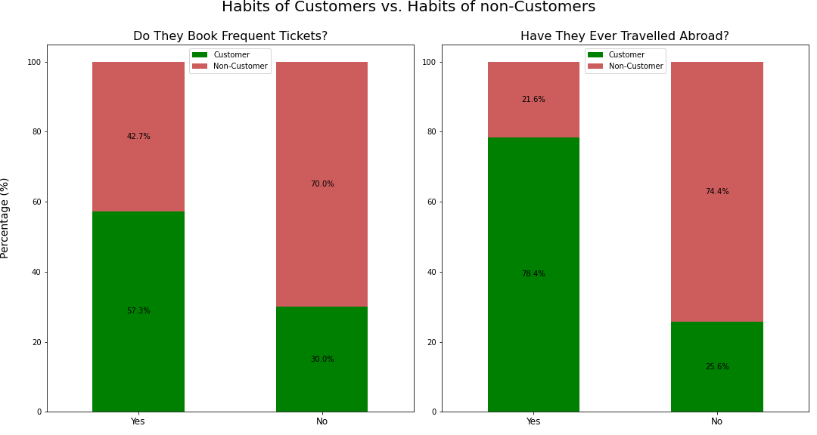

Slide 4
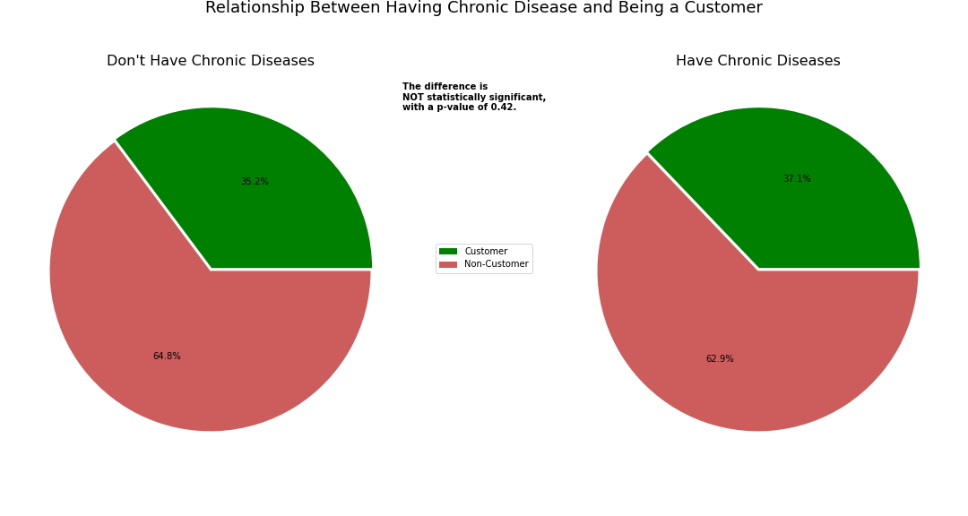

Slide 5
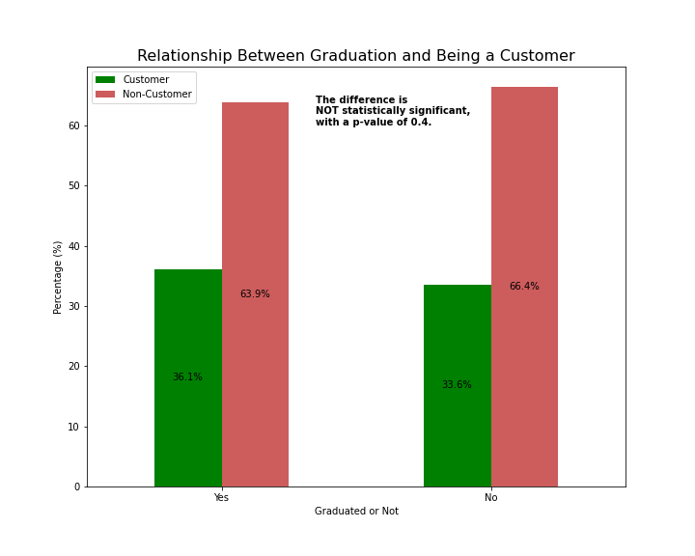
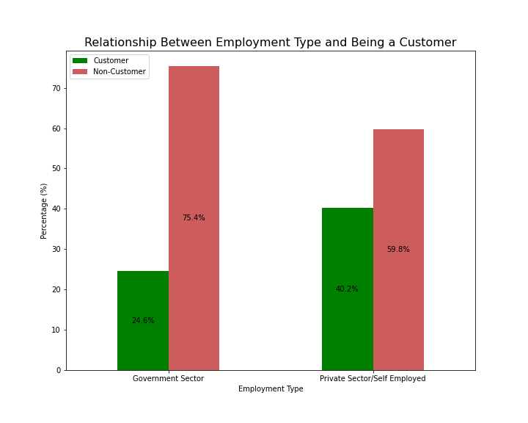

Slide 6
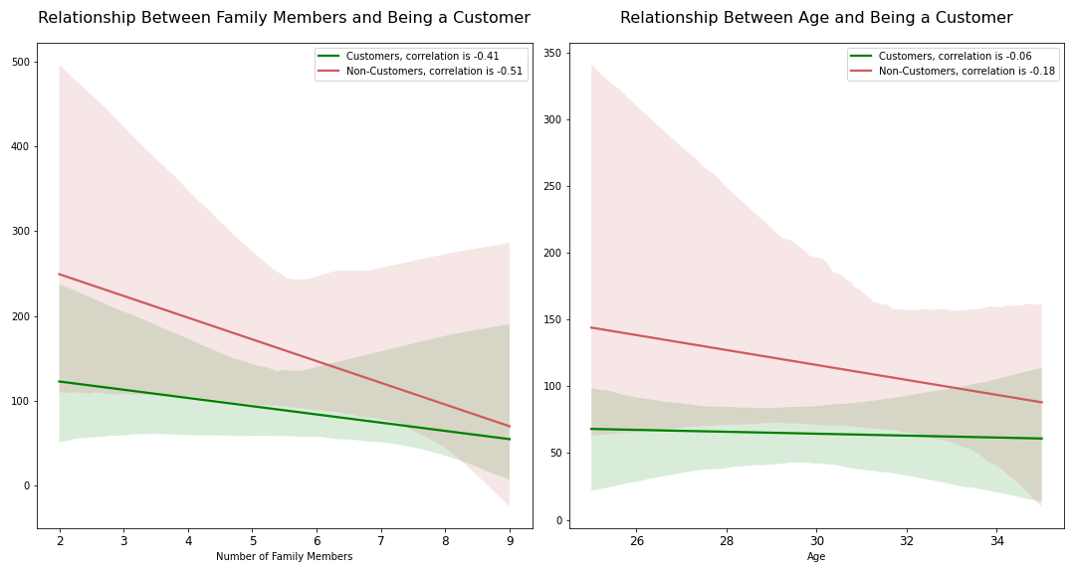

Slide 7
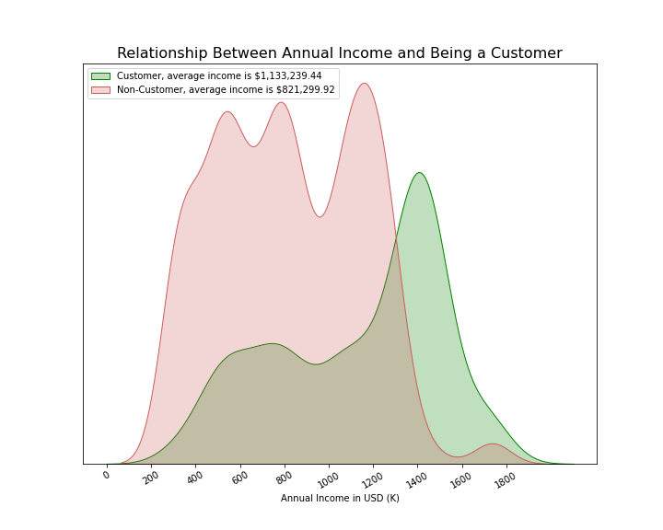

Slide 8
Key Findings:
Q1. Are there differences in the travel habits between customers and non-customers?
A1. Customers tend to travel more frequently and have higher chances to travelling abroad.
Q2. What is the typical profile of customers and non-customers?
A2. Compared to non-Customers, Customers’ profile tend to be:
Those who travel more frequently and travelling abroad.
Those who work in private sectors or self-employed.
Those who earn more, especially more than 1.2 millions USD.
As for these factors, they seem to have little to no significance to in the difference between customers and non-customers: (Age - Graduation status - Health status - Family size)

Slide 9
Recommendations:
According to the findings in this analysis, for Travel Assured to get the best out of advertising with the limited budget, what should be done is:
Try to target:
The people who travel abroad as they are more likely to be customers.
The people who are self-employed or work in private sectors.
Those who have fewer family members.
Do not waste resources on:
Trying to target people according to their health, whether they have chronic diseases or not.
Trying to target a specific age or education level.

