Slide 1

Bike Sharing
Analysis

Slide 2
Background
This is an analysis of bike sharing data from Capital Bikeshare in Washington, D.C., USA, from January 1, 2011 to December 31, 2012. The data is aggregated on an hourly basis. Additional meteorological information is available in the data.
This case study analysis has the objective of answering these questions:
Are there differences in the riffing habits between customer and casual users?
What is the weather effect on customer and casual users?
How can Capital Bikeshare use these information to improve their business?
To view the python code used to generate the figures in this case study, click here.

Slide 3
Time of rides

Slide 4
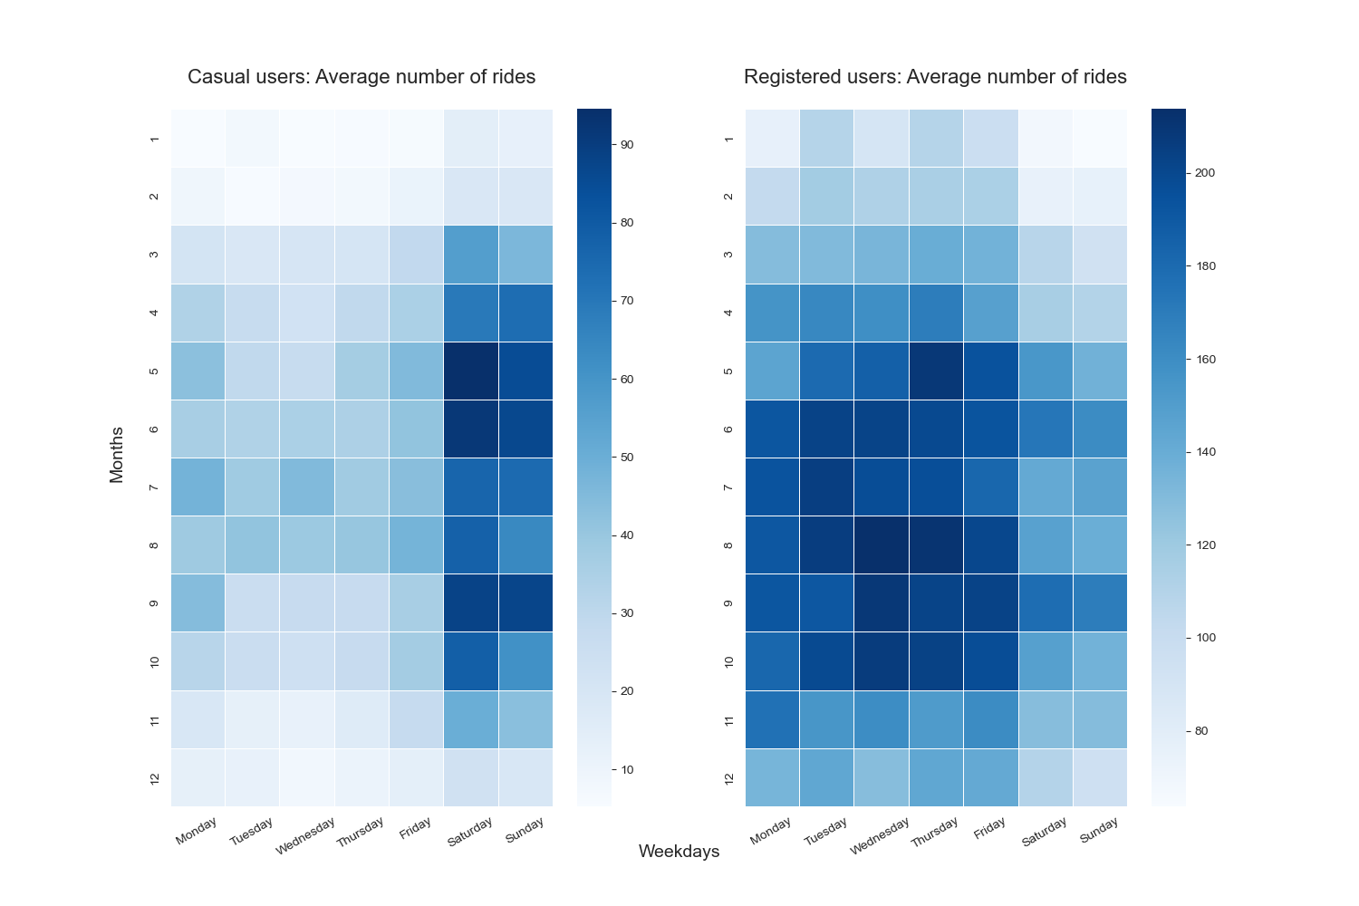
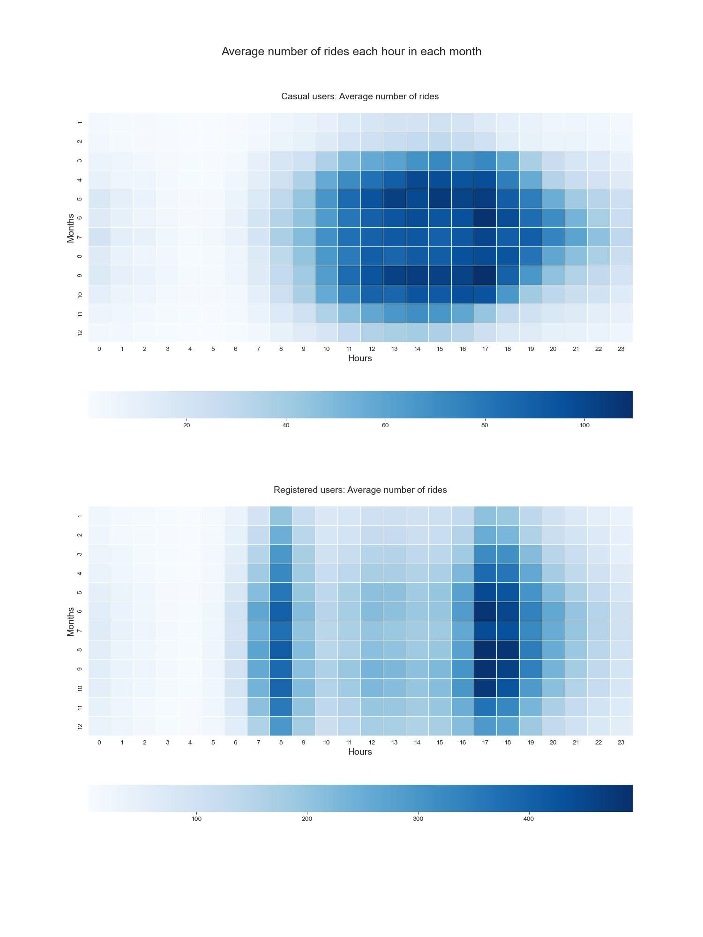
Casual Users Rides

Slide 5
Registered Users Rides

Slide 6
Key Findings:
From the previous figures, we can see that the number of casual users is higher than registered users, but sometimes the both the same patterns or trends, other times they differ. Here are the observations that can be seen:
For both casual and registered user, the rate of rides drops significantly in winter.
Registered users' rides are concentrated around 8 AM and 5-6 PM.
Registered users' rides are concentrated in workdays and decrease in weekends.
On the contrary, casual user rides are increased during weekends, and are more spread throughout the day.
This may suggest that registered users use the bikes mainly as a way of transportation between home and work.

Slide 7
Rides vs. Weather

Slide 8
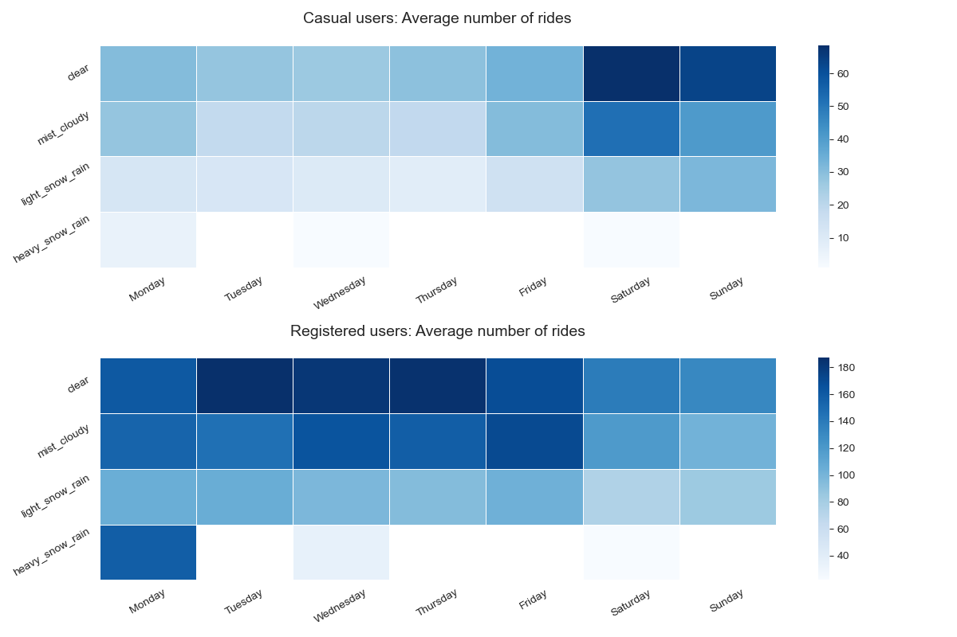

Slide 9
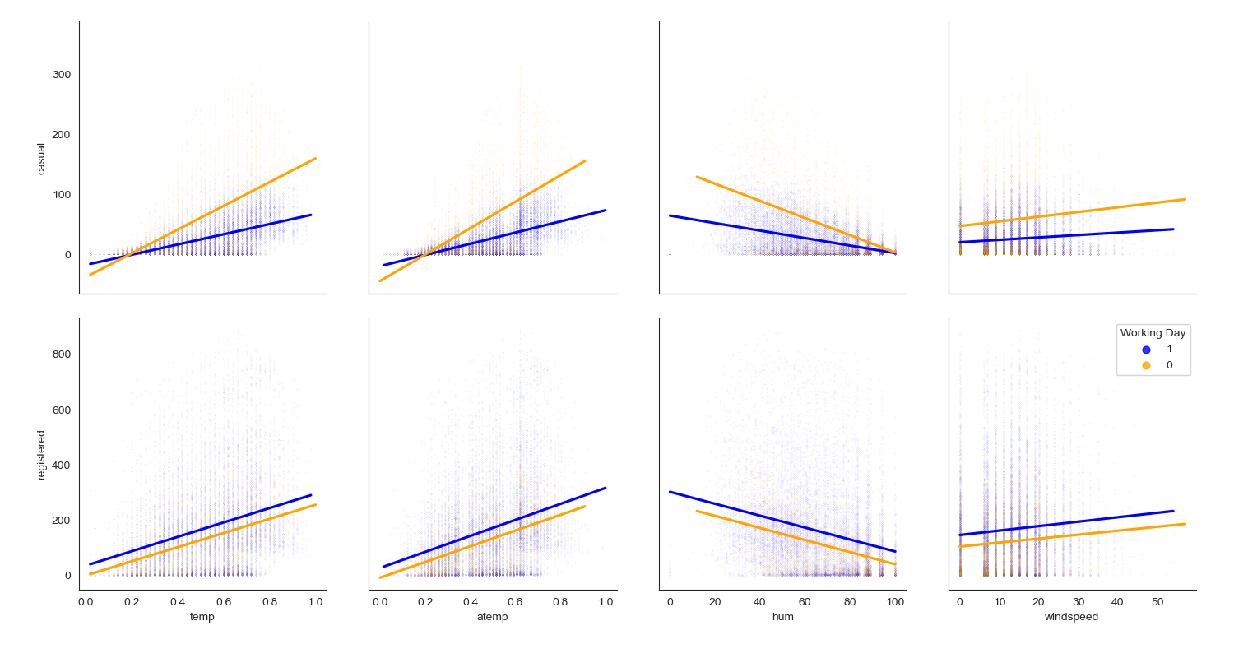

Slide 10
Key Findings:
From the previous figures, we can see that:
The difference in correlation during working days and non-working days is more diverse in case of casual users than in registered users.
The correlation between number of rides and wind speed is very weak.
The correlation between number of rides and the weather conditions is stronger for casual users than for registered user, both in positive and negative correlations.
This may suggest that weather and temperature have significantly lower effect on registered users than on casual users, probably as they use the bikes mainly as a way of transportation between home and work.

Slide 11
Recommendations

Slide 12
Recommendations:
According to the findings in this analysis, for Capital Bikeshare to improve their business:
Create a market campaign focusing on how using rides would be helpful to go to work. Combine that with an offer to draw users to register.
Increase number of available bikes in the peak hours, around 8 AM and 5-6 PM.
Increase offers during winter to get people to use bikes more.
To view the python code used to generate the figures in this case study, click here.

