Slide 1

DELIVERY WEB APPLICATION
Supervisor: Dr. Zaher Merhi
Committee Member: Dr. Milia Habib
1

Slide 2
DELIVERY WEB APPLICATION
Stage 01
Stage 02
Introduction
Problem statement
Stage 03
Stage 04
Similar systems
System Design
WEB
Stage 05
Stage 06
Implementation
Demonstration
Stage 07
Stage 08
Conclusion
Future work
2

Slide 3
DELIVERY WEB APPLICATION
Stage 01
Stage 02
Stage 03
Stage 04
Introduction
Problem statement
Similar systems
System Design
3

Slide 4
DELIVERY WEB APPLICATION
Introduction:
Delivery companies have spread by the growth of customers needs.
They are the linking relationship between one side customer and other half client.
Drivers takes all the orders to whenever the customers desire.
Managers monitor the progress of tasks
4

Slide 5
DELIVERY WEB APPLICATION
Stage 01
Stage 02
Stage 03
Stage 04
Introduction
Problem statement
Similar systems
System Design
5

Slide 6
DELIVERY WEB APPLICATION
Problem statement:
Clients
Absence of trust between customer and company due to lack of communication.
Companies
Problems in loss of cargo either through piracy or corruption.
Economic crisis affecting the transportation and telecommunication sector.
6

Slide 7
Inadequate visibility and communication: The logistics and transportation industry faces challenges related to limited visibility and ineffective communication, leading to delivery delays and lower customer satisfaction.
Increased costs: The industry struggles with rising costs due to manual processes and inefficient resource allocation, impacting profitability for logistics providers.
Intense competition and security threats: The market is highly competitive, and security threats pose risks to logistics providers, requiring measures to ensure the safety of shipments and maintain a competitive edge.

Slide 8
DELIVERY WEB APPLICATION
Will the resolution of these problems lead to the success and growth of delivery companies?
Well Yes
7

Slide 9
SPEEDRUN
"SpeedRun" is a cutting-edge cargo tracking application with an intuitive user interface, catering to a variety of user roles for an optimal cargo management process.
The app simplifies order placement, supports real-time cargo tracking, and ensures efficient delivery management with a dedicated mobile application for coordinators.
Communication is streamlined through an integrated messaging system, promoting quick and efficient collaboration among all stakeholders.
It also features robust analytics and reporting capabilities, enabling leaders to make data-driven decisions and enhance operational efficiency.
8

Slide 10
SPEEDRUN
Stage 01
Stage 02
Stage 03
Stage 04
Introduction
Problem statement
Similar systems
System Design
9

Slide 11



SPEEDRUN
Similar systems:
Aramex
Aramex is a global logistics and transportation company based in Dubai, founded in 1982
Companies
Wakilni
Wakilni is a delivery company in Lebanon founded in 2015
GoShare
GoShare is a rapidly growing logistics and transportation company based in San Diego, California, founded in 2014
10

Slide 12
SPEEDRUN
Similar systems:
Company | Advantages | Disadvantages
Aramex | Efficient global logistics solutions Diverse service offerings | Higher cost Service inconsistencies Limited coverage in certain regions
Wakilni | Reliable last-mile delivery Enhanced convenience | Limited geographic coverage Lack of real-time tracking
GoShare | On-demand delivery Flexible vehicle options | Limited availability Potential pricing variability
11

Slide 13
SPEEDRUN
Stage 01
Stage 02
Stage 03
Stage 04
Introduction
Problem statement
Similar systems
System Design
12

Slide 14
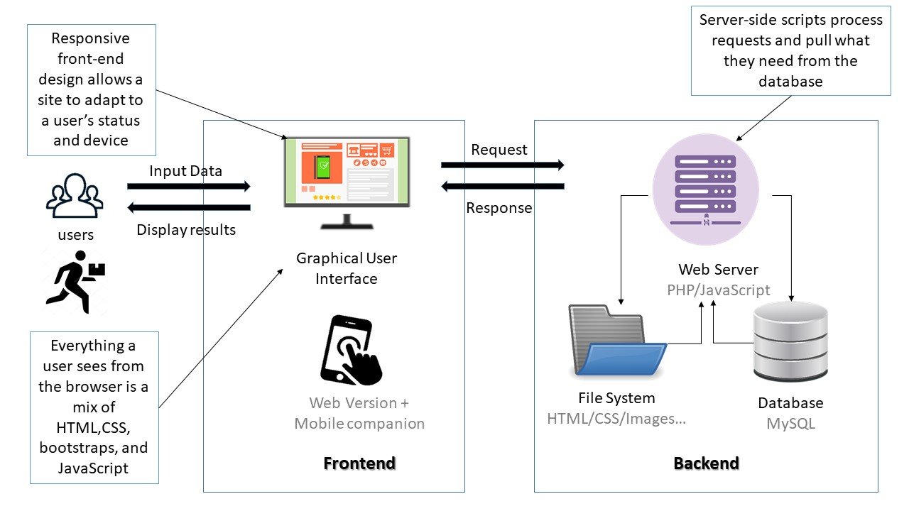
SPEEDRUN
System architecture:
13

Slide 15
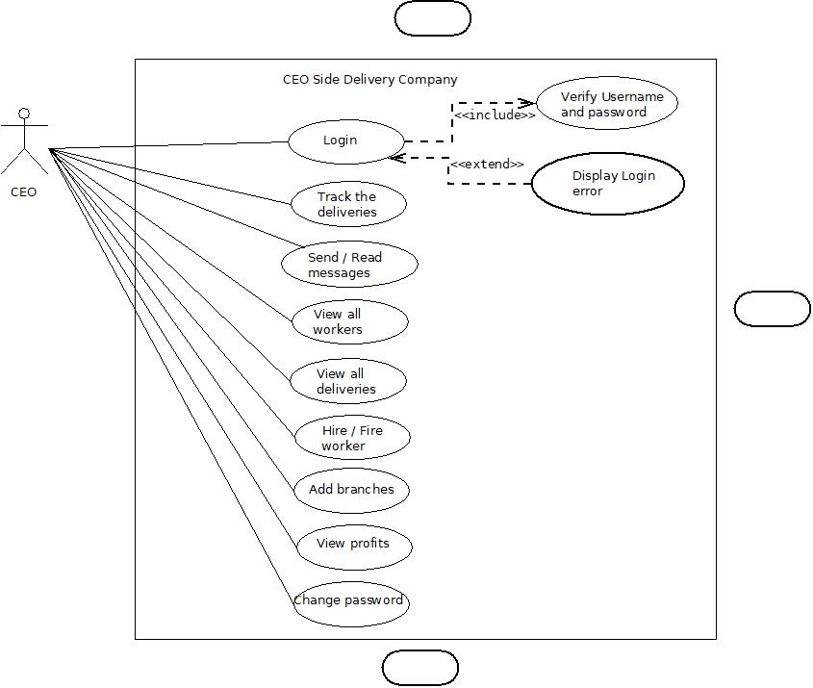
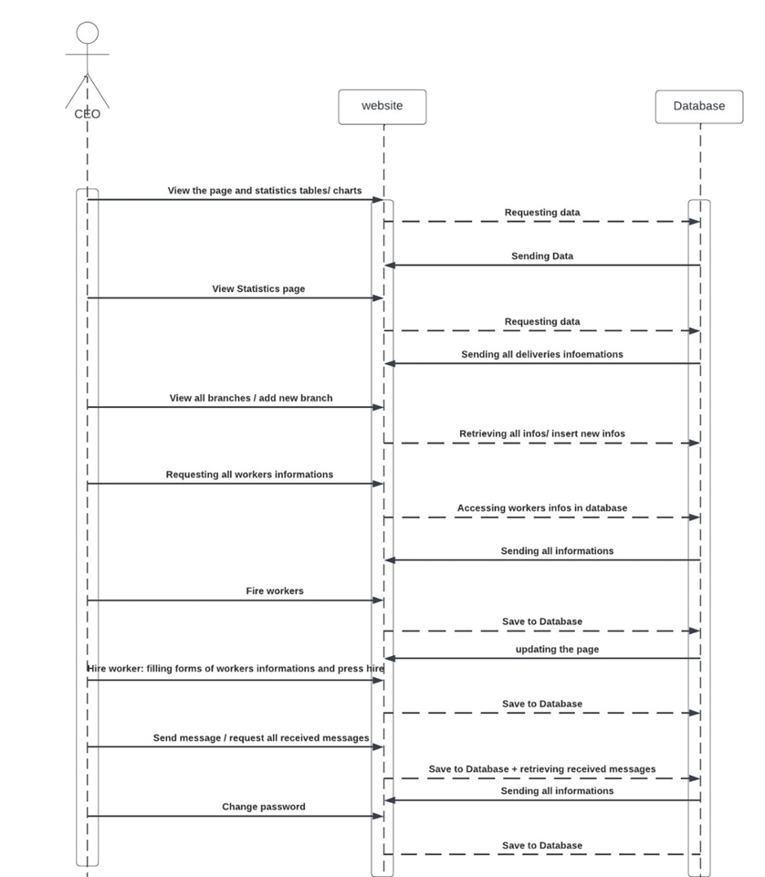
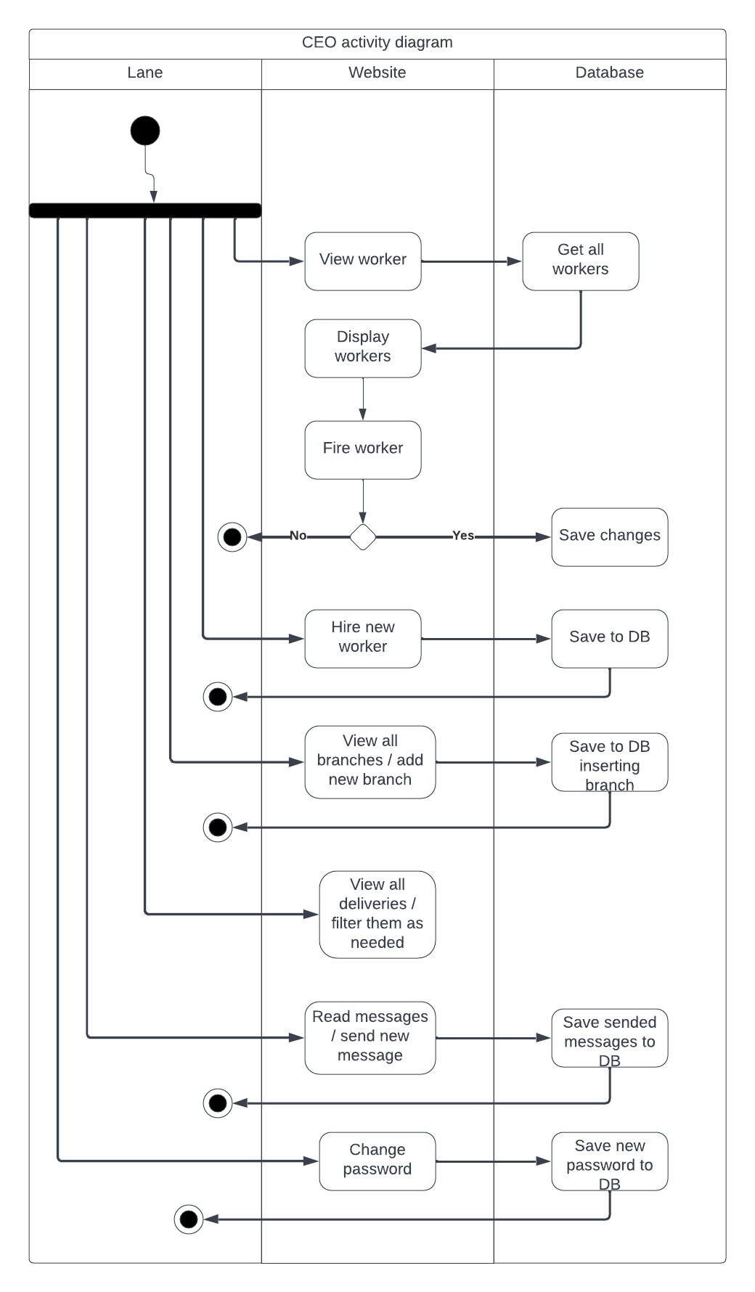
SPEEDRUN
CEO Diagrams:
14

Slide 16
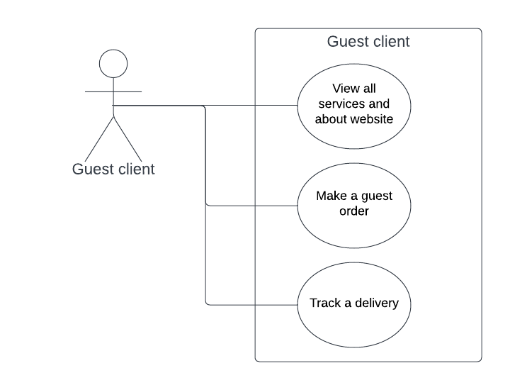
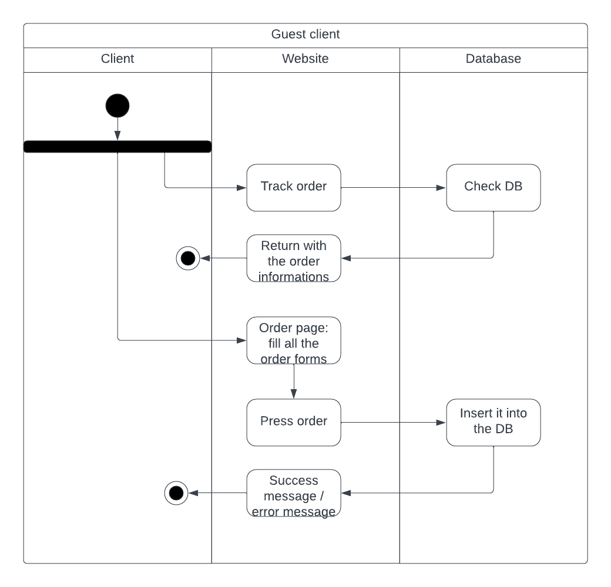
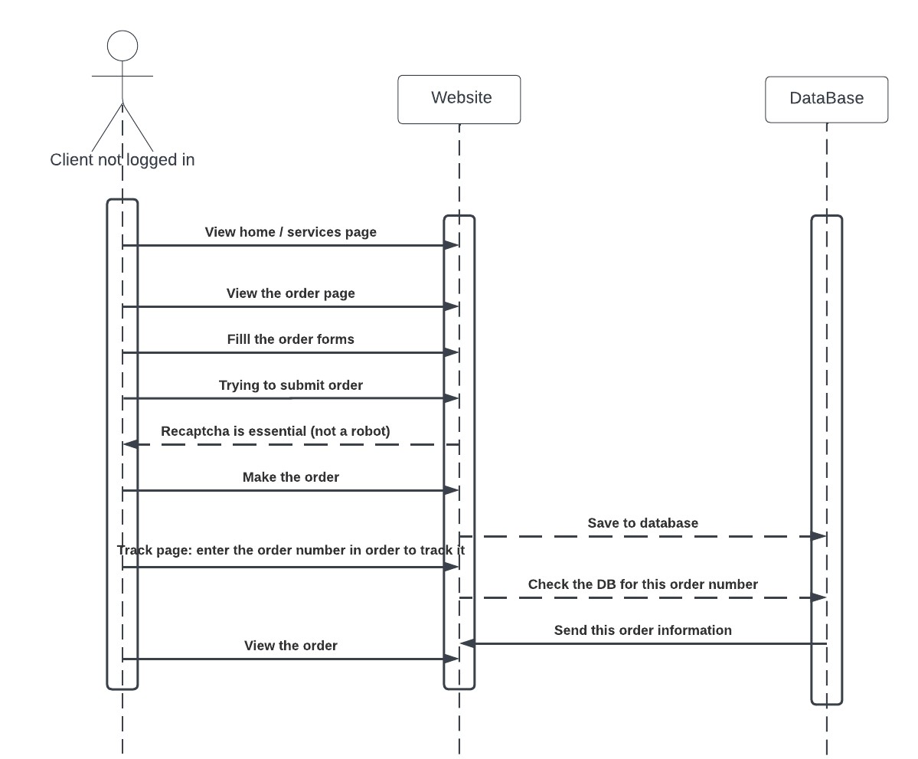
DELIVERY WEB APPLICATION
Guest user diagrams:

Slide 17
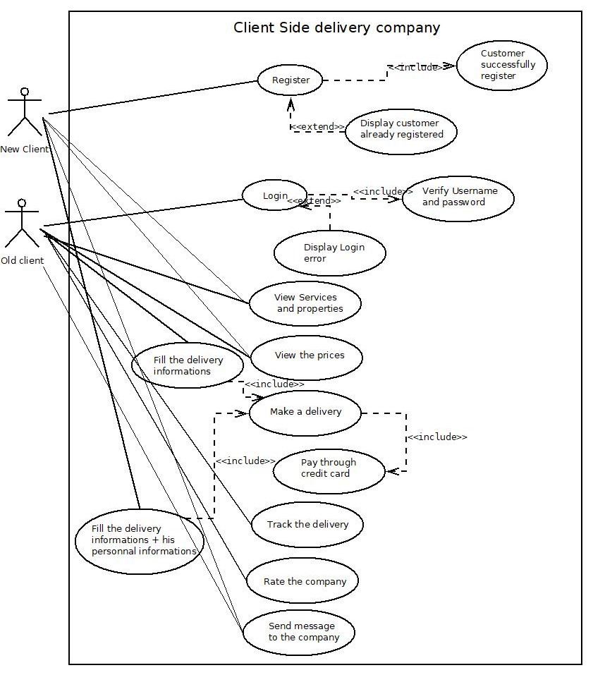
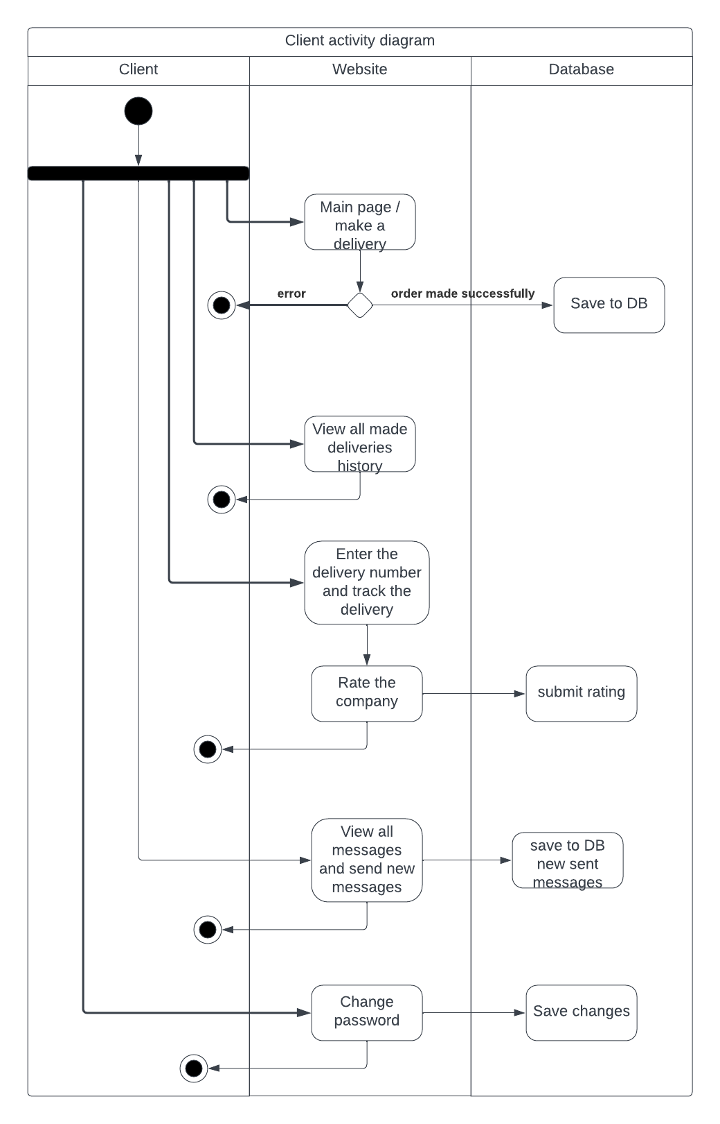
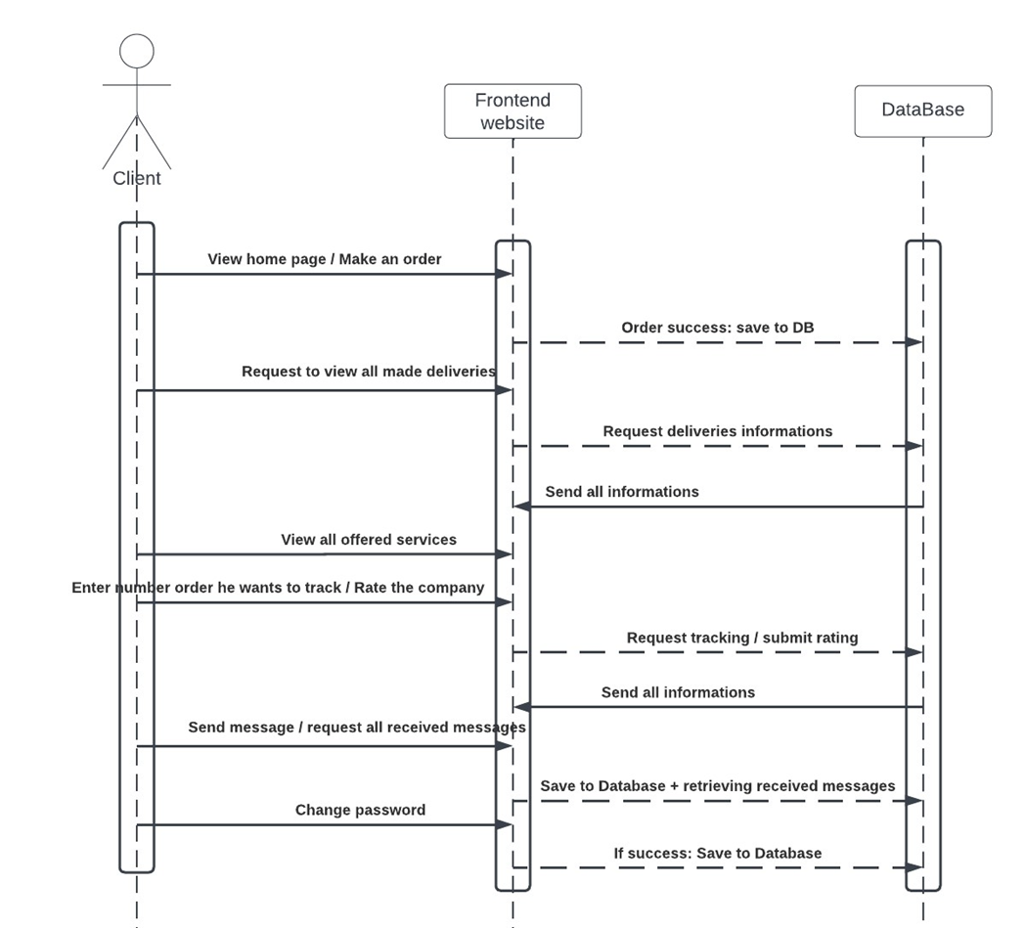
DELIVERY WEB APPLICATION
Registered Client diagrams:

Slide 18
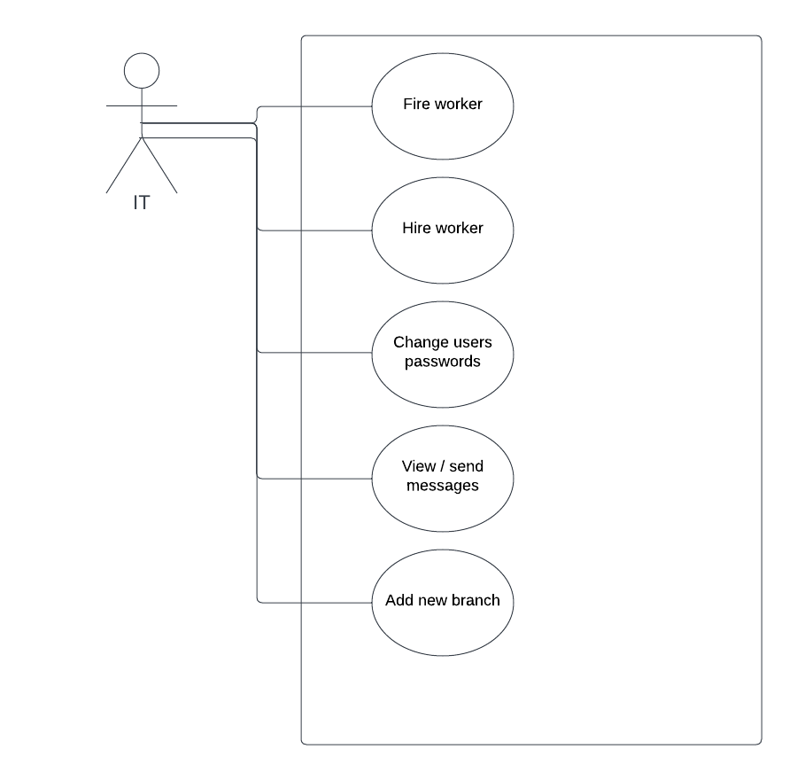
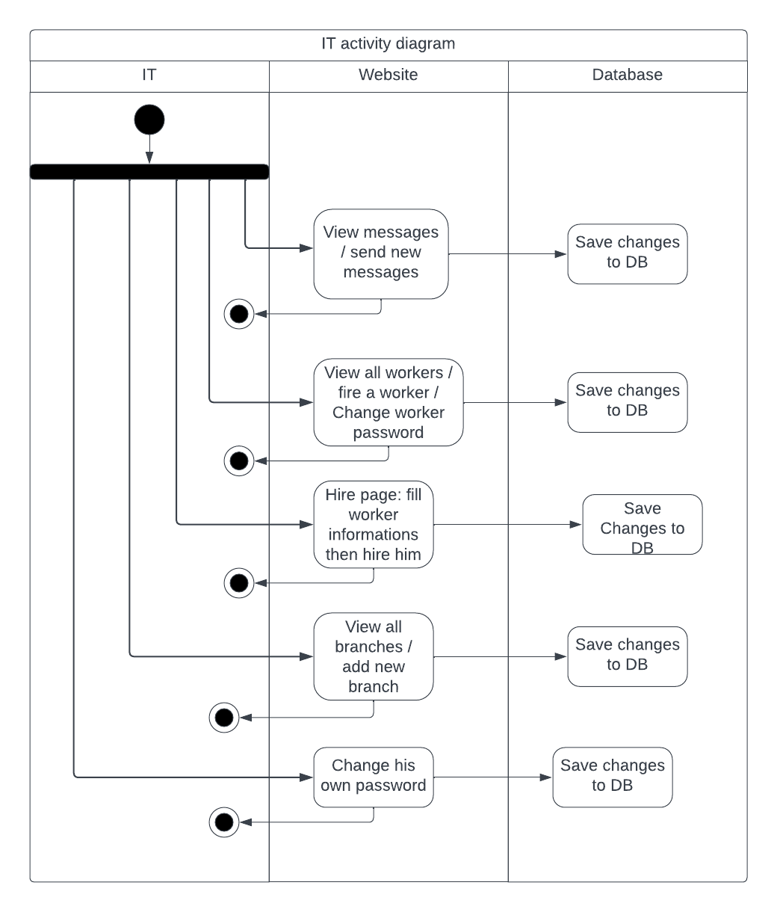
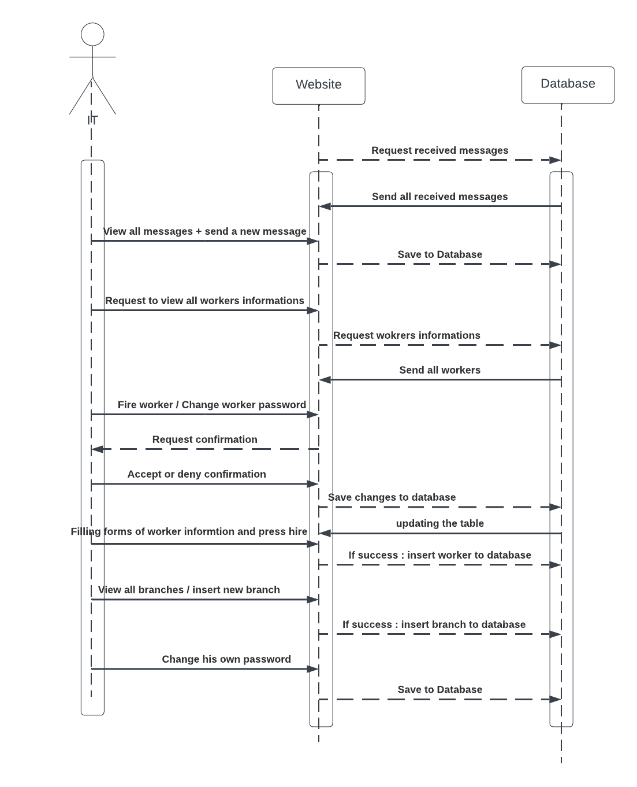
DELIVERY WEB APPLICATION
IT diagrams:

Slide 19
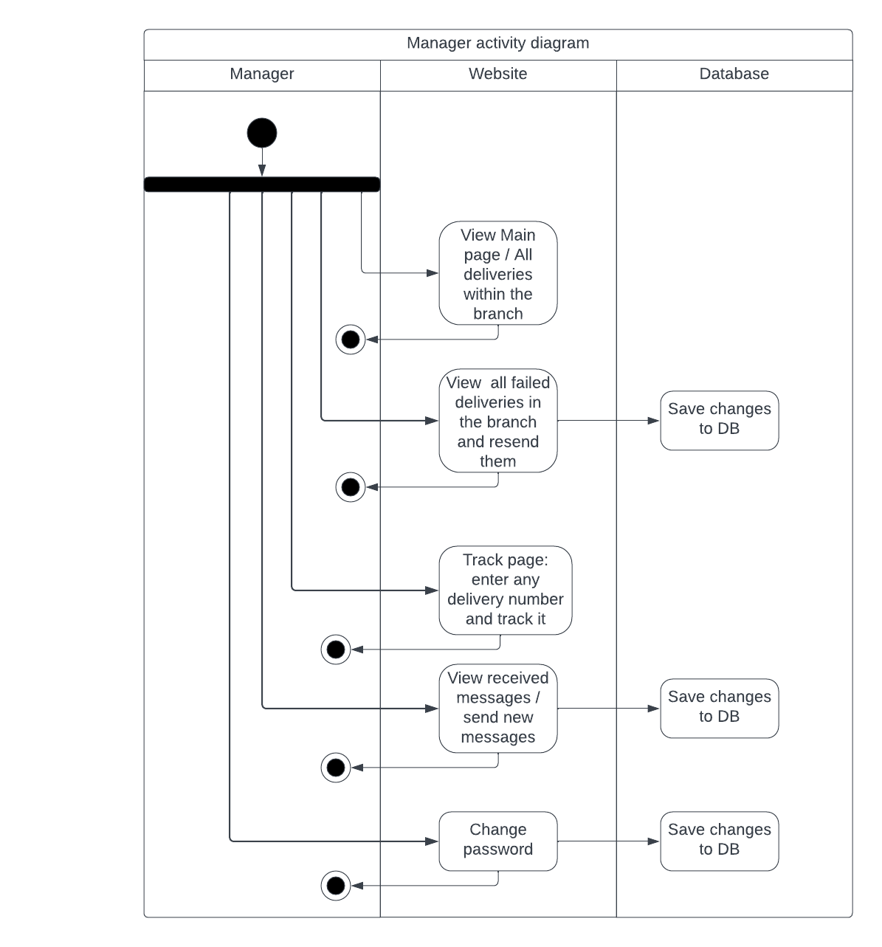
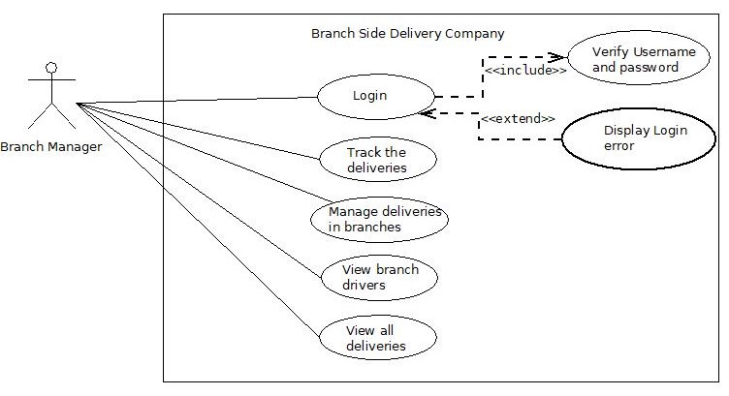
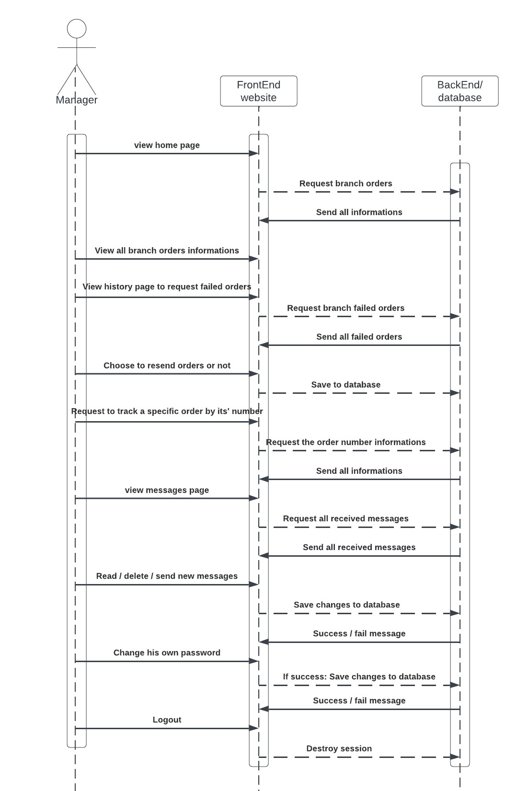
DELIVERY WEB APPLICATION
Branch Manager Diagrams:

Slide 20
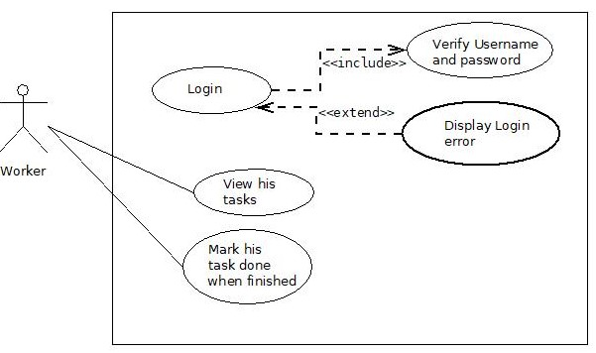
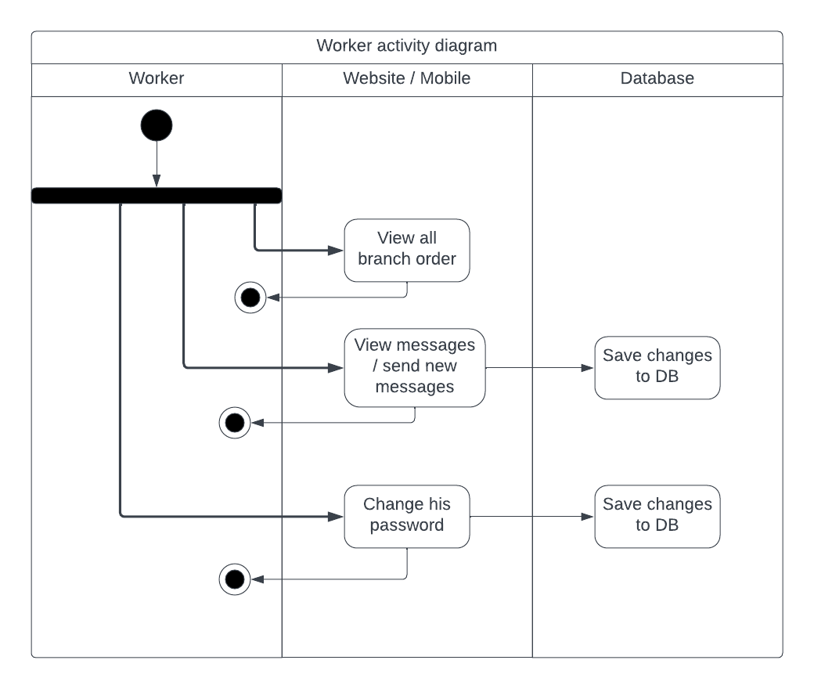
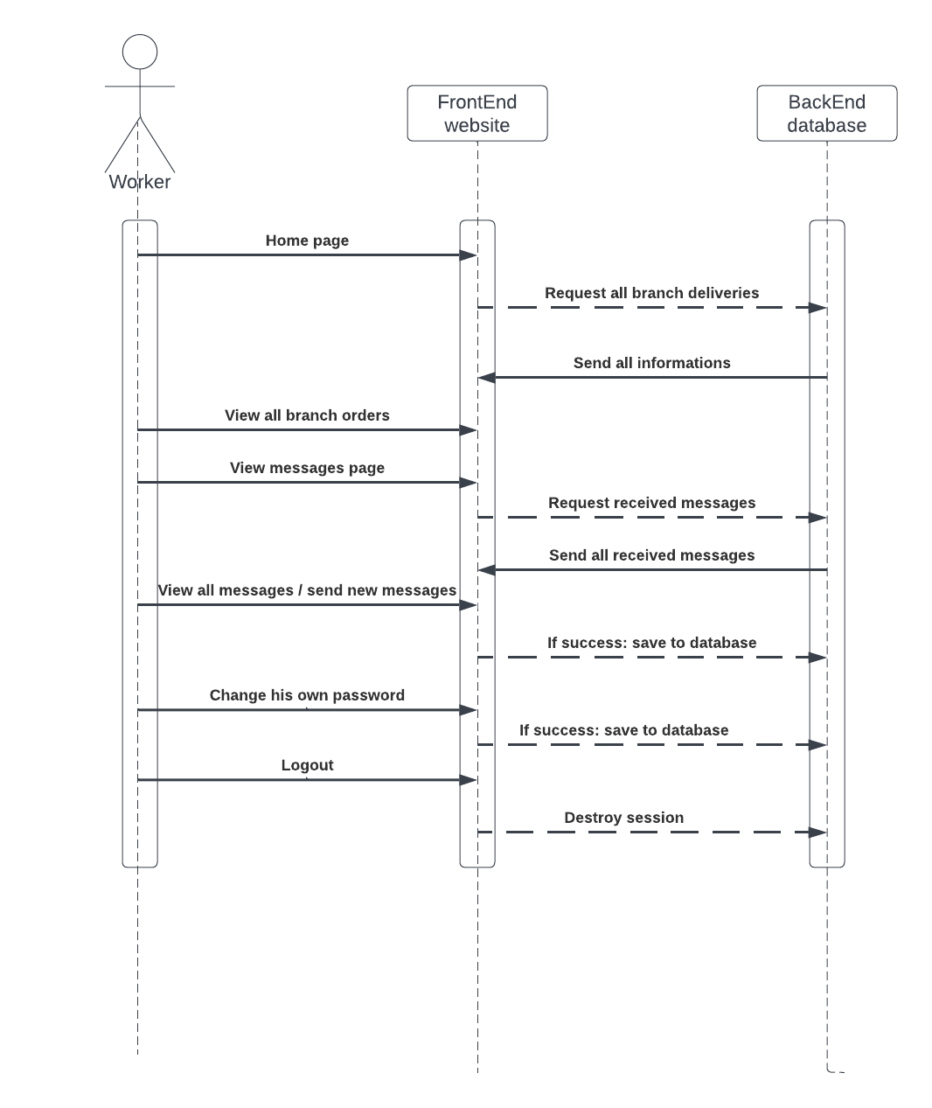
DELIVERY WEB APPLICATION
Worker Diagrams:

Slide 21
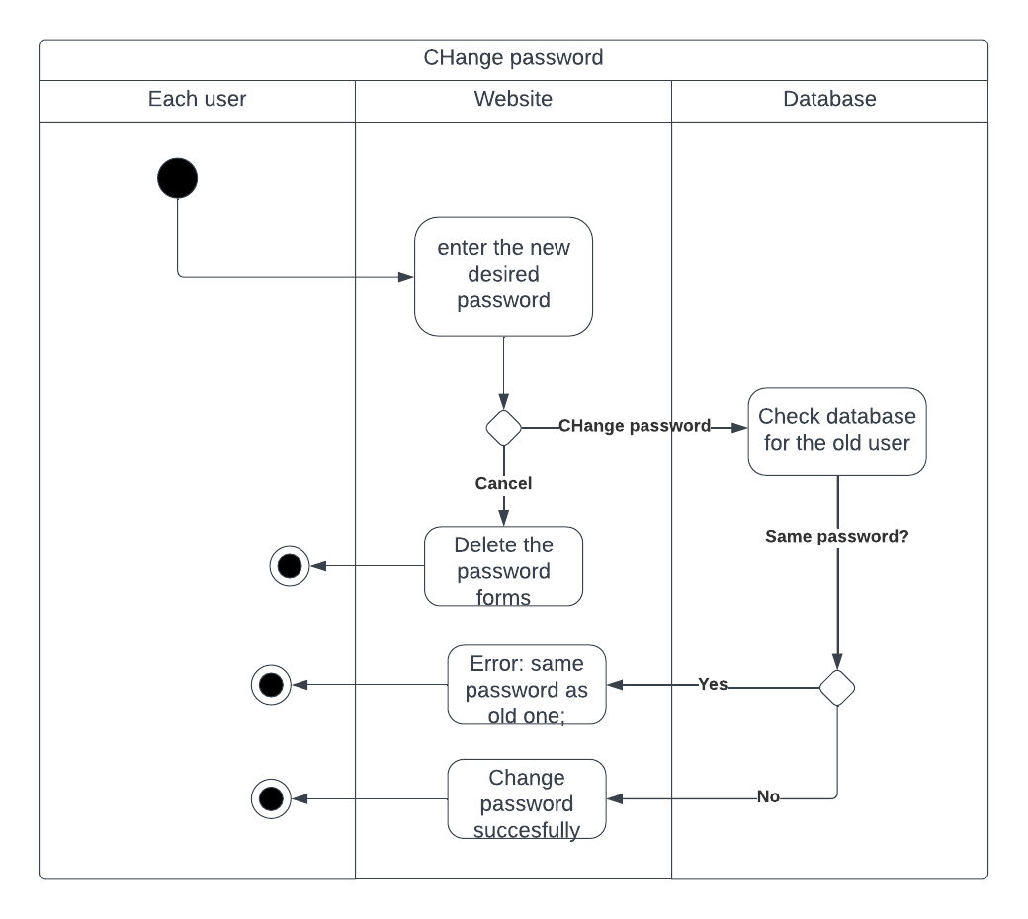
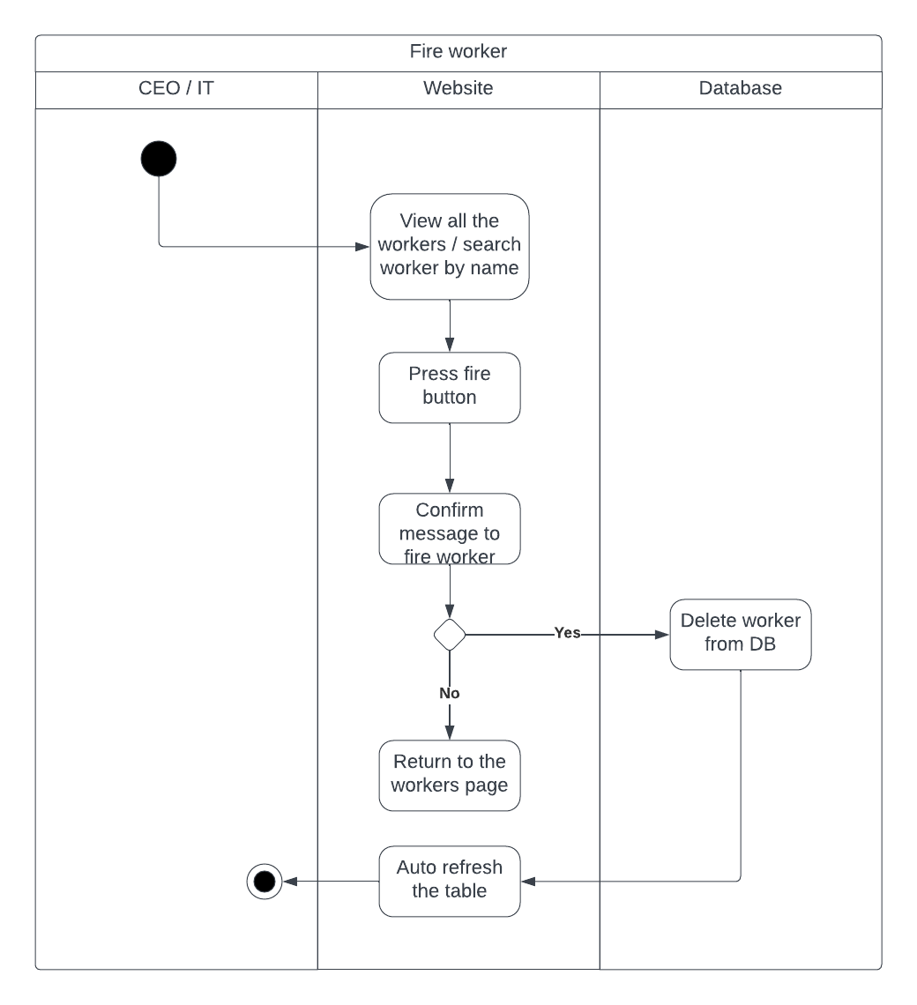
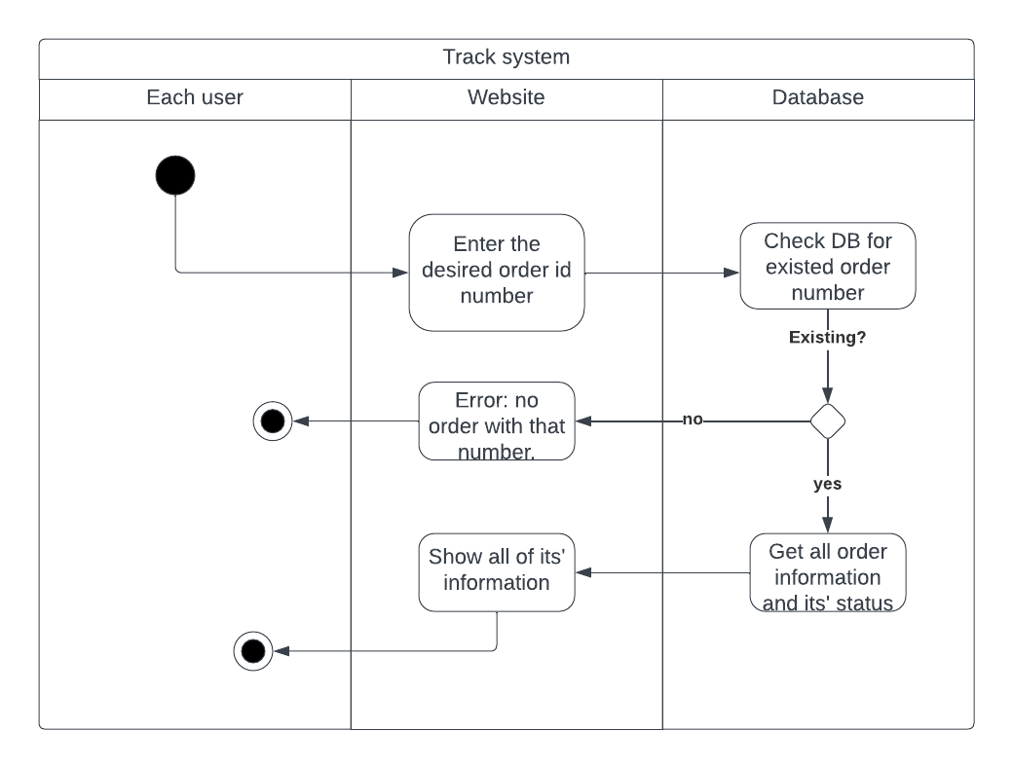
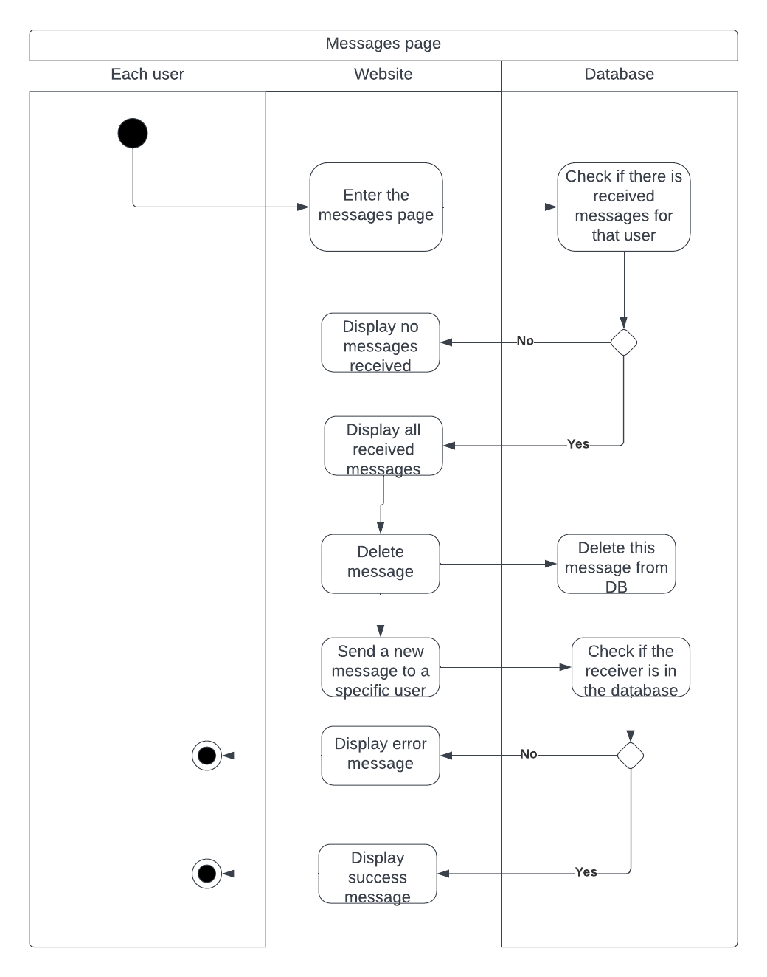
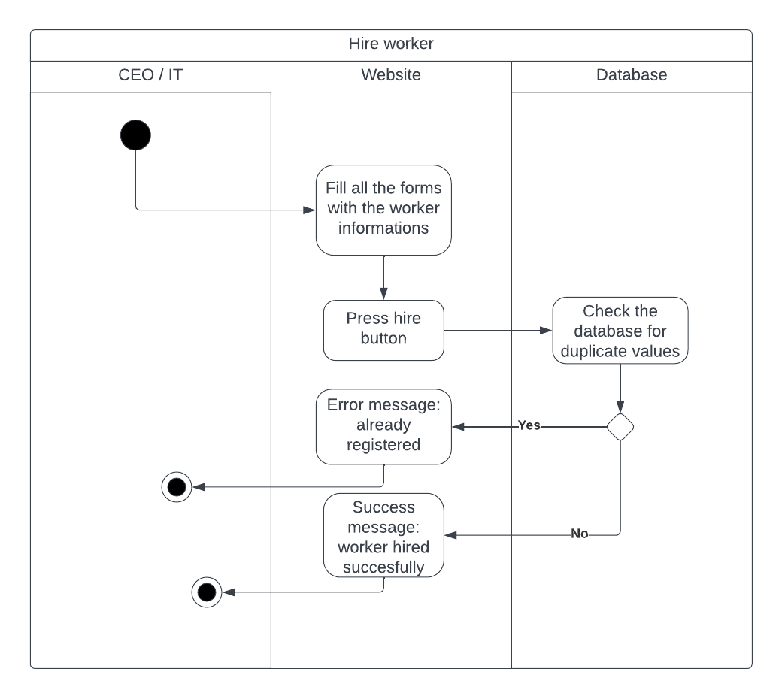
DELIVERY WEB APPLICATION
Common Pages Diagrams:

Slide 22
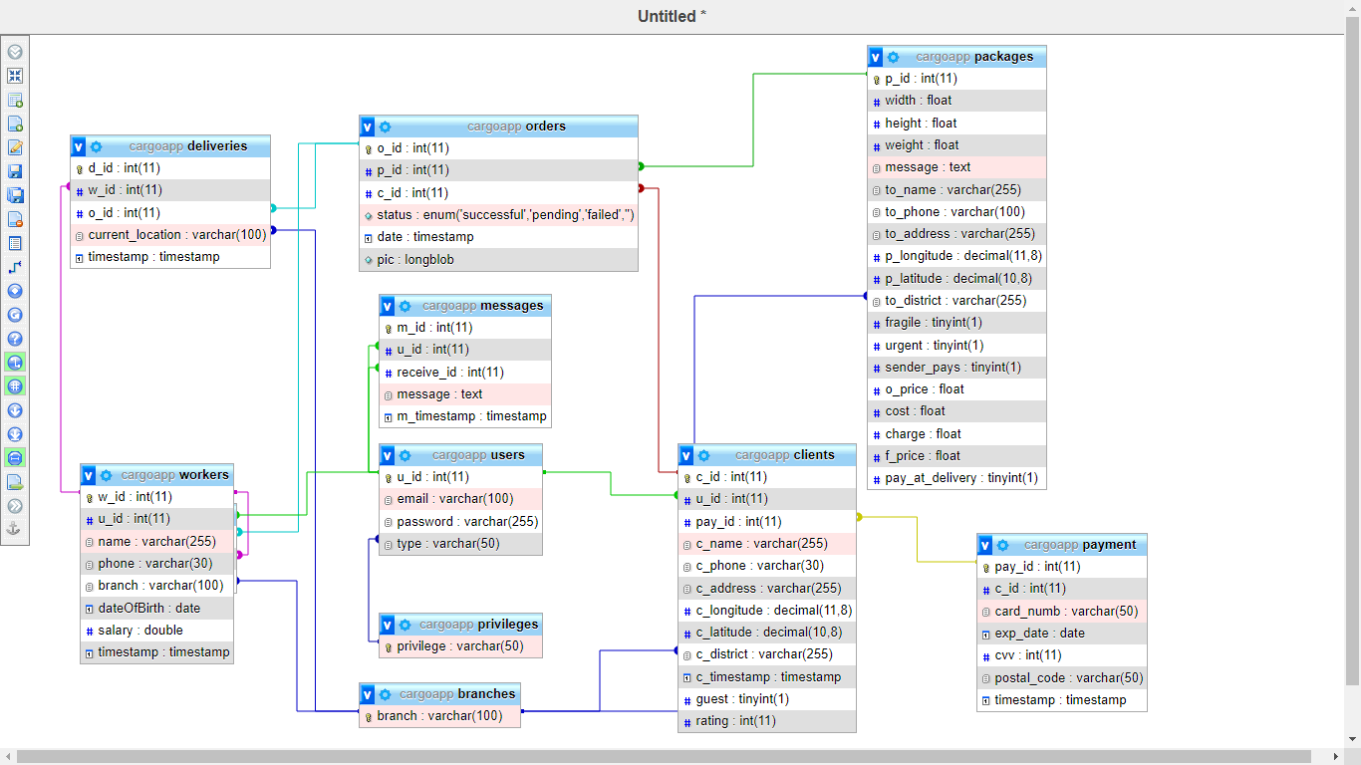
SPEEDRUN
Class diagram:
15

Slide 23
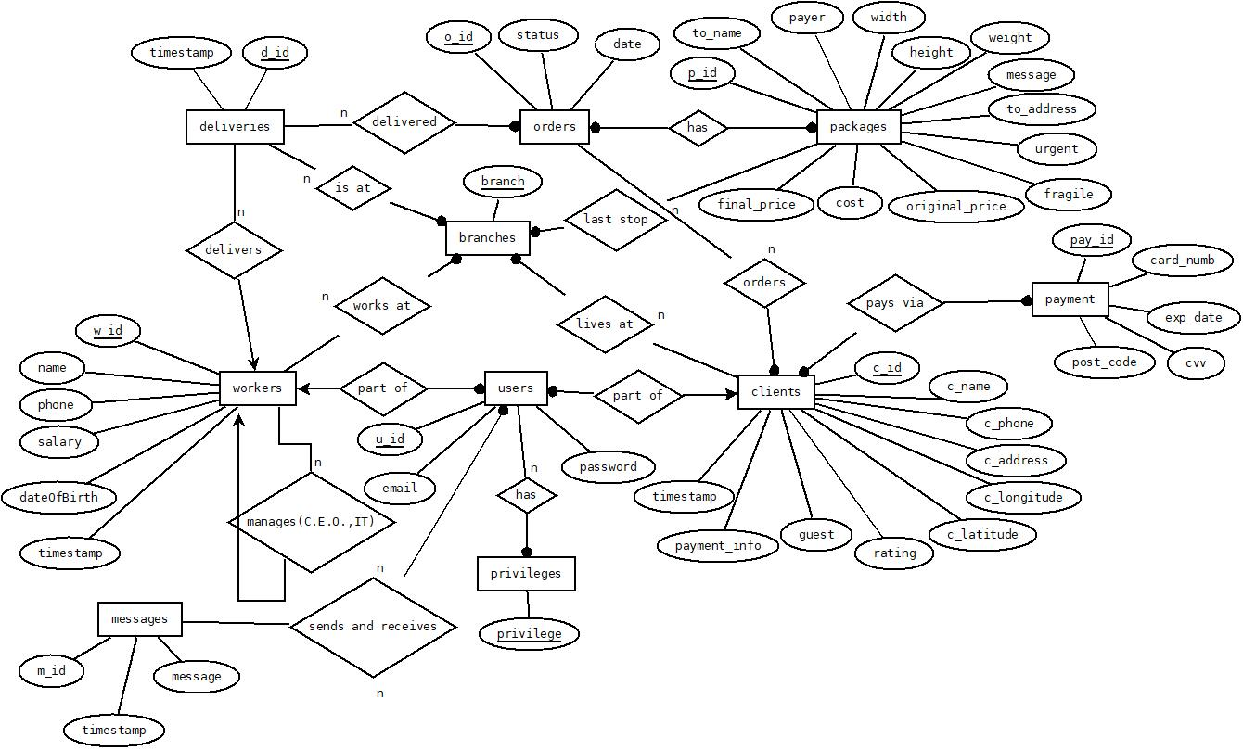
SPEEDRUN
ER diagram:
16

Slide 24
SPEEDRUN
Stage 05
Stage 06
Stage 07
Stage 08
Implementation
Conclusion
Future Work
Demonstration
17

Slide 25








SPEEDRUN Implementation
HTML5
01
02
XML
Css
03
04
Java Script
Xampp
05
Java
06
MySQL DB
PHP
08
07
18

Slide 26
SPEEDRUN Features:
IT
Workers informations
Branches
Hire
Messages
Password
He can view all workers and fire a worker
View all branches + add a new branch
Hire a new worker
He can receive or send messages to company users
He can change his password and other workers passwords
19

Slide 27
SPEEDRUN Features:
CEO
Statistics
Branches and workers
History
Messages
Password
He can view charts or tables for latest statistics
He can either hire or fire a worker and add a new branch
View all made orders + filtering them
He can receive or send messages to company users
He can change his own password
20

Slide 28
SPEEDRUN Features:
Client
Guest order
Track
View all his deliveries
Messages
Password
A guest mode delivery order is available
The client can track his deliveries
He can access all his deliveries informations
He can receive or send messages to company users
He can change his own password
21

Slide 29
SPEEDRUN Features:
Branch Manager
Deliveries informations
Fail
Track
Messages
Password
View all branch deliveries (urgent ones at top)
View all failed orders and resend them
Track an order
He can receive or send messages to company users
He can change his own password
22

Slide 30
SPEEDRUN Features:
Workers
Deliveries informations
Mobile app
Delivers
Messages
Password
View all branch deliveries (urgent ones at top)
He has an easy to use mobile app to facilitate his daily job
Delivers the orders to another location
He can receive or send messages to company users
He can change his own password
23

Slide 31
SPEEDRUN
Stage 05
Stage 06
Stage 07
Stage 08
Implementation
Demonstrarion
Conclusion
Future work
24

Slide 32
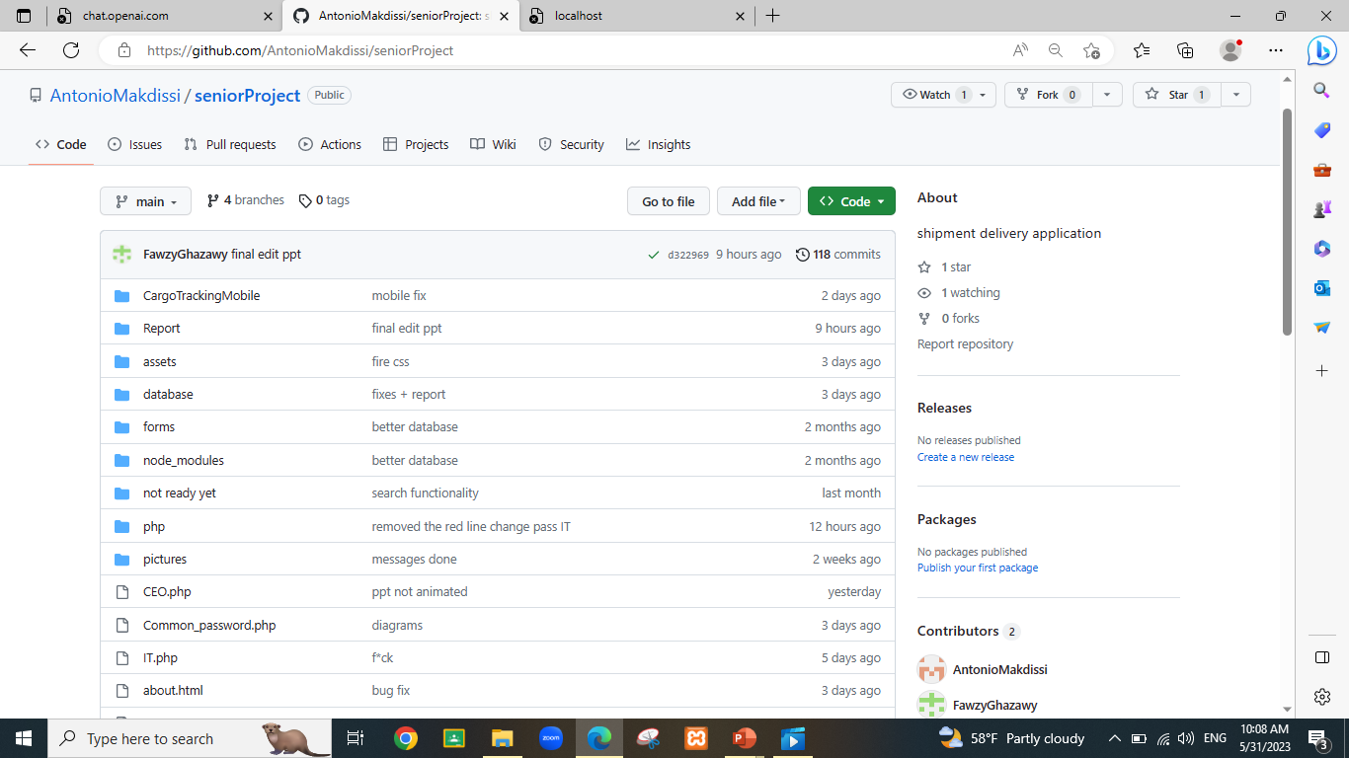
SPEEDRUN
Let’s head to the demo
25

Slide 33
SPEEDRUN
Stage 05
Stage 06
Stage 07
Stage 08
Implementation
Demonstrarion
Conclusion
Future work
26

Slide 34
SPEEDRUN
Conclusion:
Addressed challenges: Overcame transparency, efficiency, communication, security, competition, and demand issues.
Innovative solution: Developed advanced cargo tracking app with real-time tracking, automation, communication, security, and data insights.
Overcame obstacles: Achieved success through collaboration, task management, and persistence.
Industry impact: Optimized operations, reduced costs, increased revenue, improved overall satisfaction, and informed decision-making potential.
27

Slide 35
SPEEDRUN
Stage 05
Stage 06
Stage 07
Stage 08
Implementation
Demonstrarion
Conclusion
Future work
28

Slide 36
SPEEDRUN
Future work:
Strengthen cybersecurity: Implement ISO 28000 and ISO 31000 standards for enhanced information security.
Improve tracking: Integrate GPS tracking for real-time monitoring and accurate location tracking.
Streamline pricing: Enhance pricing system with bundles and dynamic adjustments for flexibility.
Enhance accessibility: Add dark mode and translation capabilities for improved usability.
29

