Slide 1
Employee Data Analysis using Excel
STUDENT NAME: FAYAZULLAH. A
REGISTER NO: 312211605
DEPARTMENT: COMMERCE GENERAL
COLLEGE THIRUTHANGAL NADAR COLLEGE

Slide 2
PROJECT TITLE
Employee Performance Analysis using Excel

Slide 3


AGENDA
Problem Statement
Project Overview
End Users
Our Solution and Proposition
Dataset Description
Modelling Approach
Results and Discussion
Conclusion
3/21/2024 Annual Review

Slide 4
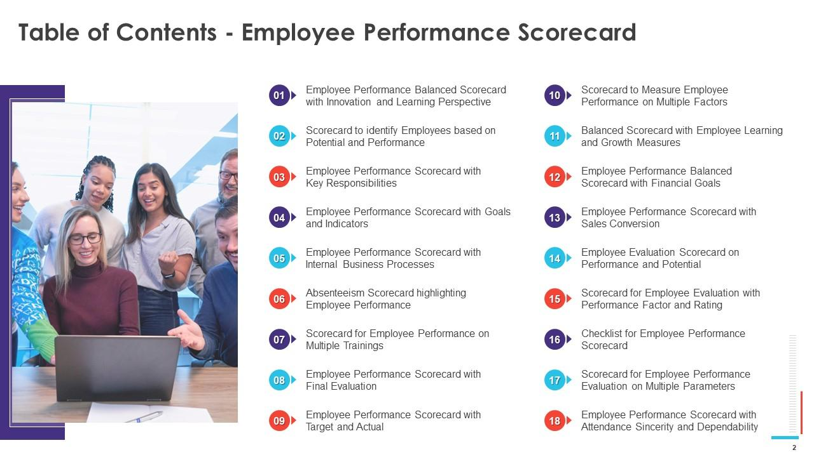

PROBLEM STATEMENT

Slide 5
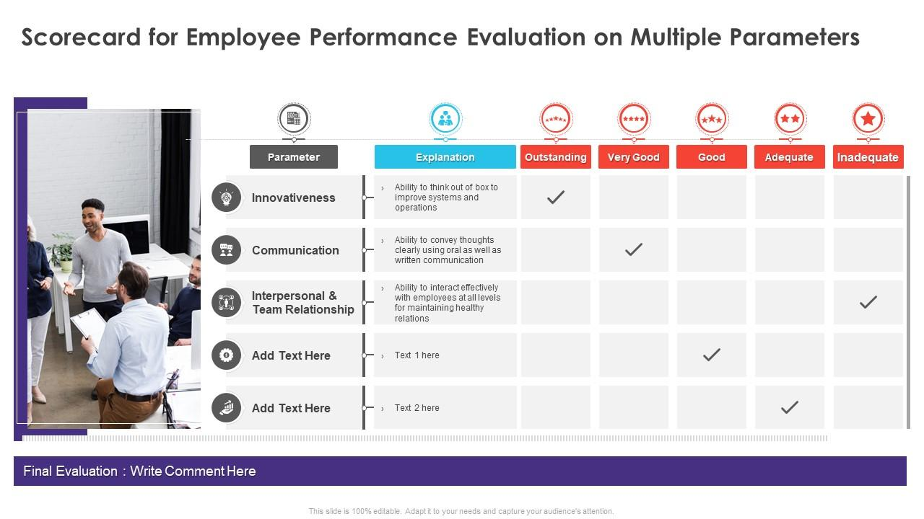

PROJECT OVERVIEW
.

Slide 6
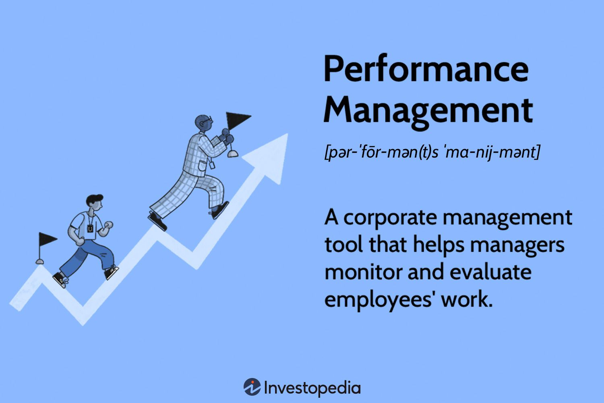

WHO ARE THE END USERS?

Slide 7

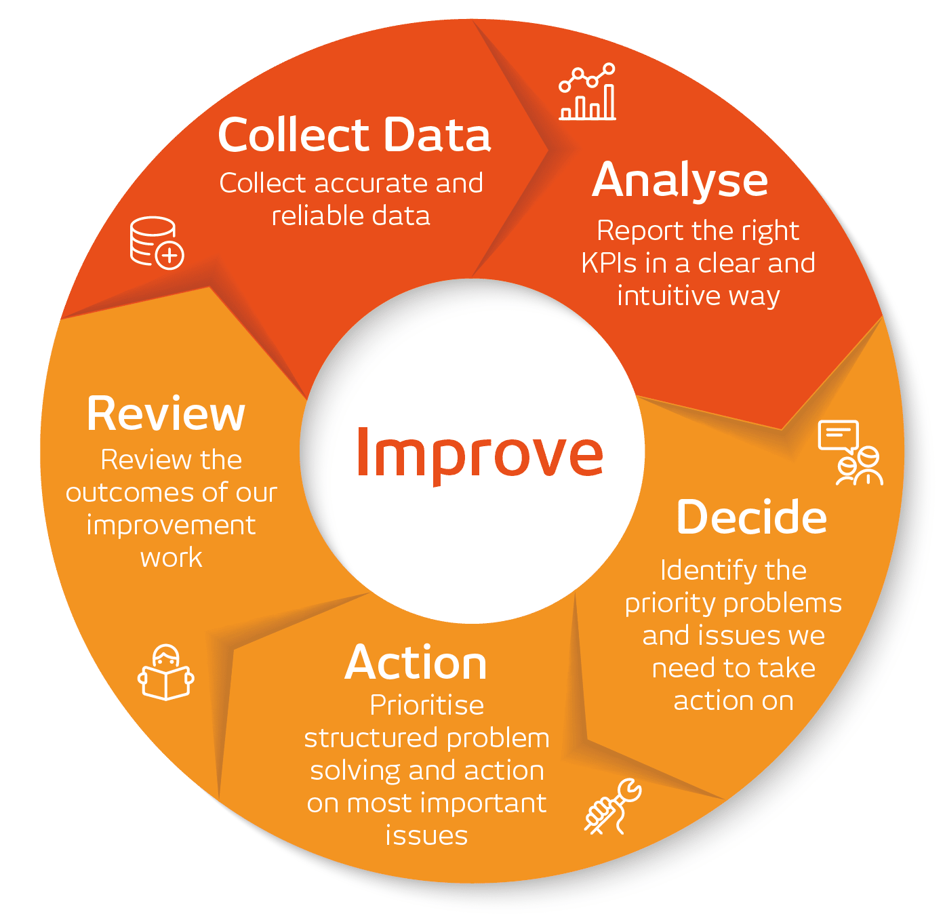
OUR SOLUTION AND ITS VALUE PROPOSITION

Slide 8
Dataset Description
A collection of data
A dataset is a structured collection of data that is organized and stored for processing or analysis. It can include many different types of data,
A research study
A dataset can also refer to a collection of raw statistics and information generated by a research study. Datasets produced by non-profit organizations or government agencies can usually be downloaded for free.
A job description
A job description dataset can include information about a job's role, job portal, job description, benefits, skills, responsibilities, company name, and company profile

Slide 9

THE "WOW" IN OUR SOLUTION
Employees
Scorecards can help managers track employee performance over time, and identify areas where employees may need training or development. They can also help managers identify employees who are meeting or exceeding expectations, and those who may need more help. Scorecards can be tailored to fit the needs of each company and can be used for any type of employee, from hourly workers to managers.
3/21/2024 Annual Review
‹#›

Slide 10
 | COUNTA of EmpID | COUNTA of Performance Score
 | 0 | 0
Aaden | 1 | 1
Aaliyah | 1 | 1
Aarav | 1 | 1
Aaron | 2 | 2
Abagail | 3 | 3
Abbigail | 3 | 3
Abby | 3 | 3
Abdellah | 1 | 1
Abdiel | 1 | 1
Abdullah | 4 | 4
Abel | 4 | 4
Abigayle | 1 | 1
Abram | 1 | 1
Abril | 2 | 2

Slide 11
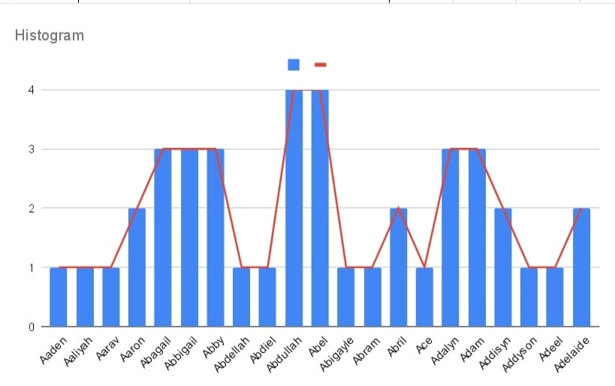
MODELLING
‹#›

Slide 12
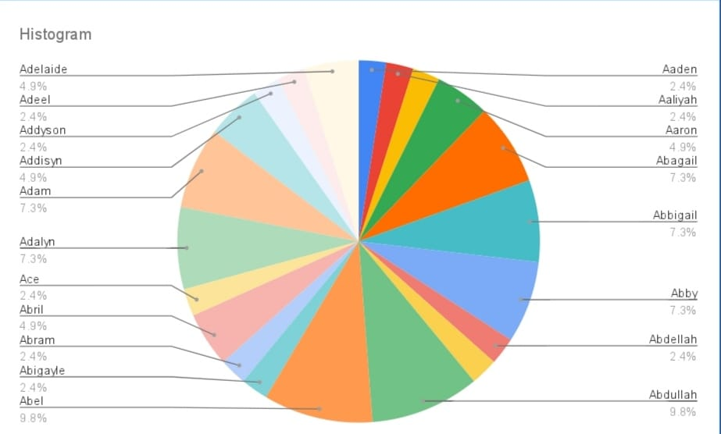
RESULTS
‹#›

Slide 13
