Slide 1
Volunteer and leadership

Slide 2
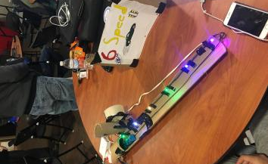
6 SPEED! Our game

Slide 3
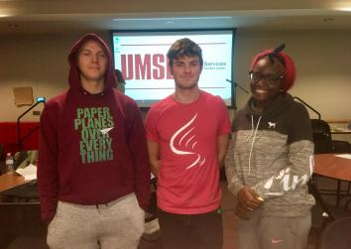
The team

Slide 4
This game is a physical game made using Arduino and Unity for the digital introduction. In the physical representation of the game, a car is pulled along a "track" using a stepper motor. LED lights represent the checkpoints in the track were you have to press the corresponding button. If a button is not pressed in the correct amount of time, your time extends. This game was made to represent drag racing and shifting. At the end of the game, your time is sent to an iPhone. There is no "losing" but the goal is to have the fastest time.

Slide 5
Women can
Chair
Compete in various computer competitions
Student Organization
Fundraising, social media, public relations, and government REP
IT and Computer Science networking for women

Slide 6

STL CYBERCON
Volunteer
Student organization leader volunteer

