Slide 1
ITCS-3160 Project campus controlled delivery service database
By Fayliette Lewis and Heath-Vonn Styles

Slide 2
Business Rules
Delivery personnel must be approved
All delivery personnel are students.
A person orders food one to many times
An individual delivery is tied to one and only one person for the order
An order is for one and only one restaurant.
Person can have one to many orders.
Food providers or restaurants must be approved

Slide 3
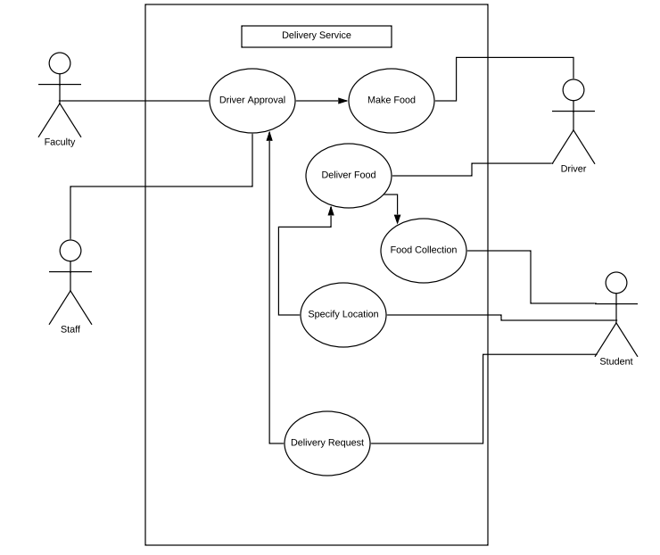
USE case diagram

Slide 4
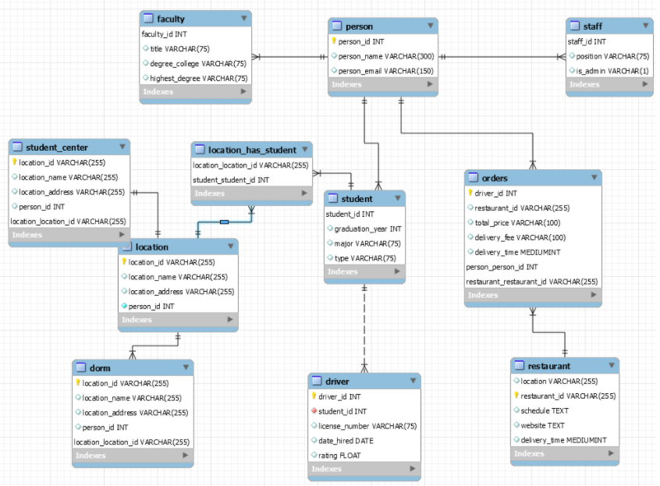
EERd

Slide 5
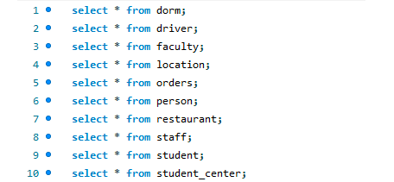
Select * queries

Slide 6
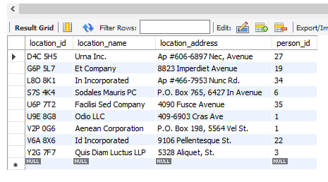
Select * queries
Select *
From dorm

Slide 7
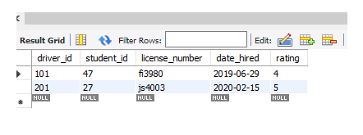
Select * queries
SELECT *
FROM driver

Slide 8
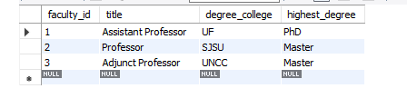
Select * queries
SELECT *
FROM faculty

Slide 9
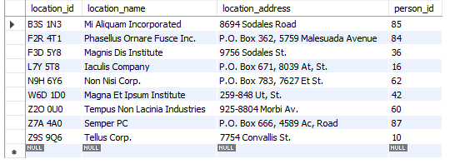
Select * queries
SELECT *
FROM location

Slide 10
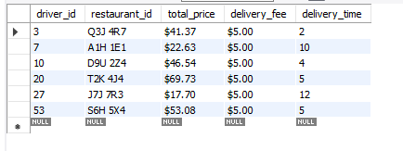
Select * queries
SELECT *
FROM orders

Slide 11
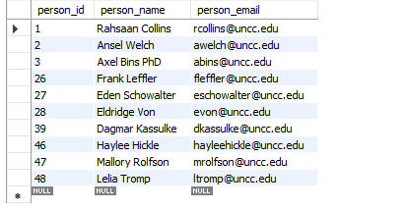
Select * queries
SELECT *
FROM person

Slide 12
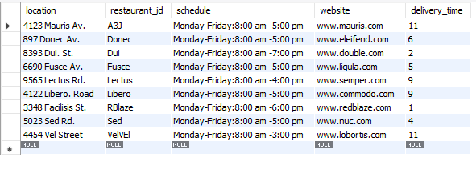
Select * queries
SELECT *
FROM restaurant

Slide 13
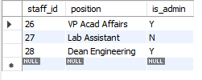
Select * queries
SELECT *
FROM staff

Slide 14
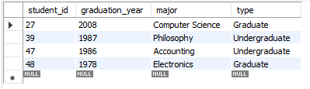
Select * queries
SELECT *
FROM student

Slide 15
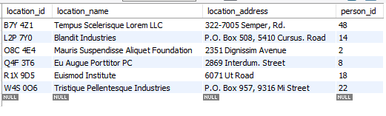
Select * queries
SELECT *
FROM student_center

Slide 16
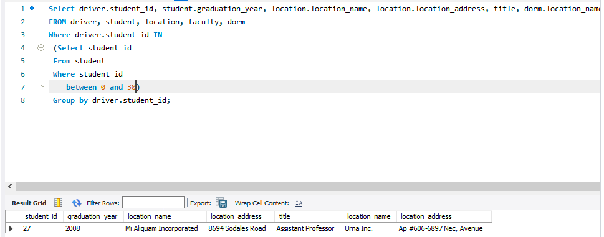
ADVANCED VIEWS
This query gives you the student id, graduation year, location name, location address, title , and dorm name where student id is between 0 and 30.

Slide 17
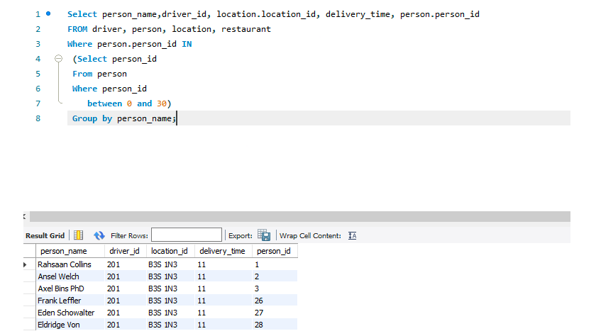
ADVANCED VIEWS
This query gives you the name of the person who received a delivery, the person id, the location where the delivery was made, the delivery time, and the driver, where the person id is between 0 and 30.

Slide 18
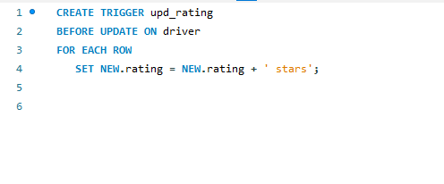
Trigger
This trigger adds the word stars to the rating number every time a new rating is added.

Slide 19
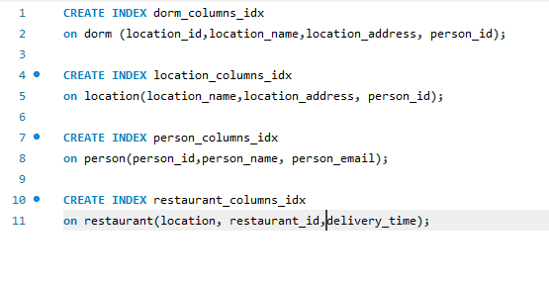
Indexes
These indexes were created to speed up the process of queries that include columns from the tables included in the index.

Slide 20
The end

