Slide 1
OPC UA-based industrial monitoring through edge gateway
Industrial Communication Prof. Dr.-Ing.Ali hayek
Team-B03
Md Azadul Islam matric no.: 2220070
Md Rafiul Islam matric no.:1232714
Md Jubair Salehin Razin matric no.: 1230281
Faysal Ahammed Tonmoy matric no.: 1230473

Slide 2
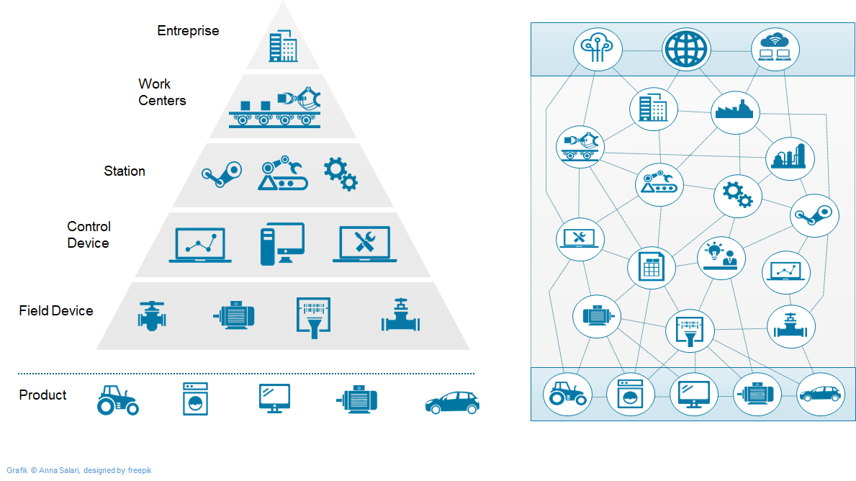
Motivation
Challenges
Multiple industrial communication protocols
Difficult system integration
Limited interoperability
Why OPC UA?
Standardized communication
Structured machine data
Industry 4.0 compatible
Visual: automation pyramid.

Slide 3
Overview
Industrial Data
Dashboard
Edge Gateway
Simulation and real sensor data
Edge gateway for data processing
OPC UA-based communication
Live dashboard visualization
Sensor Nodes
HTTP / MQTT / UDP
Raspberry Pi Gateway
OPC UA Server
Dashboard

Slide 4
System Architecture & Implementation
UaExpert
Verify NodeIds offline
OPC UA / UA TCP
read at 1 Hz
HTTP POST
JSON payload
msg.payload
live values
Prosys OPC UA
Simulation server
Python gateway
asyncua client @ 1 Hz
Node-RED
Parse + route JSON
Dashboard / HMI
Gauges + charts
exposes nodes
JSON payload
OPC UA address space
Counter = ns=3;i=1002
Sinusoid = ns=3;i=1004
Triangle = ns=3;i=1006
OPC UA / UA TCP — acquisition
HTTP / JSON — forwarding
OPC UA = structured machine-data acquisition. HTTP/JSON = forwarding clean values to the dashboard.

Slide 5
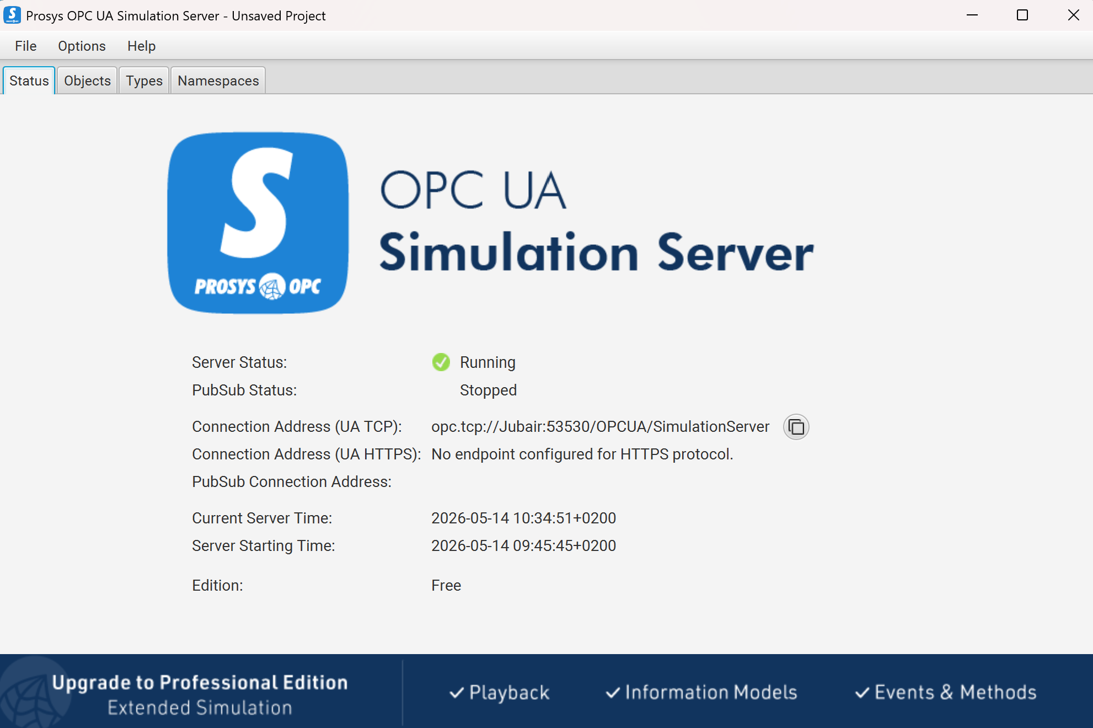
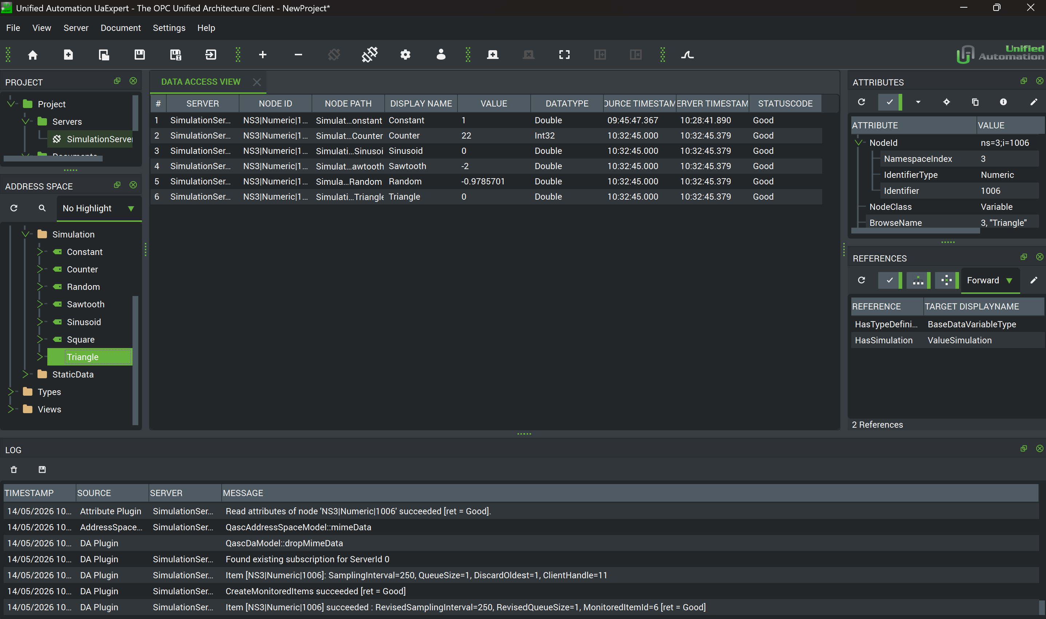
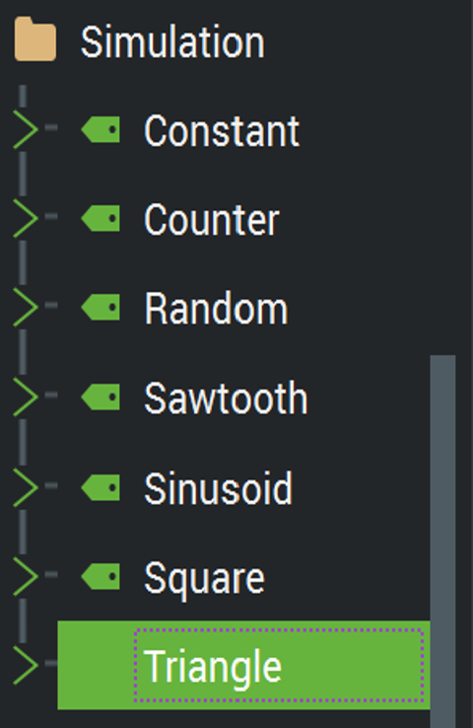
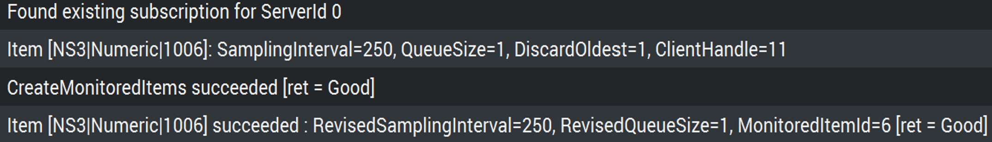
System Verification
Prosy: Simulated industrial machine
UaExpert: OPC UA client for verification

Slide 6
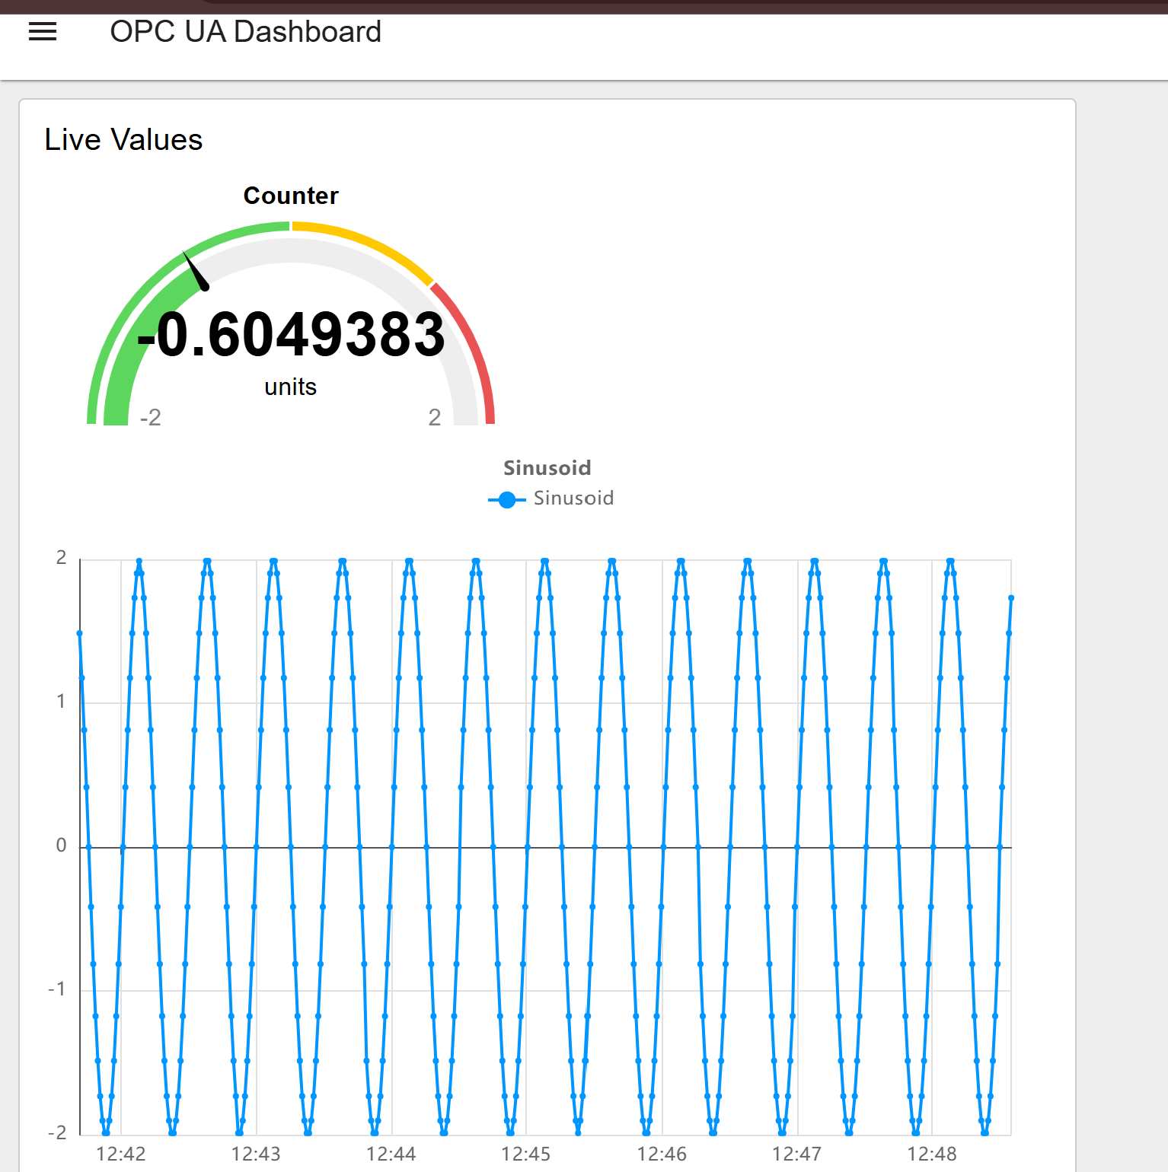
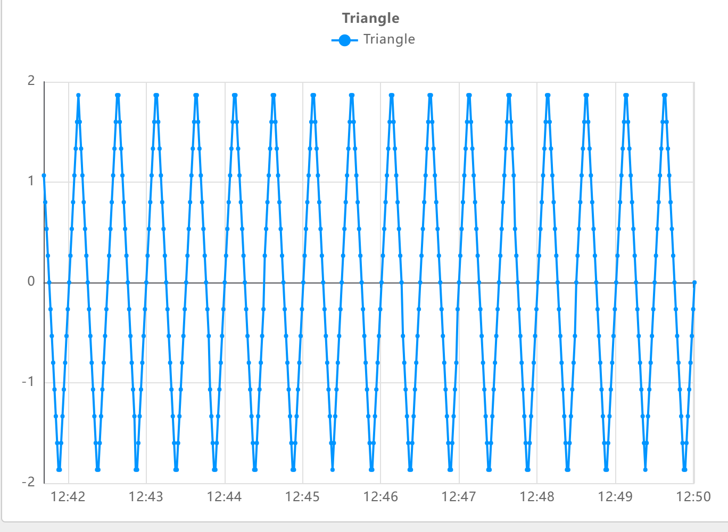
Results & Dashboard
Prosys OPC UA Server → Python Edge Gateway → Node-RED → Dashboard.

Slide 7
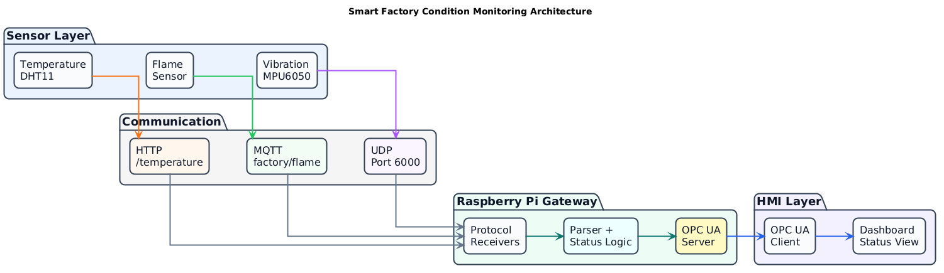
Hardware Level System Overview
Three sensor nodes
HTTP, MQTT, UDP
Raspberry Pi gateway
OPC UA to dashboard

Slide 8
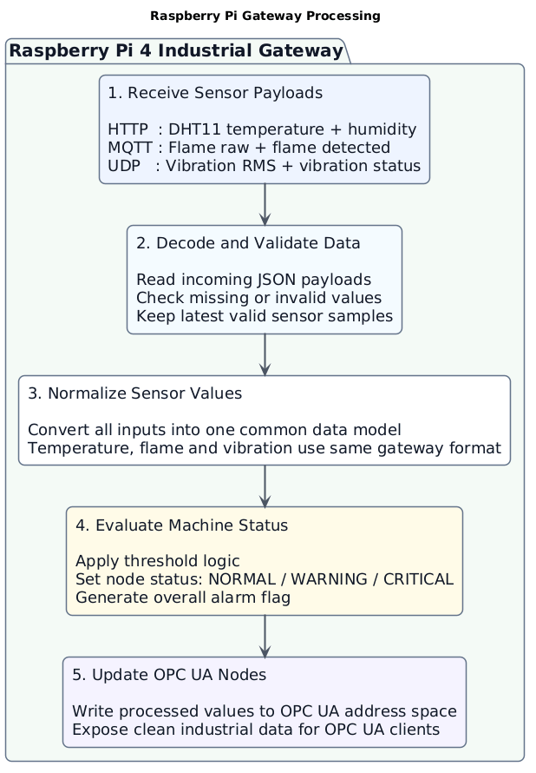
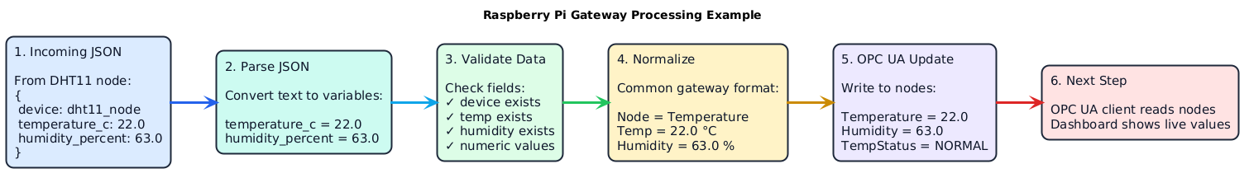
Gateway Processing
Raspberry Pi Receive sensor payloads
Decode JSON data
Normalize values
Update OPC UA nodes
Example:

Slide 9
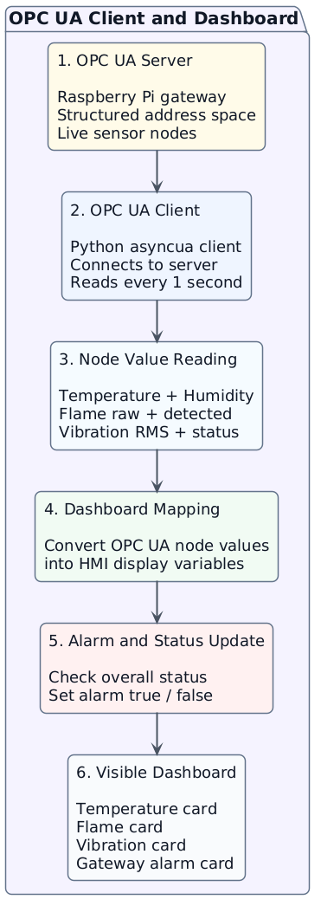
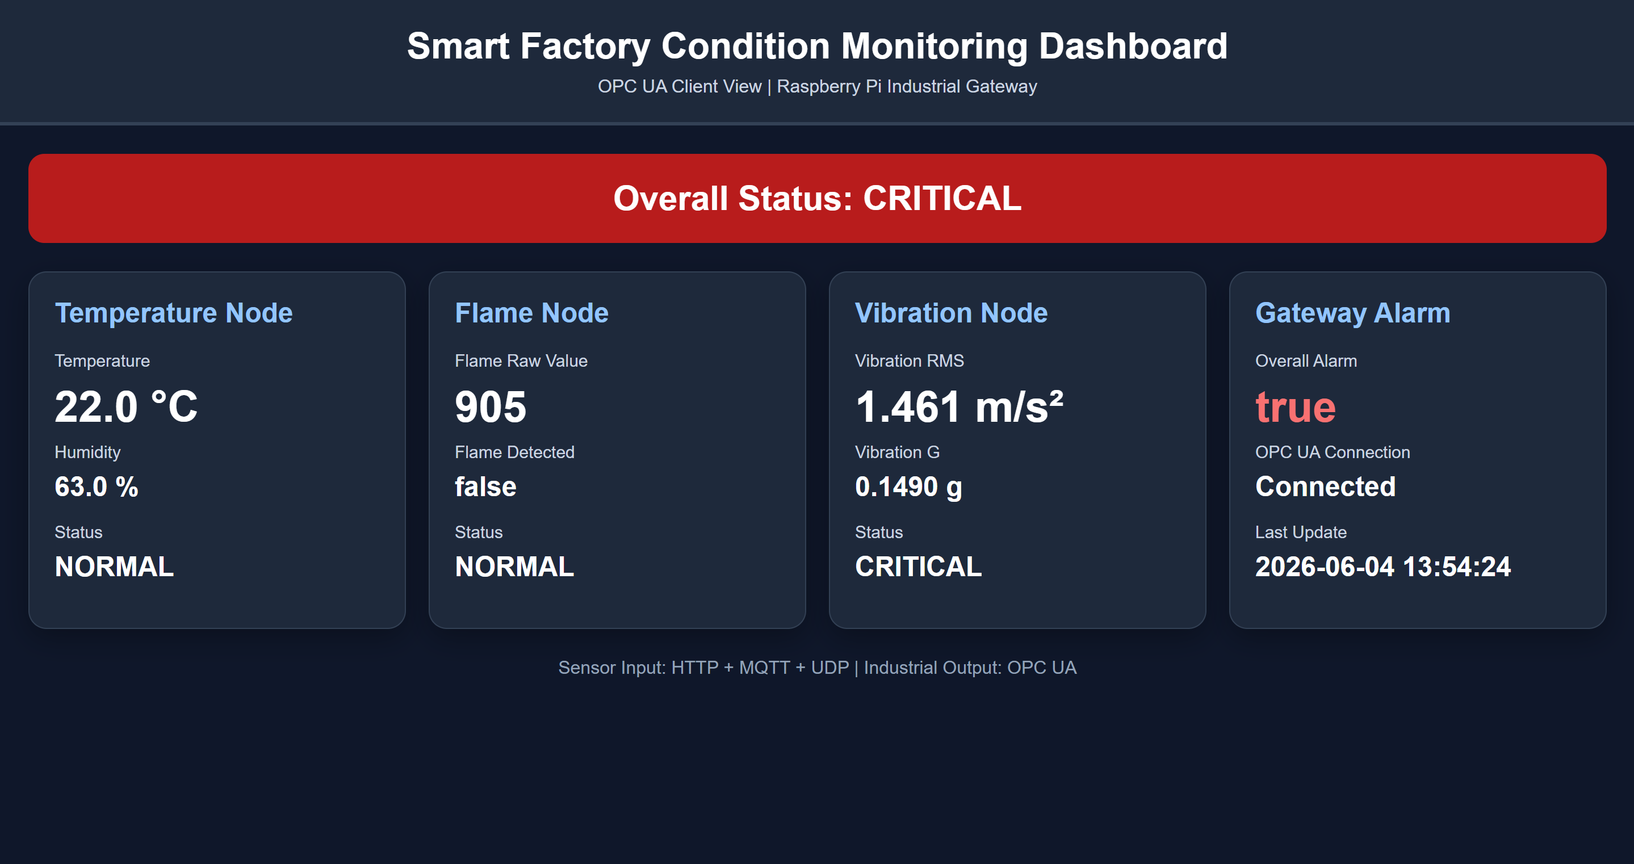
Dashboard Visualization

Slide 10
System L​imitations & Future Development
Limitations:
Not yet tested with real factory machines.
Data Storage system not added
Wi-Fi or a sensor fails, the system needs better recovery.
Future improvement:
Store data in a database.
Add auto-reconnect and error logging.

Slide 11
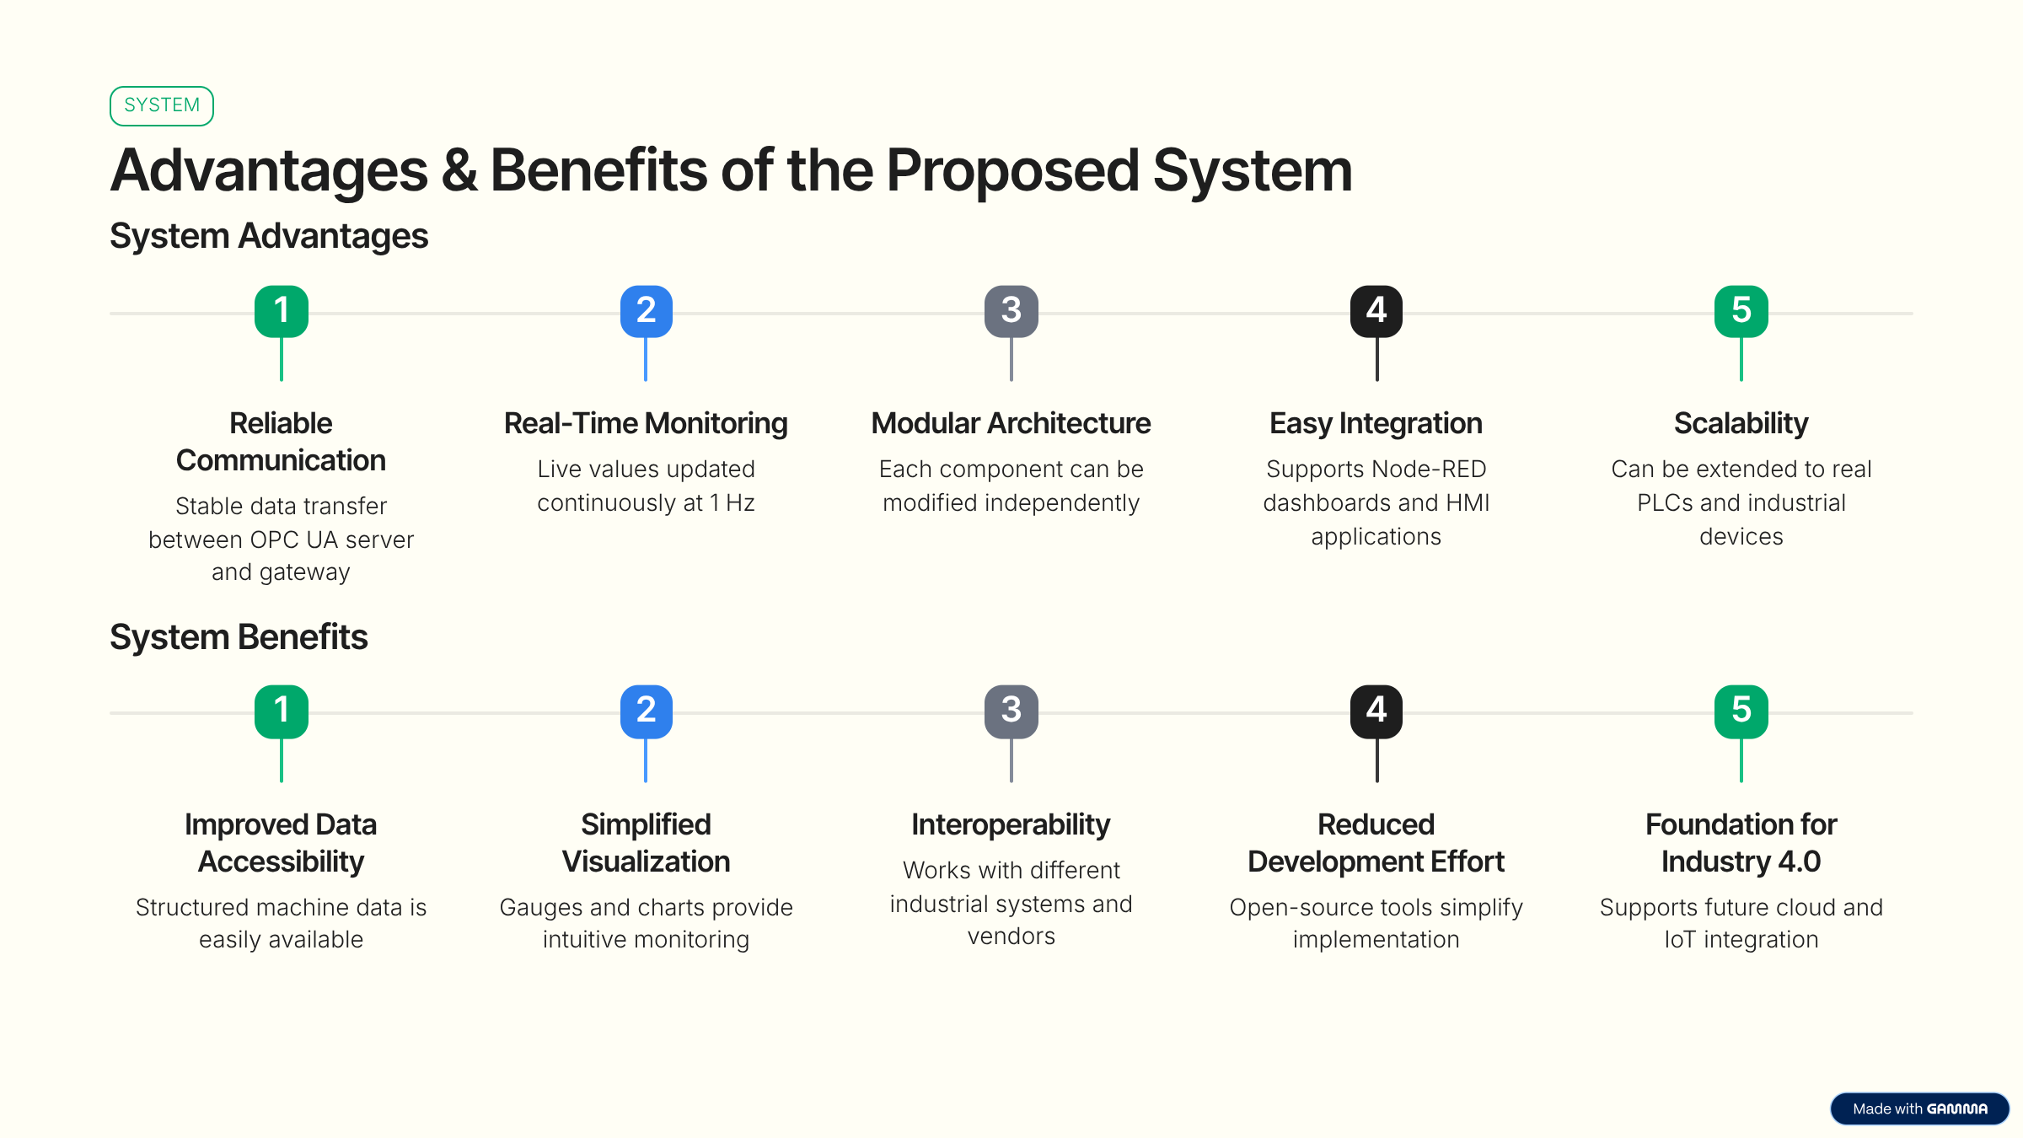
Advantages and Benefits

Slide 12
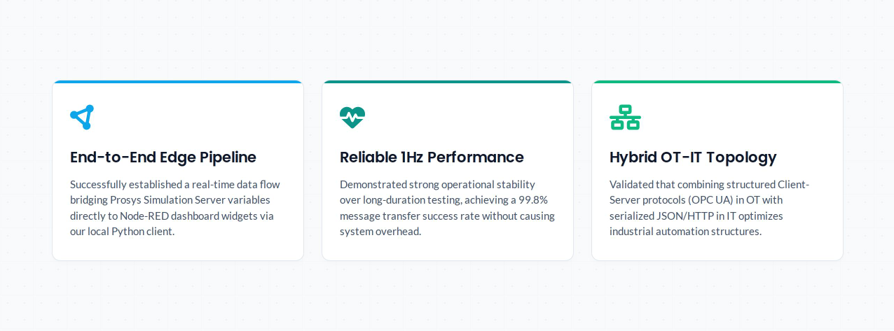
Project outcome and Summery
14

Slide 13
Thank you

