Slide 1
Predicting and Characterising
Air Pollution Patterns in Beijing
Using Machine Learning
Enrik Shabani · Daniel Schneggenburger · Faysal Fouzi
HEC Lausanne — Master in Management, Business Analytics
May 2026

Slide 2
Agenda
01
Context & Problem
Why air pollution in Beijing? Why machine learning?
02
Dataset & Preprocessing
12 stations, 420K+ observations, temporal interpolation
03
Supervised Learning
3 models × 3 feature sets — predicting hourly PM2.5
04
Unsupervised Learning
K-Means + PCA — identifying pollution regimes
05
Results & Conclusion
Key findings, limitations, outlook

Slide 3
Context & Problem
Context
The Problem
Our Objective
PM2.5 linked to respiratory & cardiovascular disease (WHO, 2018)
Beijing: one of the most polluted megacities globally
Mean PM2.5 = 79.7 µg/m³ — WHO limit is 5 µg/m³
Extreme episodes > 500 µg/m³ recorded in winter
Predict hourly PM2.5 concentrations using supervised ML
Identify recurring pollution regimes via unsupervised learning
Understand key drivers of air quality variations
12
420K+
4 years
6
monitoring
stations
hourly
observations
2013–2017
pollutants
measured

Slide 4
Dataset & Preprocessing
Data
Beijing Multi-Site Air Quality Dataset
Preprocessing Steps
Variables
Missing values: temporal linear interpolation (gap ≤ 6h)
Longer gaps: station-level median imputation
Temporal train/test split (80% / 20%) — no data leakage
Log-transform on skewed pollutants (PM2.5, PM10, CO, SO₂)
StandardScaler for unsupervised features
Pollutants:
PM2.5 (target)
PM10
NO₂
CO
SO₂
O₃
Meteorological:
Why temporal interpolation?
WSPM (wind speed)
TEMP (temperature)
DEWP (dew point)
Pollution levels evolve continuously — adjacent observations are the best proxy for missing values. Discarding incomplete records would cause significant information loss across 4 years of data.

Slide 5
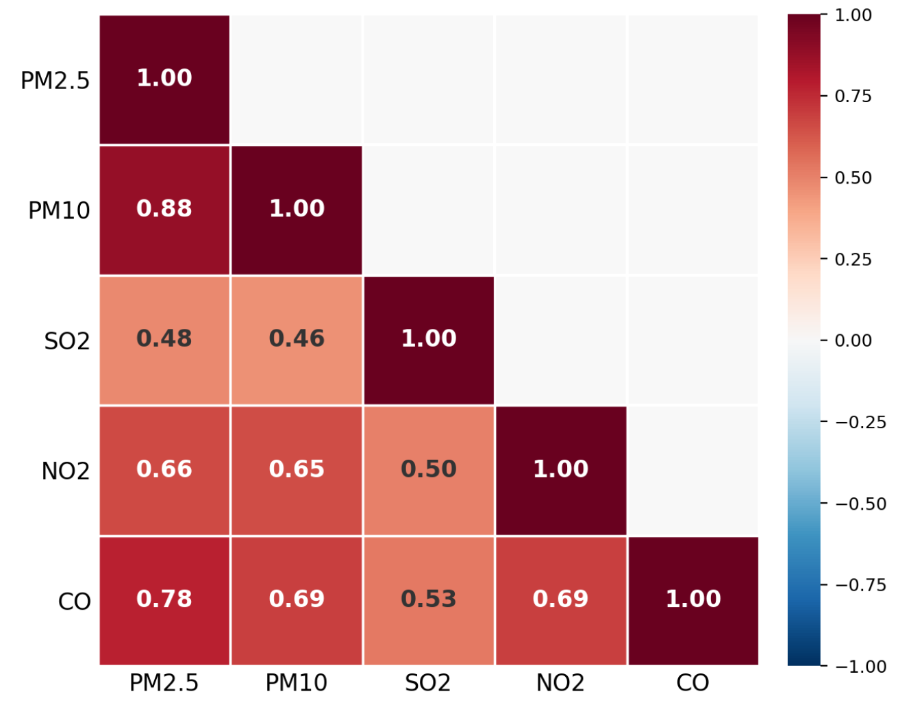
EDA — Correlation Analysis
EDA
Top correlations (PM2.5, PM10, SO₂, NO₂, CO) — Pearson correlation matrix (Figure 5)
Key Correlations with PM2.5
PM10 r = 0.88 — shared emission sources (traffic, industry)
CO r = 0.78 — combustion indicator
NO₂ r = 0.66 — vehicles and heating
SO₂ r = 0.46 — coal burning, seasonality
WSPM r = −0.27 — wind disperses particles
Key Insight
Combustion-related pollutants (CO, NO₂, PM10) cluster tightly with PM2.5 — pointing to shared traffic and heating emission sources.
These findings directly drive feature selection in the supervised models (Feature Set C includes CO, NO₂, SO₂, O₃).
Extracted from Report figure 5: Pearson correlation matrix (top 5)

Slide 6
Supervised Learning — Methodology
Supervised
Predicting hourly PM2.5 concentrations
3 Feature Sets of Increasing Richness
Set A
Set B
Set C
(final)
Weather + temporal
+ station dummies
PM2.5 lags & rolling means
(1h, 3h, 6h)
Set A + Set B
+ co-pollutants
(CO, NO₂, SO₂, O₃)
3 Model Families
OLS
Ridge
HGB ★
Linear baseline
L2 regularisation
Histogram Gradient
Boosting — final model

Slide 7
Supervised Learning — Results
Supervised
HGB with feature set C achieves best performance — RMSE 17.04 µg/m³, R² = 0.958
17.04
0.958
>70%
pm25_lag_1h
Test RMSE (µg/m³)
Test R²
RMSE drop
(Set A → C)
Top predictor
Full Model Comparison — Table 1
Key Findings
Model | Set | Tr.RMSE | Te.RMSE | Tr.R² | Te.R²
HGB ★ | C | 15.04 | 17.04 | 0.965 | 0.958
OLS | C | 18.72 | 17.41 | 0.946 | 0.956
Ridge | C | 18.72 | 17.41 | 0.946 | 0.956
Ridge | B | 20.18 | 18.77 | 0.937 | 0.949
OLS | B | 20.18 | 18.77 | 0.937 | 0.949
HGB | B | 19.80 | 19.38 | 0.939 | 0.945
HGB | A | 49.13 | 56.63 | 0.625 | 0.534
OLS | A | 63.29 | 65.19 | 0.377 | 0.382
Ridge | A | 63.29 | 65.20 | 0.377 | 0.382
Feature engineering matters far more than model complexity
PM2.5 lag features explain >70% of RMSE improvement
OLS = Ridge on sets B & C (regularisation becomes negligible)
Model underpredicts extreme episodes (>400 µg/m³)
Limitation: relies on most recent observation → poor for multi-horizon forecasting
Metric on raw PM2.5 scale — directly interpretable in µg/m³

Slide 8
Unsupervised Learning — Methodology
Unsupervised
K-Means clustering
Preprocessing for Clustering
Aggregate to daily station means (17,532 obs.)
Log-transform skewed pollutants (PM2.5, PM10, CO, SO₂) → prevent extreme pollution episodes from dominating the distance calculations.
Replace TEMP & DEWP with monthly anomalies → removes seasonal bias
Winsorise at 1st–99th percentiles
Exclude lag features (no prediction goal here)
Key insight:
By replacing raw temperature with monthly anomalies, we ensure K-Means captures actual pollution regimes — not just seasons. This is the critical preprocessing step that makes the clusters meaningful.

Slide 9
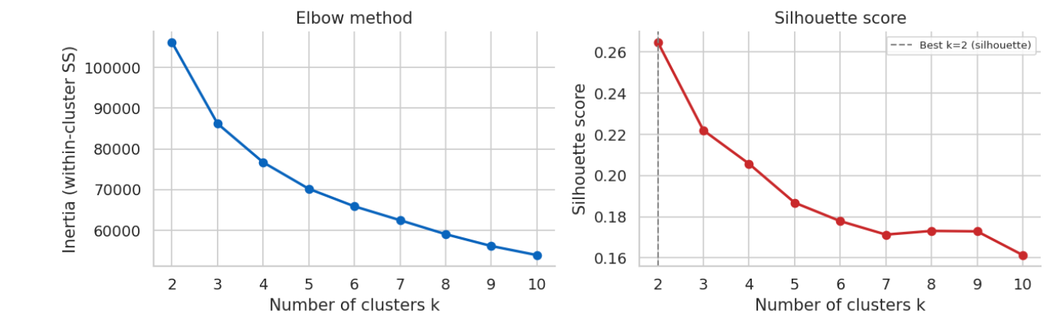
Unsupervised Learning — Choosing k
Unsupervised
Elbow method + silhouette score used to select k = 4 clusters
Inertia & Silhouette for k
K-Means Elbow method & Silhouette score
k | Inertia | Silhouette
2 | 106,201 | 0.2648
3 | 86,211 | 0.2220
4 | 76,700 | 0.2057
5 | 70,202 | 0.1868
6 | 65,892 | 0.1779
7 | 62,497 | 0.1713
8 | 59,062 | 0.1731
9 | 56,152 | 0.1729
10 | 53,923 | 0.1613
Extracted from Report figure 15
Key observations:
Inertia drops fast from k = 2 → 4, then flattens.
Silhouette peaks at k = 2 but surely only leads to a binary clean/polluted split — not actionable.
k = 4 balances compactness with meaningful interpretability.
Low silhouette (0.206) expected: pollution evolves continuously, not in discrete jumps. Common in environmental clustering literature.
Extracted from report table 3

Slide 10
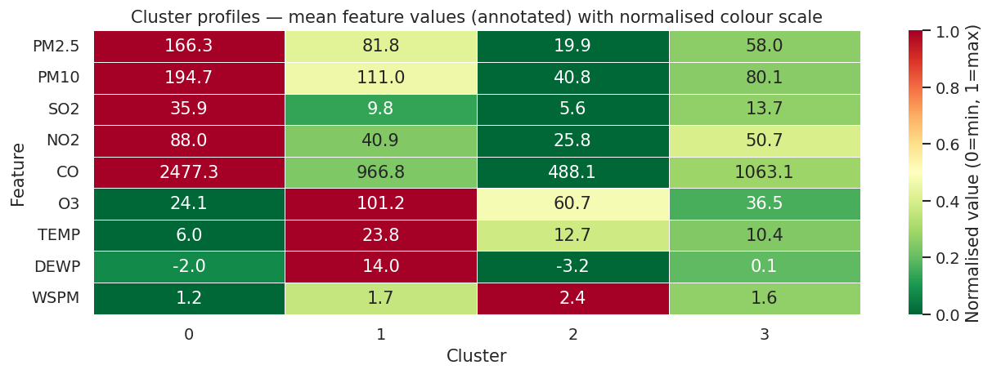
Unsupervised Learning — Results
Unsupervised
Severe Pollution
Episodes
Summer
Photochemical Haze
Clean / Windy
Moderate
Conditions
3,879 obs.
4,648 obs.
4,254 obs.
4,751 obs.
PM2.5: 166 µg/m³
CO: 2477 | Wind: 1.2 m/s
PM2.5: 82 µg/m³
O₃: 101 (high!)
PM2.5: 20 µg/m³
Wind: 2.4 m/s (highest)
PM2.5: 58 µg/m³
All vars intermediate
Winter 47%
Autumn 29%
Summer 54%
Spring 31%
Balanced
across seasons
Balanced
slight Autumn↑
Cluster profile – mean feature values
Extracted from Report figure 16

Slide 11
Conclusion & Limitations
Conclusion
What we found — and what we can do better
Limitations
Key Findings
Dataset is ~10 years old (2013–2017) — may not reflect current Beijing
Supervised model requires most recent PM2.5 → limited to one-step-ahead prediction
Silhouette score 0.206 — clusters are tendencies, not strict groups
Both approaches converge: pm2.5, wind speed, CO, NO₂ are dominant drivers
Feature engineering > model complexity (>70% RMSE reduction)
4 interpretable pollution regimes identified
Seasonal + meteorological conditions are central
Outlook
More recent data + other Chinese cities
Add traffic counts, satellite imagery
Convergence of both approaches:
The supervised model and the unsupervised clustering independently identify the same key variables — pm25, CO, NO₂, wind speed. This cross-validation reinforces our conclusions.

Slide 12
Thank you.
Any Questions?
Enrik Shabani · Daniel Schneggenburger · Faysal Fouzi
HEC Lausanne — Master in Management, Business Analytics — May 2026

Slide 13
APPENDIX
Supporting material & additional results
Enrik Shabani · Daniel Schneggenburger · Faysal Fouzi
HEC Lausanne — Master in Management, Business Analytics — May 2026

Slide 14
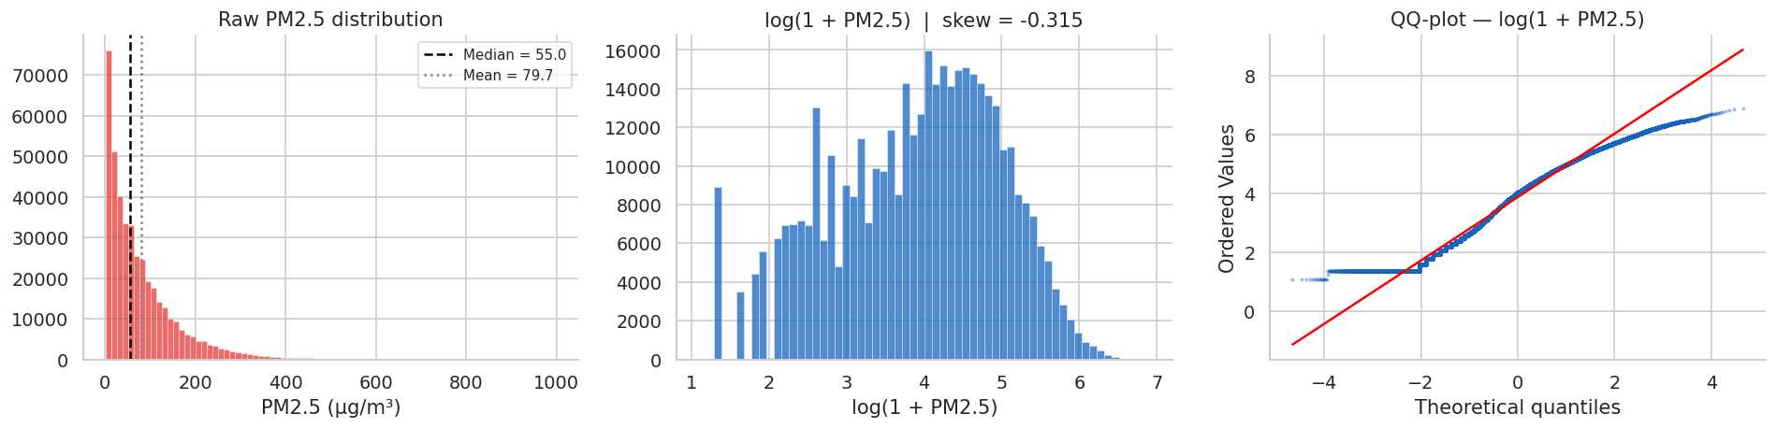
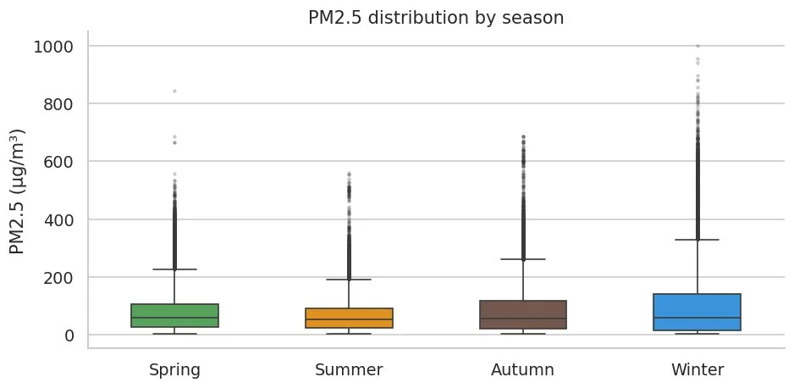
APPENDIX
Distribution and spread of PM2.5 (figure 1)
PM2.5 Distribution per season (figure 2)

Slide 15
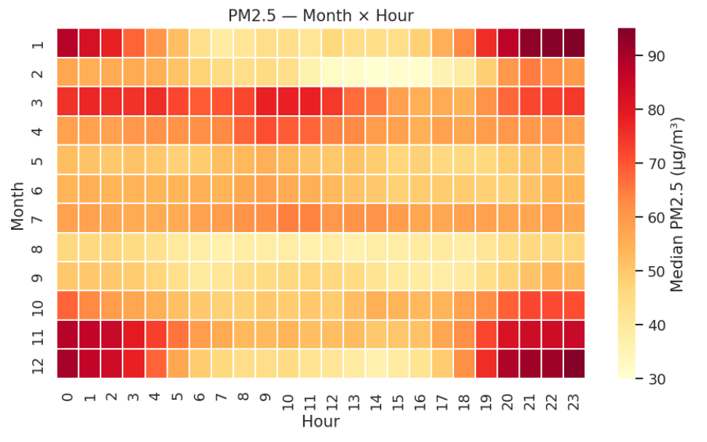
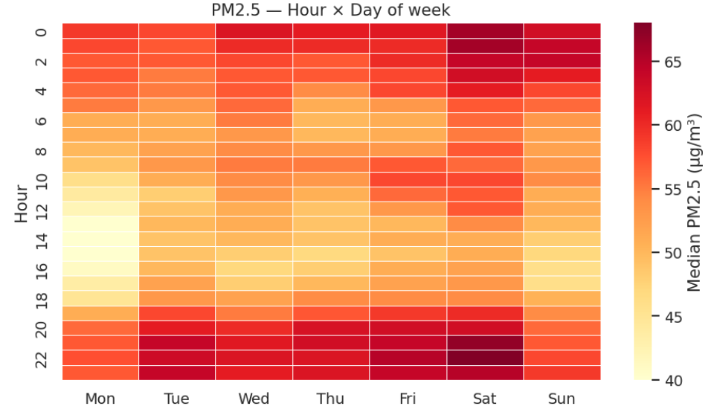
APPENDIX
Heatmap of PM2.5 month and hours (figure 3)
Heatmap of PM2.5 hour and day (figure 4)

Slide 16
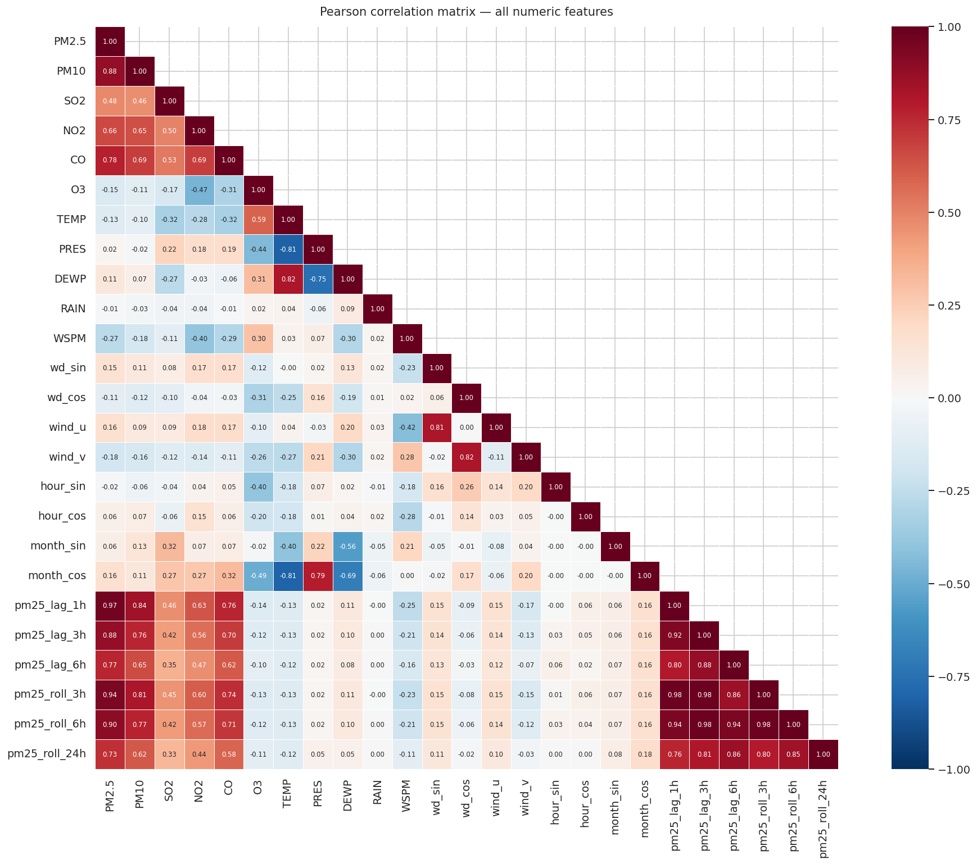
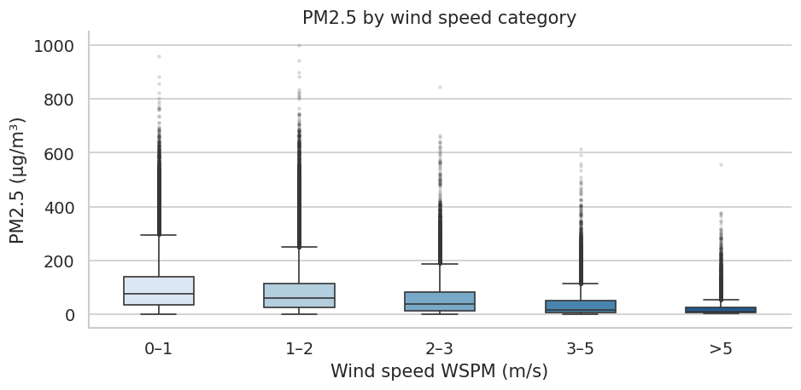
APPENDIX
PM2.5 by wind category (figure 6)
Pearson correlation Matrix (figure 5)

Slide 17
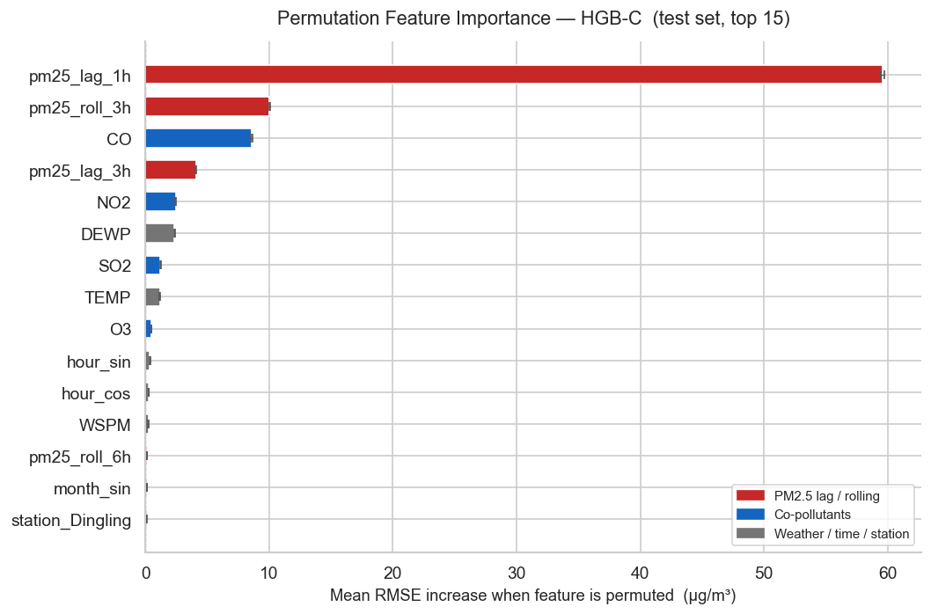
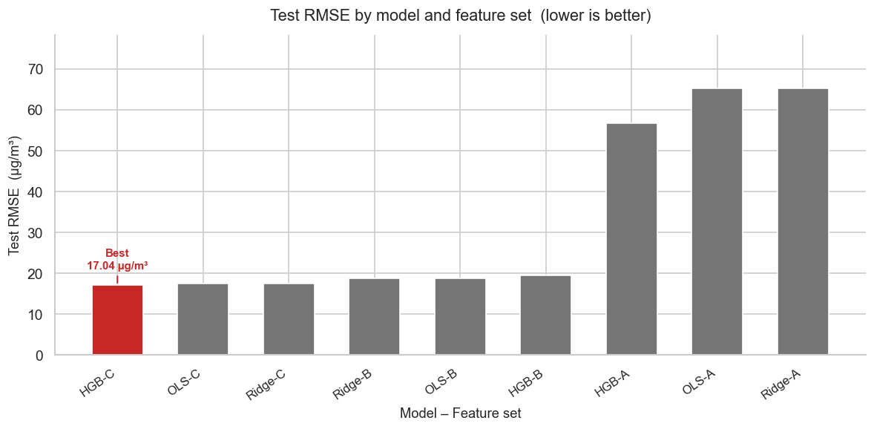
APPENDIX
Test RMSE by Model and feature set
(figure 7)
Permutation Feature Importance
(figure 8)

Slide 18
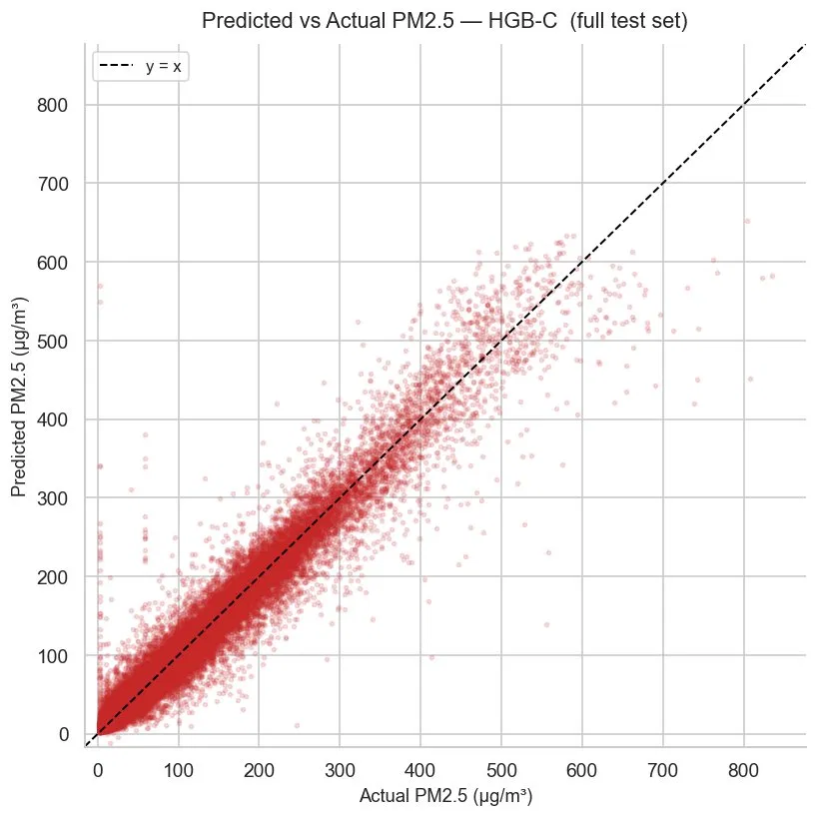
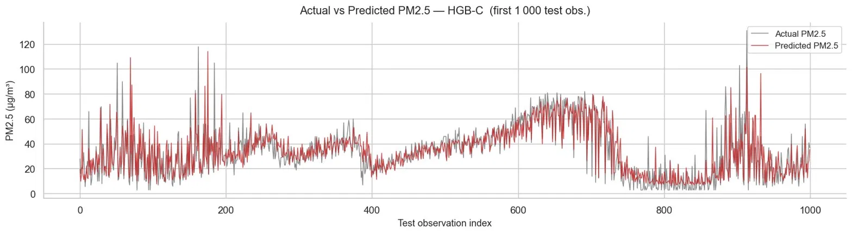
APPENDIX
Predicted vs Actual PM2.5
(figure 9)
Predicted vs Actual PM2.5
(figure 10)

Slide 19
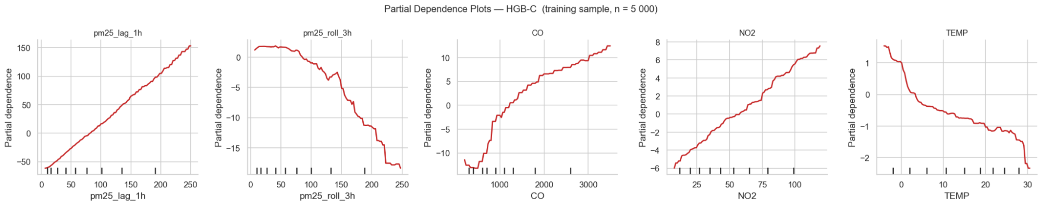
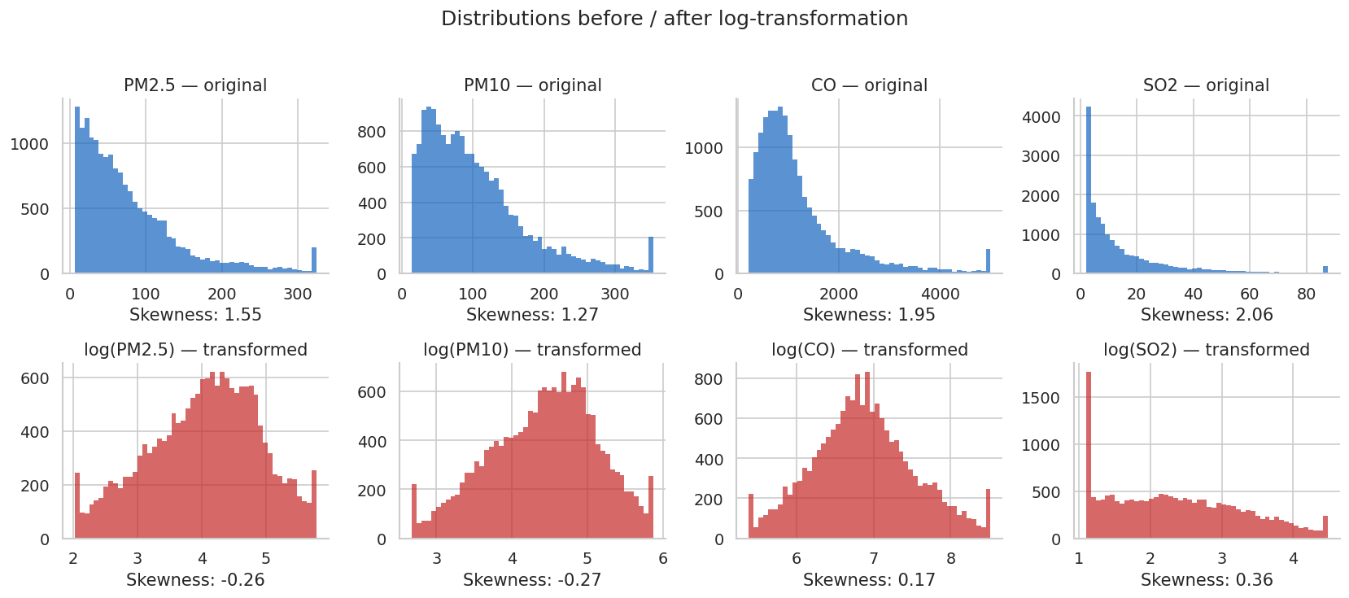
APPENDIX
Partial Dependance plots – HGB-C (figure 11)
Distributions of PM2.5, PM10, CO and SO2
before and after the log transformation (figure 12)

Slide 20
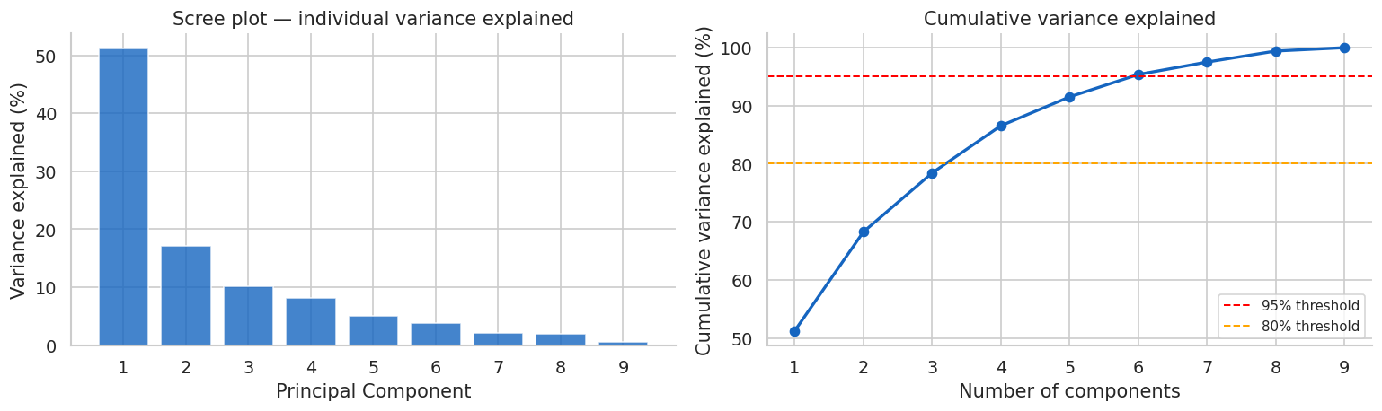
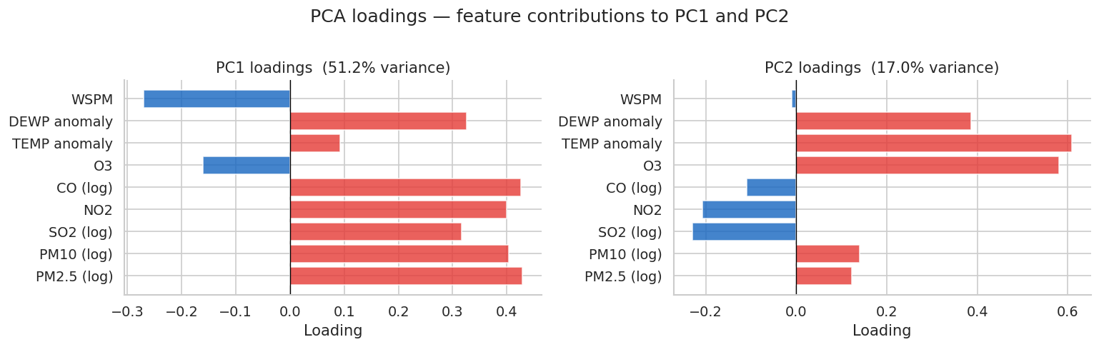
APPENDIX
PCA scree plot and variance explained (Figure 13)
PCA loadings – feature contributions to PC1 and PC2 (Figure 14)

Slide 21
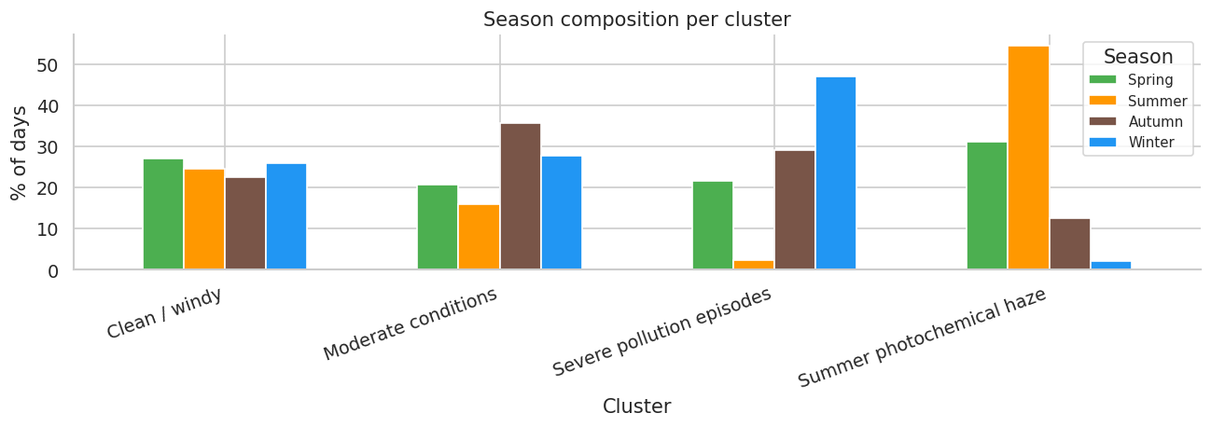
APPENDIX
Season composition per cluster (Figure 17)

Slide 22
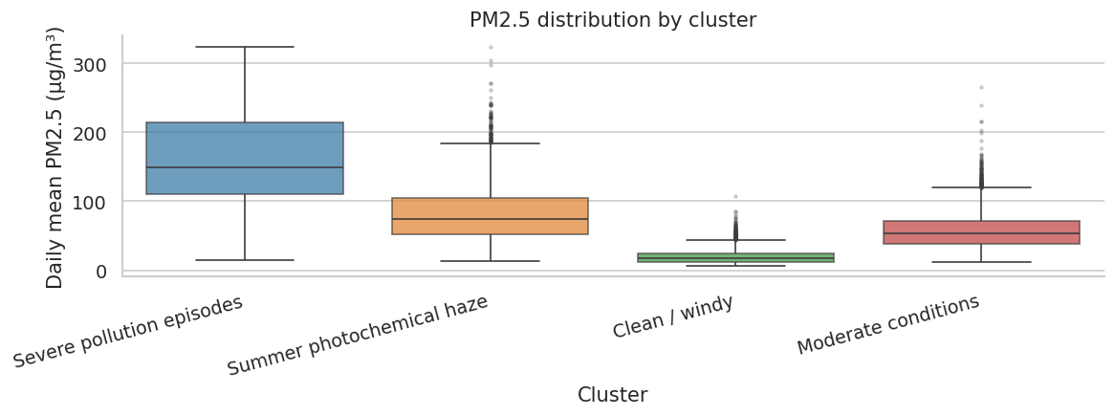
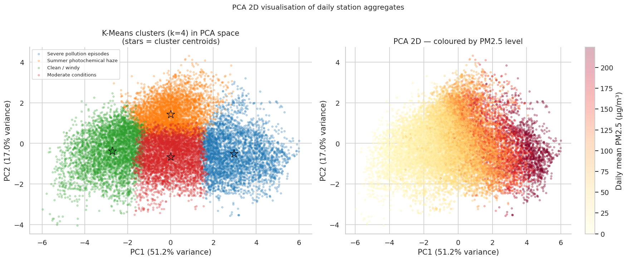
APPENDIX
PM2.5 boxplot distribution by season (figure 18)
PCA 2D visualisation of daily station aggregates.
(Figure 19)

