Slide 1
Tawlatna
FEASIBILITY STUDY & PROJECT PRESENTATION
Faysal Hossain Piyal · Albaraa Sait · Abdullah Bawazir
Aligned with UN SDGs & Saudi Vision 2030

Slide 2
Problem to be Solved
"Local cafés in Jeddah have empty tables during off-peak hours and cannot afford effective advertising, while people who enjoy board games have no reliable, safe and Arabic-friendly way to find and join organized game nights."
● Tawlatna is an event-management mobile platform that connects cafés seeking more foot traffic with people looking for board-game events.
● Affected stakeholders: Café owners · Casual players · Cashiers · Platform operators (Developer/Admin)
SDGs & Vision 2030:
SDG 8 Economic Growth · SDG 11 Sustainable Communities · Vision 2030 Quality of Life
Tawlatna — 2 / 12

Slide 3
Market Study — Feasibility (1/2)
Technical
Relies on proven technology: Flutter mobile app (iOS and Android), cloud hosting in Saudi-region data centers, payment-gateway integration, and offline-cached QR codes. Low technical risk.
Operational
Lean founding team of four growing to nine by the end of Year 1. No venues, inventory or major facilities are needed because the model is asset-light.
Legal & Regulatory
Compliance with SDAIA data-protection rules, ZATCA e-invoicing, SAMA guidelines for digital-wallet transactions, and commercial registration and licensing.
Tawlatna — 3 / 12

Slide 4
Market Study — Feasibility (2/2)
Marketing
Instagram and TikTok campaigns, on-table QR standees in partner cafés, micro-influencers and referral incentives: low-cost channels that suit a mobile-first audience.
Financial
Seed funding of SAR 250,000; break-even in Month 10; Year 3 net profit margin above 32%; about 144% return on investment over three years.
Recommendation
Proceed with the project. The market study confirms strong demand for accessible, organized social entertainment in Jeddah that pairs coffee culture with board gaming.
Tawlatna — 4 / 12

Slide 5
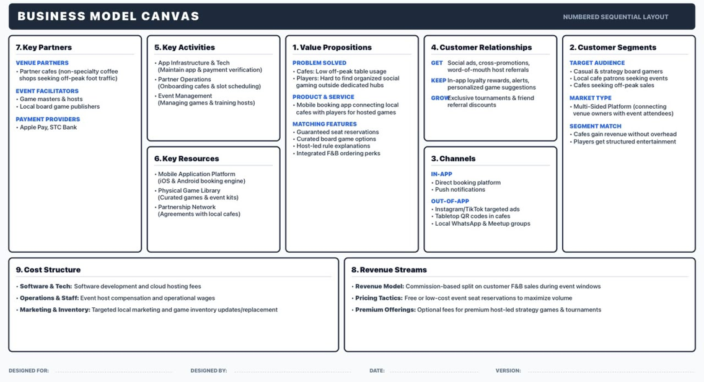
Tawlatna — 5 / 12

Slide 6
Personas
Omar — Casual Player
Layla — Café Owner
Ahmed — Cashier
Age 24 · Bachelor's in Supply Chain
Age 36 · Bachelor's in Business
Age 26 · Diploma in Hospitality Management
Goals: Find fun, affordable social activities and meet like-minded people who enjoy the same hobby.
Goals: Increase foot traffic and drink sales during slow mid-week evenings without paying high advertising costs.
Goals: Check in players quickly with the QR scanner ; log F&B transaction amounts accurately; apply loyalty rewards without slowing service.
Pain points: Organized social game nights are hard to find nearby; coordinating group outings through WhatsApp chats is messy.
Pain points: Empty tables on Tuesday and Wednesday evenings; high cost of social media ads; no organized way to host and manage events.
Pain points: Manual logging is slow and error-prone; unclear instructions during peak hours; customers asking about loyalty points.
Tawlatna — 6 / 12

Slide 7
Requirements & Elicitation Methods (1/2)
Functional (SMART)
Non-functional & business rules
● REQ-1 The system shall allow a casual player to reserve upto 4 seats for a selected board game event
● NFR-1 Reservation response time under 3 seconds
● REQ-2 The system shall generate a unique QR code linked to the reserved seat
● NFR-2 QR should be unique per reservation
● REQ-3 The system shall display the QR code in the player's mobile app and allow offline access.
● NFR-4 Transaction logging in under 20 seconds end to end
● REQ-6 The system shall allow the café owner to create a recurring event with a start date, end date and recurrence pattern
● NFR-6 Offline mode shall store atleast caches 100+ transactions
● REQ-8 The system shall display the event to players after it is created or updated.
● BR-3 15% commission on F&B sales only; café keeps 85%
● REQ-12 The system shall allow the cashier to scan a player's QR code with the tablet camera.
● BR-4 Loyalty ratio: 1 point per 1 SAR spent
15 SMART requirements (REQ-1 to REQ-15) · 8 non-functional requirements · 5 business rules
Tawlatna — 7 / 12

Slide 8
Requirements & Elicitation Methods (2/2)
Elicitation Methods Used
● Market & competitor analysis — compared SeatUp, Meeple Match and OpenTable → gaps to fill
● Customer review analysis — Google Play, App Store and forums → pain points and features to keep
● Business Model Canvas analysis — core scope: café events, commission model, loyalty rewards
● Stakeholder & persona analysis — 4 actors, 3 personas with goals and pain points
● Scenarios & user stories — one scenario per persona; 10 core user stories
● SMART requirement transformation — stories converted into REQ-1 to REQ-15
● Use-case modeling — 18 use cases, business rules, non-functional requirements
Validation still recommended: interviews or surveys with café owners and cashiers, prototype walkthrough, peer review.
Tawlatna — 8 / 12

Slide 9
Use Case Titles
Casual Gamer
Café Owner
Cashier
Developer / Admin
UC-1 · Must
Browse and Reservation
UC-2 · Must
Schedule Board Game Event
UC-8 · Must
Scan QR & Check-In Player
UC-16 · Must
Manage User Accounts
UC-5 · Must
Loyalty Points
UC-9 · Must
Log F&B Transaction
Tawlatna — 9 / 12

Slide 10
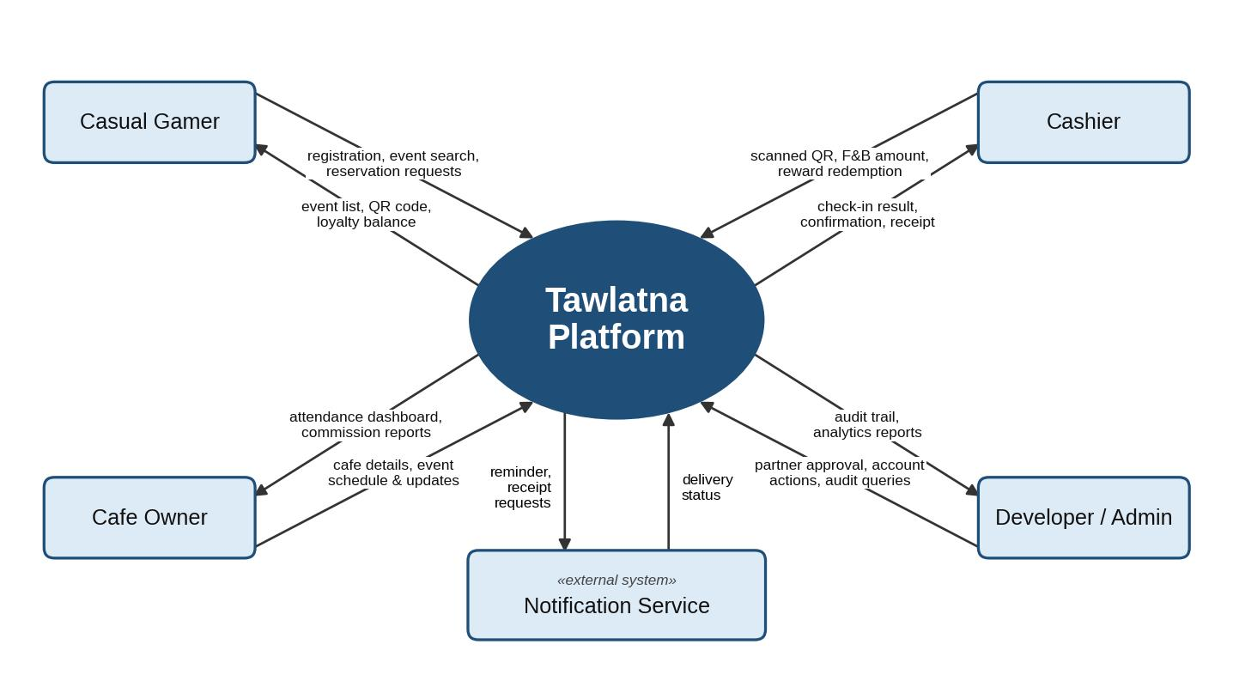
Context Diagram
Tawlatna — 10 / 12

Slide 11
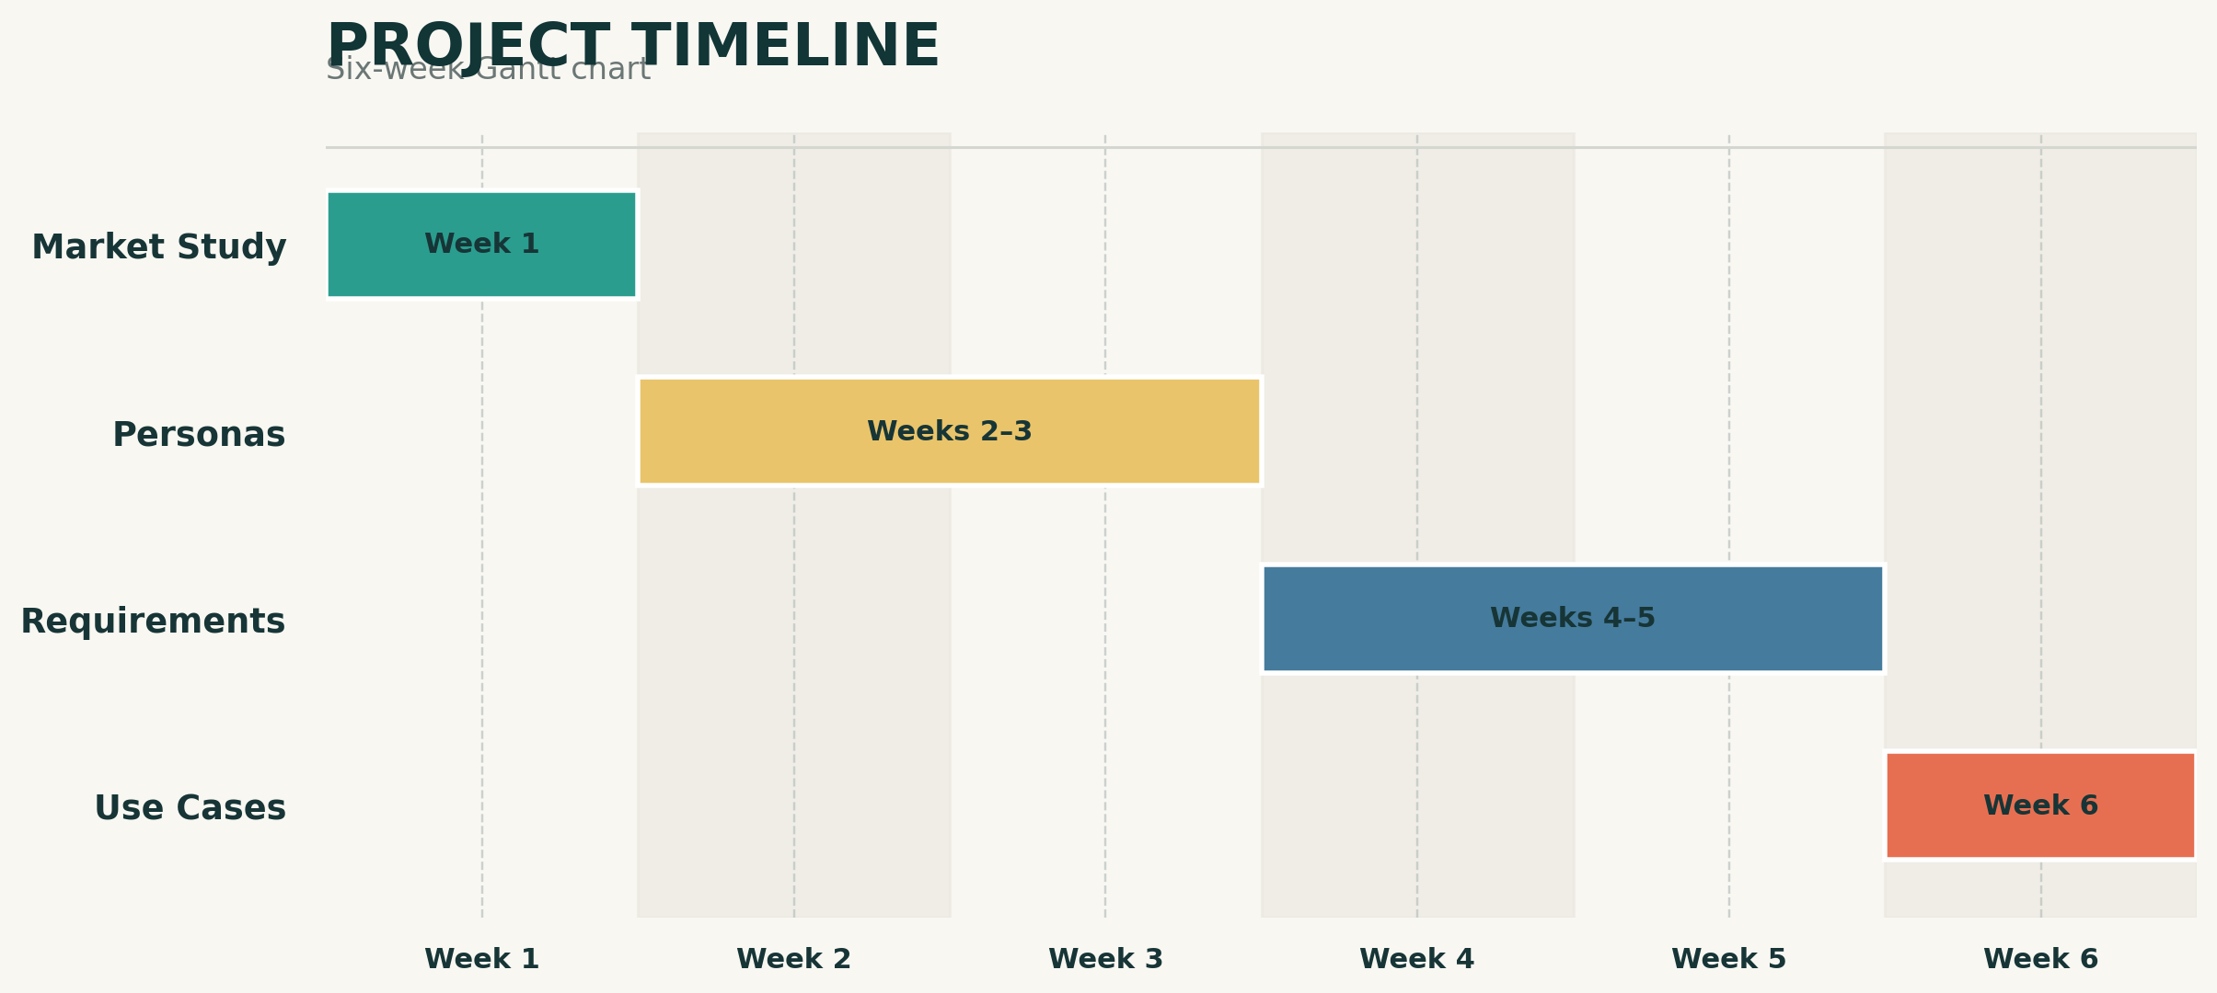
Project Management
What was done, and by whom
Week 1, 2 , 3: Faysal Hossain Piyal
Week 4, 5: Abdullah Bawazir
Week 6: Albaraa Sait
Tawlatna — 11 / 12

Slide 12
Thank You
Questions & Discussion
Tawlatna — 12 / 12

