Slide 1




Metro Interstate Traffic Volume
Prediction System
Fazal Rehman

Slide 2

Objective of the Project
To develop a predictive model that estimates traffic volume on metro interstate highways based on real-time data, such as weather conditions, day of the week, holidays and temperature. The goal is to provide accurate predictions that help optimize traffic management, reduce congestion, and improve urban mobility in metro areas.
Real world Use Case
Navigation apps can recommend optimal routes by predicting traffic volumes on various paths, helping drivers avoid congested routes.
Traffic prediction allows dynamic adjustment of traffic light timings, optimizing flow and reducing congestion in busy urban areas.
Predicting traffic volume assists in assessing environmental impacts, enabling better planning for reduced pollution and more sustainable traffic management.

Slide 3

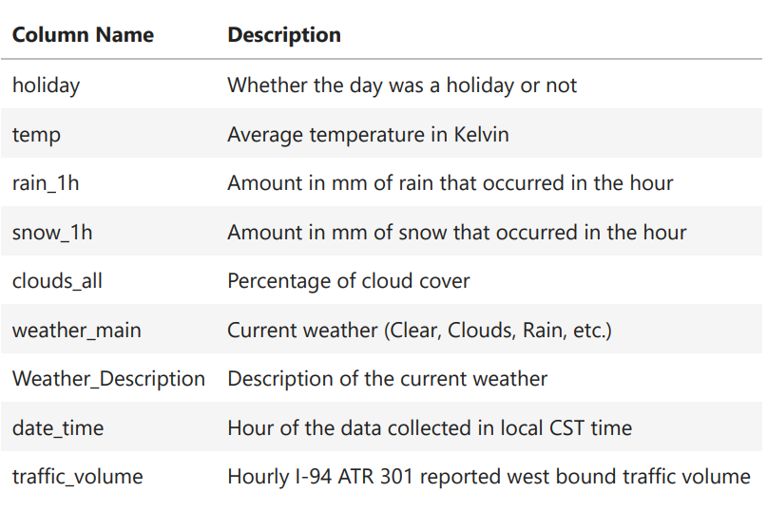


Data Understanding

Slide 4

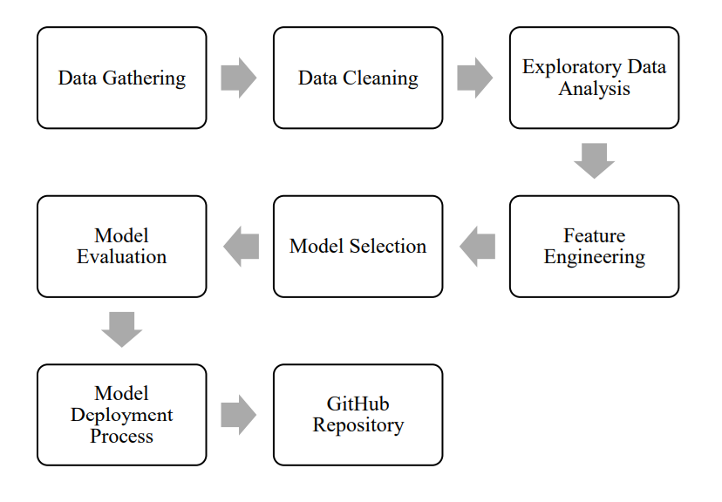
Architecture

Slide 5

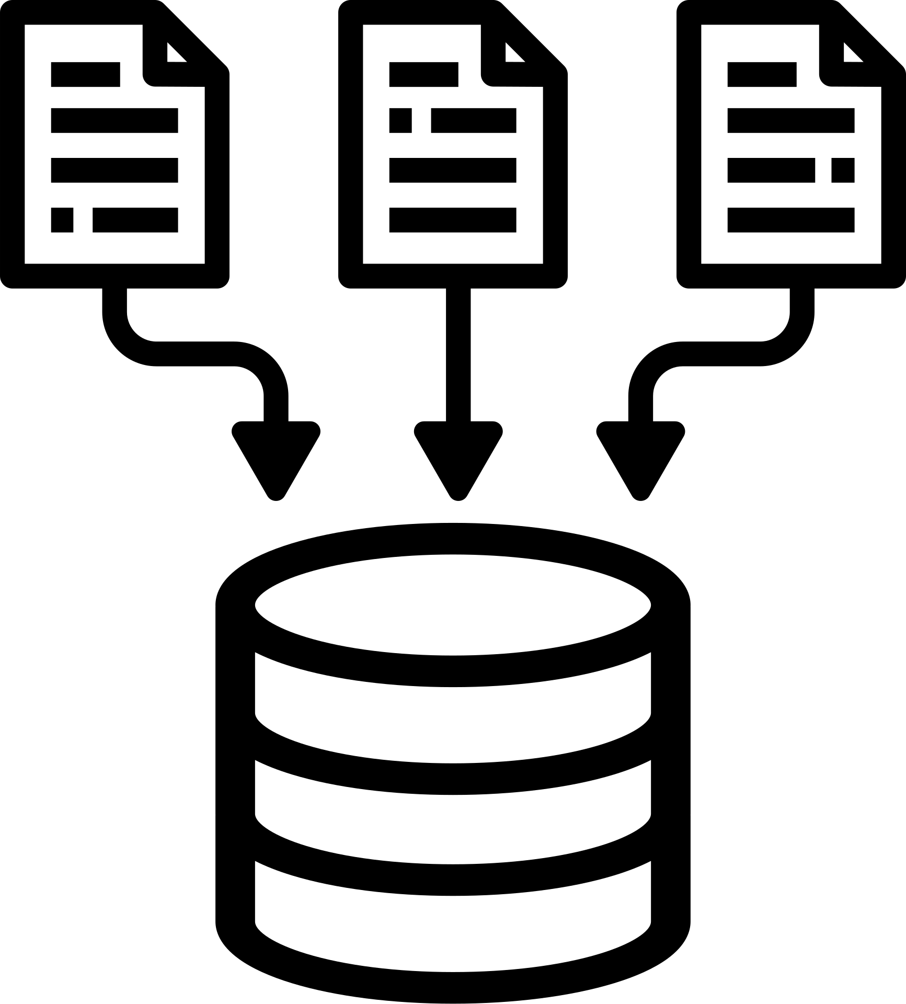

Data Validation and Transformation
Missing values in numerical columns were filled using median, and in categorical columns using most frequent value.
Categorical variables were ordinal encoded with predefined category order.
StandardScaler was used to normalize both numerical and encoded categorical features.
Pipelines were created separately for numerical and categorical data using Pipeline and combined via ColumnTransformer.
The transformation was applied on training and test data separately to avoid data leakage.
The final preprocessing object was saved as a .pkl file for reuse during prediction.

Slide 6

Model Training
To identify the most accurate model for traffic volume prediction, a structured model training pipeline was developed. The following steps were performed:
Data Splitting:
The preprocessed train_array and test_array (generated from the data transformation pipeline) were split into independent features (X) and the target variable (y). This separation ensured that model training and evaluation could be conducted properly using supervised learning techniques.
Model Selection:
A range of popular regression models was considered to ensure performance comparison across different algorithmic approaches. The models used include:
Decision Tree Regressor
AdaBoost Regressor
Gradient Boosting Regressor
Random Forest Regressor
XGBoost Regressor
CatBoost Regressor

Slide 7

Model Training
Model Evaluation Framework:
All models were passed to a custom evaluation function (evaluate_model), which internally trained each model on the training data and predicted on the test data. The R² score was used as the primary performance metric, as it effectively quantifies the proportion of variance explained by the model.
Best Model Identification:
After evaluating all models, the one with the highest R² score on test data was selected as the best-performing model. The R² scores were printed and logged for transparency and comparison.
Model Saving:
The best model was then serialized using Python's pickle module and saved at the specified path (artifacts/model.pkl). This enables seamless model reuse during the prediction phase, without the need to retrain.
Logging and Exception Handling:
Throughout the training process, detailed logs were maintained using a custom logger. Any unexpected errors were caught using a custom exception class (CustomException) to ensure debugging and error tracking are efficient.

Slide 8

Prediction
The saved model was loaded from the .pkl file using a utility function.
The same preprocessing pipeline used during training was applied to incoming data to maintain consistency.
Once the input data was transformed, it was passed to the trained model for prediction.
The predicted traffic volume was returned in real-time, ready for use in downstream applications or display.
This ensured an end-to-end workflow from raw input to predicted output using the trained machine learning pipeline.

Slide 9
Q & A
Q1) What’s the source of data?
The main source is Kaggle and for the prediction the data for training is provided by the client in the form answers to certain questions asked which the user has to input.
Q 2) What was the type of data?
The data was the combination of numerical and Categorical values.
Q 3) What’s the complete flow you followed in this Project?
Refer slide number 4 for better understanding .
Q 4) How logs are managed?
Following s are the logs that we are using :
Data Insertion log, Model Fitting log, prediction log, etc.

Slide 10

Q & A
Q 6) What techniques were you using for data pre-processing?
Removing Unwanted Attributes
Visualizing Relation of Independent Variables with Each Other and Output Variable
Checking and Changing Distribution of Continuous Values
Removing Outliers
Cleaning Data and Imputing If Null Values Are Present
Converting Categorical Data into Numeric Values
Scaling the Data
Q 7) How training was done or what models were used?
Data Split: Data was divided into training and testing sets (80:20).
Models Used: Decision Tree, Random Forest, XGBoost, AdaBoost, CatBoost and Gradient Boosting.
Training: Models were trained and fine-tuned on training data.
Evaluation: Performance checked using R².

Slide 11


Q & A
Q 8) How was prediction done?
Some questions were asked to the user like date, time of day, weather condition, numeric percentage of cloud cover, and the temperature of weather and these responses are taken as inputs which are then feed to the model as a single test case and the traffic volume prediction are then returned on the screen after a few seconds in which the data pipeline processes the input data to get the output.
Q 9) What are the different stages of deployment?
Frontend Development: The frontend of the application is built using HTML and CSS to create the user interface.
Backend Development: Flask is used for backend development, handling the logic, data processing, and communication between the frontend and the models.
Integration: The frontend and backend are connected to ensure smooth interaction and functionality, with Flask serving the dynamic web pages.
Deployment: The Flask app is deployed on Render, a cloud platform, to make the application accessible to users over the web.

