Slide 1
Developing a website for freelancers in Sri Lanka

Slide 2
Our Group Members
Group-1
2017/ASP/15 N.P.T.M.Cassim
2017/ASP/31 J.T.M.Jayarathna
2017/ASP/42 A.L.Hanan Ahamed
2017/ASP/57 M.N.M.Fazan
2017/ASP/64 A.J.Samarasinghe
Supervise
MS.R.Yasotha

Slide 3
Introduction
It is a freelancing website.
It connects employee and employeer
Employee is who is finding job
Employeer who need to hire employee for particular work
Therefore both employee and employeer can register using our web page

Slide 4
Background
In SriLanka we don’t have any freelancing site for house hold works
There are lack of difficulties to find a employee with affordable prices
There is no authorized parties to rate work of and employee

Slide 5
Literature Review
Allan Jay (n.d) “freelance platforms are a meeting place where qualified and skilled freelancers from anywhere in the world can find work and get payment.”
In our country we don’t have proper any freelancing platform for house hold works.
This will be full fill the particular house hold work requirements.
This may a good oppotunity for who are willing to work as freelancer in house hold work.
In worldwide we have some existing system for freelancing website for Information technology(fiverr,upwork).

Slide 6
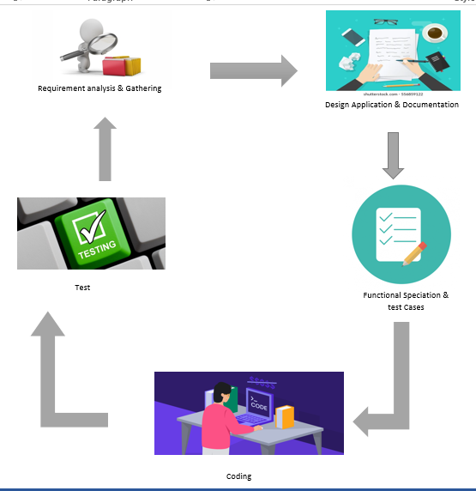
Methodology

Slide 7
System Design

Slide 8
System Design

Slide 9
System Design

Slide 10
System Design

Slide 11
Implementation

Slide 12
UI Design

Slide 13
Future Improvements

Slide 14


