Slide 1


Observability Made Easy with .NET 6 and OpenTelemetry
Jimmy Bogard
@jbogard
github.com/jbogard
jimmybogard.com

Slide 2
What is Observability?

Slide 3
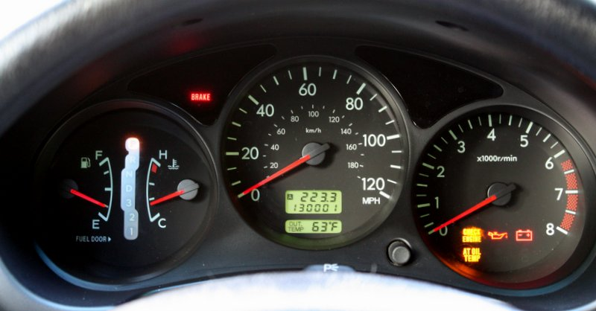
Notes:
Observability lets us understand a system from the outside
Allows us to easily troubleshoot and handle

Slide 4
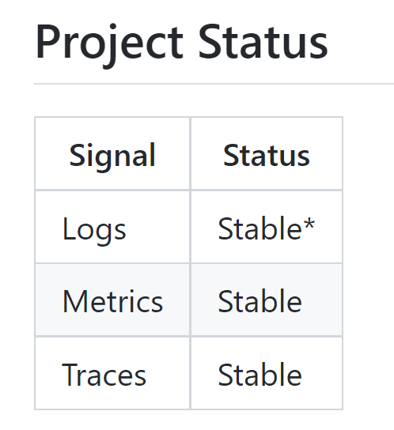
OpenTelemetry in .NET
Logging – Microsoft.Extensions.Logging
Tracing – System.Diagnostics.DiagnosticSource
Metrics – System.Diagnostics.DiagnosticSource

Slide 5
Demo

Slide 6
Microservices - GET
Sales API
SQL
Angular UI
Composition Gateway (BFF)
Finance API
SQL
Customers API
SQL

Slide 7
Microservices - POST
Angular UI
Sales API
Sales Endpoint
SQL
SubmitOrder
OrderSubmitted
Finance
Shipping
Customers
InitiatePaymentProcess
ShipViaFedEx
Payment Gateway
PaymentSucceeded
IT/Ops

Slide 8
Observability Made Easy with .NET 6 and OpenTelemetry
Jimmy Bogard
@jbogard
github.com/jbogard
jimmybogard.com
github.com/jbogard/presentations

