Slide 1



Distributed Tracing Made Easy with .NET 5
Jimmy Bogard
@jbogard
github.com/jbogard
jimmybogard.com

Slide 2
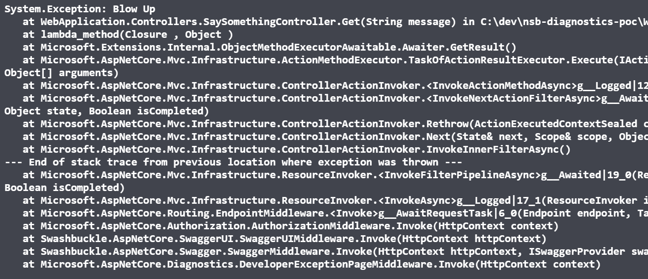
The App
dot exe

Slide 3
Worker Service
API
Other Worker Service

Slide 4
Distributed Tracing
Worker Service
Id:2
ParentId: 1
Id:1
API
Other Worker Service
Id:3
ParentId: 2

Slide 5
Distributed Tracing (Zipkin)
Worker Service
X-B3-SpanId:2
X-B3-ParentSpanId:1
X-B3-SpanId:1
API
Other Worker Service
X-B3-SpanId:3
X-B3-ParentSpanId:2

Slide 6
W3C TraceContext + Activity
Worker Service
Activity.Id:2
traceparent:1
Activity.Id:1
API
Other Worker Service
Activity.Id:3
traceparent:2

Slide 7
Non-HTTP?
Worker Service
Id:2
ParentId: 1
Id:1
API
Other Worker Service
???

Slide 8

Reporting Traces - Zipkin
API
Worker Service
Other Worker Service

Slide 9

Reporting Traces - Jaeger
API
Worker Service
Other Worker Service

Slide 10



OpenTelemetry
API
Worker Service
Other Worker Service

Slide 11
Demo
Activities for W3C propagation
OpenTelemetry for ActivityListener
Jaeger and Zipkin as OpenTelemetry exporters

Slide 12
Demo – Activity Basics

Slide 13
Demo – OpenTelemetry

Slide 14
Microservices - GET
Sales API
SQL
Angular UI
Composition Gateway (BFF)
Finance API
SQL
Customers API
SQL

Slide 15
Microservices - POST
Angular UI
Sales API
Sales Endpoint
SQL
SubmitOrder
OrderSubmitted
Finance
Shipping
Customers
InitiatePaymentProcess
ShipViaFedEx
Payment Gateway
PaymentSucceeded
IT/Ops

Slide 16
Distributed Tracing Made Easy with .NET 5
Jimmy Bogard
@jbogard
github.com/jbogard
jimmybogard.com
github.com/jbogard/presentations

