Slide 1


Observability Made Easy with .NET 7 and OpenTelemetry
Jimmy Bogard
@jbogard
github.com/jbogard
jimmybogard.com

Slide 2
What is Observability?
Notes:
Observability lets us understand a system from the outside, by letting us ask questions about that system without knowing its inner workings.

Slide 3
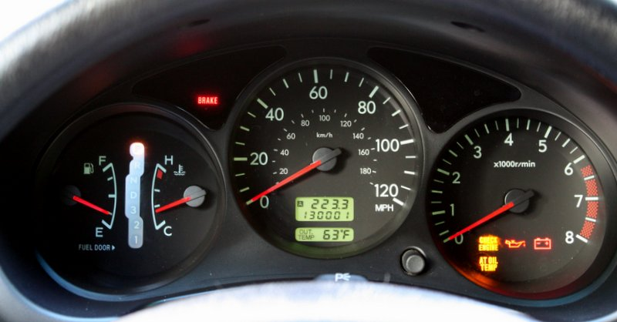
Notes:
Observability lets us understand a system from the outside
Allows us to easily troubleshoot and handle

Slide 4
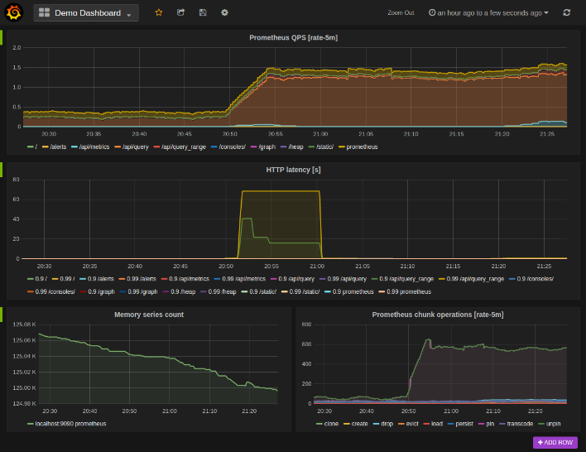
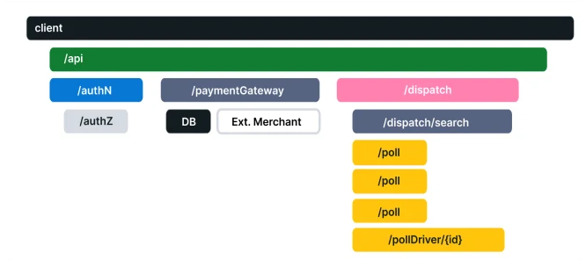
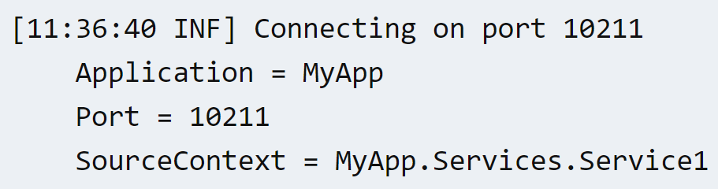
Three Pillars of Observability
Logging
Tracing
Metrics
Notes:
A Log is a timestamped message emitted by services or other components
A Span represents a unit of work or operation
A Distributed Trace, more commonly known as a Trace, records the paths taken by requests (made by an application or end-user) as they propagate through multi-service architectures, like microservice and serverless applications.

Slide 5

Reporting Traces - Zipkin
API
Worker Service
Other Worker Service

Slide 6

Reporting Traces - Jaeger
API
Worker Service
Other Worker Service

Slide 7



OpenTelemetry
API
Worker Service
Other Worker Service

Slide 8
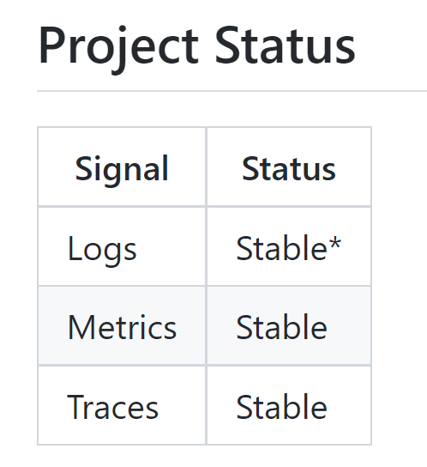
OpenTelemetry in .NET
Logging – Microsoft.Extensions.Logging
Tracing – System.Diagnostics.DiagnosticSource
Metrics – System.Diagnostics.DiagnosticSource

Slide 9
Demo

Slide 10
Microservices - GET
Sales API
SQL
Angular UI
Composition Gateway (BFF)
Finance API
SQL
Customers API
SQL

Slide 11
Microservices - POST
Angular UI
Sales API
Sales Endpoint
SQL
SubmitOrder
OrderSubmitted
Finance
Shipping
Customers
InitiatePaymentProcess
ShipViaFedEx
Payment Gateway
PaymentSucceeded
IT/Ops

Slide 12
Observability Made Easy with .NET 7 and OpenTelemetry
Jimmy Bogard
@jbogard
github.com/jbogard
jimmybogard.com
github.com/jbogard/presentations

