Slide 1


Tales from the .NET 7 Migration Trenches
Jimmy Bogard
@jbogard
github.com/jbogard
jimmybogard.com

Slide 2
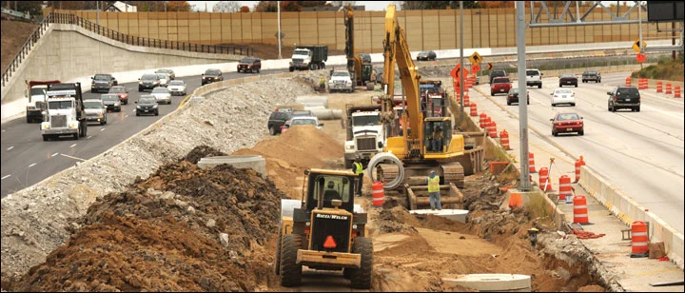
Migration Strategy

Slide 3

System.Web Adapters

Slide 4
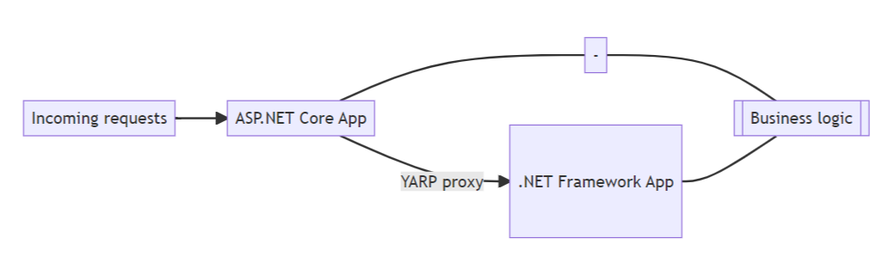
System.Web Adapters

Slide 5
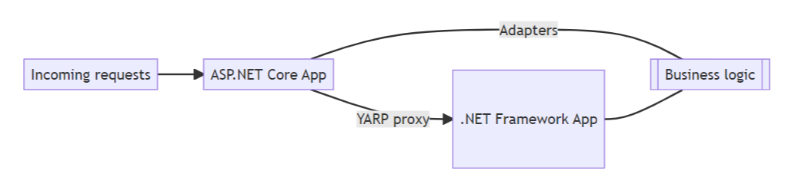
System.Web Adapters

Slide 6
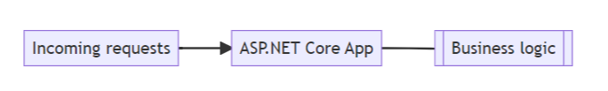
System.Web Adapters

Slide 7
Sample Application
ASP.NET MVC 5 w/ Razor
SignalR
Session
Hangfire
“State of the Art” circa 2010

Slide 8
Tales from the .NET 7 Migration Trenches
Jimmy Bogard
@jbogard
github.com/jbogard
jimmybogard.com
github.com/jbogard/presentations

