Slide 1

FUTURE SALES PREDICTION
GROUP-3
PHASE-4 DEVELOPMENT PART-2

Slide 2

TEAM MEMBERS :
PRIYADHARSHINI.P
MADHAN.R
DHATCHANA MOORTHY.P
MUNIRAJ.N
FAZIL AHAMMED.N

Slide 3

PROBLEM STATEMENT :
Build your project by performing feature engineering, model training and evaluation. Perform different analysis as needed. After performing the relevant activities create a document

Slide 4

FEATURE ENGINEERING
Feature engineering for LSTM involves creating sequences of data. LSTM models are capable of learning patterns from sequential data. In the case of sales forecasting, you might do the following:
Sequence Creation:
Organize your sales data into sequences. Each sequence could represent a window of historical sales data.
Normalization:
Normalize the data to ensure the LSTM model converges faster. You can use Min-Max scaling or standardization.
Input Features and Targets:
Create input features (X) and corresponding targets (y). For example, X could be a sequence of past sales values, and y could be the next sales value.
Look-Back Period:
Decide on the look-back period, which is the number of past time steps the model should consider when making a prediction.

Slide 5

MODEL TRAINING:
To train an LSTM model for top-selling book sales prediction:
1. Preprocess data: Collect historical sales data, create sequences of sales with features like publication date.
2. Split data into training and testing sets.
3. Normalize data.
4. Build an LSTM model with appropriate architecture.
5. Compile the model with loss function and optimizer.
6. Train the model on the training data, tuning hyperparameters.
7. Evaluate the model using metrics like MSE on the testing data.
8. Use the trained model to make future sales predictions based on new input sequences.

Slide 6

EVALUATION :
For evaluating book sales prediction models, use regression metrics like Mean Absolute Error (MAE), Mean Squared Error (MSE), Root Mean Squared Error (RMSE), and R-squared (R²) score.
MAE measures the average prediction error, MSE emphasizes larger errors, RMSE provides a more interpretable error measure, and R² measures the model's explanatory power.
Lower MAE, MSE, and RMSE and higher R² indicate better model performance.
Evaluate your model using these metrics to assess its accuracy and predictive power.

Slide 7
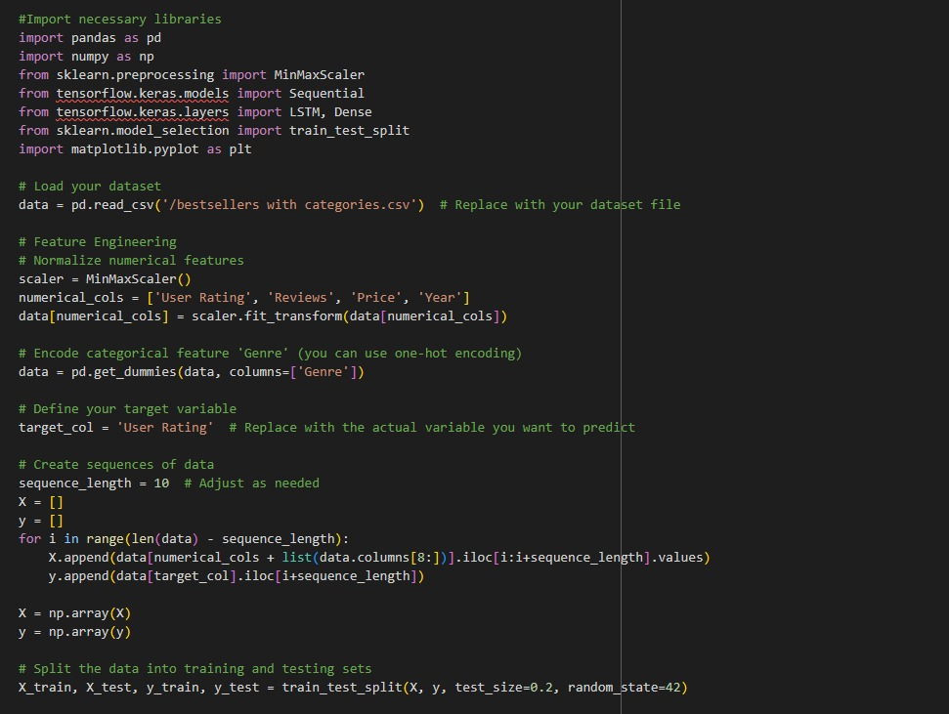

Slide 8
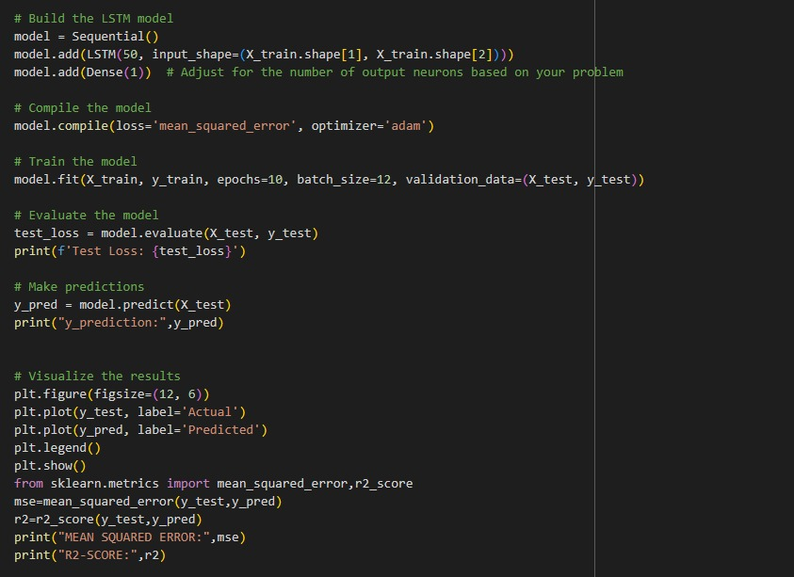

Slide 9
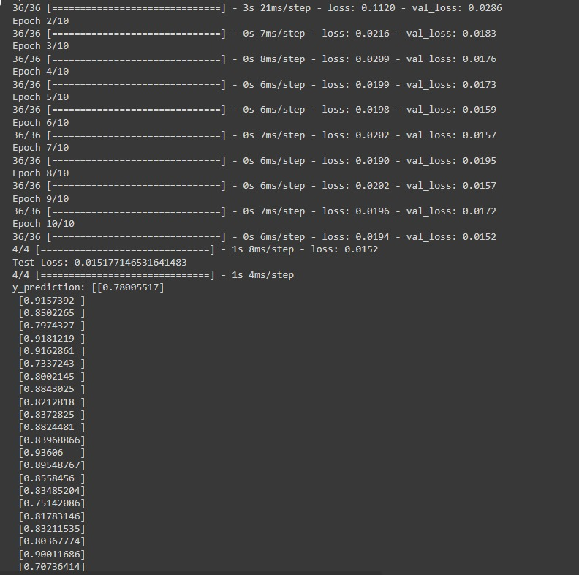

Slide 10
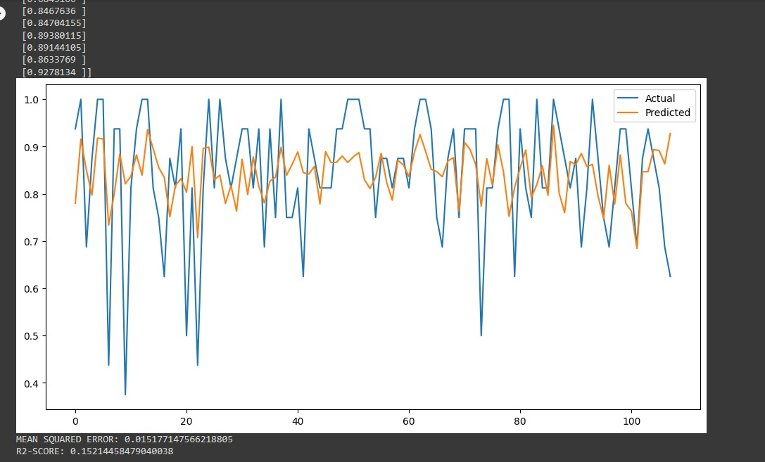

Slide 11

CONCLUSION :
creating a predictive model using historical sales data is a strategic move for retail companies. It can optimize inventory management and drive data-driven decisions. Key steps include feature engineering, model training, and thorough evaluation, ensuring accurate future sales predictions.

Slide 12

THANK YOU

