Slide 1

FUTURE SALES PREDICTION
GROUP-3
PHASE-3 DEVELOPMENT PART-1
COLLEGE CODE – 7321
Notes:
F

Slide 2
TEAM MEMBERS:
PRIYADHARSHINI .P
MADHAN.R
DHATCHANA MOORTHY. P
MUNIRAJ.N
FAZIL AHAMMED. N

Slide 3

PROBLEM STATEMENT:
Build your project by loading and pre-processing the dataset. Perform different analysis as needed. After performing the relevant activities create a document .

Slide 4
IMPORT LIBRARIES:
Start to import necessary libraries like pandas, numpy, tensorflow, etc..
PROGRAM: Import numpy as np
Import pandas as pd
Import sklearn

Slide 5

LOADING DATASET:
Load your dataset into a Pandas DataFrame. You can typically find future sales prediction datasets in CSV format, but you can adapt this code to other formats as needed.
PROGRAM:

Slide 6
PRE- PROCESSING THE DATA :
1.Data Cleaning: Address duplicates, missing values, and outliers that can distort predictions. 2. Feature Selection/Engineering: Choose relevant predictors and create new features if necessary. 3.Data Transformation: Normalize numerical data and one-hot encode categorical variables. 4. Data Splitting: Divide the dataset into training, validation, and test sets, with attention to temporal order in time series data. 5. Handling Imbalanced Data: Address class imbalances using oversampling, under sampling, or synthetic data generation if needed.

Slide 7
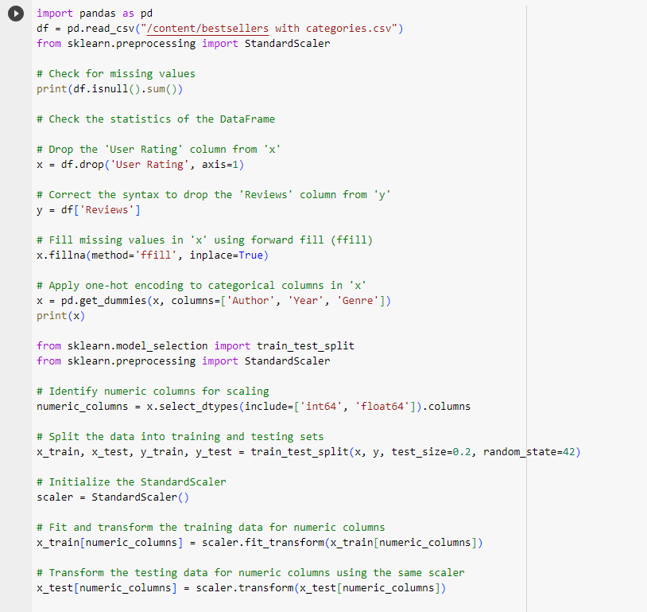

Slide 8
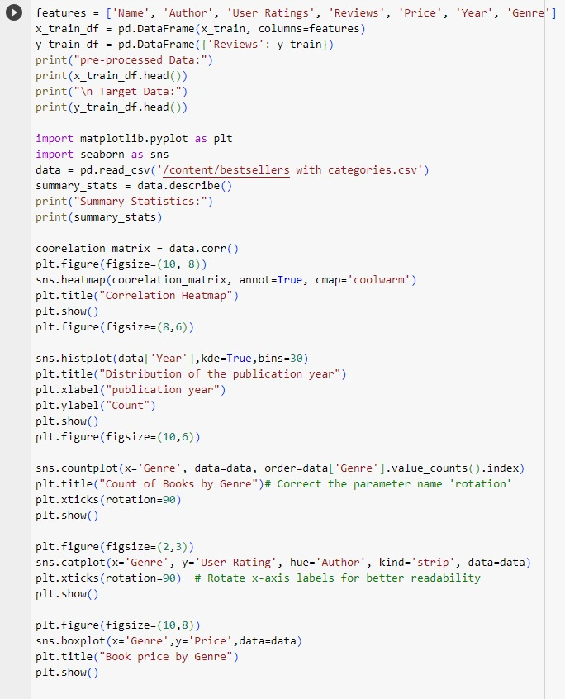

Slide 9
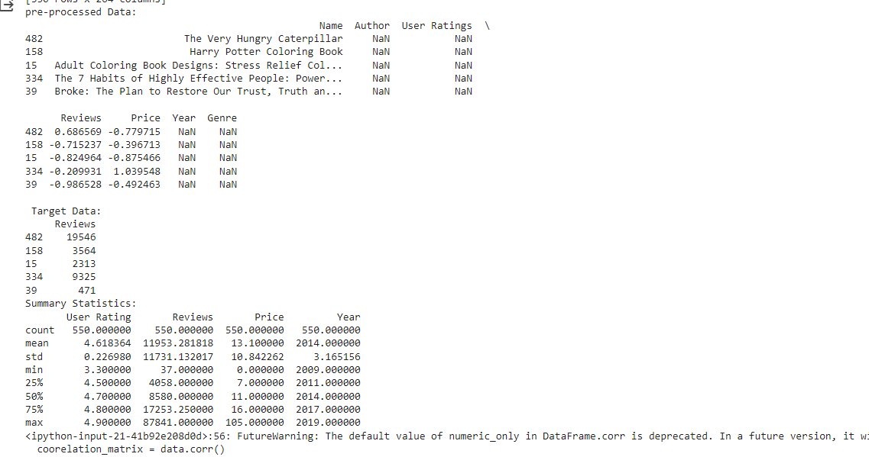

Slide 10
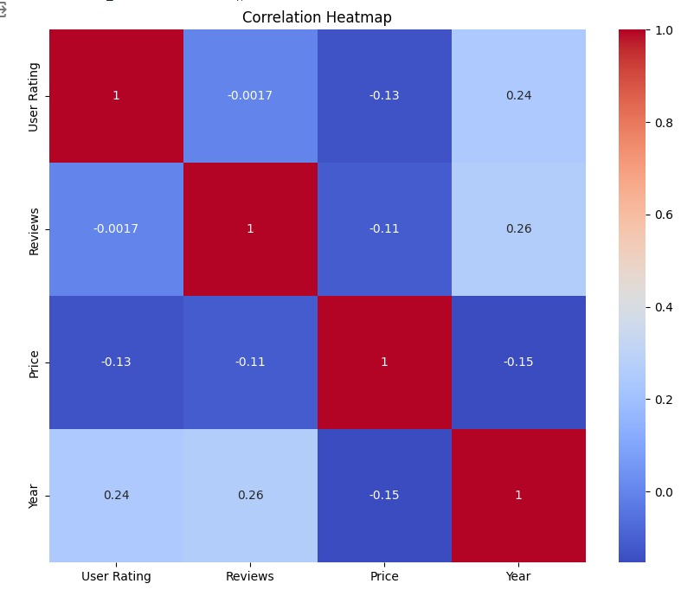

Slide 11
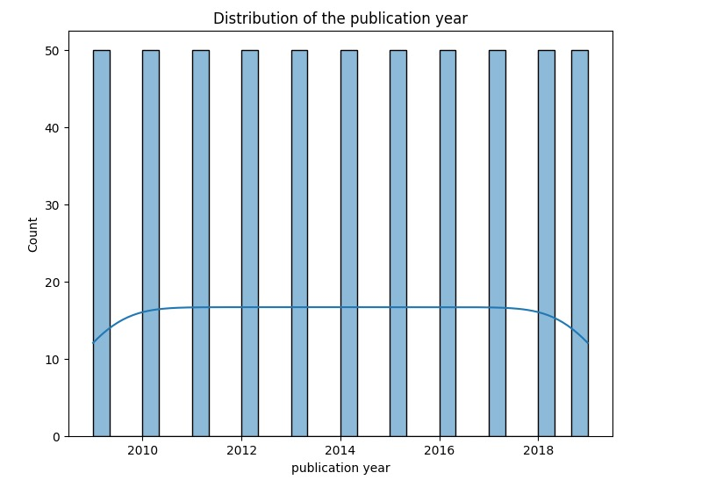

Slide 12
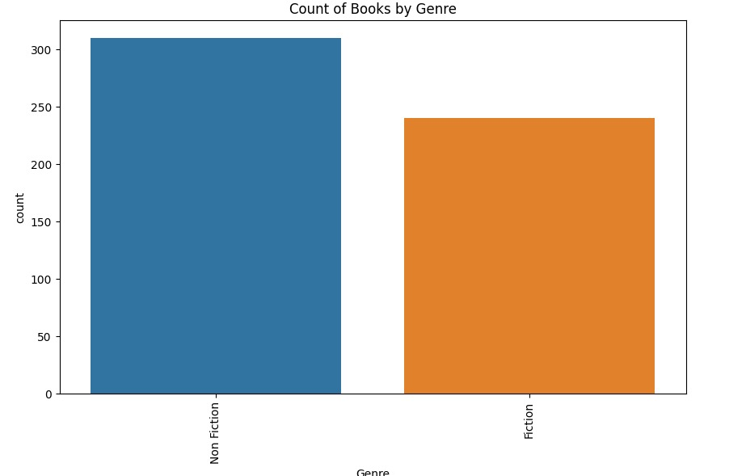

Slide 13
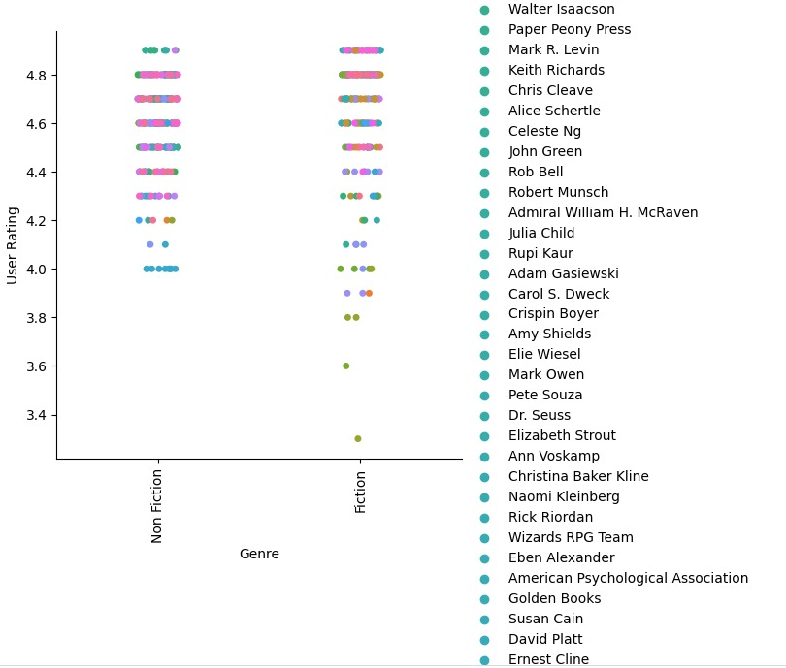

Slide 14
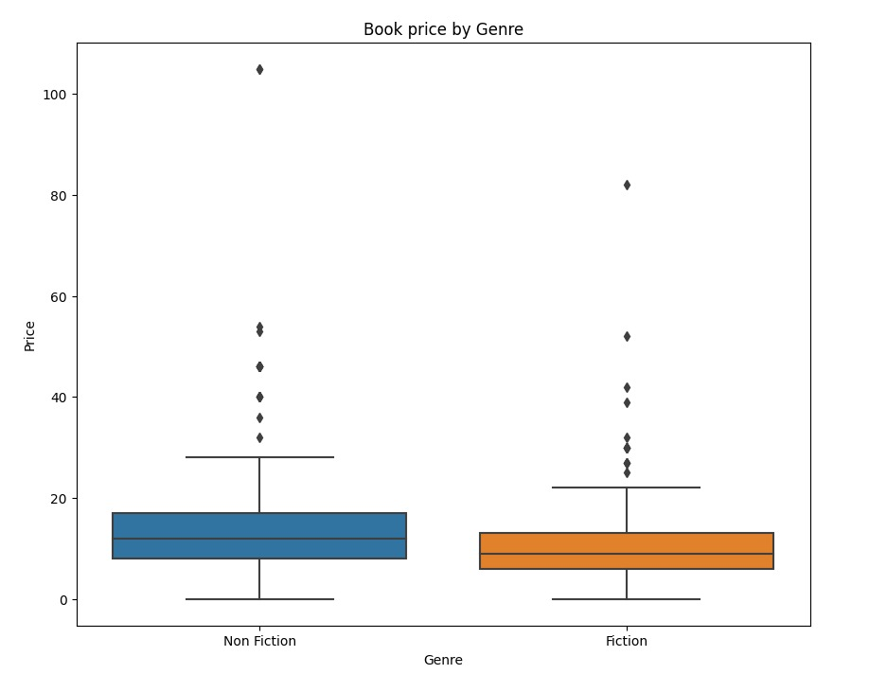

Slide 15

THANK YOU

