Slide 1
Note: The data and information in this document is reflective of a hypothetical situation and client. This document is to be used for KPMG Virtual Internship purposes only.
Data analytics approach

Slide 2
Note: The data and information in this document is reflective of a hypothetical situation and client. This document is to be used for KPMG Virtual Internship purposes only.
Agenda
Introduction
Data Exploration
Model Development
Interpretation

Slide 3
Introduction
Data Cleaning
Records with Missing Fields were Dropped.
Join Keys between Tables were considered and conflicting Records were Dropped.
Age, Last Purchase (Days Ago) and Profit Fields were Added.
Records pertaining to Deceased Customers were Dropped.
Transactions more than a year old were Dropped.

Slide 4
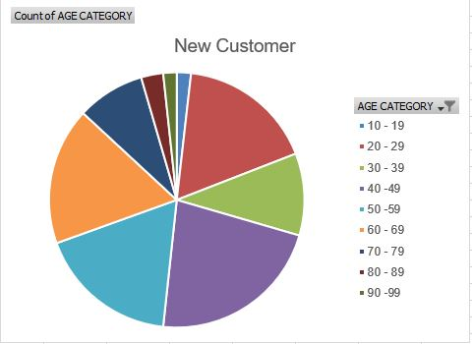
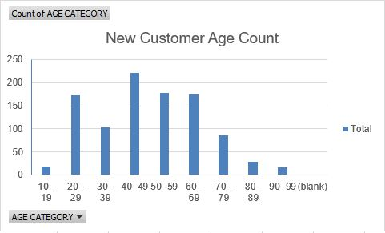
Data Exploration : Age Distribution
New customers are more from the age group of 40-49 , followed by 50-59 & 60-69.
Fewer customer are from 10-19 & 90-99 for obvious reasons.
Data shows age group 40-50 has high count in terms of bike purchased in last 3 years with a slightly greater female ratio.
Notes:
.

Slide 5
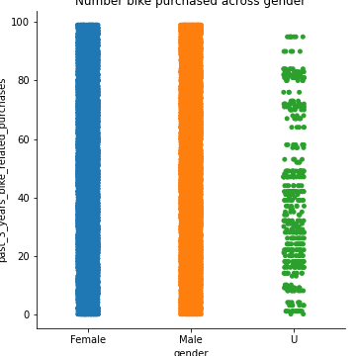
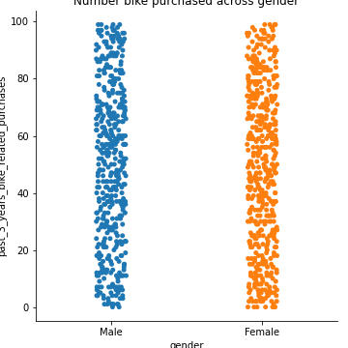
Note: The data and information in this document is reflective of a hypothetical situation and client. This document is to be used for KPMG Virtual Internship purposes only.
Model Development
Bike purchases within the last 3 years
In the new customers groups, there are slightly more female (50.6%/ 25,212 bikes) compared to male (47.7%/ 23,765 bikes) buyers.
The distribution the two group very similar, so depending on the marketing strategy, you could either try to attract more male buyers or focus on female retention rates.

Slide 6
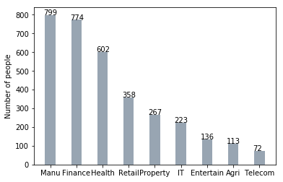
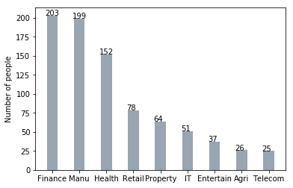
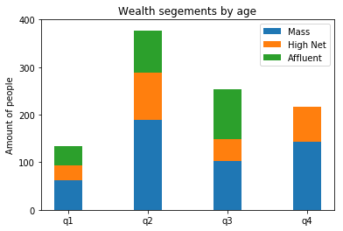
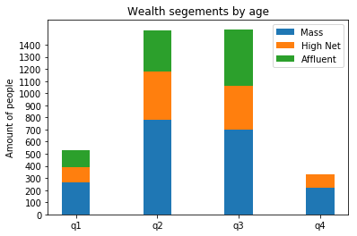
Note: The data and information in this document is reflective of a hypothetical situation and client. This document is to be used for KPMG Virtual Internship purposes only.
Interpretation
Job industry category
Mostly our new customers are on Finance industry and our Manufacturing customers are still on top 2.
The rest industries is still same
Wealth segments
In all ages, the number of Mass Customers is the highest so we should focus on this social class.
After that, we should focus on High Net Customer.
Then Affluent Customers but mostly second and third quadrant

Slide 7
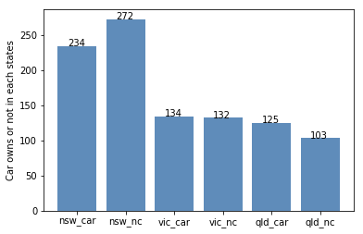
Note: The data and information in this document is reflective of a hypothetical situation and client. This document is to be used for KPMG Virtual Internship purposes only.
Interpretation
Wealth segment
VIC and QLD cars seem to have more customers that own car, so NSW should be considered.
NSW cars category should be prioritized the most for now, since numbers of customers that don’t own a car is significantly larger than the number of customers who own one.

Slide 8
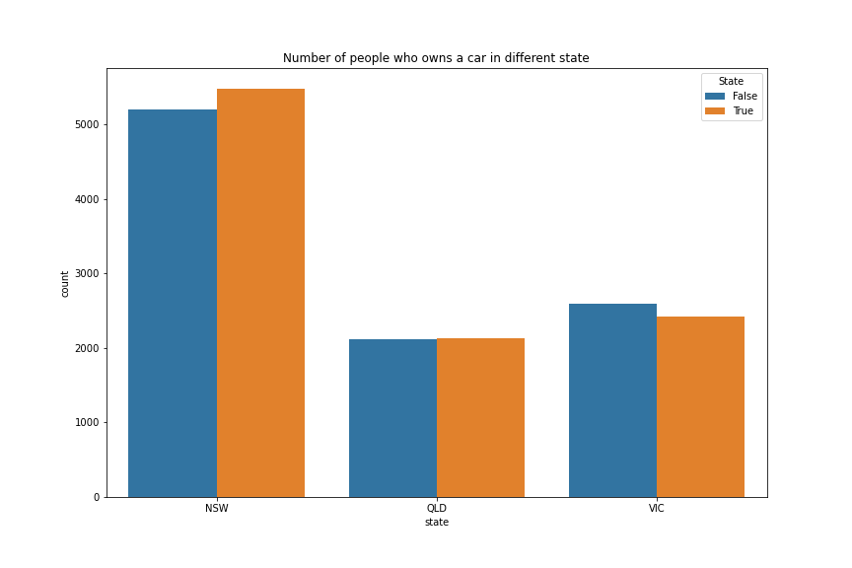
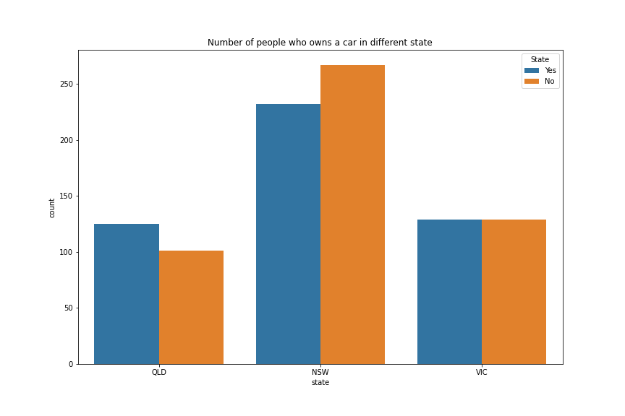
Note: The data and information in this document is reflective of a hypothetical situation and client. This document is to be used for KPMG Virtual Internship purposes only.
Interpretation
Numbers of cars owned in each state
NSW has the most number of owned cars, but proportionally has more customers who doesn’t own cars.
VIC is the next highest in the number of owned cars, and there relatively equal proportion who doesn’t own cars.
QLD has the least number of owned cars, so we could target this state.

Slide 9
Note: The data and information in this document is reflective of a hypothetical situation and client. This document is to be used for KPMG Virtual Internship purposes only.
Thank You

