Slide 1
E-Provost
Team Members:
Habibur Rahman
Fazle Rabbi Rakib

Slide 2



Our plan of approach
CONCEPT
Work
About various functionality
Plan
Distribution
CONCEPT
START
Discussion
Database Design
A full discussion of project plan.
Steps
CONCEPT
Analysis
Integration of Frontend & Backend

Slide 3
A
B
Work-Flow
Idea Submission &
Prototyping
System Requirement Specification (SRS)
C
Database Design/ Schema Table Design
D
System Development

Slide 4
A
B
Work-Flow
Work-Flow
Idea Submission &
Prototyping
System Requirement Specification (SRS)
C
Database Design/ Schema Table Design
D
System Development

Slide 5
A
B
Work-Flow
Idea Submission &
Prototyping
System Requirement Specification (SRS)
C
Database Design/ Schema Table Design
D
System Development

Slide 6
A
B
Work-Flow
Idea Submission &
Prototyping
System Requirement Specification (SRS)
C
Database Design/ Schema Table Design
D
System Development

Slide 7
A
B
Work-Flow
Idea Submission &
Prototyping
System Requirement Specification (SRS)
C
Database Design/ Schema Table Design
D
System Development

Slide 8
User Classes
Login & Signup
Login & Signup
Student can create account with his institutional mail id. He will also a profile with details information.
01
Provost can login & also can create a account. He will have a profile with details information
Post Problem
Notice
Student user class can post hall problem in E-provost.
02
Only a provost can create a notice to give some information to students.
Comment
Comment
Student can comment in the post which was created by student user.
03
Provost can comment in the problem post created by the student user class.
Facilities
Admin Facilities
Student will get the opportunity to delete or edit his post or comment. He will also get the notification of comments of his post.
04
Provost can delete any post or comment posted by student.Provost also get the notification of posts created by student.

Slide 9
Features we added
Comment
Newsfeed
User can comment in a post
Login
Previous user can login
A Universal Newsfeed
Notification
6
4
Create an account
2
Post Problems
User will get notification of post & comment
A user can create an account
User can post problems
5
1
3

Slide 10
Features we added
Admin
Profile
Dashboard
There is an admin panel of provost
A profile for each
user
User will have a dashboard of his own post
Notice
9
7
A Notice board for user
10
8

Slide 11
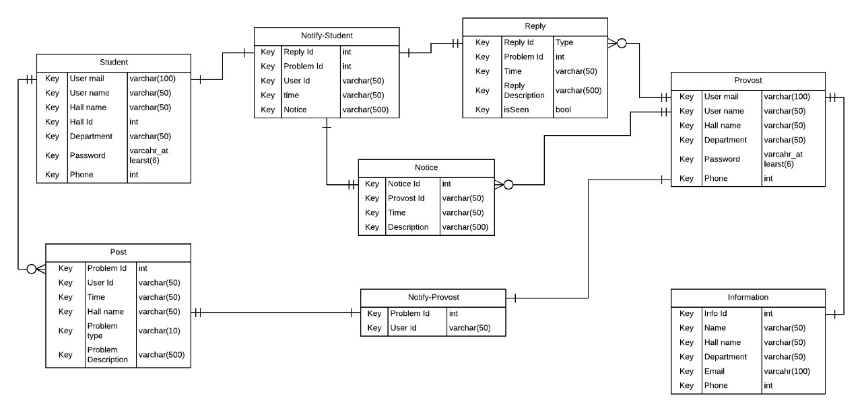
Schema-Table
HEADING
HEADING
HEADING
HEADING
Add Some Brief Text Here to Explain
Add Some Brief Text Here to Explain
Add Some Brief Text Here to Explain
Add Some Brief Text Here to Explain

Slide 12
Feature: Post
User can create a post of a problem.
The problem will be posted in News feed
Also will be posted in user dashboard for edit or delete .
Provost will get a notification of the post.

Slide 13
Feature: Comment
Both the user class can comment on a particular post.
The comment will be posted in comment box of the post.
Commented user can edit or delete his comment.
The post creator will be notified of the posted comment.

Slide 14
Feature: Notice
Provost can create notice.
The notice will be posted in notice board.
Also will be posted in the provost dashboard for edit or delete .

Slide 15




Tools Used
Web Design (Frontend )
Version Control
HTML 5
CSS 3
Java-script
Bootstrap 4
Using gitlab for version control.
Database
ER-Diagram
Mysql
lucidchart
Backend
PHP (laravel)

Slide 16




I N F O G R A P H I C
Achieve
Achieve
Achieve
Achieve
1
2
3
4
Database
User Interface
Backend
Working Project
A relational Database
An attractive UI
A supportive backend
Completed

Slide 17

O U R T E A M C R E W
01
02
Fazle Rabbi Rakib
Md. Habibur Rahman
SWE,SUST
SWE,SUST
Work on ER Diagram
And
Backend & Frontend
Work on Schema Design
And
Backend

Slide 18
T H A N K Y O U

