Slide 1
The Last Picks
Team Members:
Fazle Rabbi Rakib
Souhardya Saha
Md. Mehedi Hasan
Gourab Saha

Slide 2



Our plan of approach
CONCEPT
Work
About various functionality
Plan
Distribution
CONCEPT
START
Discussion
Database Design
A full discussion of project plan.
Steps
CONCEPT
Analysis
Integration of Frontend & Backend

Slide 3
Features we added
Comment
Search
User can comment for an idea
Login
User can search by ideas
Previous user can login
6
4
Vote
Create an account
2
Post Ideas
User can vote for an Idea
A normal user can add an account
User can post ideas
5
1
3

Slide 4
Features we added
Admin
Profile
There is an admin panel
A profile of a user
Notification
Introduce notification system
Dashboard
9
7
A universal dashboard
10
8

Slide 5
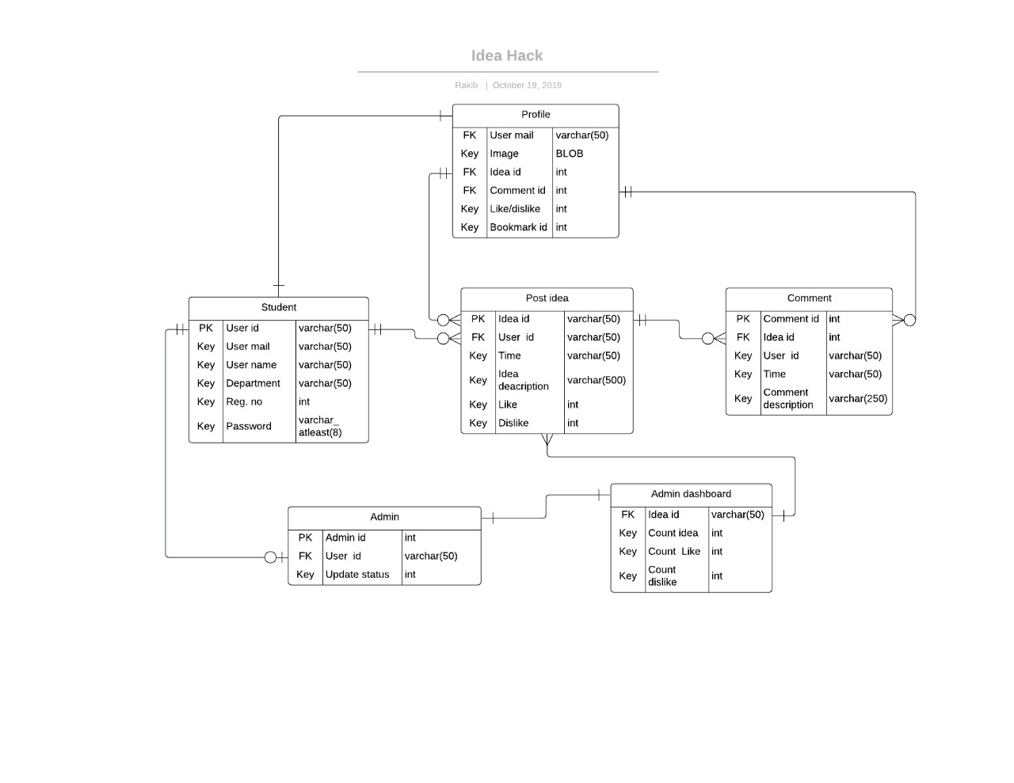
ER-Diagram
HEADING
HEADING
HEADING
HEADING
Add Some Brief Text Here to Explain
Add Some Brief Text Here to Explain
Add Some Brief Text Here to Explain
Add Some Brief Text Here to Explain

Slide 6




Tools Used
Web Design (Frontend )
Version Control
HTML 5
CSS 3
Java-script
Using github for version control.
Database
ER-Diagram
Mysql
lucidchart
Backend
PHP (laravel)

Slide 7




I N F O G R A P H I C
Achieve
Achieve
Achieve
Achieve
1
2
3
4
Database
User Interface
Backend
Working Project
A relational Database
An attractive UI
A supportive backend
Completed

Slide 8
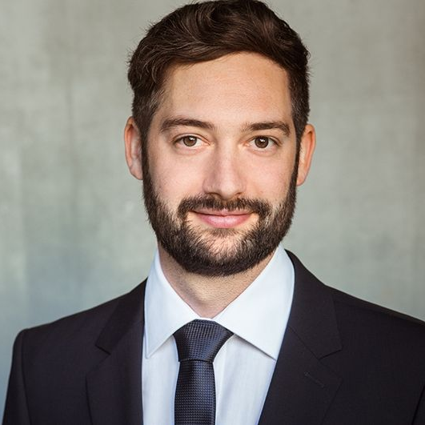
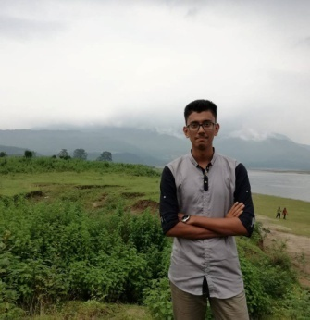
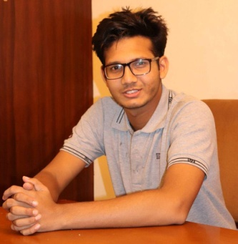
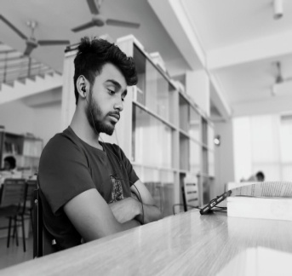

O U R T E A M C R E W
01
02
03
04
Fazle Rabbi Rakib
Souhardya Saha
Md. Mehedi Hasan
Gourab Saha
SWE,SUST
SWE,SUST
SWE,SUST
SWE,SUST
Work on ER Diagram
And
Backend
Work on Backend
Work on Frontend
Work on Frontend

Slide 9
T H A N K Y O U

