Slide 1
SUST_Team_PHYSIS
Product: VROMON
Team Member: Fazle Rabbi Rakib (Team Leader)
Mohammad Akhlaqur Rahman
Gourab Saha
Mehedi Hasan

Slide 2
The problem we trying to solve:
We offer users a complete tour solution through our platform.
Our goal is to help the user in every expect in his tour to make it memorable.

Slide 3

Our Solution:
We Offer the uses : Tour Spots(Sights).
Hotel Managements.
Transportation.
Tour Package.

Slide 4
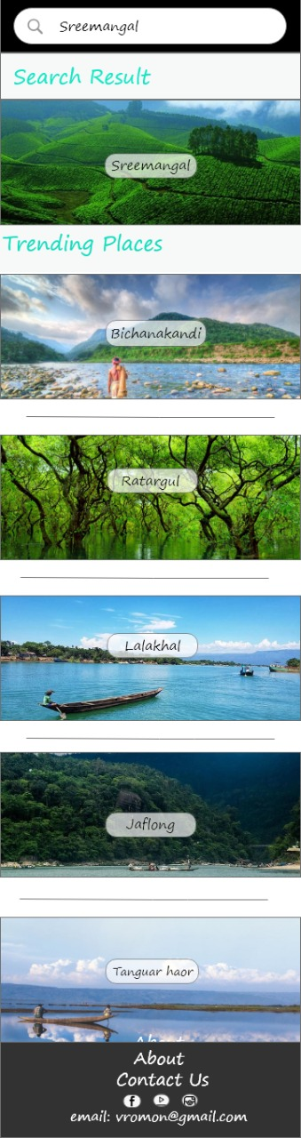
Tour Spots: Some Important Features
Information
Map
Travel Guide
Local Guide
Cultures & Specialities
Near Places
Experiences
Share your Experience

Slide 5
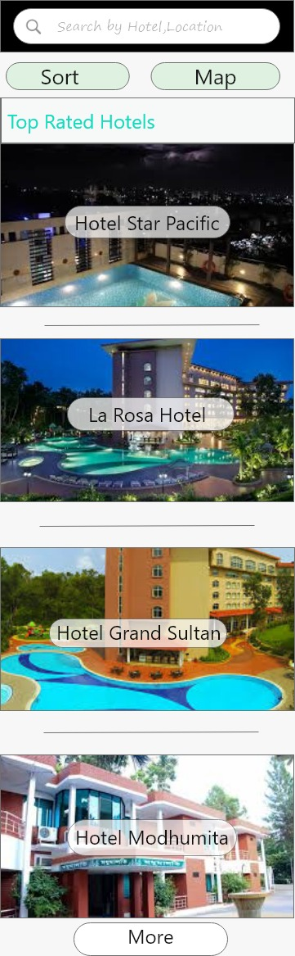
Hotel Management:
Sort by:
Price
Rating
Hotel Room Reservation System.
Reservation Cancelation.

Slide 6
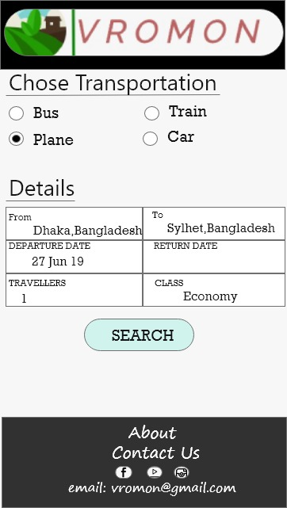
Transportation:
Bus
Train
Plane
Car

Slide 7

Tour Package:
User can join in a fix plan program.
Customize Plan

Slide 8
Innovation:
Customized tour plan through tour package.
360° VR of the tour sight.
Emergency contacts.
Local guide will be provided.
A proper solution for make your trip more comfortable.

Slide 9
Business Model:
We can get revenue from hotels that will use our platform.
When our platform will get popular , by adds we can get revenue.
More hotels added to our platform, The more comparison user will get.
All types of booking in one platform.
User will get discount on the basis of booking.
Local people of tourism spots will be benefited.
Both customized and fixed plan both will attract the tourists to travel around Sylhet.

Slide 10
Critical Thinking:
Customize a tour plan for your favourite one or for those who need a vacation.
Promote the specialities and cultures of the sights.
Articles , videos , photos for the tourist attractions.
Special foods of tourism spots will increase tourist attraction.

Slide 11
Thank You , all. Any questions??

