Slide 1


Consumer Goods Ad hoc Insights
This presentation provides an overview of Atliq Hardware, a leading computer hardware producer over 27 countries. We will explore ad hoc requests, query results, and insights derived from the company's data.
Present by Md. Fazle Rabbi Mugdho

Slide 2
Ad hoc request with Insights
Analysis data with graph, charts
Overview of company
Objective

Slide 3

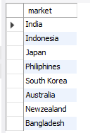
Request 1: Provide the list of markets in which customer "Atliq Exclusive" operates its business in the APAC region.
SQL Query :
select market
from dim_customer
where region = 'APAC' && customer = 'Atliq Exclusive'
group by market;
Output :
Visualization:

Slide 4
Request 1: Provide the list of markets in which customer "Atliq Exclusive" operates its business in the APAC region.
Atliq Exclusive has operations in 26 countries and, vis-à-vis, also has an enviable APAC market presence with 8 countries, viz, India, Indonesia, Japan, Philippines, South Korea, Australia, New Zealand, and Bangladesh. Thus, APAC becomes the region of significant concern for the organization. In this region, it has the most number of stores, demonstrating its geographical significance. Next comes Europe (EU), which has 6 stores, while North America (NA) has 2, indicating a wider but sparser expanse of presence beyond the APAC region. The company has a noticeably large market in this region due to its emphasis on this fast-growing domestic market.
INSIGHTS

Slide 5

Request 2: Unique Product Increase
SQL Query :
set @unique_products_2020 = (
select count(distinct product_code)
from fact_gross_price
where fiscal_year = 2020);
set @unique_products_2021 = (
select count(distinct product_code)
from fact_gross_price
where fiscal_year = 2021);
set @percentage_chg = round(((@unique_products_2021-@unique_products_2020) / @unique_products_2020)*100, 3);
SELECT @unique_products_2020 AS unique_products_2020,
@unique_products_2021 AS unique_products_2021,
@percentage_chg;
Output :

Slide 6
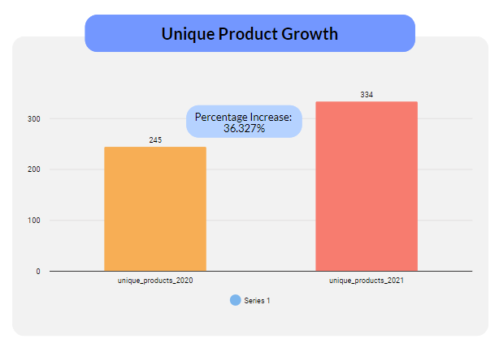
Request 2: Unique Product Increase
Visualization:
INSIGHTS
The unique products increased from 245 in 2020 to 334 in 2021, reflecting a significant growth of 36.33%. This surge suggests successful market expansion and heightened consumer demand. If this trend continues, it could lead to increased innovation and investment opportunities. Overall, this growth indicates a robust market environment for unique products.

Slide 7
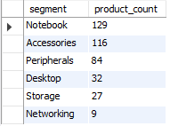
Request 3: Product Counts by Segment
SQL Query :
select dim_product.segment,
COUNT(distinct dim_product.product_code) AS product_count
from dim_product
group by segment
order by product_count desc;
Output :

Slide 8
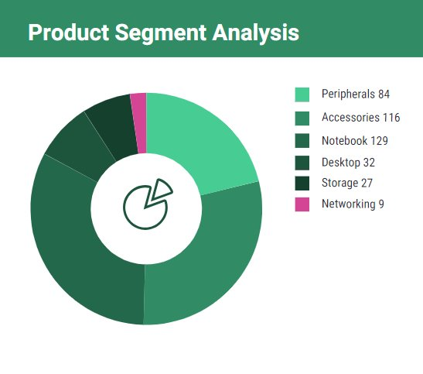
Request 3: Product Counts by Segment
Visualization:
INSIGHTS
In the notebook category, the leads stand at 129 units supported by the growing virtue of portable computing devices, which is likely a result of remote work and mobile computing. Accessories closely come after at 116 units, those of add-ons showing an aspiring market improved tech usability. In 84 units, peripherals play a significant role, proving how external devices such as keyboards and monitors are well regarded.
Giving contrast, desktop (32 units) and storage (27 units) do not take center stage, showing lesser traditional system preference compared to mobile tech. The networking aspect, with just 9 units, reveals a very niche market, likely catering to specific demands. By and large, the products that the market offers are primarily those that encourage mobility alongside the accessories.

Slide 9
Request 4: Segment with Most Unique Product Increase
SQL Query :
select
dim_product.segment,
count(case when fact_gross_price.fiscal_year = 2020 then dim_product.product_code end) as product_count_2020,
count(case when fact_gross_price.fiscal_year = 2021 then dim_product.product_code end) as preduct_count_2021,
count(case when fact_gross_price.fiscal_year = 2021 then dim_product.product_code end) - count(case when fact_gross_price.fiscal_year = 2020 then dim_product.product_code end) as increase
from dim_product
inner join fact_gross_price on dim_product.product_code = fact_gross_price.product_code
group by dim_product.segment
order by increase desc;

Slide 10
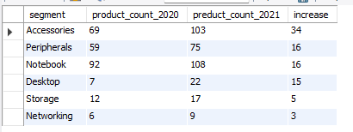
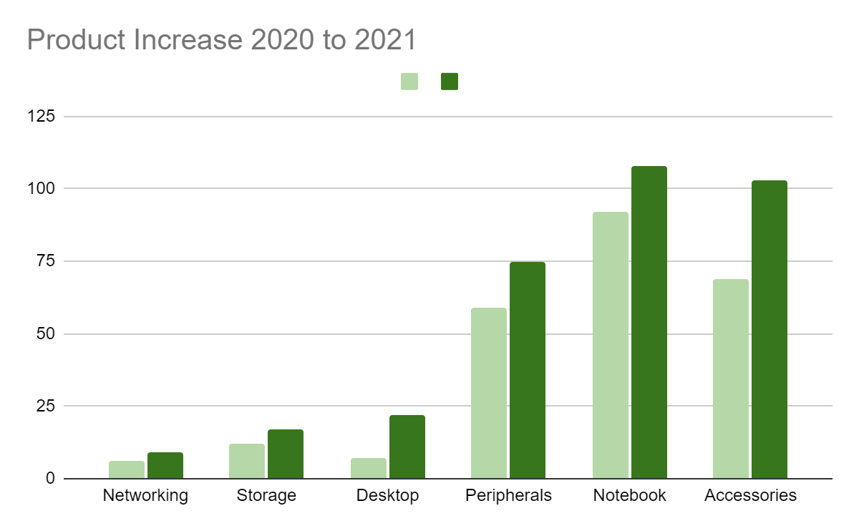
Request 4: Segment with Most Unique Product Increase
Output :
Visualization:

Slide 11
Request 4: Segment with Most Unique Product Increase
In the year 2021, the accessories segment experienced a significant rise in the number of items stocked within that category, going up to 34 units from the previous year’s stock of 2020, showing more emphasis on the product category expansion as it was followed by 16-1 for the inertia segment, notebooks and associated peripherals and even each component seller was able to record an increase per unit for this most vital. At the same time, such a solution strategy is referred to as constructive and, therefore, its simplifications are not acceptable as it would distort this. The desktop segment, however, had only 7 products at the beginning of the year two thousand and twenty, but it is also quite notable that it reached 22 by the year twenty twenty-one, this correlation in the number of offerings, suggests that there is growing demand from the market, even perhaps in expectations for desktop-oriented products such as storage and connectivity resources. This implies that even as these segments are on expansion, they do not provide as much attention as several other segments.
INSIGHTS :

Slide 12

Request 5:Products with Highest and Lowest Manufacturing Costs
SQL Query :
select
fact_manufacturing_cost.product_code,dim_product.product, manufacturing_cost
from
fact_manufacturing_cost
inner join dim_product on fact_manufacturing_cost.product_code = dim_product.product_code
where
fact_manufacturing_cost.manufacturing_cost =
(select max(manufacturing_cost) from fact_manufacturing_cost) or
fact_manufacturing_cost.manufacturing_cost =
(select min(manufacturing_cost) from fact_manufacturing_cost)
order by manufacturing_cost desc;
Output :

Slide 13
Request 5:Products with Highest and Lowest Manufacturing Costs
INSIGHTS
AQ HOME Allin1 Gen 2's manufacturing cost is much higher at 240.5364, while AQ Master wired x1 Ms's cost is 0.8920, which is much cheaper, indicating a simpler or less functional product. The distinct gap in the costs suggests that the Allin1 Gen 2 is likely a high-class or multi-purpose device aimed at a more particular or expensive consumer market. In contrast, the AQ Master wired x1 Ms is probably a basic product available across all markets, leading to lower production costs and thus lower prices. Such differences in costs will most likely affect the pricing strategy, where expensive items like the Allin1 have to be sold with a mark-up to remain profitable, while the cheaper item depends on sales volume rather than a high price.

Slide 14
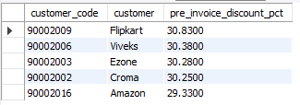
Request 6: Top 5 Customers with Highest Discounts
SQL Query :
select dim_customer.customer_code, dim_customer.customer, fact_pre_invoice_deductions.pre_invoice_discount_pct * 100
from dim_customer
inner join fact_pre_invoice_deductions on dim_customer.customer_code = fact_pre_invoice_deductions.customer_code
where dim_customer.sub_zone = 'INDIA' and fact_pre_invoice_deductions.fiscal_year = 2021
order by fact_pre_invoice_deductions.pre_invoice_discount_pct desc limit 5;
order by manufacturing_cost desc;
Output :

Slide 15
Request 6: Top 5 Customers with Highest Discounts
INSIGHTS
Analysis of customer data provided by Flipkart and Viveks shows that most of their customers enjoy a 30.83% pre-invoice discount. This likely indicates that these two customers have either the strongest purchasing power or the closest strategic partnerships with the supplier, which explains the high discount. Ezone and Croma stand very close, with discount percentages of 30.28% and 30.25%, respectively, suggesting similar but slightly lower offers. As for Amazon, customers receive the least discount at 29.33%, which is quite unusual. This could indicate that Amazon is negotiating or operating differently from the others. This suggests a structured discount model, where higher discounts are given to chief partners to reward their loyalty or encourage more significant purchases.

Slide 16
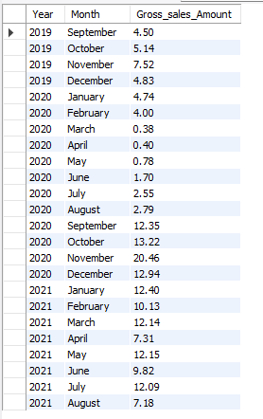
Request 7: Monthly Gross Sales for Atiq Exclusive
SQL Query :
select
Year(date) as Year,
monthname(date) as Month,
round(sum(sold_quantity * fact_gross_price.gross_price/1000000),2) as Gross_sales_Amount
from
fact_sales_monthly
inner join
dim_customer on dim_customer.customer_code = fact_sales_monthly.customer_code
inner join
fact_gross_price on fact_gross_price.product_code = fact_sales_monthly.product_code and fact_gross_price.fiscal_year = fact_sales_monthly.fiscal_year
where dim_customer.customer='Atliq Exclusive'
group by Month, Year
order by Year;
Output :

Slide 17
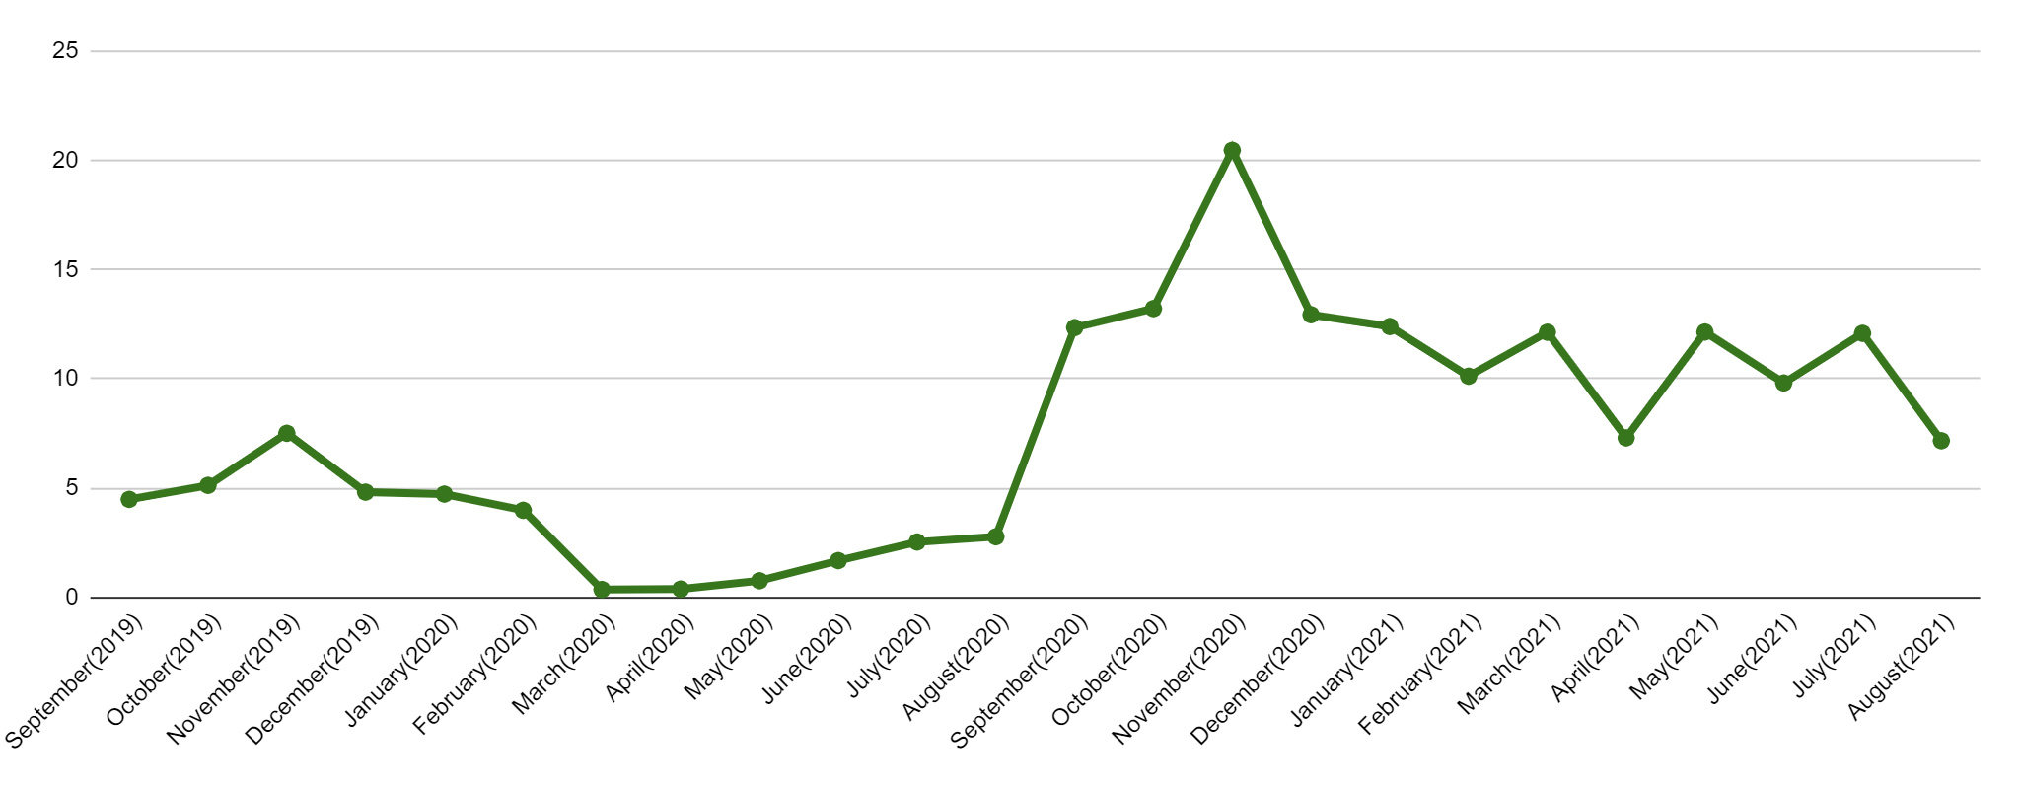
Request 7: Monthly Gross Sales for Atiq Exclusive
Visualization:

Slide 18
Request 7: Monthly Gross Sales for Atiq Exclusive
INSIGHTS
Gross sales exhibited considerable variations during the period from September 2019 to August 2021. In 2019, the volume sales peaked in November, accounting for 7.52, while the least was in September, which stood at 4.50. There was a drastic reduction in sales in March 2020 to 0.38, likely due to the COVID-19 outbreak, with the decline persisting into April, where sales were 0.40. However, in December 2020, sales saw a tremendous recovery, reaching a high of 20.46, likely driven by the festive season.
The year 2021 started strong, with sales at 12.40 in January, and the highest record in May being 12.15, before dropping to 7.18 in August. The analysis reveals both seasonality, such as spikes during holidays, and shocks, including the COVID-19 outbreak. While the recovery in early 2021 was encouraging, the pace slowed in the second half of the year, suggesting potential challenges in sustaining momentum.

Slide 19
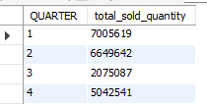
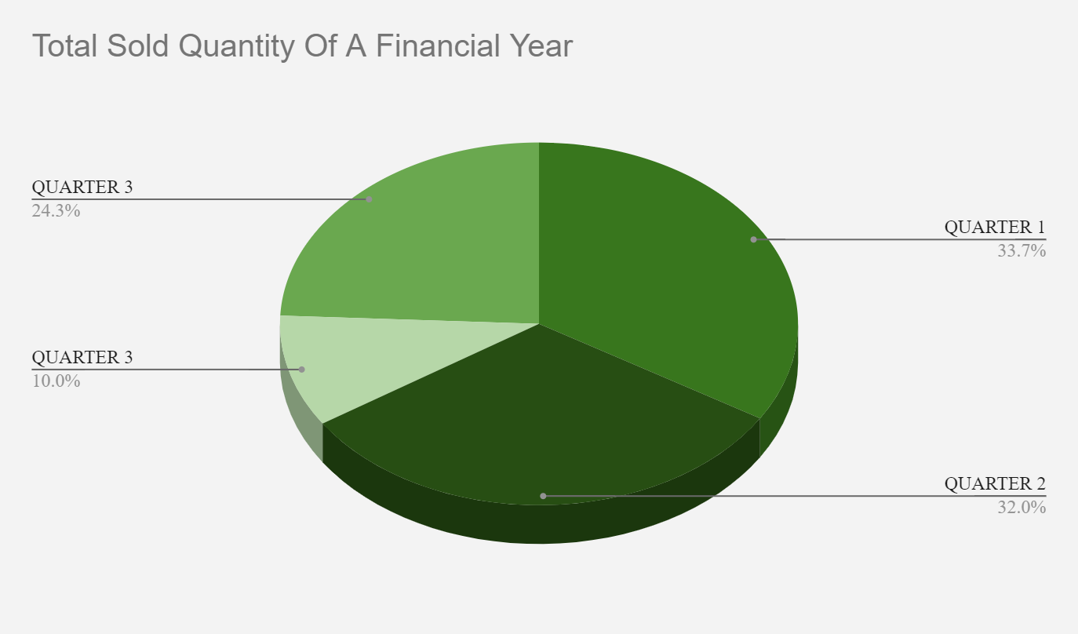
Request 8: Monthly Gross Sales for Atiq Exclusive
SQL Query :
select
case
when month(date) in(9, 10, 11) then '1'
when month(date) in(12, 1, 2) then '2'
when month(date) in(3, 4, 5) then '3'
when month(date) in(6, 7, 8) then '4'
end as QUARTER,
sum(sold_quantity) as total_sold_quantity
from fact_sales_monthly
where fiscal_year = 2020
group by QUARTER
order by QUARTER;
Output :
Visualization:

Slide 20
Request 8: Highest Total Sold Quantity in 2020
INSIGHTS
The quarterly total sold quantities present an intriguing dispersion pattern over the four quarters. The first quarter records the highest sales volume, with over 7 million units sold, making it the most productive period. The second quarter follows closely, with approximately 6.6 million units sold. However, the third quarter experiences a sharp decline, with sales dropping to around 2 million units, roughly a third of the volume in the previous quarter. The fourth quarter shows an improvement, reporting sales of about 5 million units.
This pattern suggests that the greatest demand occurs during the early part of the year, while the latter half exhibits more variability in sales performance, with a notable drop in the third quarter followed by a rebound in the fourth.

Slide 21
Request 9: Channel with Highest Gross Sales in 2021
SQL Query :
select
channel,
round(sum(fact_gross_price.gross_price * fact_sales_monthly.sold_quantity/1000000), 3) as gross_sales_mln,
round(sum(fact_gross_price.gross_price * fact_sales_monthly.sold_quantity) /
(select sum(fact_gross_price.gross_price * fact_sales_monthly.sold_quantity)
from fact_sales_monthly
inner join fact_gross_price
ON fact_gross_price.product_code = fact_sales_monthly.product_code
where fact_sales_monthly.fiscal_year = 2021) * 100 , 3) as percentage
from dim_customer
inner join fact_sales_monthly on dim_customer.customer_code = fact_sales_monthly.customer_code
inner join fact_gross_price on fact_gross_price.product_code = fact_sales_monthly.product_code
where fact_sales_monthly.fiscal_year = 2021
group by channel;

Slide 22

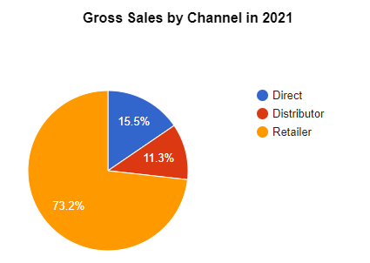
Request 10: Channel with Highest Gross Sales in 2021
Output :
INSIGHTS
Looking at the sales by channel, we see that the overwhelming majority comes from retailers, accounting for more than 73% of total sales at 1924.17 million. Direct sales contribute 15.5% (406.687 million), followed by distributors with the smallest share of 11.3% (297.176 million). This heavy dependence on retailers suggests a potential market vulnerability if these networks were disrupted, as the direct and distributor channels are nearly auxiliary. To mitigate such risks and seize growth opportunities, there is potential to expand the distribution strategy, diversifying sales channels to reduce reliance on retailers.
Visualization:

Slide 23
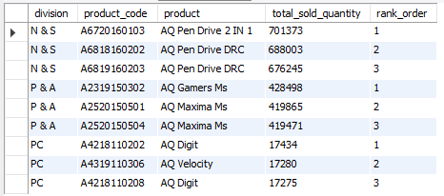
Request 10: Top 3 Products by Sold Quantity in 2021
SQL Query :
with ranked as(
select
dim_product.division as division,
dim_product.product_code as product_code,
dim_product.product as product,
sum(fact_sales_monthly.sold_quantity) as total_sold_quantity,
rank() over(partition by dim_product.division order by sum(fact_sales_monthly.sold_quantity) desc) as rank_order
from dim_product
inner join fact_sales_monthly on fact_sales_monthly.product_code = dim_product.product_code
where fact_sales_monthly.fiscal_year = 2021
group by dim_product.division, dim_product.product_code, dim_product.product
)
select
division,
product_code,
product,
total_sold_quantity,
rank_order
from ranked
where rank_order<=3
order by division, total_sold_quantity desc;
Output :
​

Slide 24
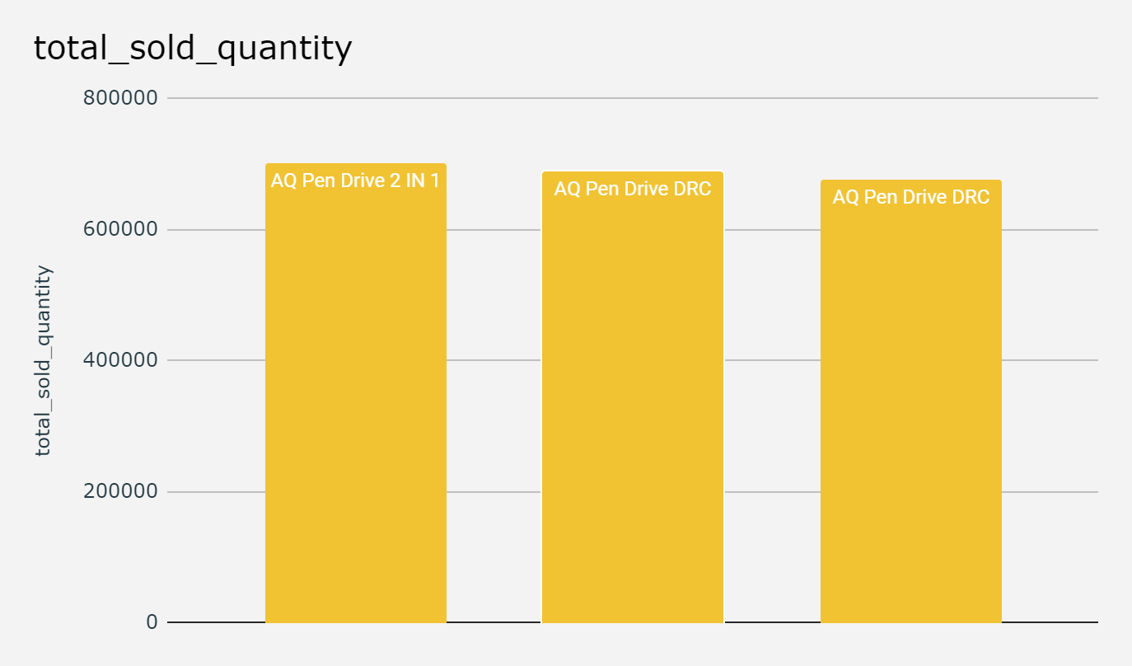
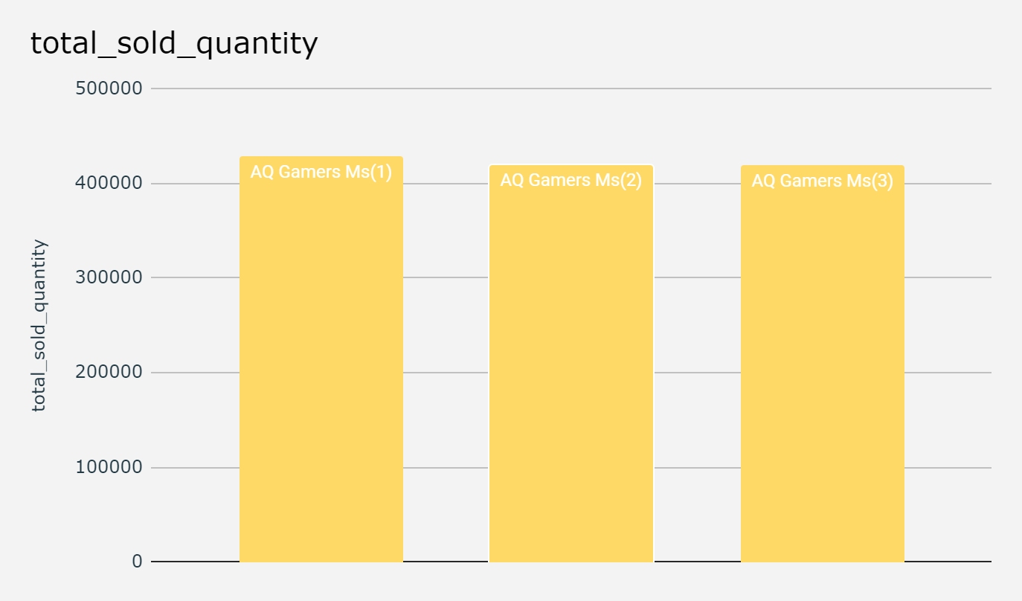
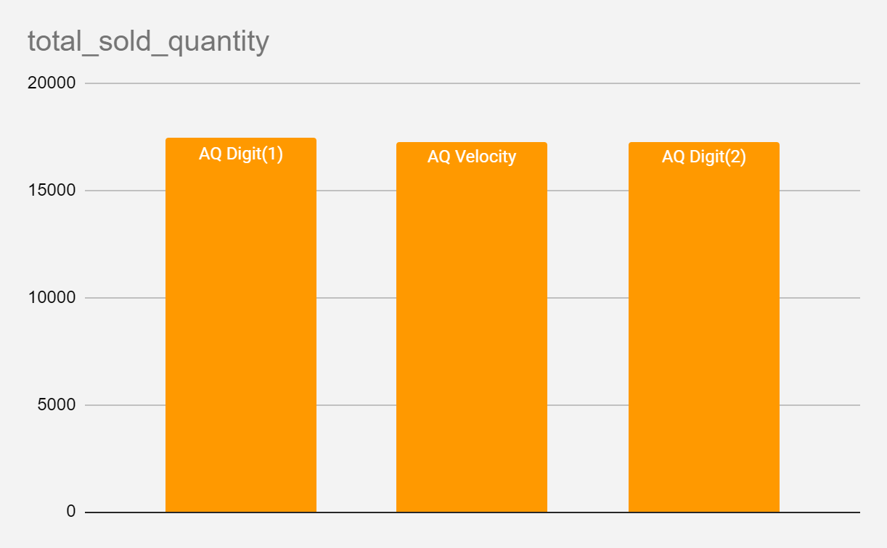
Request 10: Top 3 Products by Sold Quantity in 2021
Division : N & S
Division : P & A
Division : PC

Slide 25
Request 10: Top 3 Products by Sold Quantity in 2021
INSIGHTS
In the N&S segment, the AQ Pen Drive 2 IN 1 emerged as the top-selling product with an impressive 7,01,373 units sold in FY 2021, followed closely by two variants of AQ Pen Drive DRC, selling 6,88,003 and 6,76,245 units respectively. In the P&A division, the AQ Gamers Ms led the sales with 4,28,498 units, with two variants of AQ Maxima Ms also performing strongly. For the PC segment, the top-seller was the AQ Digit PC, although with a much smaller volume of 17,434 units. This suggests that the PC division has significant room for improvement, and the company could consider strategic initiatives to boost sales in this area.

Slide 26
Thank you for your Time and Attention

