Slide 1

AUDIO EDITOR
COURSES
DIGITIZATION
ADVANCED WEB DESIGN
VENHAR ADEMI 201501
BEQIR FAZLI 191045
ANDI ZAHIRI 191560

Slide 2

CONTENTS
01
02
Introduction
Required Libraries/Packages
03
04
Detailed Instructions
Final Steps and Conclusion

Slide 3
1. Introduction
Audio Editor App – an innovative, web-based audio editing solution that empowers users with two distinct modes of operation:
Node-Based Editing
Track-Based Editing
In this presentation, we will explore the design, key features, and underlying technology that power the Audio Editor App

Slide 4









2. Required Libraries/Packages

Slide 5
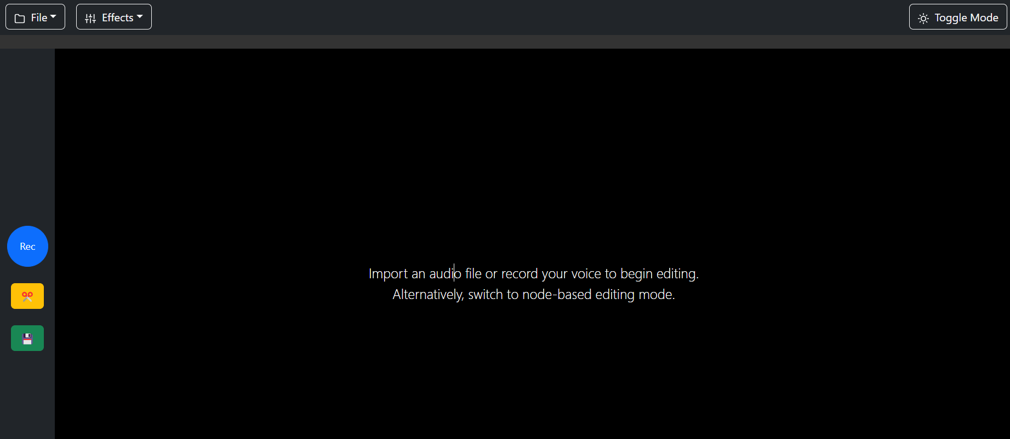
3. Detailed Instructions
3.1 Accessing Audio Editor

Slide 6
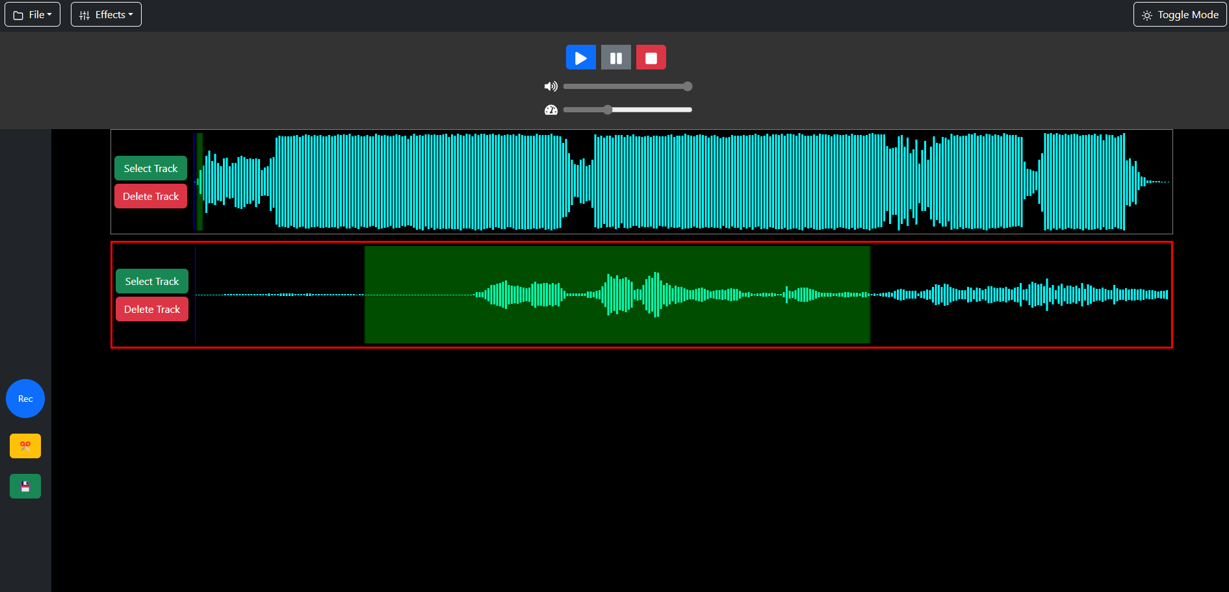
3.2 Track-Based Editing

Slide 7
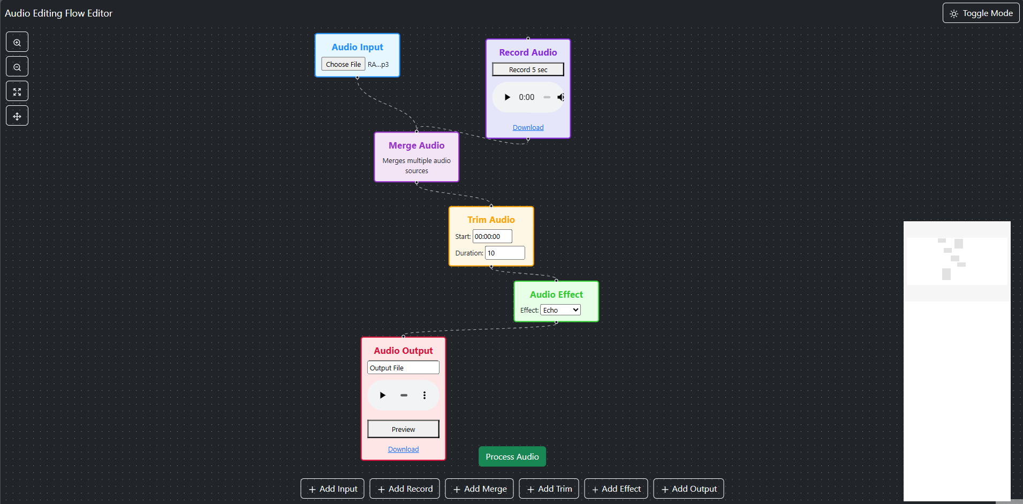
3.3 Node-Based Editing

Slide 8
4. Final Steps and Conclusion
Challenges & Lessons Learned
Defining the Starting Point
Choosing between node-based and track-based editing, aiming for seamless integration.
Library Integration
Leveraged React Flow, WaveSurfer.js, and FFmpeg.wasm for node management, waveform visualization, and audio processing.

Slide 9
Challenges & Lessons Learned
UI & Navigation
Developed an intuitive menu for easy mode switching and streamlined workflows.
Complexity & Refactoring
Added features increased code complexity. Frequent refactoring ensured maintainability.
Audio Synchronization
Synchronizing playback and effects (e.g., fade in/out, trim) was a significant challenge.

Slide 10
You can access the Web app to this link audio-editor-app.vercel.app
Thank you for your attention!
Questions or feedback?

